Slide 1
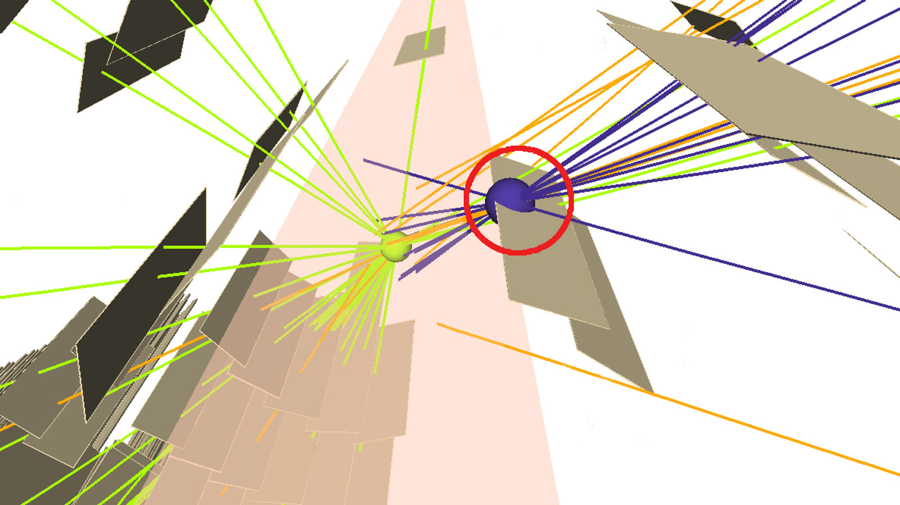
Techniques and Results of Neutral Long-Lived Particle Searches in ATLAS and CMS in LHC Run 2
Claudia-Elisabeth Wulz
Institute of High Energy Physics, Vienna
For the ATLAS and CMS Collaborations
La Thuile, 18 March 2019
Rencontres de Moriond, Electroweak Session

Slide 2
Sources of neutral long-lived particles
Standard model (SM): neutral B, D and K mesons, neutrons, neutrinos
Beyond standard model (BSM): plethora of different models
  R-parity violating SUSY
  Gauge-mediated SUSY breaking scenarios
  Anomaly mediated SUSY breaking scenarios
  Split SUSY
  Stealth SUSY
  Hidden valley scenarios
  Dark QED (particularly dark photons)
  Dark QCD (particularly dark hadrons)
  Dark matter models
  Left-right symmetric models (particularly heavy neutrinos)
  Axion-like particles (ALPS)
  Approximate symmetries
  ...
Conditions for models with long-lived particles (at least one)
  Small phase space - nearly degenerate mass spectra
  Small couplings
  Highly virtual intermediate states
Green: covered in this talk
Notes:
Lifetime of K mesons: 10^-8 to 10^-11 s, B mesons:10^-12 s, free neutrons: 900 s, neutrinos: infinite
GMSB: Gravitino is LSP. SPLIT SUSY: The striking feature of split supersymmetry is that the gluino becomes a quasi-stable particle with a lifetime that could be up to 100 seconds long. Scalars are ultraheavy. STEALTH SUSY: Stealth SUSY differs from many SUSY models because it preserves R-parity, but lacks missing energy signatures. This is accomplished by having a new hidden sector of particles at the weak scale. These particles are lighter than the lightest SM superpartner. The new particles feel SUSY breaking only by their couplings to the MSSM. Since SUSY breaking is small, the fermion and boson pairs will be almost degenerate in mass, leading to a small amount of phase space available for decays, and suppressing missing energy. Possible discovery methods are large numbers of b-jets, γjj resonances, and displaced vertices.

Slide 3
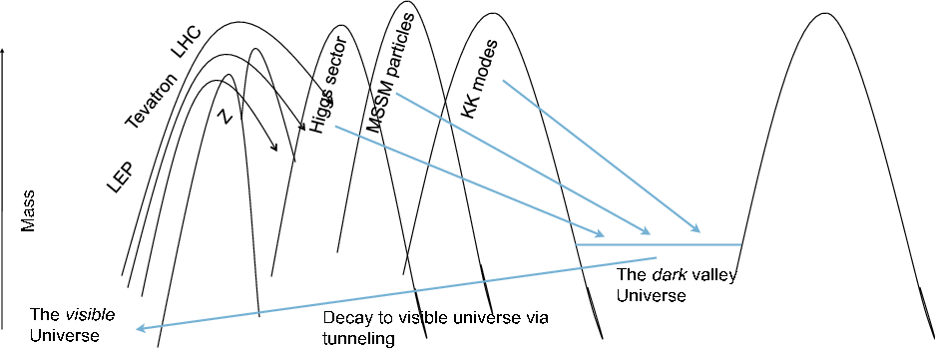
Motivation to search for new long-lived particles
Searches for new long-lived particles (cτ > 1 mm) ongoing for several years
  ATLAS/CMS a priori designed/optimized for prompt particles, not new LLP‘s
  Clever ideas for triggering / data acquisition / reconstruction / analysis have been and are being developed, in parallel with theory developments
… but no signal observed so far!
    Preparations for Run 3 and detector upgrades for HL-LHC have strong focus on new LLP‘s
Figure by
Kathryn Zurek
Notes:
Detector upgrades: e.g. muon timing detector (MTD) with 30 ps resolution in CMS.

Slide 4
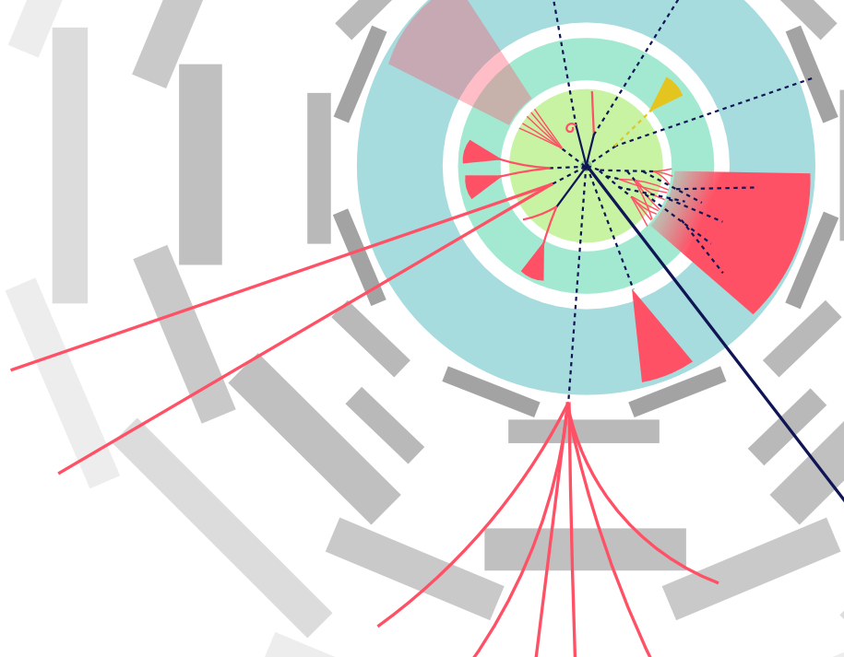
Signature-driven searches
Figure adapted from
Heather Russell
Displaced decays
  Displaced multitrack vertices
  Displaced photons
  Displaced jets
  Emerging jets
  Trackless jets, with low
  electromagnetic energy fraction
  Displaced dileptons and lepton-jets
Delayed decays and trapped stable particles
    Particles stopped in detector
    Particles trapped in detector,
    e.g. magnetic monopoles
    Out-of-time detection possible
multitrack vertices
photons
emerging
jets
dileptons, lepton-jets
trackless,
low-EMF jets
multitrack vertices
in muon system
Notes:
Lepton-jets: leptons and light mesons. Decay vertex can be outside tracker for multitrack vertices. Photons may also be converted.

Slide 5
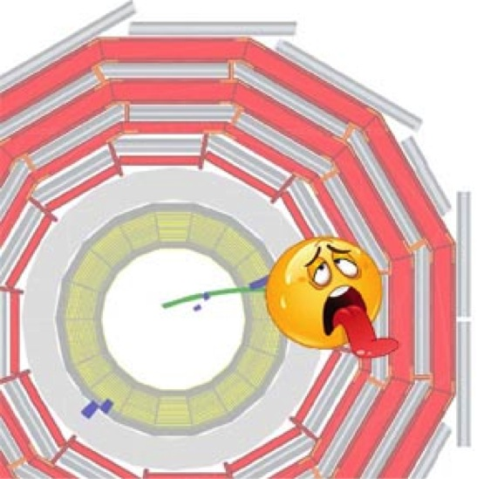
Challenges
Physics
  Unusual fractions of electromagnetic / hadronic energies in calorimeters
  Decays outside usual detectors, e.g. jets in muon system
  Unusual, not yet known signatures
Trigger, reconstruction and data analysis
  Inadequate triggers or triggers with low efficiency
  Timing information not always available
  Standard object reconstruction often inadequate
  Secondary vertex finding algorithms not optimized
  Interaction point constraint in triggering / reconstruction not usable
  Systematic uncertainties need to be specially estimated
  Simulation samples not readily available
Backgrounds
    In-time and out-of-time pileup
    Long-lived standard model hadrons (K_{L}, b, …)
    Cosmic rays
    Accelerator-related backgrounds (beam halo, satellite bunches)
  Electronic noise
  Material interactions
Notes:
Satellite bunches - collisions of very low luminosity bunches at 2.5ns steps from main bunches. Beam halo (delayed if from following main or satellite bunch).
The LHC RF cavities operate at a frequency of 400 MHz, such that RF ’buckets’ are separated by ≈ 2.5 ns. In order to achieve the desired bunch spacing, only one in 10 of these buckets should be filled. However, during filling a small number of protons (O(10−5) smaller than the main bunch) can be placed in adjacent ’satellite’ bunches.
Electronic noise: decays in calorimeters can look like electronic noise!

Slide 6
Specific techniques
Trigger and data acquisition
    Simple requirements, without saturating bandwidth
    Trigger on prompt particles in associated production
    Trigger on subsequent bunch crossings, or during gaps in bunch trains
    Scouting: store only reduced event information, but at high rate
    Parking: store full raw data, without immediate processing
    Non-standard information, such as timing, added to event record
Reconstruction
  Avoid that events get rejected at early stages of reconstruction -> check initial basic requirements
  Track reconstruction optimized for prompt particles -> need dedicated tracking algorithms
  Secondary vertices: b tagging algorithms extended to work better at distances beyond 1 cm
  Particle flow reconstruction (CMS) needs to be adapted
  Electrons and taus need further development
  Spike cleaning in calorimeters must be checked and adapted
  Instrumental and non-collision backgrounds from data
  Pileup can be useful for low-p_{T} displaced tracks, e.g. from sexaquarks
Notes:
Stable Sexaquark, G. Farrar, arXiv:1708.08951. Scouting: used for example for resonance searches and could be used for displaced dimuon searches.
Finetuning: put in context which have already been used. /jets, tracks – electrons, taus have not been studied yet.
tracks, timing HCAL with low EMF, then muons. Delayed jets and displaced jets: reorder.

Slide 7

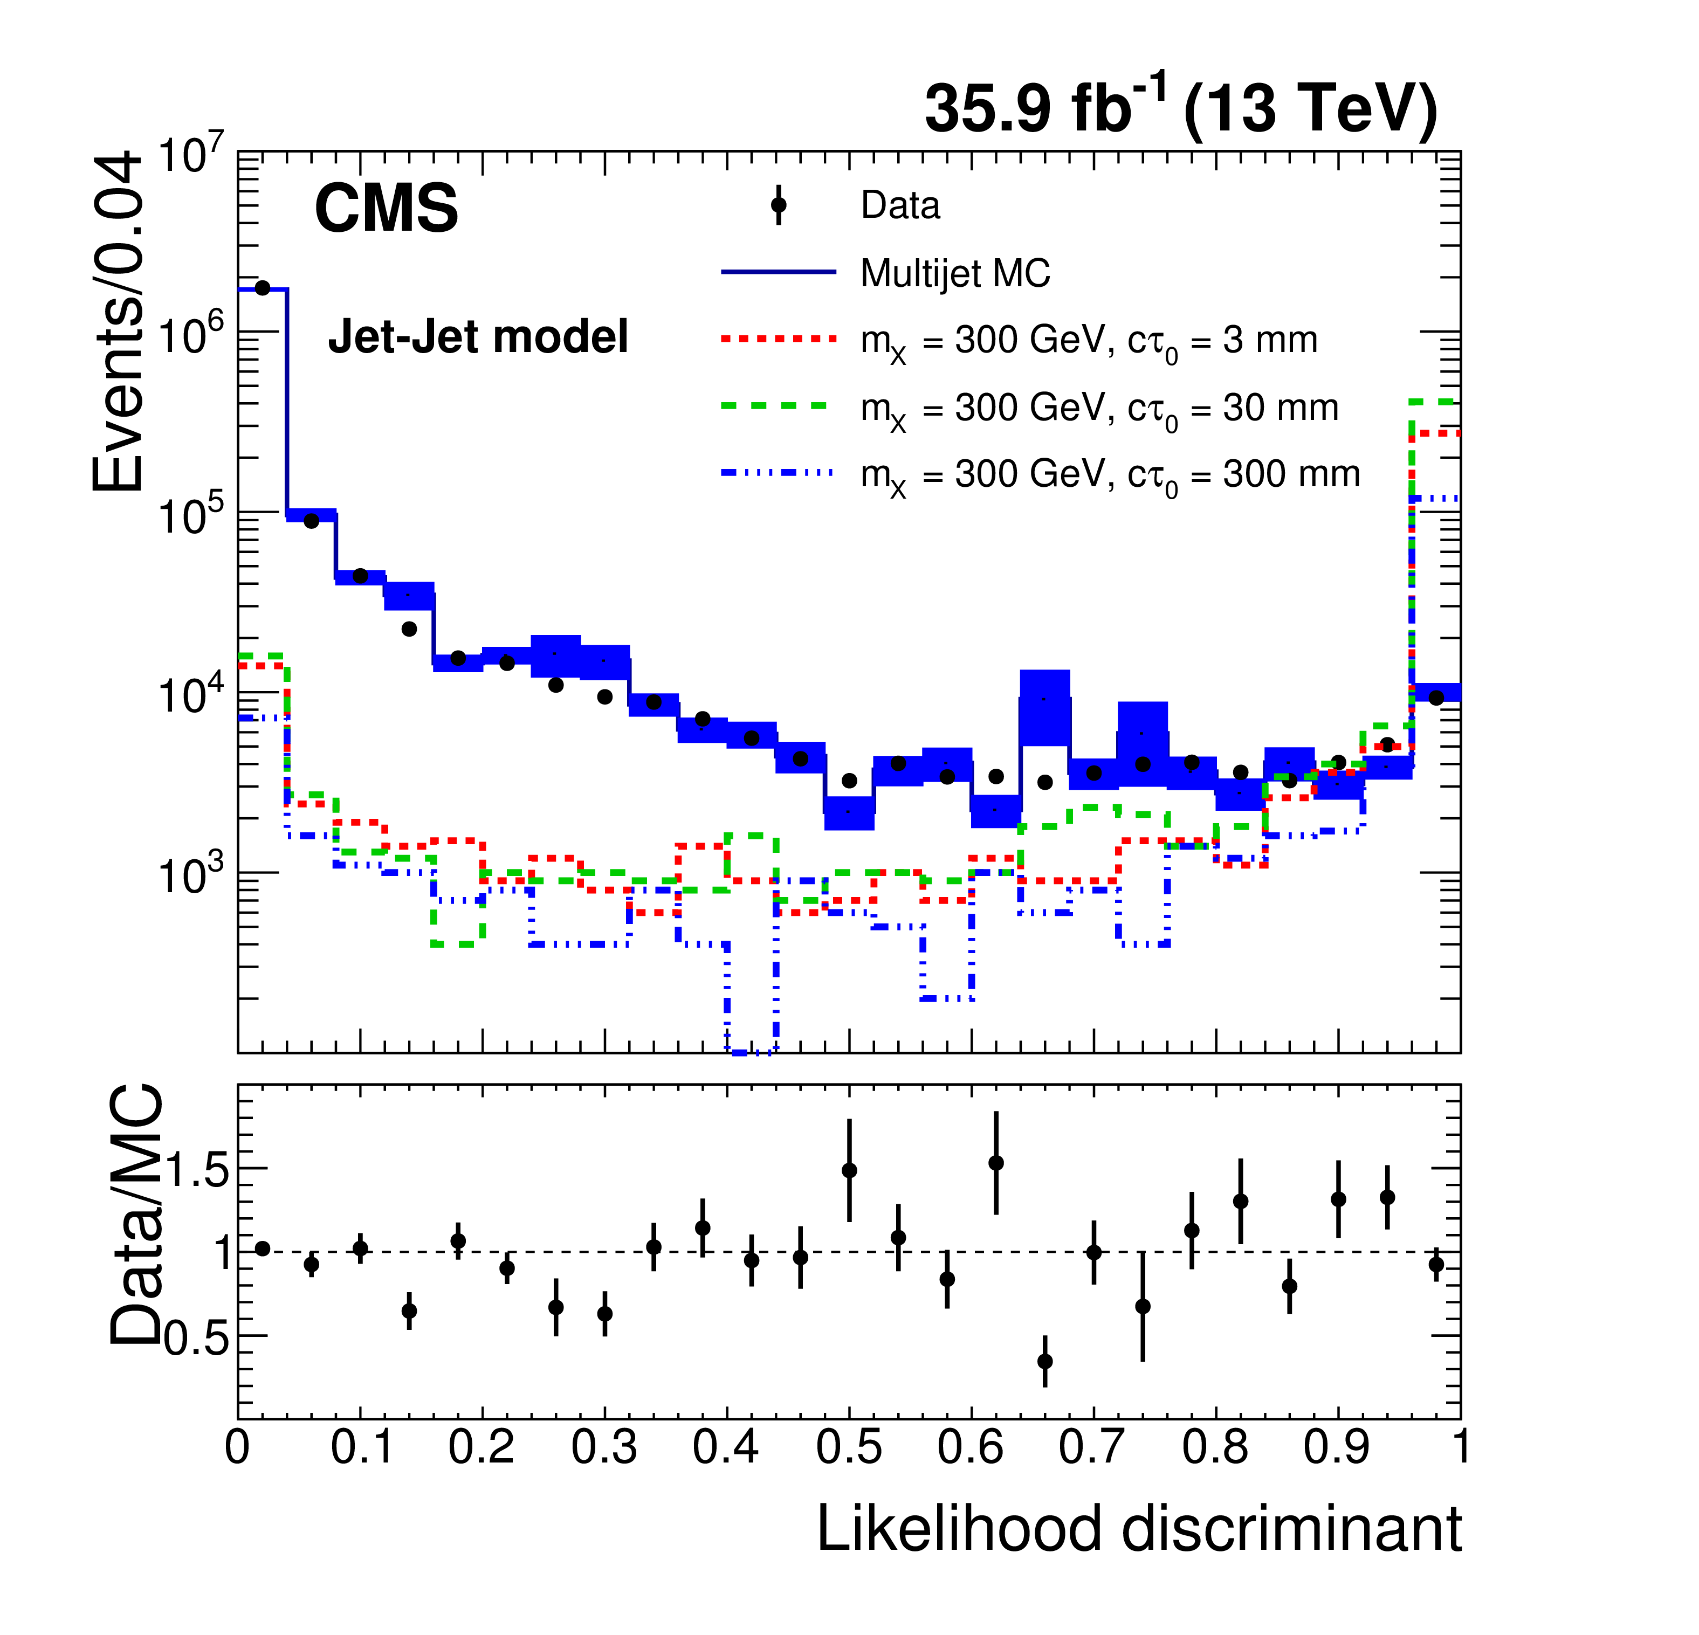
Displaced jets
  Benchmark models and interpretations
  Jet-jet model: pp -> XX, X -> qq (X = neutral scalar)
  SUSY models with LLP, e.g. GMSB model with long-lived gluino, decaying to gluon and gravitino (g -> g G)
arXiv 1811.07991
CMS-EXO-18-007
~
~
  Signature
  Jets with vertices displaced up to 55 cm from primary vertex in transverse plane, reconstructed from energy deposits in calorimeter towers, with or without MET
  Dedicated displaced jet trigger
  H_{T} > 350 GeV
  ≥ 2 jets with p_{T} > 40 GeV, IηI < 2
  ≤ 2 associated prompt tracks
  ≥ 1 associated displaced track
  Background suppression
  QCD multijets
  Likelihood discriminant from track, jet and vertex information
Notes:
Likelihood discriminant based on three variables: • vertex track multiplicity; • vertex Lxy significance; • cluster RMS.

Slide 8
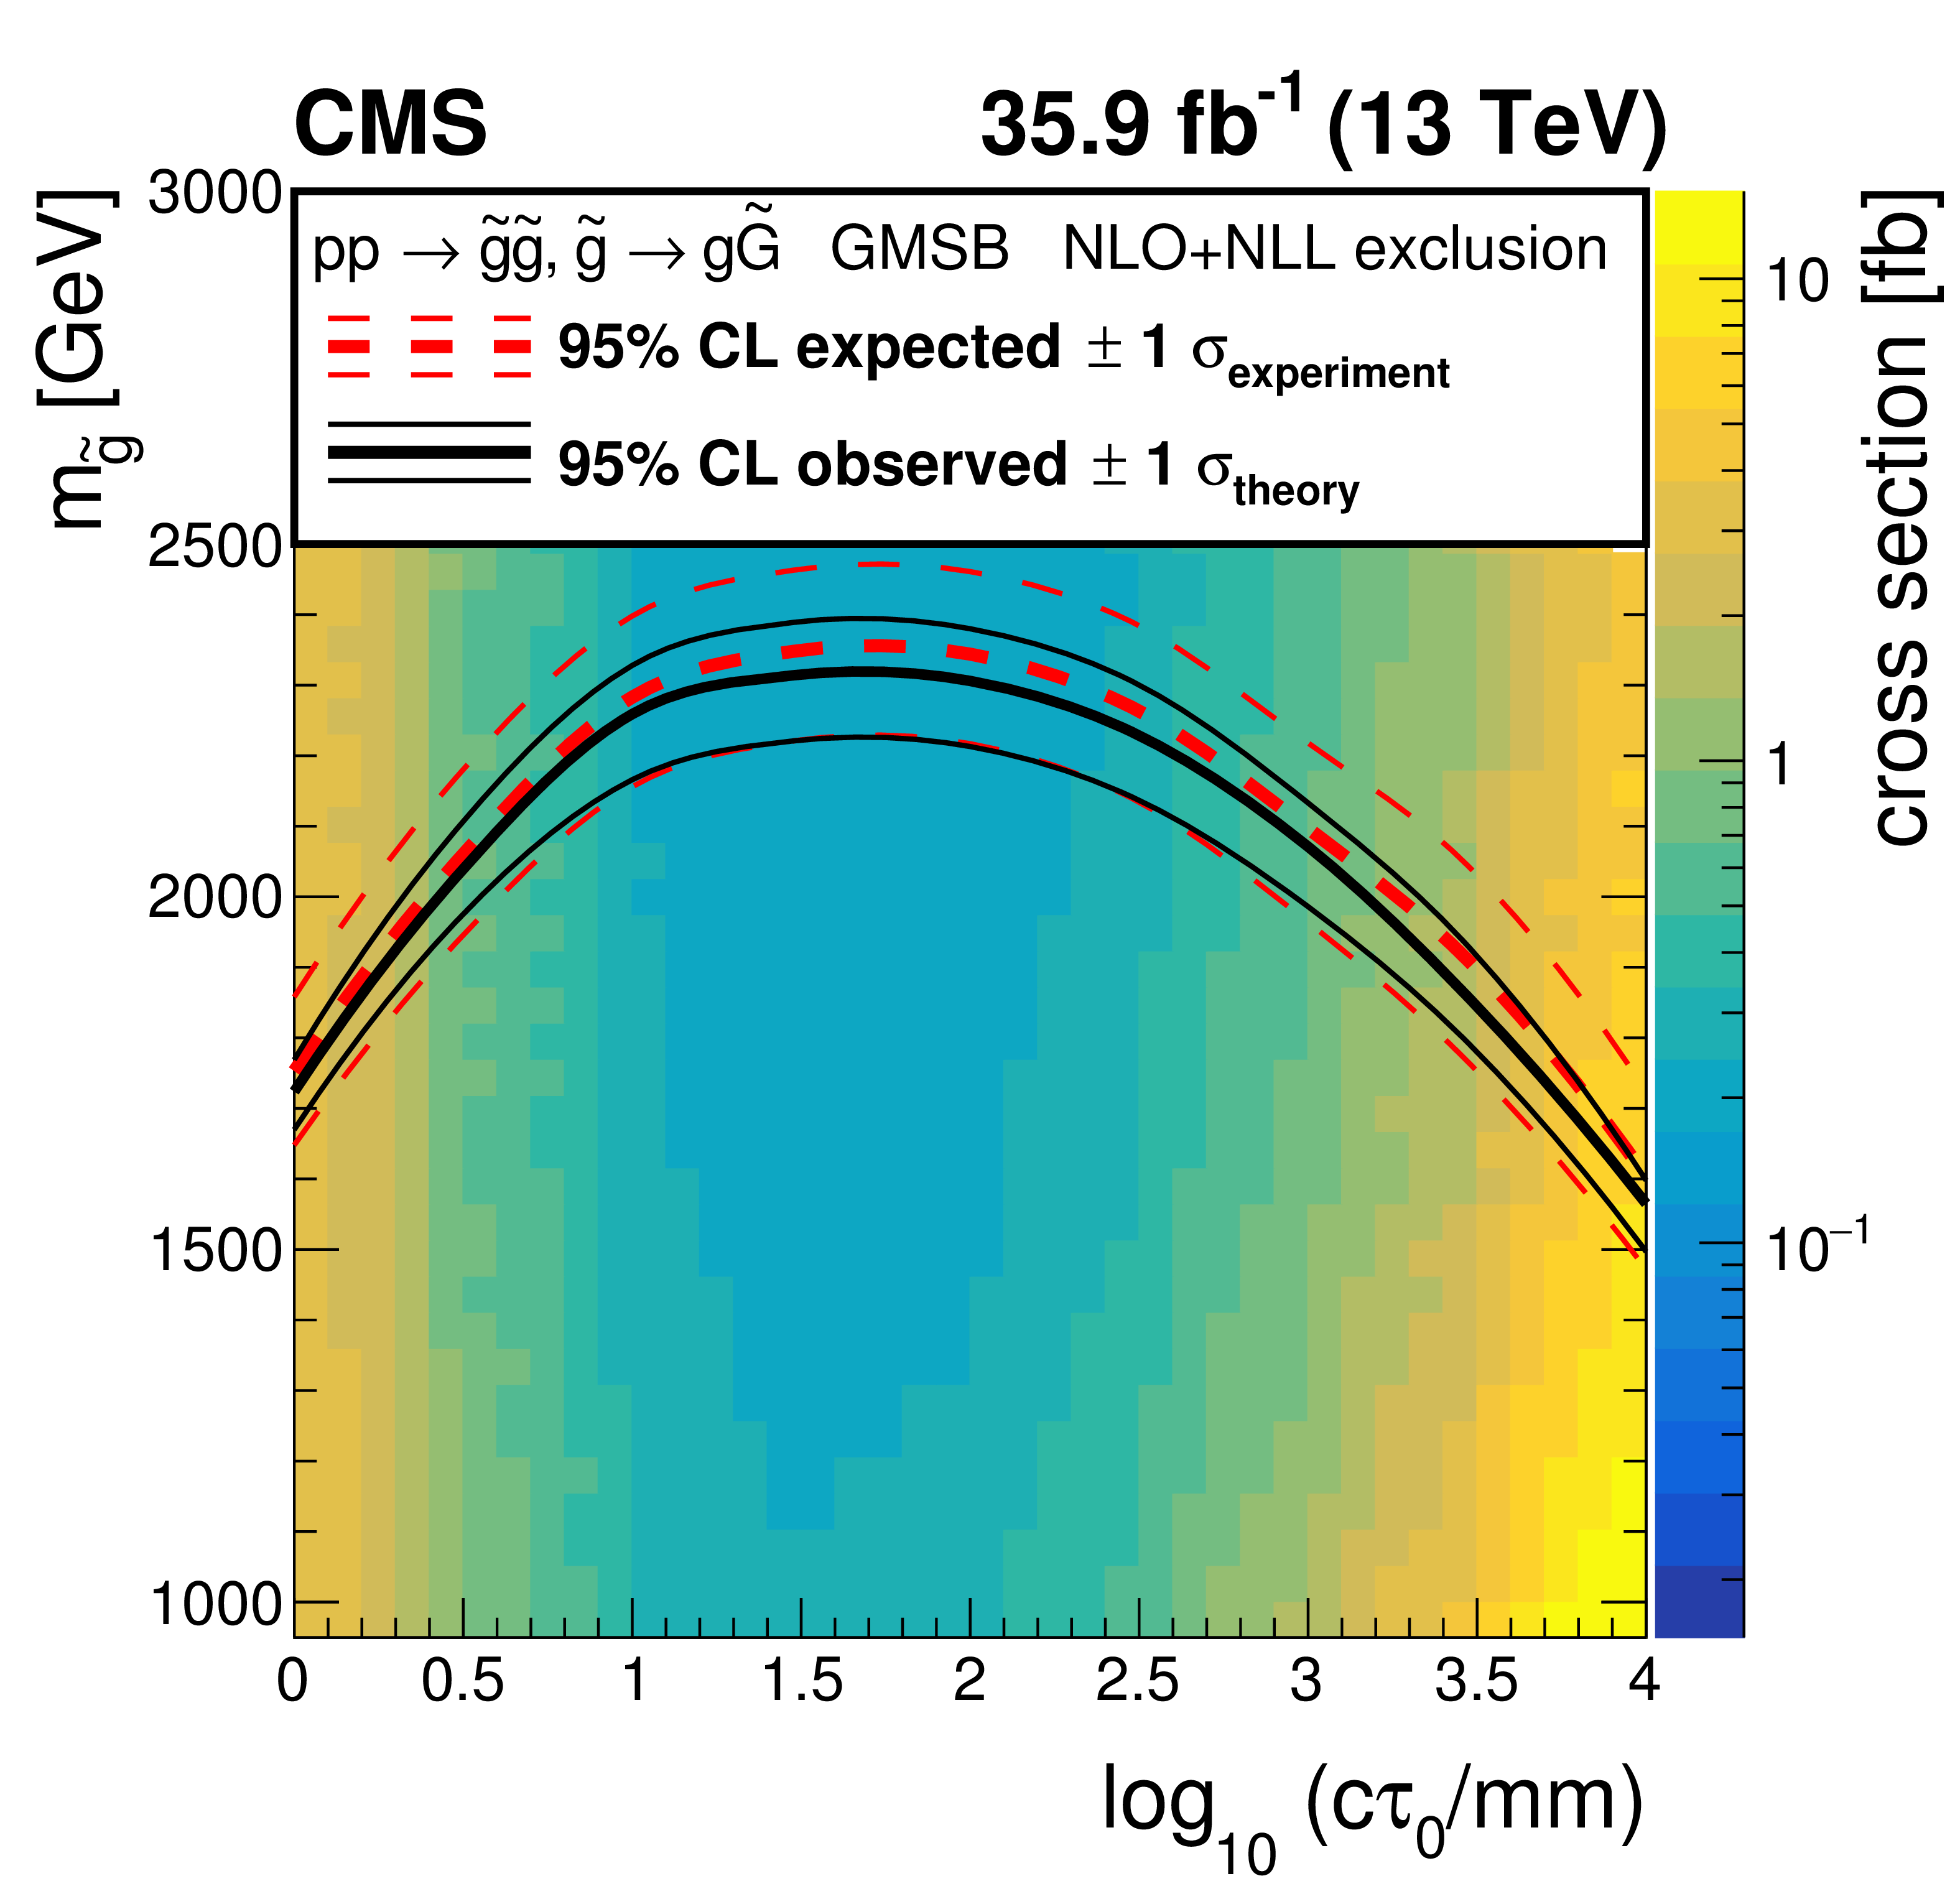
Displaced jets
arXiv: 1811.07991, CMS-EXO-18-007
  Gluino masses up to 2300 GeV excluded for proper decay lengths between 20 and 110 mm
Notes:
Although in the g → gG signature each displaced vertex is associated with only one jet, the two separate displaced single jets can be paired together and pass the selections, therefore the analysis is sensitive to this kind of signature.
The limits are most stringent for ct0 between 3 and 100 mm. For smaller decay lengths, the limits become less restrictive because of the vetoes on prompt activity. Since the tracking efficiency decreases with larger displacement, the limits also become less stringent for larger decay lengths when ct0 > 100 mm.

Slide 9
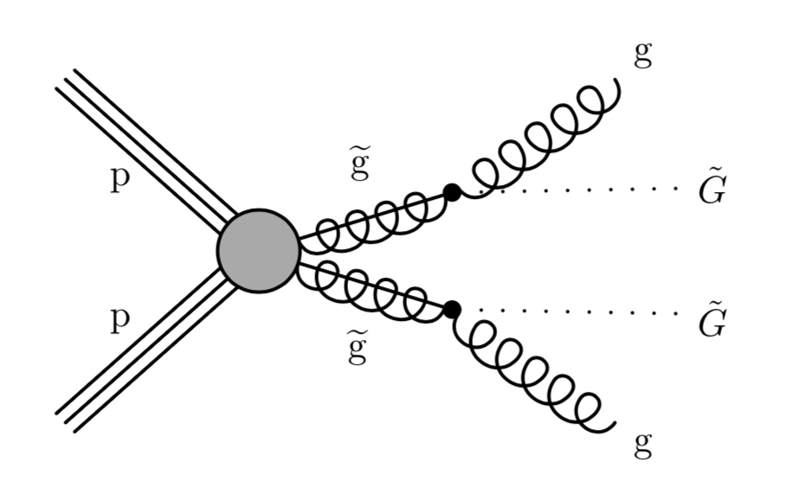
Delayed jets
  Model assumption and dataset
  GMSB SUSY model: g -> gG
  Full Run 2 dataset: 137 fb⁻¹
  Trigger and signal selection
  HLT trigger: MET > 120 GeV
  MET + delayed calorimeter jet: 3 ns < t_{jet} < 20 ns
  Particle flow not used for jet reconstruction due to non-standard tracker component, calorimeter clustering only
~
~
  Jet timing in barrel ECAL
  PbWO₄ crystals with Si APDs
  Time resolution ≈ 200 ps
  Cells within ΔR < 0.4 of jet
  t_{jet} defined by median cell time
CMS-EXO-19-001
  NEW!
Notes:
t>20 ns: reject contributions from previous or following collisions. Cell time calibration: particle travelling from origin to cell with velocity c arrives at t = 0 ns.
DOES NOT REQUIRE MC, THEREFORE FAST ANALYSIS

Slide 10
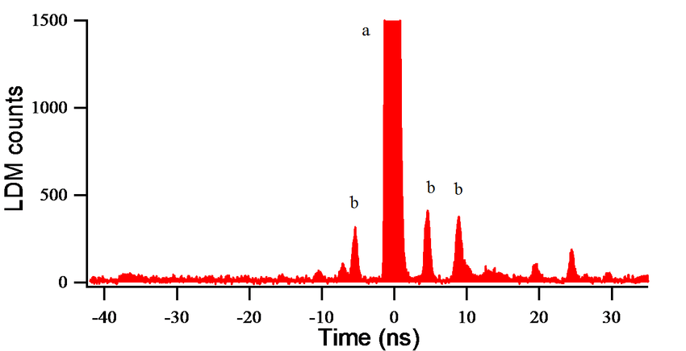
Delayed jets
  Backgrounds estimated from control regions with data
  ECAL resolution tails
  Direct APD hits
  In-time and out-of-time pileup
  Beam halo
  Satellite bunches (2.5 ns steps)
  Cosmic muon deposits in ECAL
  Rejection of main backgrounds through jet cleaning
  number of ECAL cells > 25
  electromagnetic / total calorimeter energy fraction > 0.2
  fraction of tracks associated to primary vertex < 1/12
  RMS of t_{jet}
Satellite bunches (example profile)
After jet cleaning
Before jet cleaning
March 2019
Notes:
Jet cleaning reduces background by many orders of magnitude.
LDM: longitudinal density monitor of the LHC: single-photon counting system measuring synchrotron light.

Slide 11
Delayed jets
  Significantly extended reach in cτ compared to tracker based searches
  Gluino masses up to 2500 GeV (2150 GeV) excluded for cτ of 1m (30 m)
Notes:
No events in data beyond 3 ns.

Slide 12
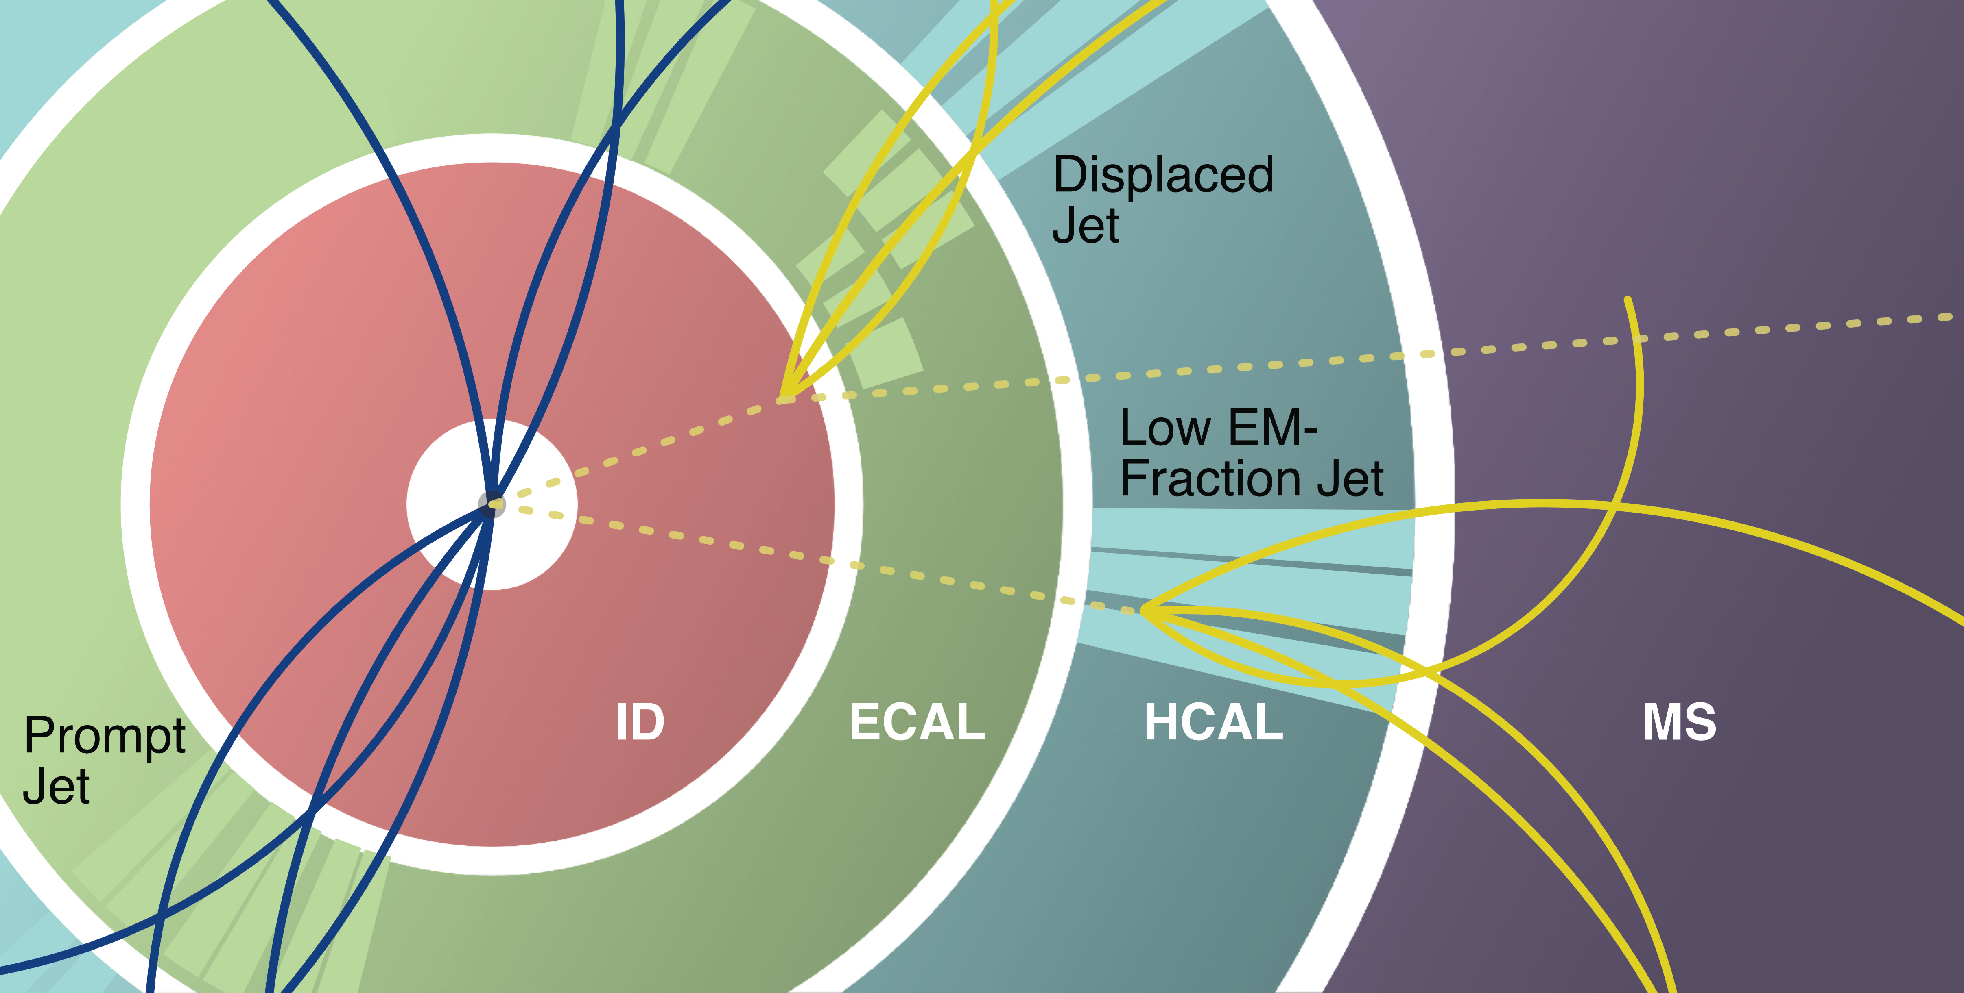
Trackless jets - scalars decaying in calorimeters
  Models and dataset
  Hidden-sector models
  10.8 fb⁻¹ and 33.0 fb⁻¹ at √s = 13 TeV
  cτ range few cm to tens of m
  Signature and trigger
  Displaced jets in HCAL or outer edge of ECAL
  At least 2 trackless and low-EMF jets - CalRatio (CR) jets
  dedicated low- and high-E_{T} triggers
  Analysis strategy and background
  Machine learning techniques (neural network to determine jet origin, BDT classifier for jets)
  Backgrounds: mainly multijet and beam-induced, estimated with ABCD method
arXiv:
1810.12602
A: signal region
  NEW!
m_{Φ} = 600 GeV, m_{s} = 150 GeV
EXOT-2017-025, arXiv 1902.03094
Notes:
2 luminosities: depending on trigger. To select events with trackless jets, an additional event-level variable, DeltaRmin(jet, tracks), is used. The quantity Delta R_min(jet, tracks) is defined as the angular distance between the jet axis and the closest track with pT > 2 GeV, and Sigma R_min(jet, tracks) is calculated by summing this distance over all the clean jets with pT > 50 GeV.

Slide 13
Trackless jets - scalars decaying in calorimeters
  95% CL limits set on σ(ϕ) x B(ϕ→ss)
  Mediator ϕ with m_{ϕ} = 125 GeV: m_{s} between 5 and 55 GeV excluded for cτ between 5 cm and 5m, for B(ϕ→ss) = 10%
  For m_{ϕ} = 400 GeV, m_{ϕ} = 600 GeV, and m_{ϕ} = 1000 GeV, σ(ϕ) × B(ϕ→ss) values > 0.1 pb excluded between 12 cm and 9 m, 7 cm and 20 m, and 4 cm and 35 m respectively, depending on m_{s}
Run I (scaled)
m_{Φ} = 600 GeV, m_{s} = 150 GeV
Combination with displaced jet analysis in muon system
arXiv 1811.07370
Related analysis with CR jet and Z: arXiv 1811.02542
C.-E. Wulz
Notes:
Run 1 analysis [37] scaled by the ratio of parton luminosities for gluon–gluon fusion between 13 TeV and 8 TeV for a particle of appropriate mass.
The combination is performed using a simultaneous fit of the likelihood functions of each analysis.
For the models with m = 125 GeV, the MS analysis has higher sensitivity than the CR analysis at large decay lengths. For short decay lengths (< 10 cm) the sensitivities of the two analyses are comparable and the combination of their limits provides a slight improvement.

Slide 14
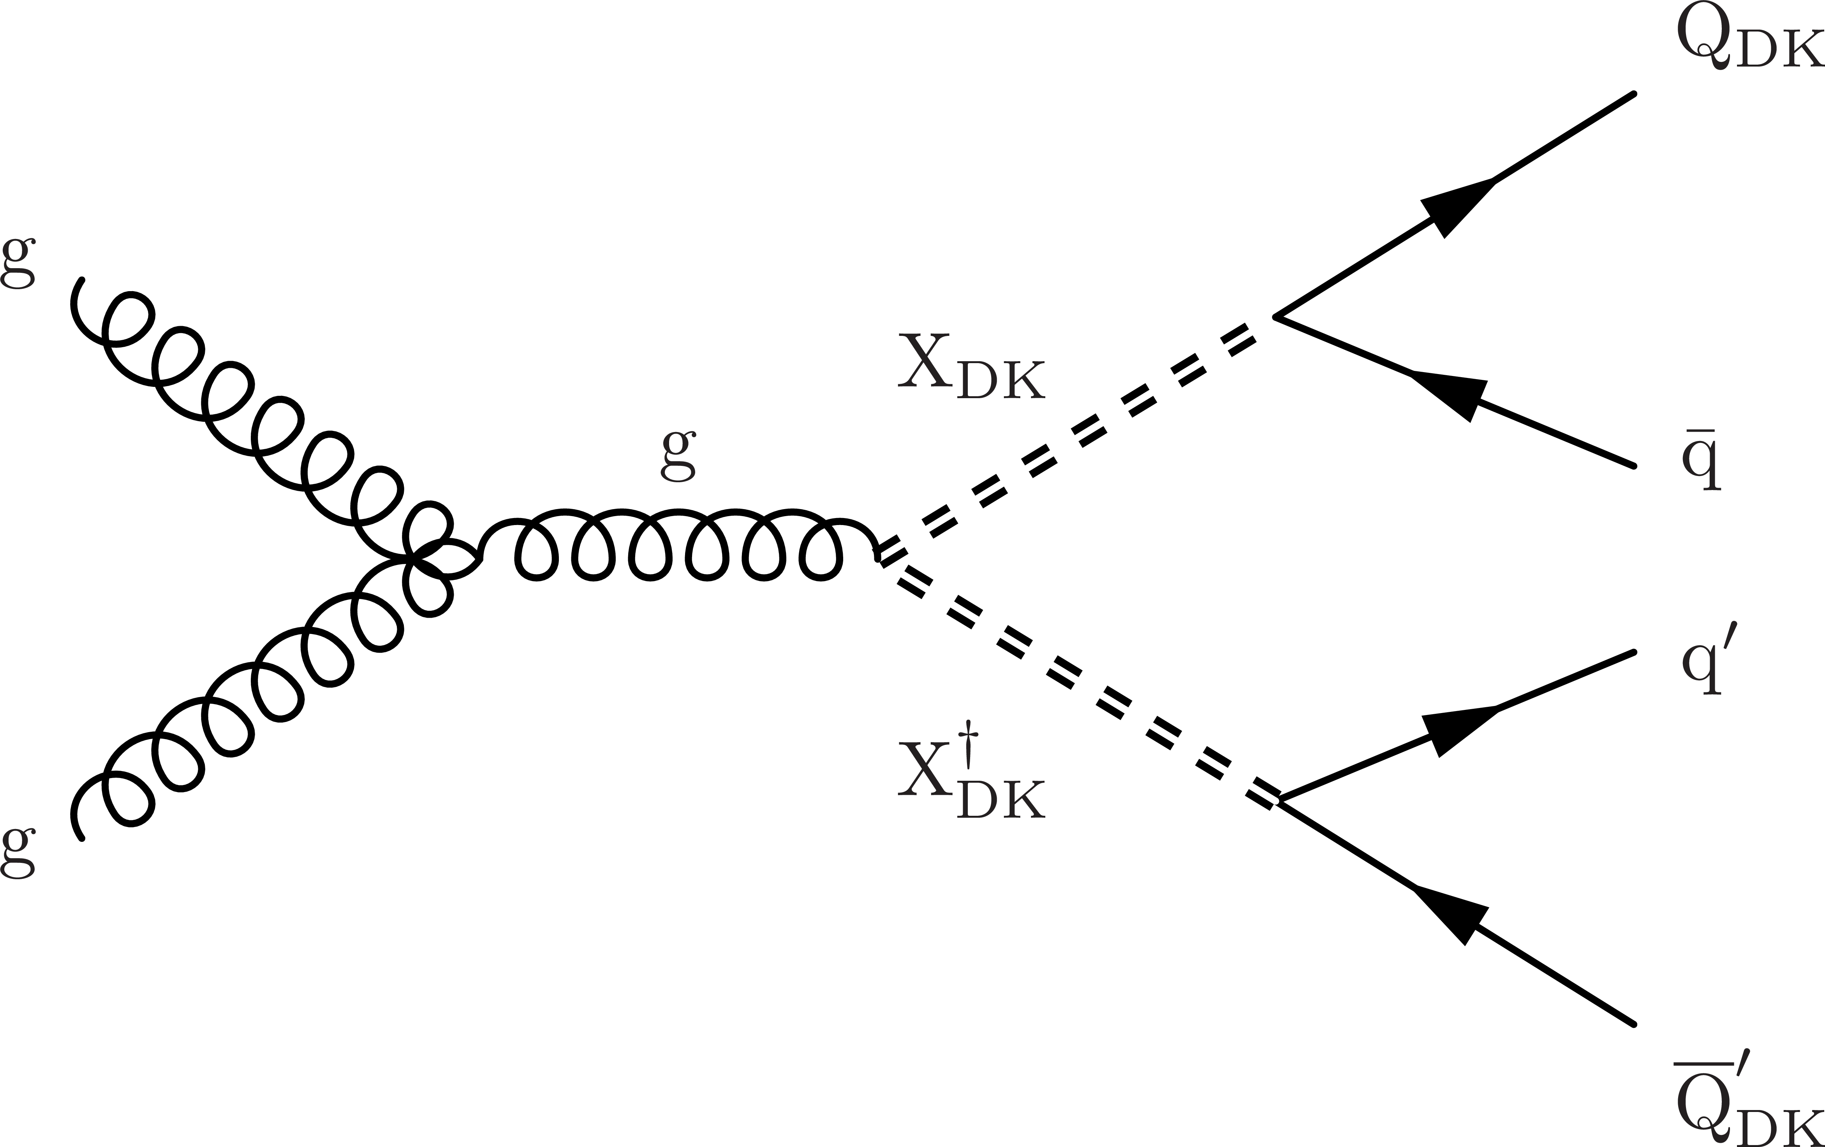
Emerging jets
  Dark QCD model arXiV:1502.05409
  Mediator X_{DK ,} dark fermions Q_{DK}
  Hadronization of Q_{DK} to e.g. dark pions (π_{DK})
  Displaced decays of π_{DK} back to SM particles
  Exponential decay of π_{DK}
  Trigger and signature
  H_{T} > 900 GeV
  2 calorimeter jets with displaced tracks and many different vertices within the jet cone
  2 regular jets
CMS-EXO-18-001, arXiv: 1810.0169
  Background
  data-driven estimate from 4-jet sample without emergent jets
  misidentification probability of regular jet as emerging jet modelled, depending on parton flavour and track multiplicity
Notes:
Mediator: electrical charge -1/3, 2/3, decaying to q of same charge; charged under QCD and dark QCD. Dark fermions: only charged under dark QCD.
MET: if dark hadrons have decay lengths of the order of the detector size or larger

Slide 15
Emerging jets
  m(π_{D}) = 5 GeV
  Fraction of jet p_{T} associated
  with prompt tracks
  Mediator masses excluded between 400 and 1250 GeV for decay lengths 5 to 225 mm
C.-E. Wulz
Notes:
A variable called α3D, which is the scalar pT sum of the associated tracks whose values of D_N are smaller than a threshold, divided by the scalar pT sum of all associated tracks, is used to quantify the fraction of the pT of the jet that is associated with prompt tracks.

Slide 16
Displaced dimuons
arXiv: 1808.03057, PRD 99 (2019) 012001
  Model assumptions and search strategy
  Long-lived neutralinos in GMSB scenario
  Long-lived dark photons Z_{D} from Higgs decay
  High-mass (Z → μ⁺μ⁻) and low-mass (Z_{D} → μ⁺μ⁻)
  m(χ₁⁰) = 300-1100 GeV, m(Z_{D}) = 20-60 GeV
  Signature and trigger
  2 opposite-sign μ in muon system with vertex up to 4 m from interaction point
  1μ trigger efficiency 70% at IP, 10% at 4m → MET trigger compensates
~
Multijet bkg
not included
Signal (simulation)
Notes:
Dark sector gauge boson model. Trigger as inclusive as possible.
Vertices are selected, depending on the pT and the opening angle between the 2 muons. Average resolution in r_vtx 2-3 cm.
Multijet BKG is localised at low dimuon mass.

Slide 17
Displaced dimuons
  Z cosmic
GMSB model
Dark photon model
  No significant excess in number of vertices above background -> lower and upper lifetime limits from 0.3 to 2400 cm, depending on model parameters

Slide 18
ATLAS LLP searches – 95% CL exclusion
March 2019

Slide 19
Bibliography
ATLAS
https://twiki.cern.ch/twiki/bin/view/AtlasPublic/ExoticsPublicResults
  Displaced hadronic jets in calorimeter: arXiv 1902.03094, EXOT-2017-025
  Displaced hadronic jets in muon spectrometer: arXiv 1811.07370, hepdata 1704138, EXOT-2017-025
  LLP decaying in calorimeter in association with Z boson: arXiv 1811.02542, hepdata 1702261, EXOT-2017-024
  Displaced dimuon vertices: PRD 99 (2019) 012001, arXiv 1808.03057, EXOT-2017-024
https://twiki.cern.ch/twiki/bin/view/AtlasPublic/SupersymmetryPublicResults
  Displaced vertices plus MET: PRD 97 (2018) 052012, arXiv 1710.04901, hepdata 78697, SUS-2016-08
  Variable RPV coupling strength and LL R-hadrons: ATLAS-CONF-2018-003
CMS
https://cms-results.web.cern.ch/cms-results/public-results/publications
  Delayed jets: EXO-19-001
  Displaced vertices in multijet events: PRD 98 (2018) 092011, arXiv 1808.03078, hepdata 1685992, EXO-17-018
  Emerging jets: JHEP 02 (2019) 179, arXiv 1810.10069, hepdata 1700173, EXO-18-001
  Displaced jets: PRD 99 (2019) 032011, arXiv 1811.07991, EXO-18-007

Slide 20
Conclusions
  Searches for long-lived particles are underway
  Full Run 2 analyses will be published soon
  Non-standard trigger, data acquisition and analysis strategies and techniques are being further developed
  Detector hardware and trigger upgrades will come to play in the HL-LHC phase
  I always believed in leaving no stone unturned
  Arnold Schwarzenegger

Slide 21
BACKUP

Slide 22
CMS LLP searches – 95% CL exclusion
August 2016

Slide 23
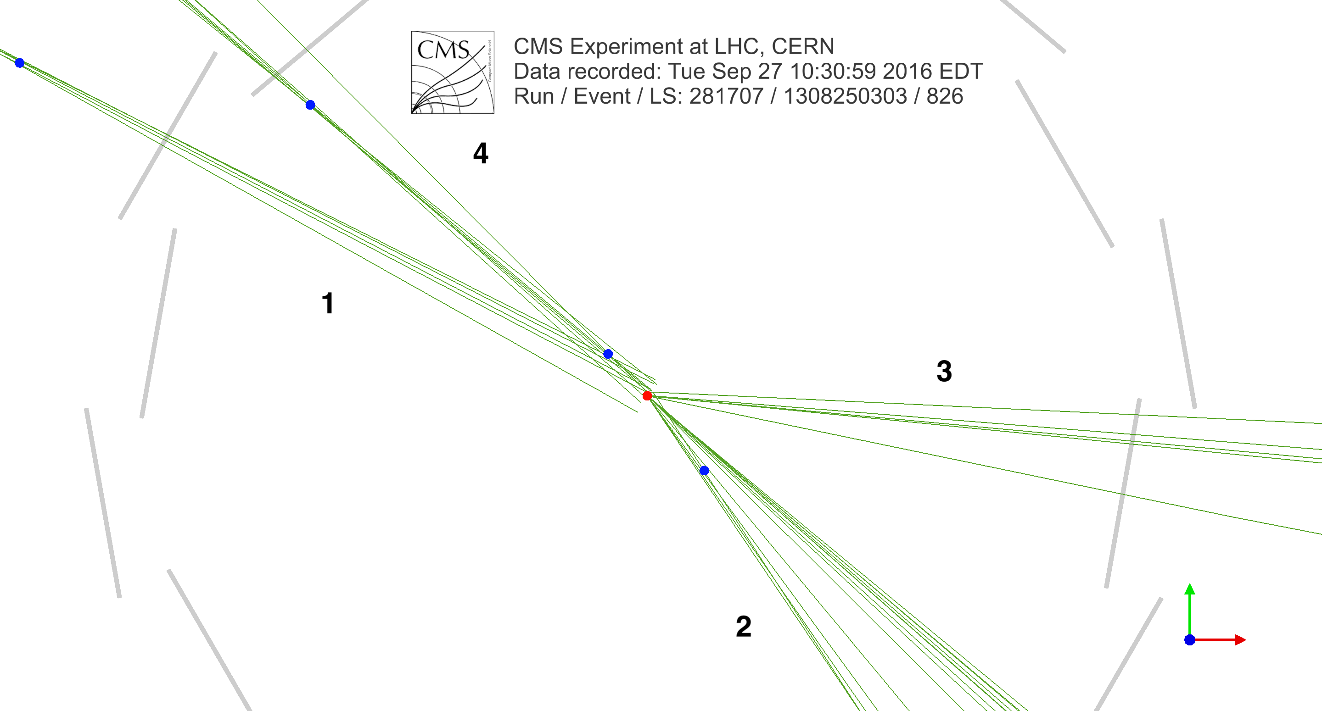
Emerging jet event in CMS

Slide 24
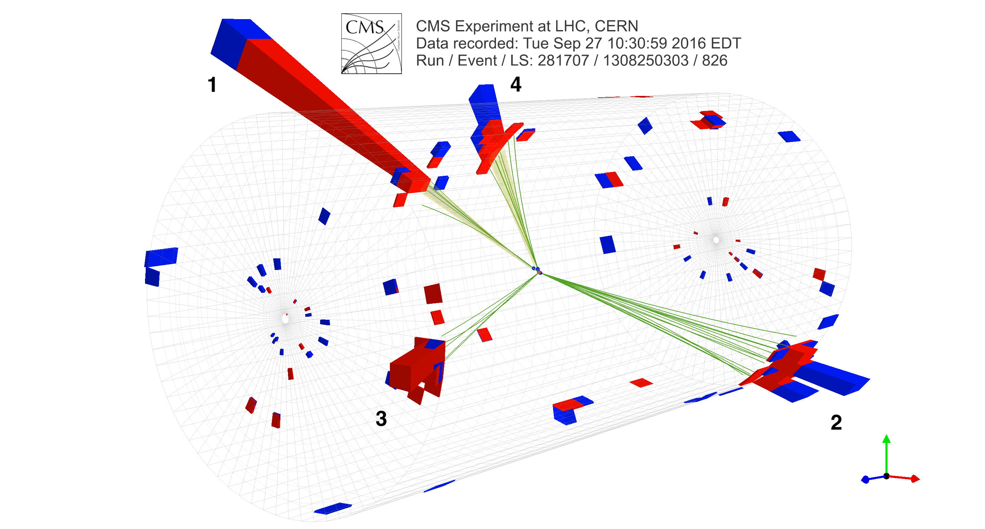
Emerging jet event in CMS

Slide 25
Emerging jet event in CMS

