Slide 1
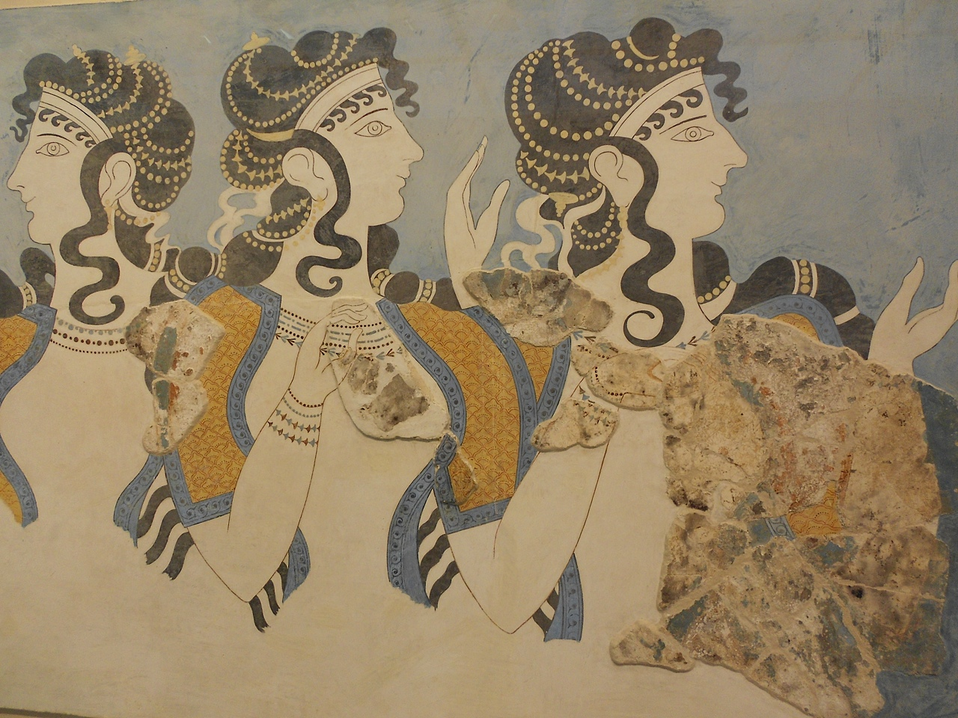

Exotica in CMS
ICNFP 2015
Kolymbari, Crete
25 August 2015
Claudia-Elisabeth Wulz
CMS Collaboration
Institute of High Energy Physics, Vienna

Slide 2
Overview
Selected recent results:
Dark matter searches
Searches with boosted objects
  Weak bosons, tops, Higgs in final state
Long-lived signatures
Classic narrow resonance searches
EXO-14-004, EXO-12-054, EXO-12-048, EXO-12-047
EXO-14-010, EXO-14-009, EXO-13-007
EXO-12-038, EXO-12-036, EXO-12-034, EXO-12-026,
EXO-13-006, EXO-14-012, EXO-14-017
DP-15-017, EXO-14-010, EXO-13-007,
EXO-12-059, EXO-12-052, EXO-12-050,
EXO-12-049, EXO-12-046, EXO-12-045,
EXO-12-024
All CMS public BSM physics results:
https://twiki.cern.ch/twiki/bin/view/CMSPublic/PhysicsResultsEXO
https://twiki.cern.ch/twiki/bin/view/CMSPublic/PhysicsResultsB2G

Slide 3
Dark Matter Searches
Contact
interaction
g_{q}
g_{χ}
Mediator
Complementary to direct/indirect searches,
best for low DM mass and spin-dependent couplings
CMS-EXO-12-048, EPJC 75 (2015) 235
Select events with ISR –> mono-objects, e.g. mono-jets, mono-Z, mono-γ
mono-jets
CMS-EXO-
12-054
mono-Z

Slide 4
Dark Matter Searches
Recent razor analysis of dijet + E_{T}^{miss} signature
CMS-EXO-
14-004
R_{Λ} quantifies fraction of events for which EFT hypothesis is still valid
g_{eff} = √g_{q}g_{χ}

Slide 5
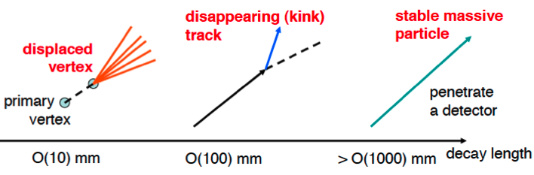
Long-lived Particle Signatures
Long-lived particles are predicted in many BSM scenarios
SUSY: GMSB, AMSB, split SUSY, RPV SUSY
Hidden valley scenarios
Signatures:
Displaced objects
Delayed objects
Disappearing or kinked tracks
Lepton jets
Recent examples of searches:
Neutral particles decaying to photons (CMS-EXO-14-017)
Neutral particles decaying to muons (CMS-EXO-14-012)
Heavy stable charged particles (CMS-EXO-13-006)

Slide 6
Long-lived Neutral Particles Decaying to Photons
Model with GMSB: long-lived lightest neutralino decays to gravitino and photon
Event selection: 2γ, with one converting to e⁺e⁻, at least 2 jets, and E_{T}^{miss}
Scenario: 0.4 cm ≤ cτ ≤ 100 cm
transverse impact
parameter
CMS-EXO-14-017
ICNFP, Aug. 2015

Slide 7
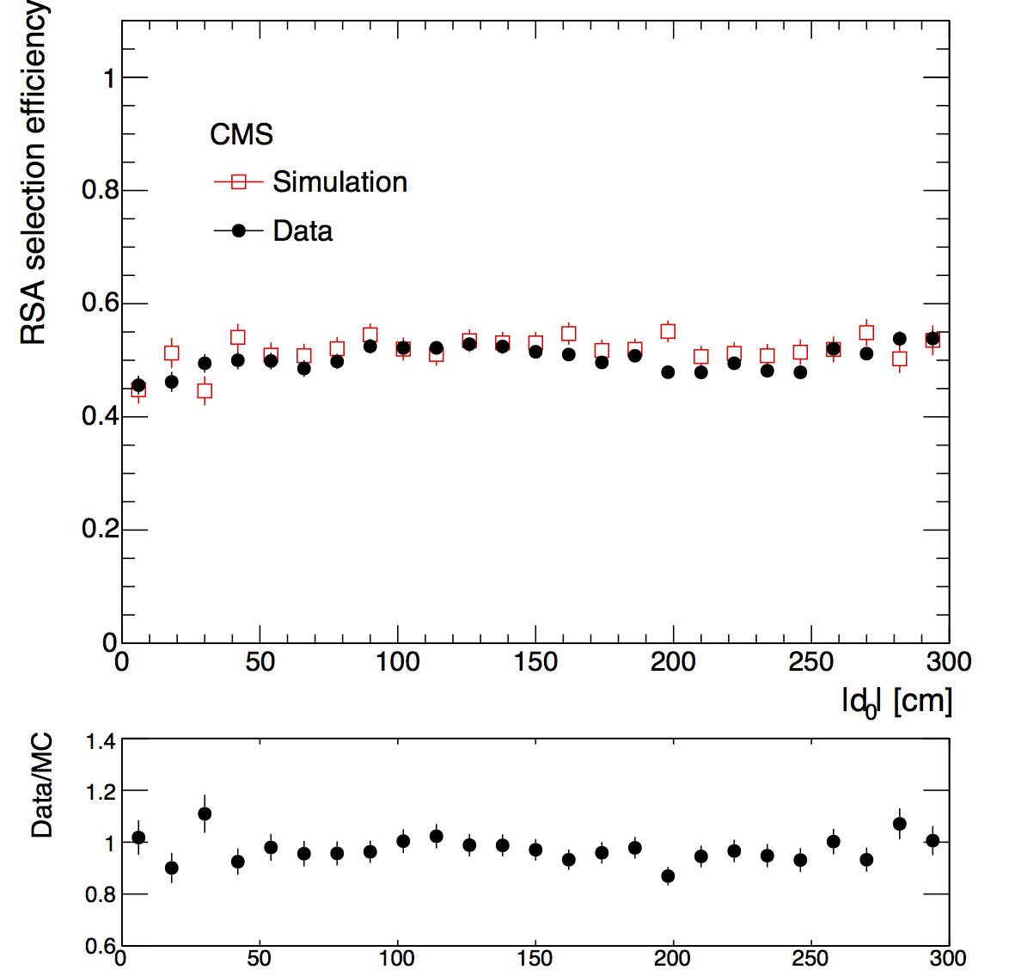
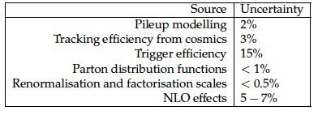
Long-lived Neutral Particles Decaying to Muons
Topology: Two muons originating from displaced secondary vertex, detected in muon chambers only
Limits derived for two specific models:
H⁰ -> XX -> 4μ (H⁰ … non-SM Higgs boson, X … long-lived boson with spin 0)
2 squark pairs, with q -> qχ⁰, long-lived χ⁰ -> μμν (R-parity violated)
~
~
~
μ reconstruction and selection efficiency
CMS-EXO-14-012
Signal systematic errors
Data: cosmics
This analysis is orthogonal to a previous one that used only the tracker (arXiv:1411.6977) – the two analyses have been combined to improve limits
d⁰: transverse impact parameter

Slide 8
Long-lived Neutral Particles Decaying to Muons
Combined 95% CL upper limits for muon chamber and tracker analyses
~
~
~
H⁰ -> XX -> 4μ
q -> qχ⁰, χ⁰ -> μμν

Slide 9
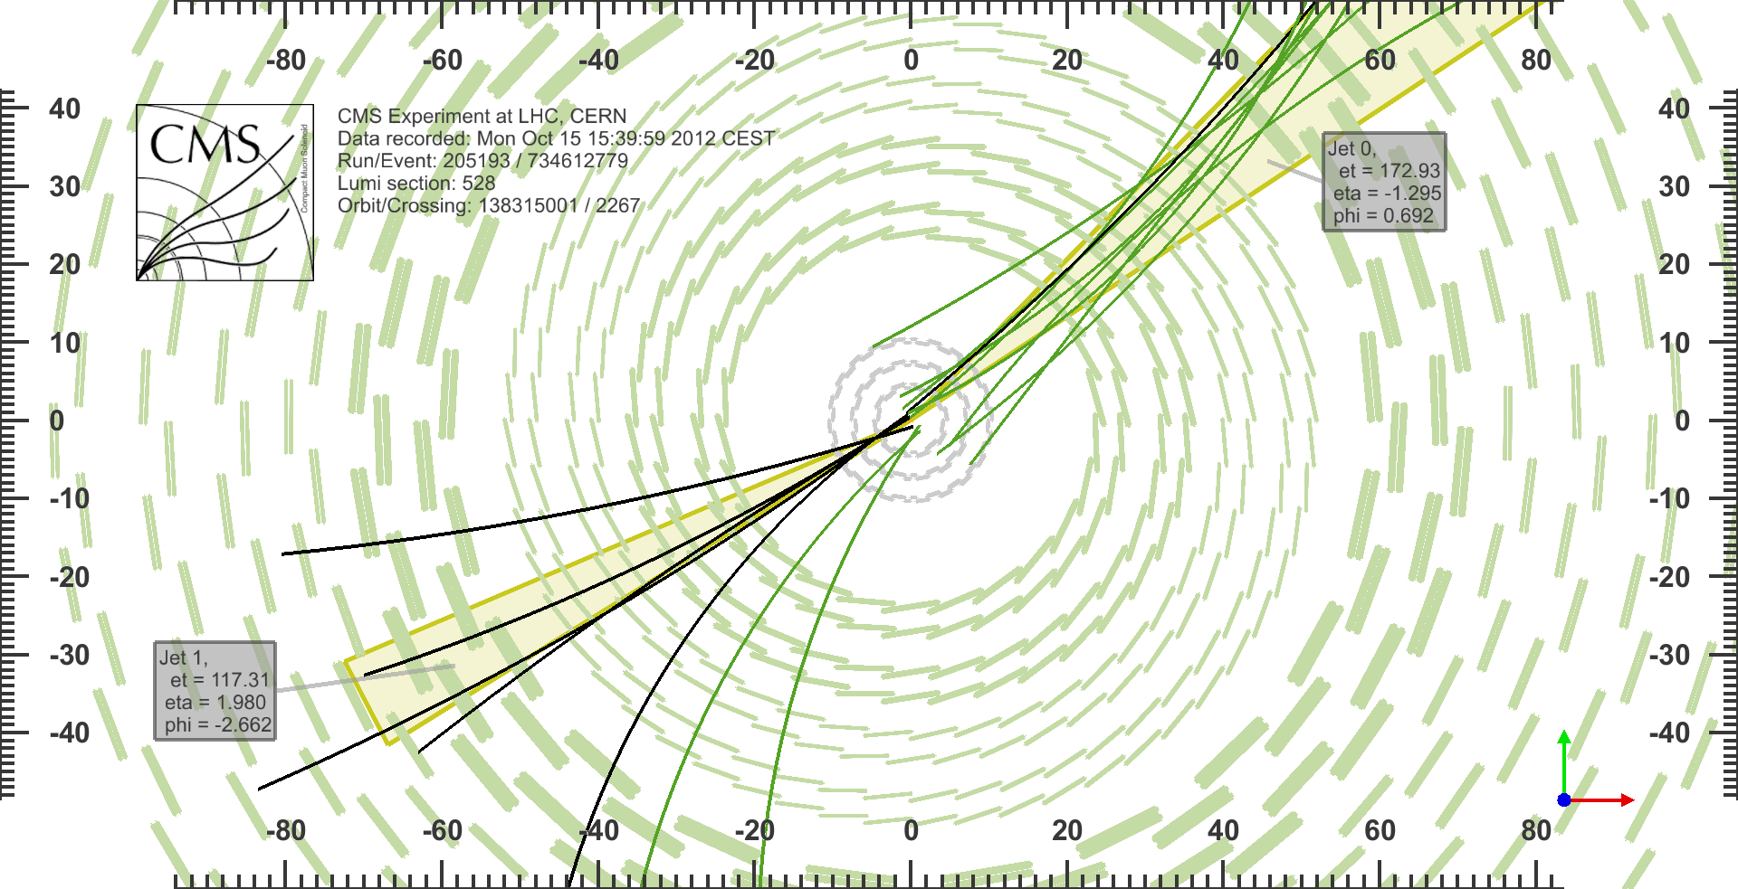
Displaced Jets
Hidden valley benchmark model: H/Φ -> Φ_{hs} -> π_{v}π_{v} with π_{v} ->jj/ll
Decays of v-particles must occur via hidden sector mediator as they do not couple directly to SM particles.
Topology studied: 2 hadronic jets originating from same displaced vertex.
CMS-EXO-12-038, PRD 91 (2015) 012007
H⁰ -> X⁰X⁰,
X⁰ -> qq
-

Slide 10
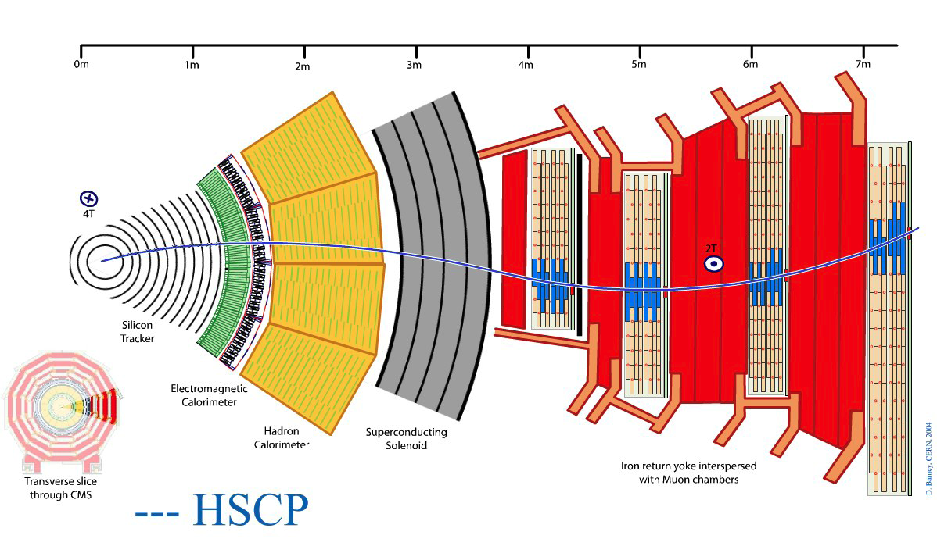
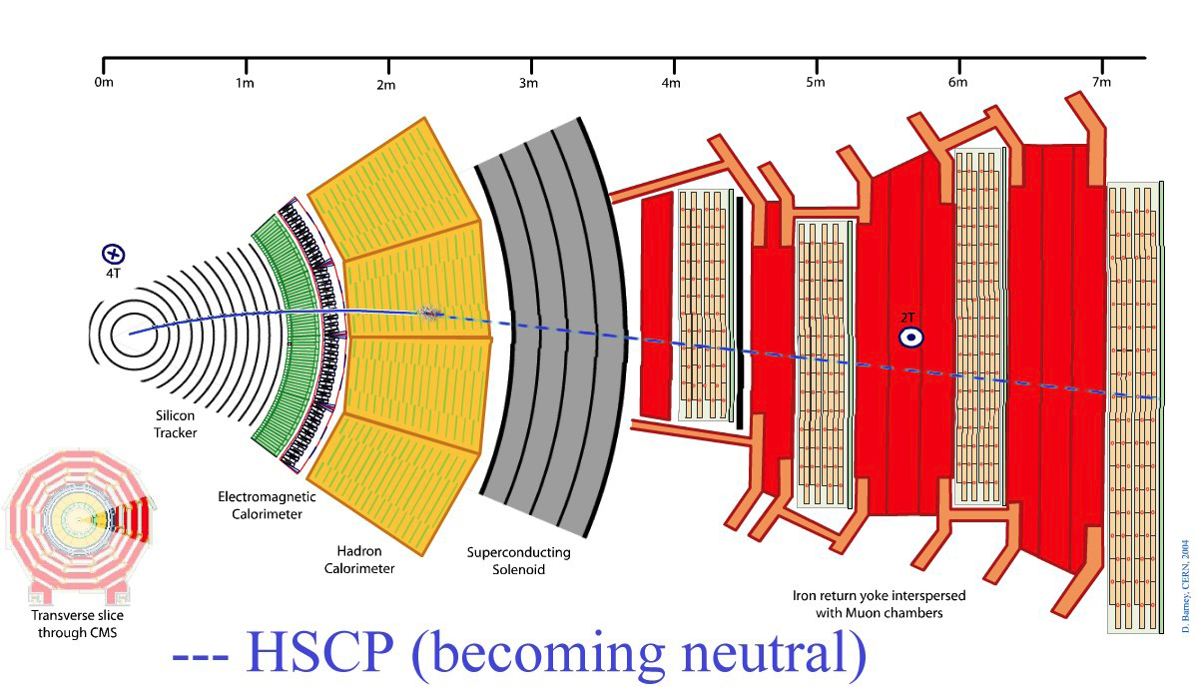
Long-lived Heavy Charged Particles
~
~
_
~
R-hadrons: long-lived gluinos could hadronize to e.g. g-g, g-qq, g-qqq states
Stable chargino or stau, etc.
If mass greater than about 100 GeV: β < 0.9.
Nuclear interactions may lead to charge exchange.
Tracker (high dE/dx) + μ system (long TOF)
Tracker only (charge exchange)

Slide 11
Long-lived Heavy Charged Particles
Reinterpretation of previous results on long-lived chargino production [JHEP 07 (2013) 122] in context of pMSSM (first constraints at the LHC) and AMSB models, based on highly-ionizing and penetrating particles
CMS-EXO-13-006

Slide 12
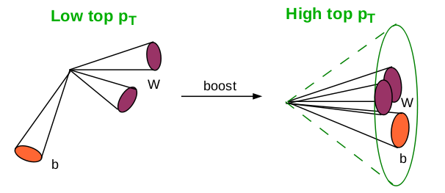
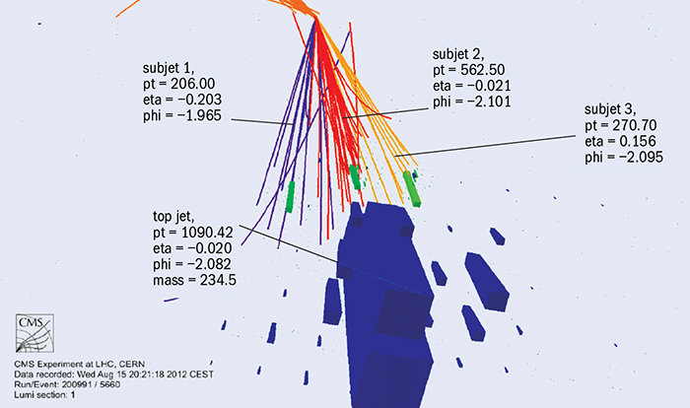
Boosted Objects
Massive final-state particles (m_{X} > 1 TeV mass) with high Lorentz boost (γ > 2)
- overlapping jets
- jet substructure
- non-isolated leptons
New analysis techniques to improve high-mass sensitivity (up to factor ~10)
- grooming (remove noise and pile-up)
- pruning (remove soft, large-angle particles from jets)
- tagging (b, t, W/Z, …)
- subjettiness, mass-drop
Low-p_{T} top High-p_{T} top

Slide 13
Boosted Objects: X -> WH
First search in semi-leptonic WH final state
Search strategy close to one for high-mass WW resonances in lνqq final state, with additional b-tag requirements
Main backgrounds: W+jets, WW/WZ, tt
_
_
CMS-EXO-14-010

Slide 14
Boosted Objects: X -> ZH -> qqττ
Novel analysis feature: τ pair in boosted regime
Six search channels: leptonic(τ_{e}τ_{e}, τ_{e}τ_{μ}, τ_{μ}τ_{μ}), semi-leptonic(τ_{e}τ_{h}, τ_{μ}τ_{h}), all-hadronic (τ_{h}τ_{h})
Different backgrounds according to search channels : Z/γ+jets for leptonic channels, for τ_{e}τ_{h}, τ_{μ}τ_{h} tt and W+jets, for τ_{h}τ_{h} QCD
Event selection: single jet or H_{T}
_
HVT model
Combination of 6 search channels
PLB 748 (2015) 255, CMS-EXO-13-007

Slide 15
Boosted Objects: X -> WH, VH, VV

Slide 16
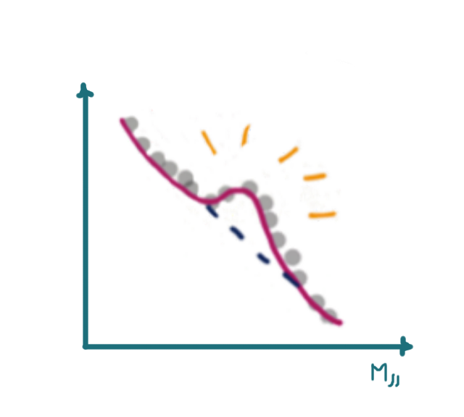
Classic Narrow Resonance Searches
Example: Dijet spectrum
Background estimation: data-driven, parameterization by smooth function
Interpretation possible for many exotica scenarios
Sensitive beyond the Run I reach for resonances with M > 5 TeV
CMS-EXO-12-059, PRD 91 (2015) 052009
CMS-DP-2015-017,
cds.cern.ch/record/2037378

Slide 17
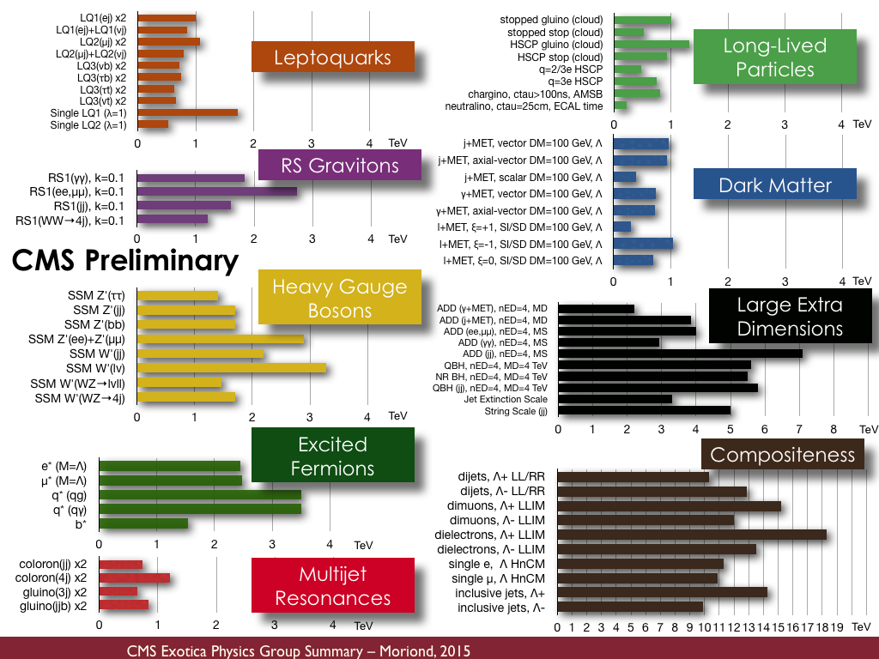
Exotica Limits
March 2015

Slide 18
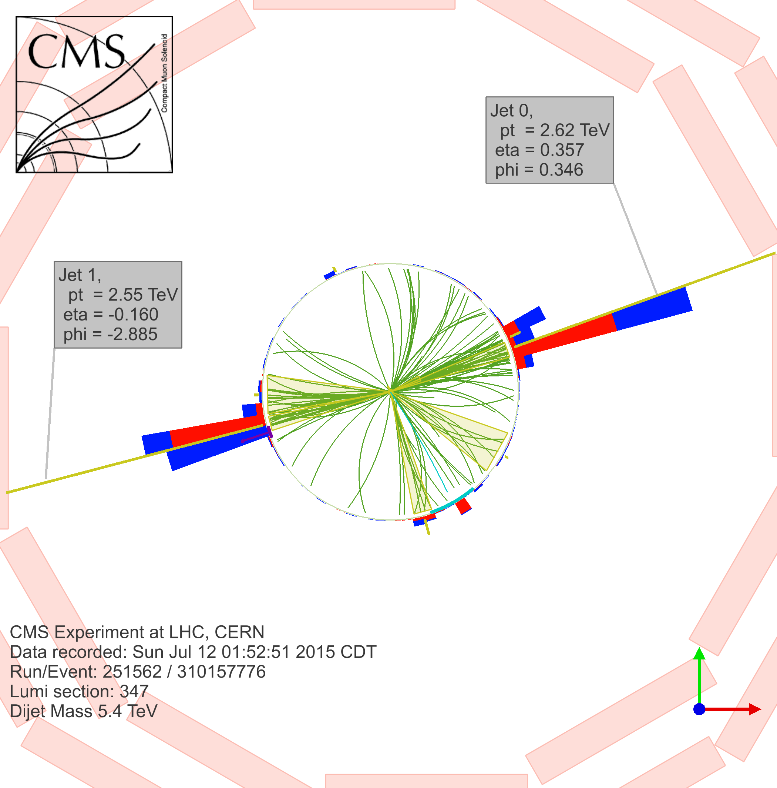
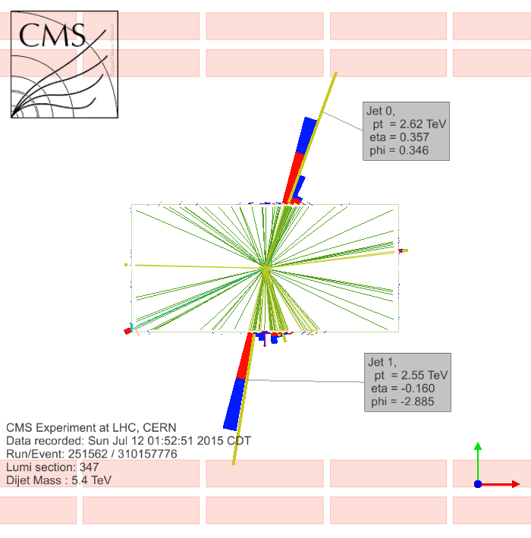
Conclusions
CMS has studied a plethora of Exotica signatures with √s = 7 TeV and √s = 8 TeV data and has derived limits for many scenarios.
Interesting excesses have been seen – stay tuned for more results at √s = 13 TeV !
Sensitivity for New Physics is expected to grow fast during Run II.
ICNFP, Aug. 2015

