Slide 1
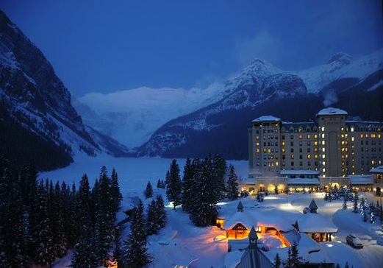

Searches for Dark Matter
with CMS at 13 TeV
Claudia-Elisabeth Wulz
Institute of High Energy Physics, Vienna CMS Collaboration
21 February 2017
Lake Louise Winter Institute

Slide 2

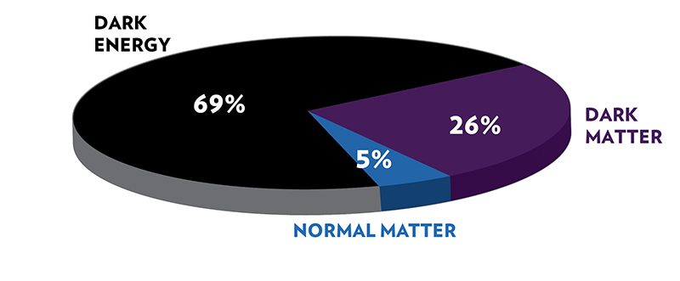
Dark Matter Searches
Dark Matter (DM) could be produced at the LHC, directly or through decays (LSP in SUSY cascades, Higgs portal).
Collider searches:
complementary to direct and indirect searches
best for low DM masses and spin-dependent couplings
68%
27%
Direct production: only detectable as missing transverse momentum in association with additional, visible objects (q, g, γ, W, Z, h, t, b, tt, bb)
-
-
Contact interaction –
effective field theory
g_{χ}
g_{q}
Simplified models
Mediator
Cutoff Λ
Simplified models less model-dependent than UV-complete models (SUSY etc.)
DM parameters: DM and mediator masses, couplings, type of mediator (scalar, pseudoscalar, vector, axial-vector, tensor).
e.g. ATLAS/CMS DM Forum, arXiv 1603.04156 (2016)
Notes:
"Thermal freeze-out”: DM is no longer dense enough to annihilate all the time due to the expansion of the early universe.
EFTs assume that production of DM takes place through a contact interaction involving a quark-antiquark pair, or two gluons, and two DM particles. In this case, the MET distribution of the signal is determined by the nature and the mass of the DM and the Lorentz structure of the interaction. Only the overall production rate is a free parameter to be constrained or measured.

Slide 3
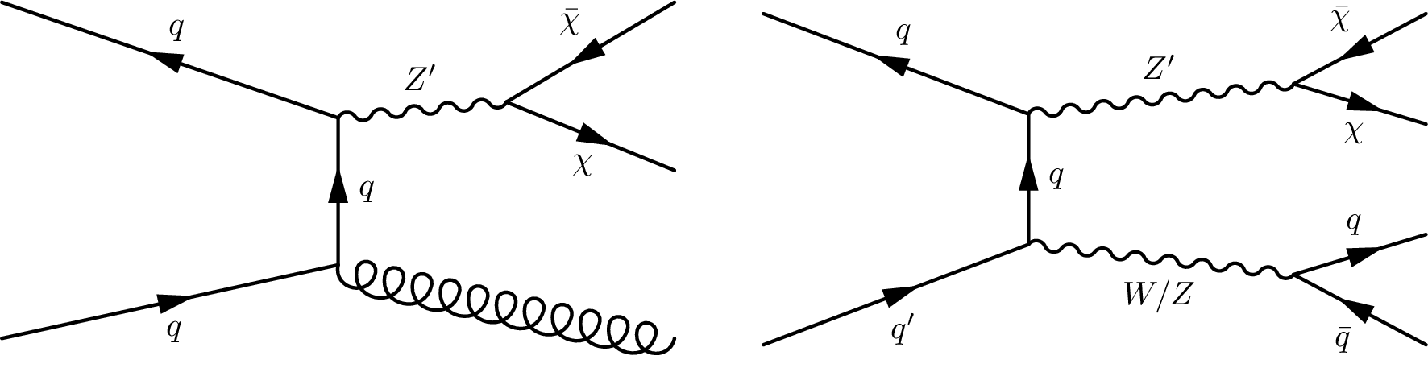
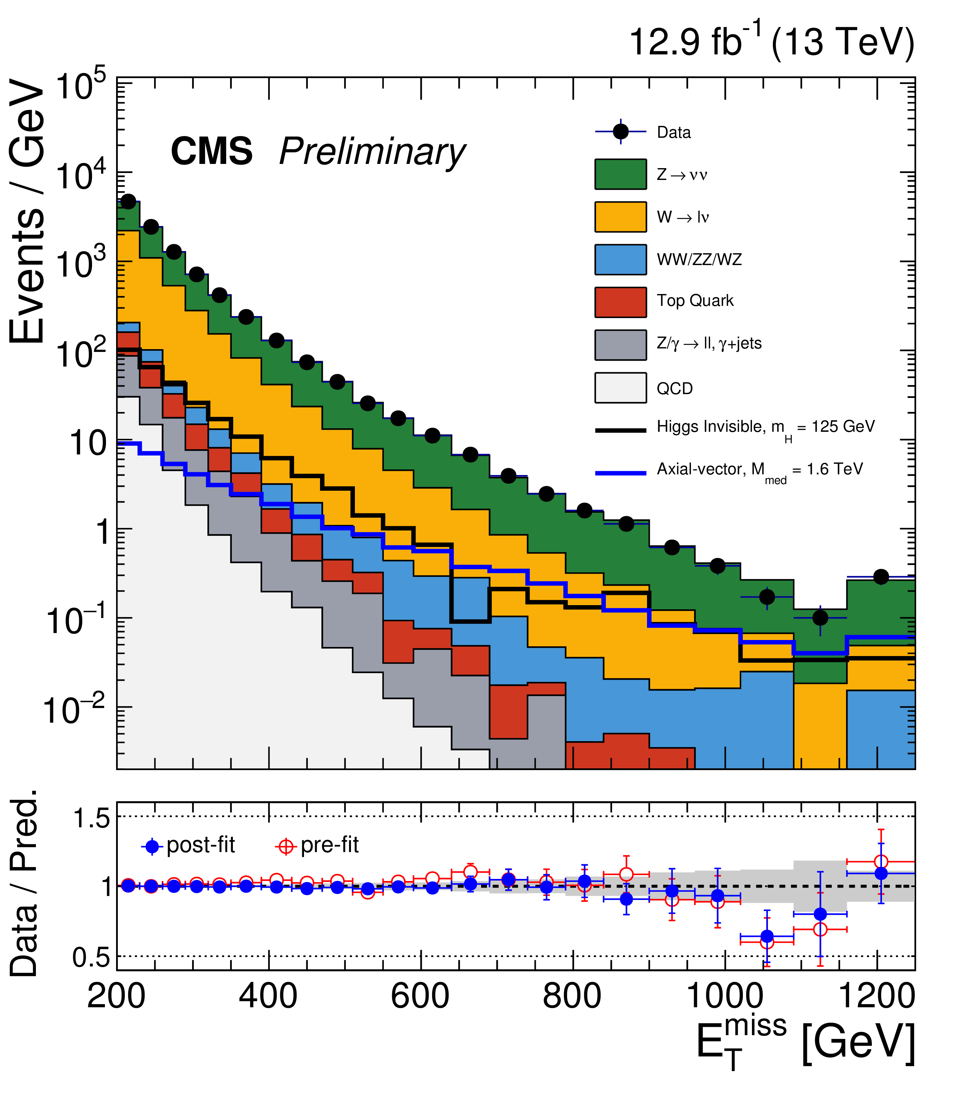
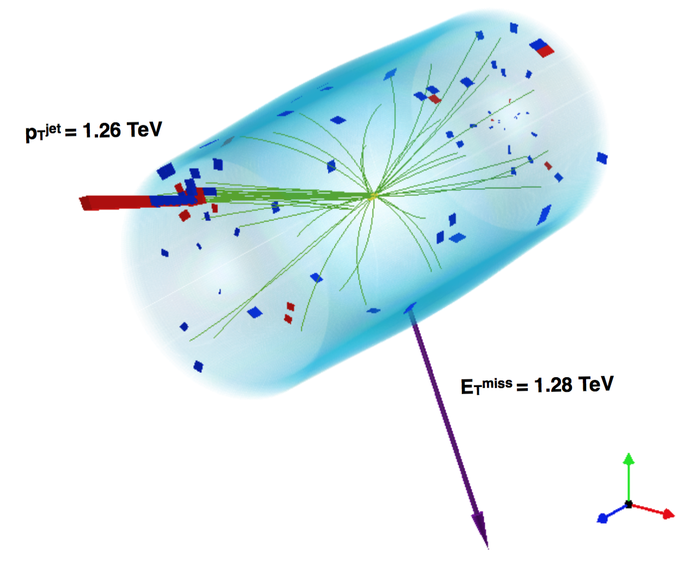
Monojets and hadronically decaying mono-V
Backgrounds:
Z(νν)+jets (irreducible) dominates
W(lν)+jets: lepton veto
tt: b-jet veto
QCD multijets: angular cuts
-
Examples: spin-1 mediator (V, AV)
CMS-PAS-EXO-16-037
Monojets
Notes:
Angular cuts: At least 0.5 radians between leading jets > 30 GeV and pTmiss. For QCD multijets the BKG arises mainly from mismeasurement of the jet momenta.
The DM signal is searched for by fitting the ETmiss distribution.

Slide 4
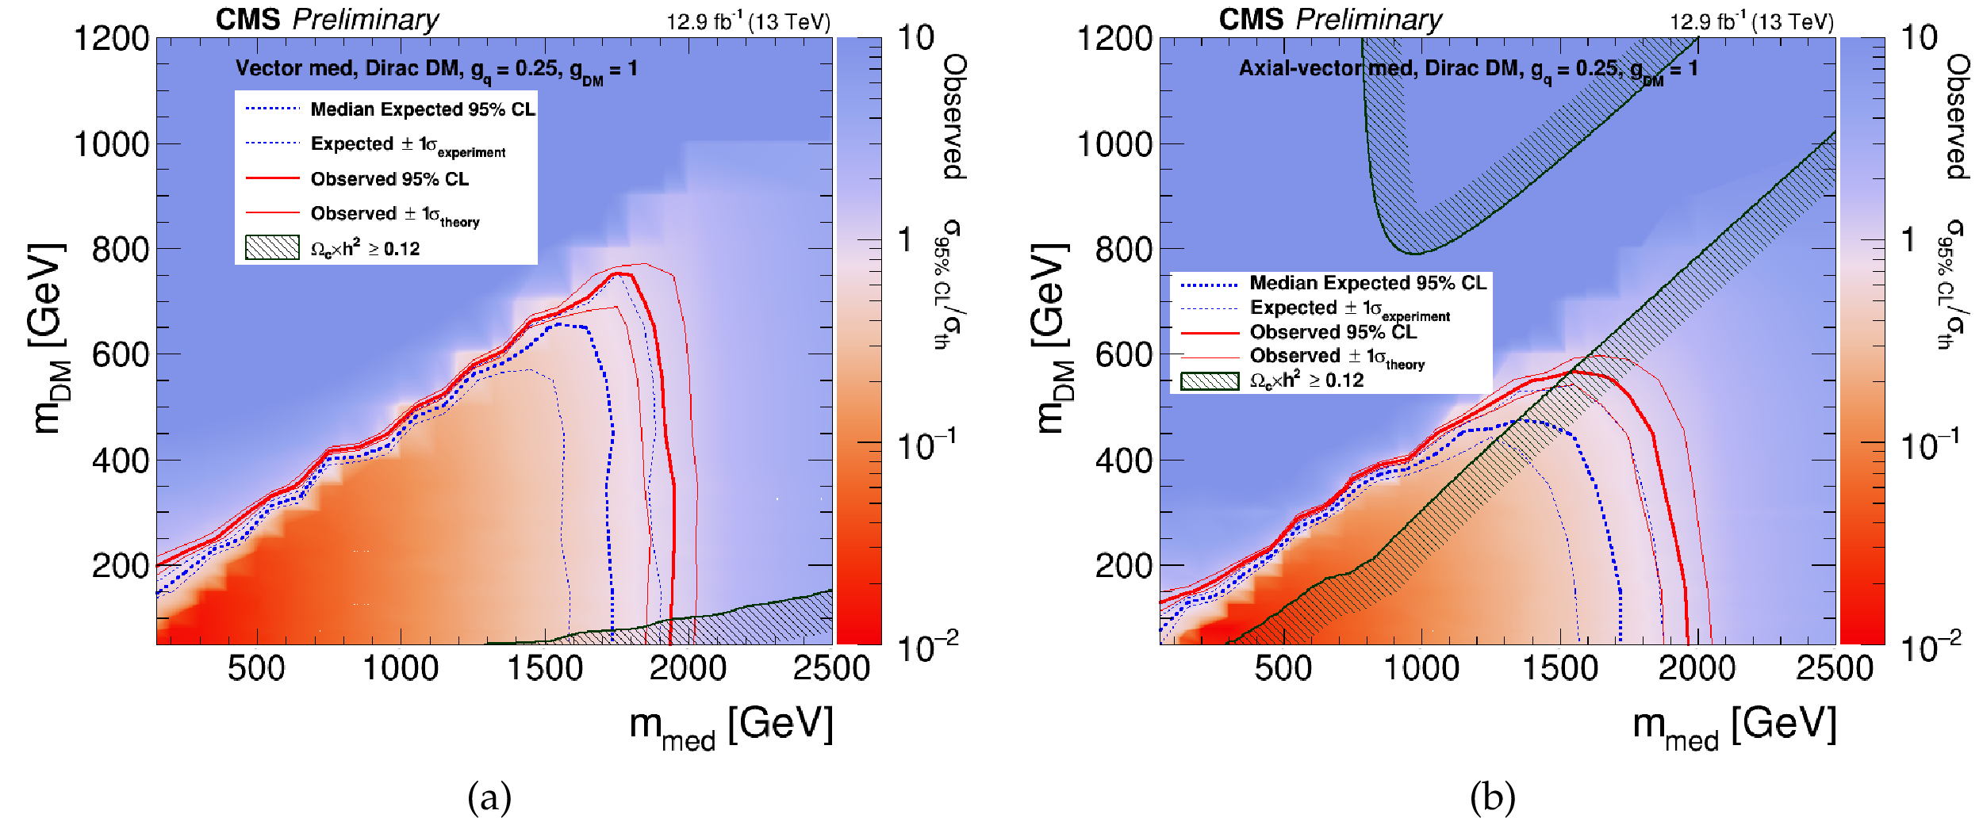
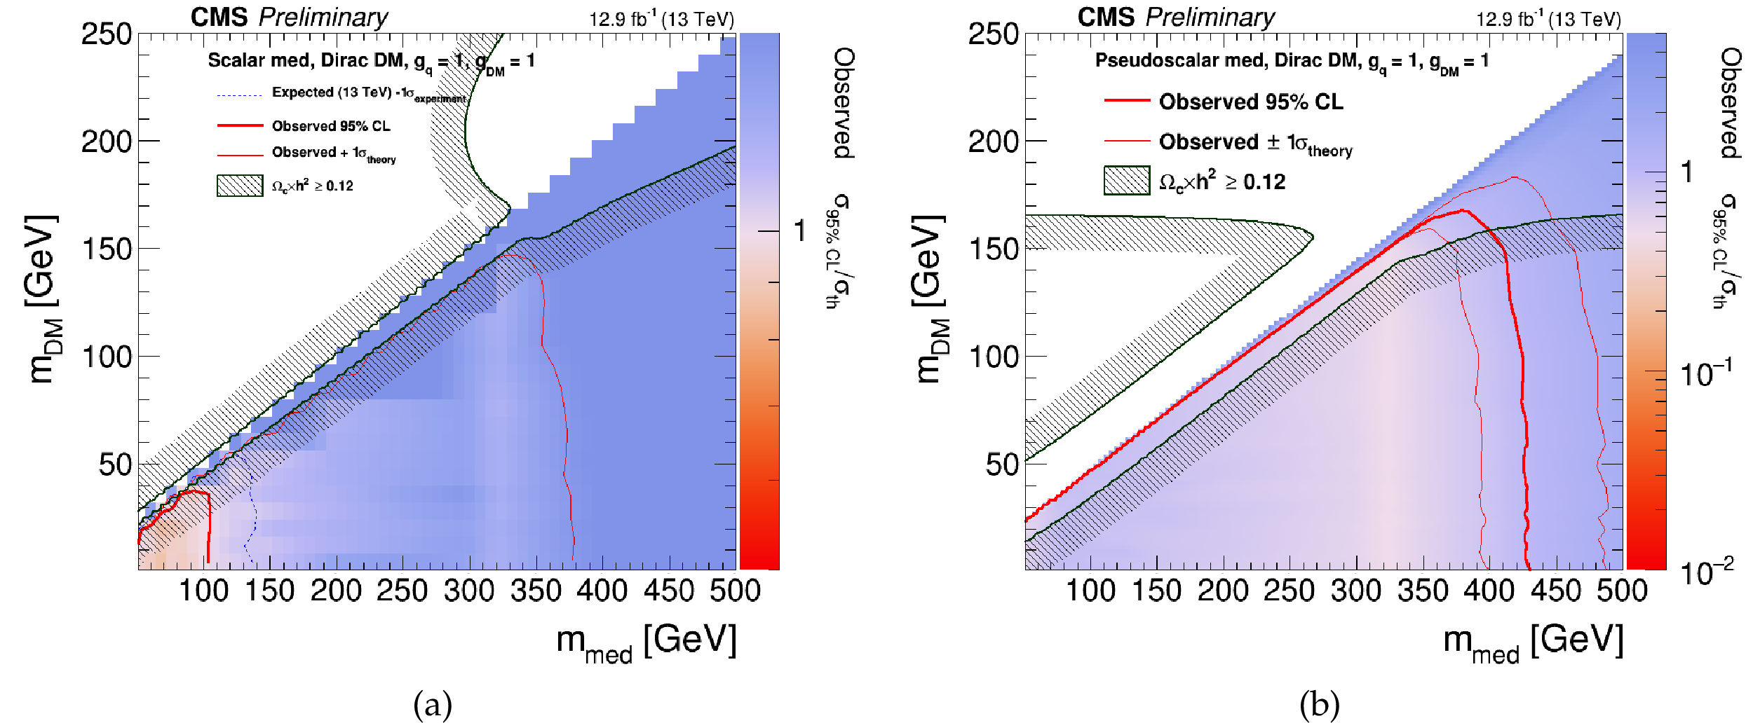
Monojets and hadronically decaying mono-V
Interpretation in terms of simplified model (g_{DM} = 1)
Axial-vector
Vector
Scalar
Monojets
Monojets + mono-V
Pseudoscalar
4
Notes:
Mediator masses for V/AV interactions excluded up to 1.95 TeV. Scalar: up to 100 GeV, pseudoscalar: up to 430 GeV.

Slide 5
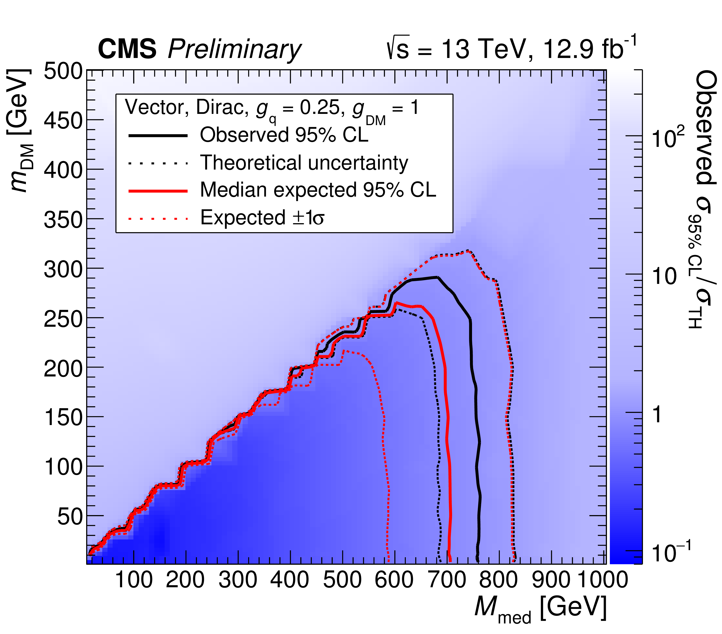
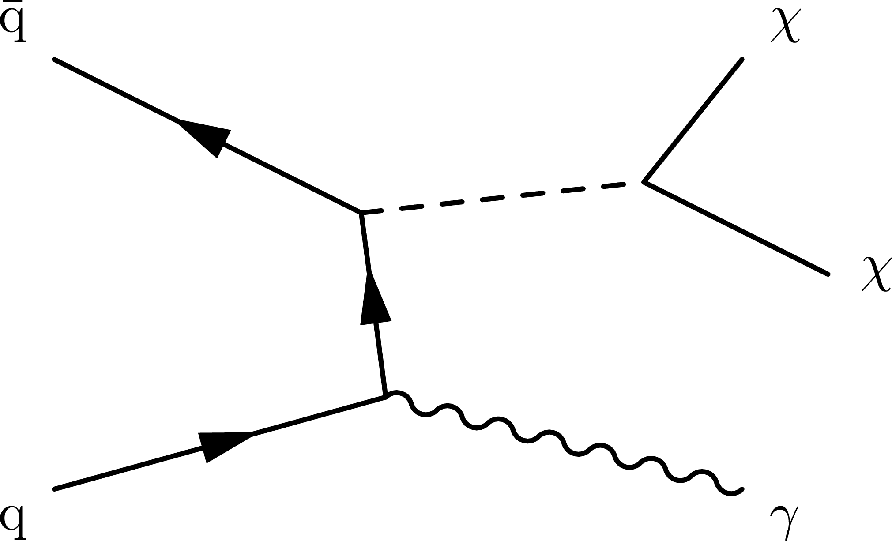
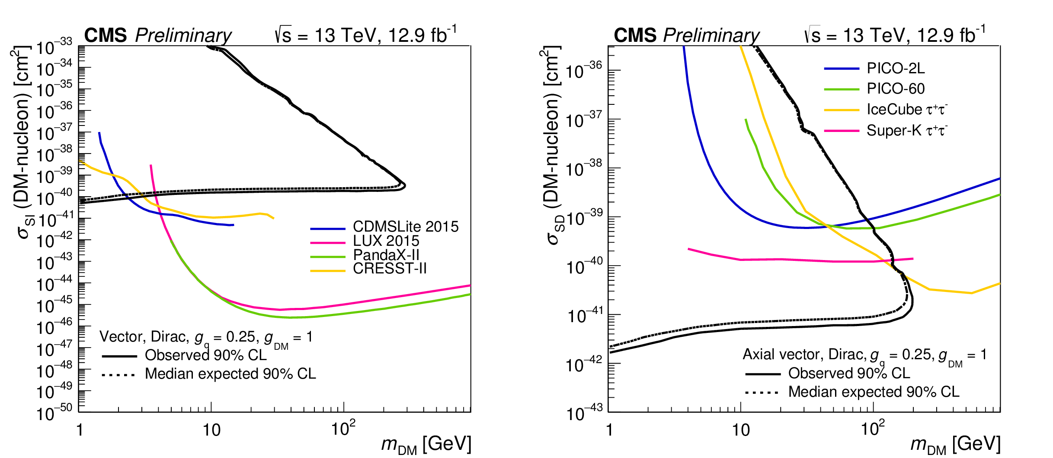
Monophotons
Cleaner than monojet channel, but less sensitive
Event selection:
single γ with E_{T} > 175 GeV and IηI ≤ 1.44
E_{T}^{miss} > 170 GeV
CMS-PAS-EXO-16-039
q
spin-independent
spin-dependent
Notes:
Exclusion contours are also translated into the sigmaSI/SD–mDMplane. For the simplified dark matter production models considered, the
search excludes mediator masses of up to 760 GeV for small dark matter masses.

Slide 6
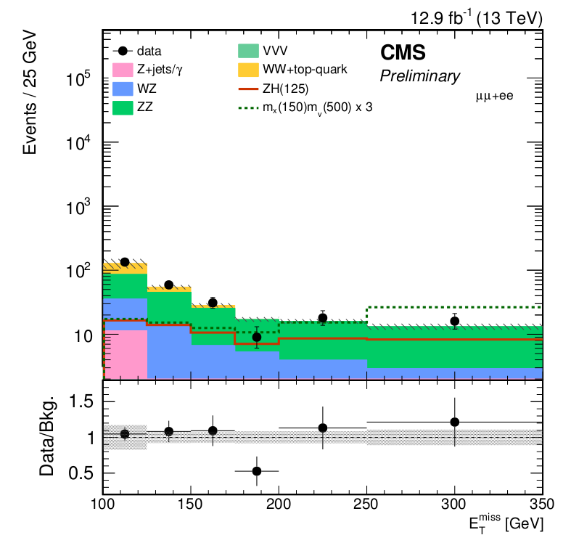
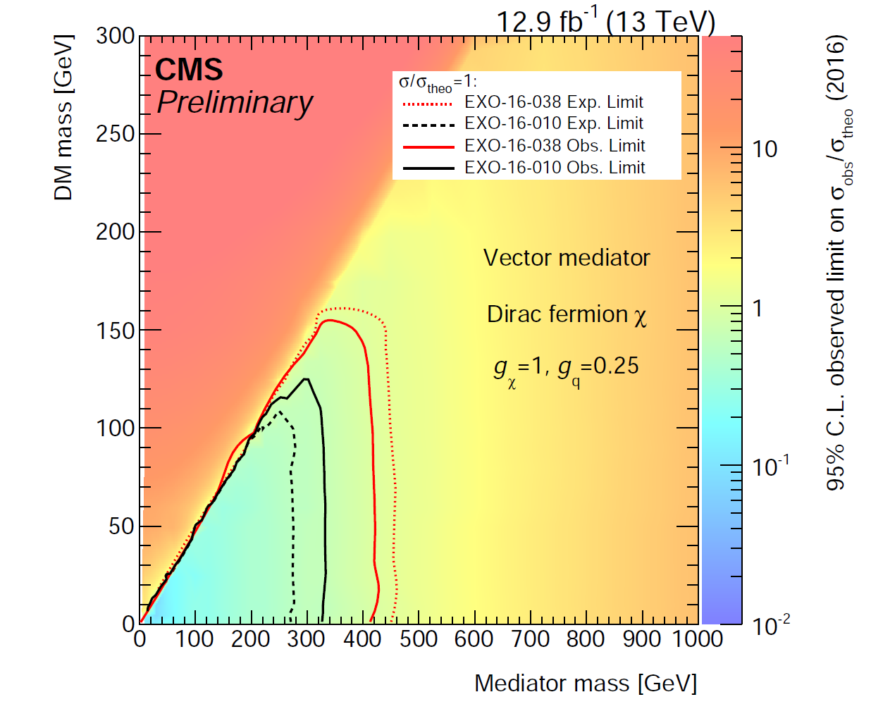
Mono-Z decaying to leptons (electrons, muons)
Z
H -> χχ
CMS-PAS-EXO-16-038, 16-010
Observed B(H->invisible): < 0.86
Comparison of 2015/2016 analyses
Signal region
Notes:
This Z+ETmiss analysis also considers decays of SM Higgs to invisible particles, produced in association with a Z decaying leptonically. 2015 lumi: 2.3 fb-1.

Slide 7
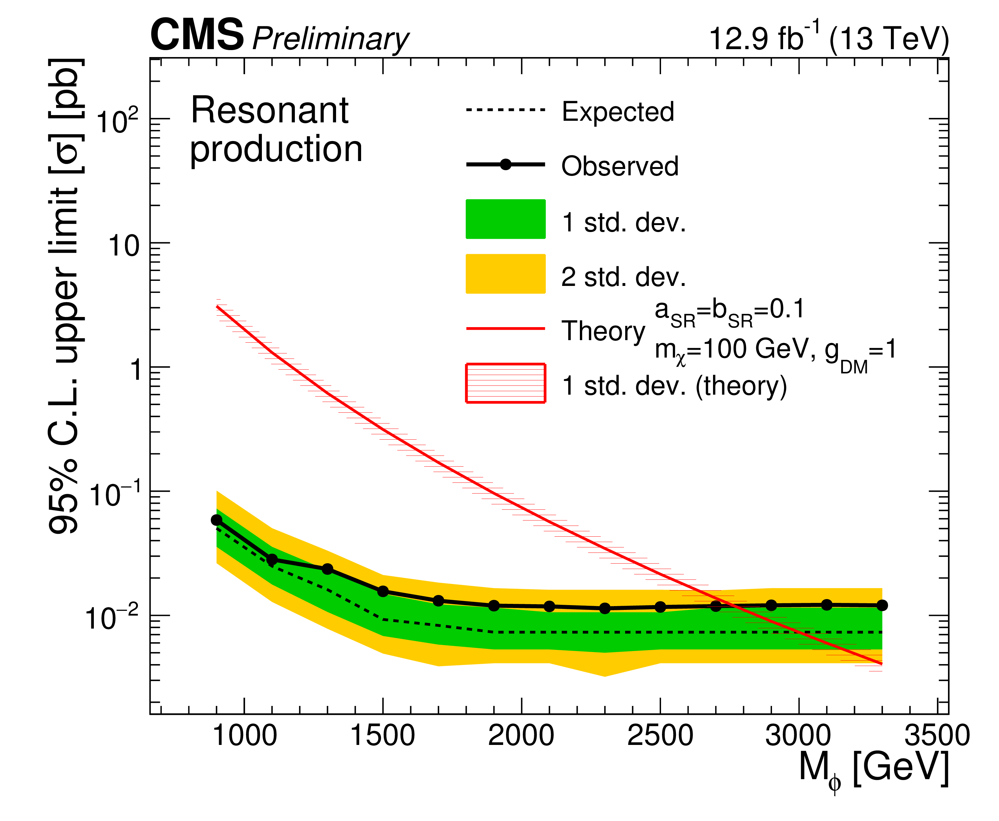
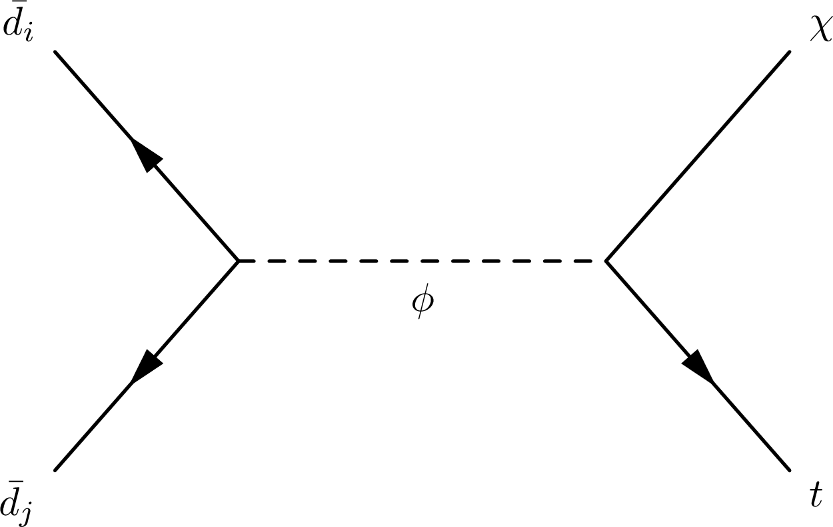
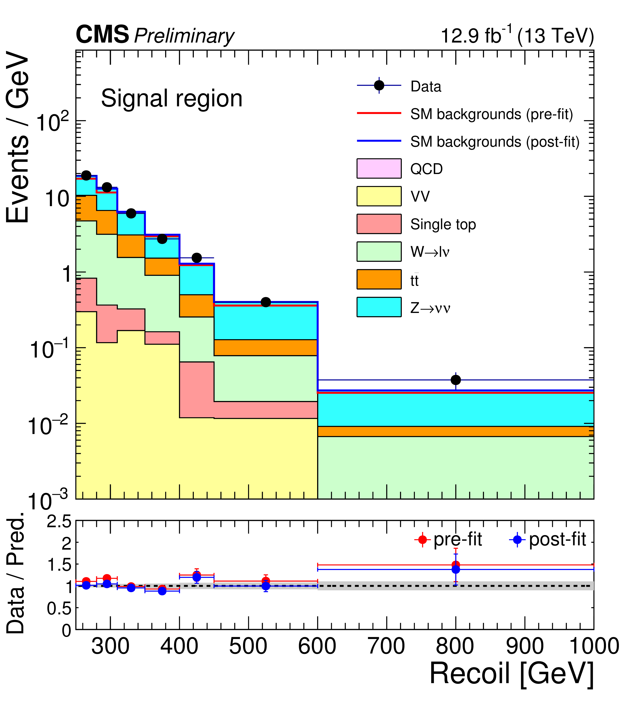
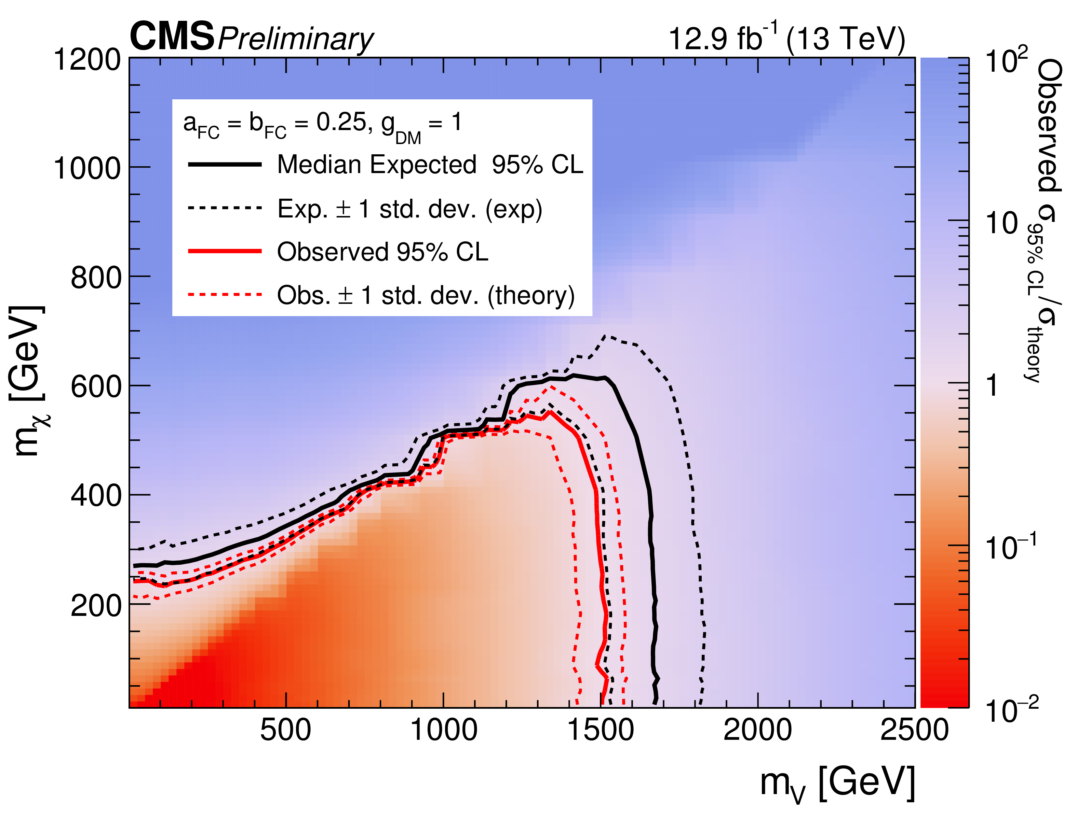
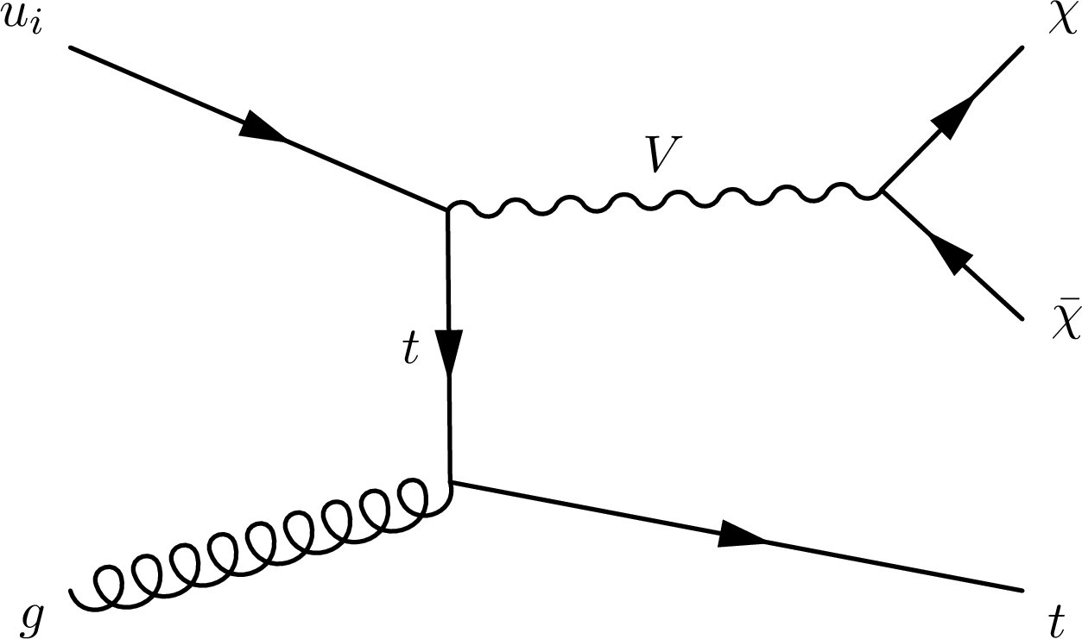
Boosted hadronically decaying monotops
Events with hadronically decaying W from t selected.
q-χ couplings in scalar interactions could be enhanced for heavy flavors.
DM signal searched by fitting E_{T}^{miss} distribution in signal region, assuming background-only hypothesis
CMS-PAS-EXO-16-040
Notes:
Two models considered: one with scalar mediator, and one with a FCNC current, where a single t is produced associated with a V mediator that has FC couplings to top and light quarks. The scalar mediator is charged and colored. FCNC is excluded for mediator masses between 0.3 and 1.5 TeV assuming mDM = 10 GeV. The resonant model is excluded over a mass range between 0.9 and 2.7 TeV, for a DM mass of 100 GeV. Previous limit was 1.6 TeV.

Slide 8
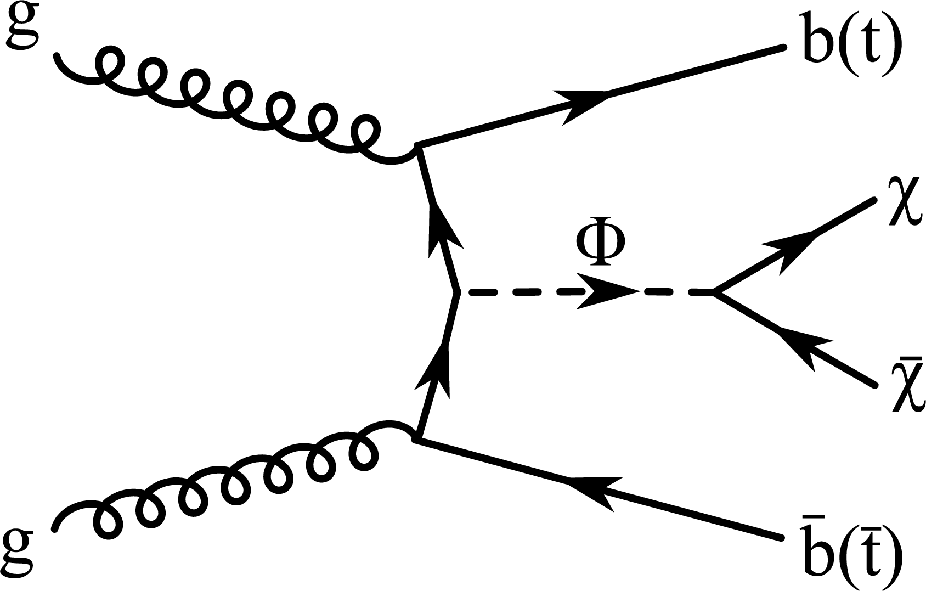
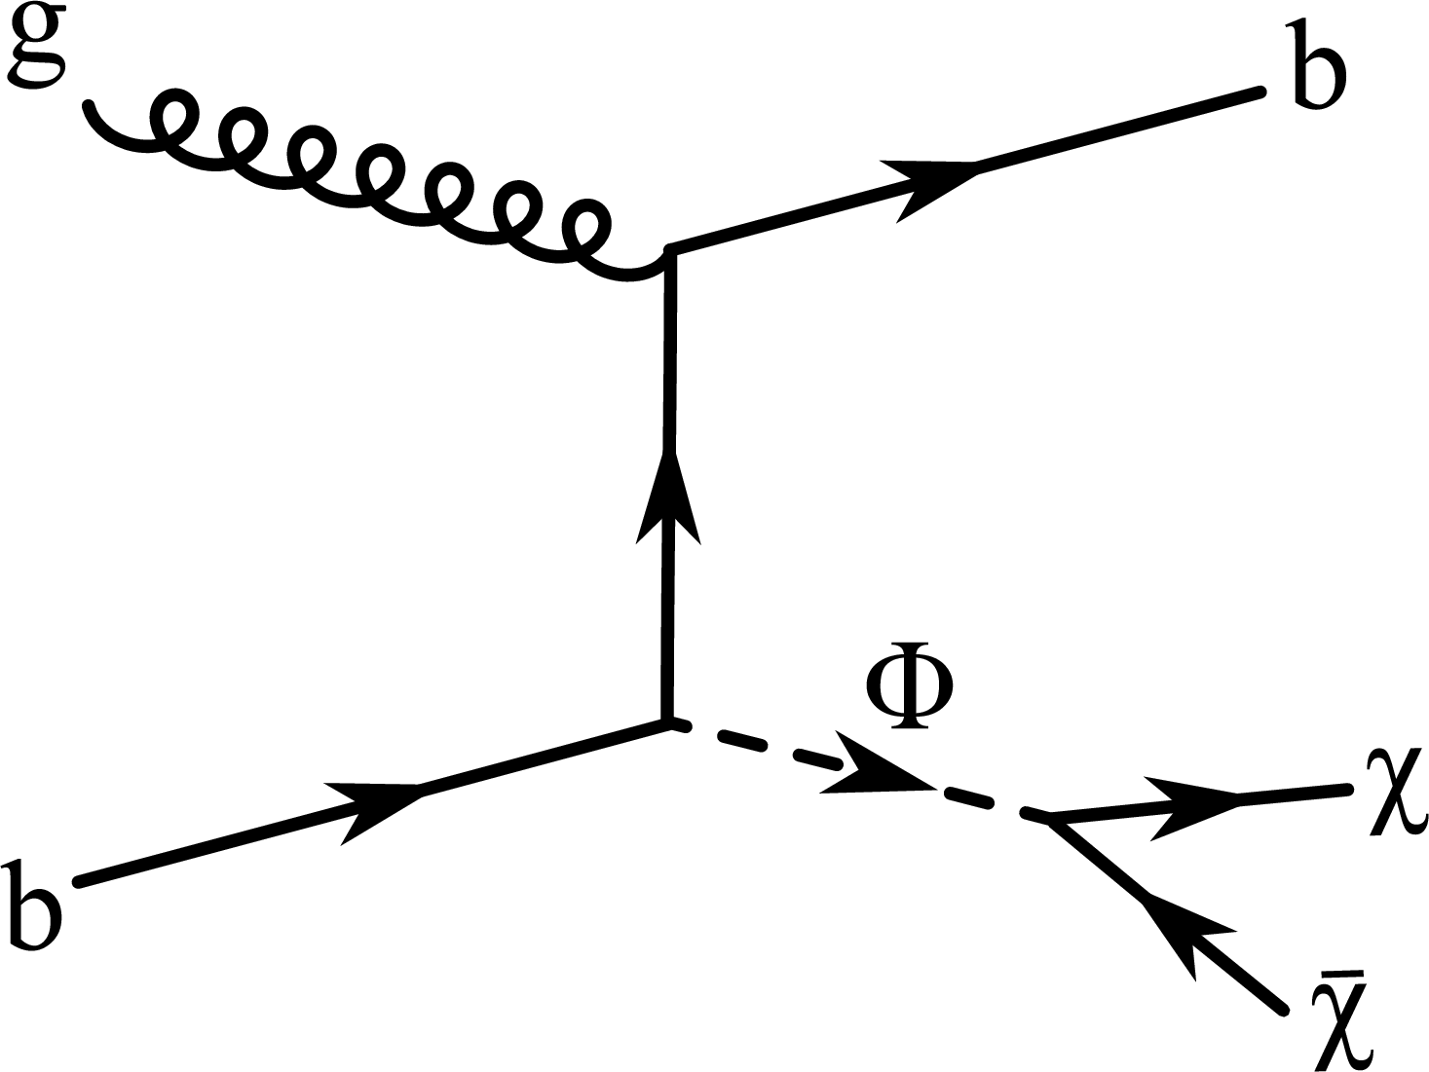
Dark Matter in association with b quarks
Signature: b (1 or 2) + E_{T}^{miss}
This analysis is sensitive also to DM production processes in association with t quarks, which decay to b’s.
CMS-PAS-B2G-15-007
DM+bb
DM+bb/tt
Mediator-DM couplings down to 5 x σ/σ(g_{DM}=1) for a scalar mediator are excluded.
Notes:
Scalar mediator. Mass of the DM particle is assumed to be 1 GeV.

Slide 9
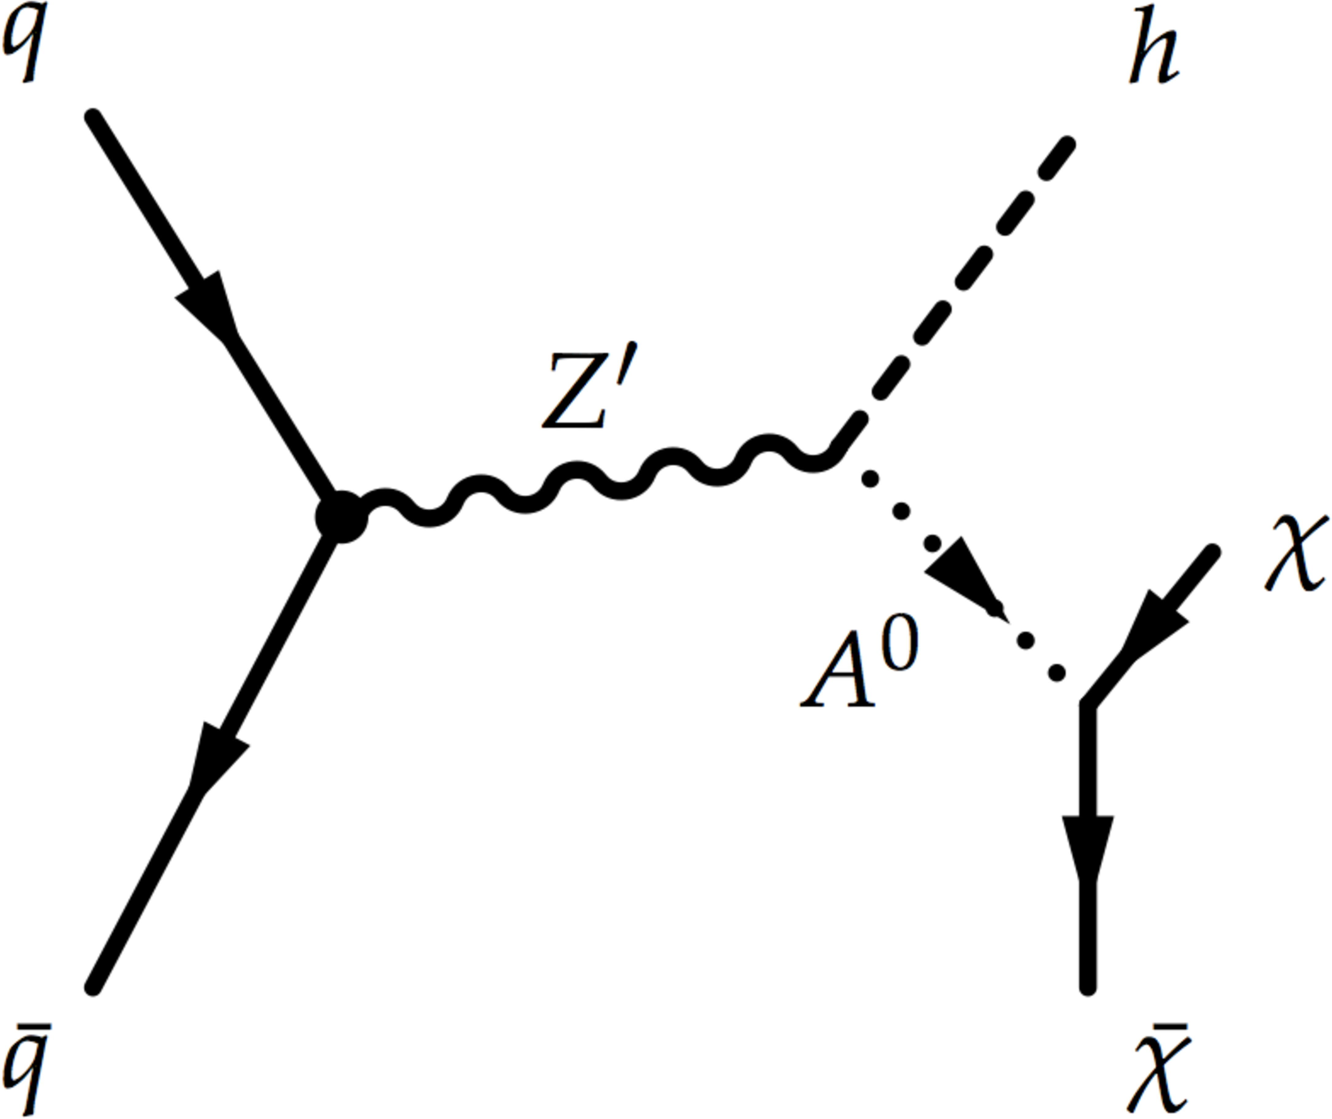
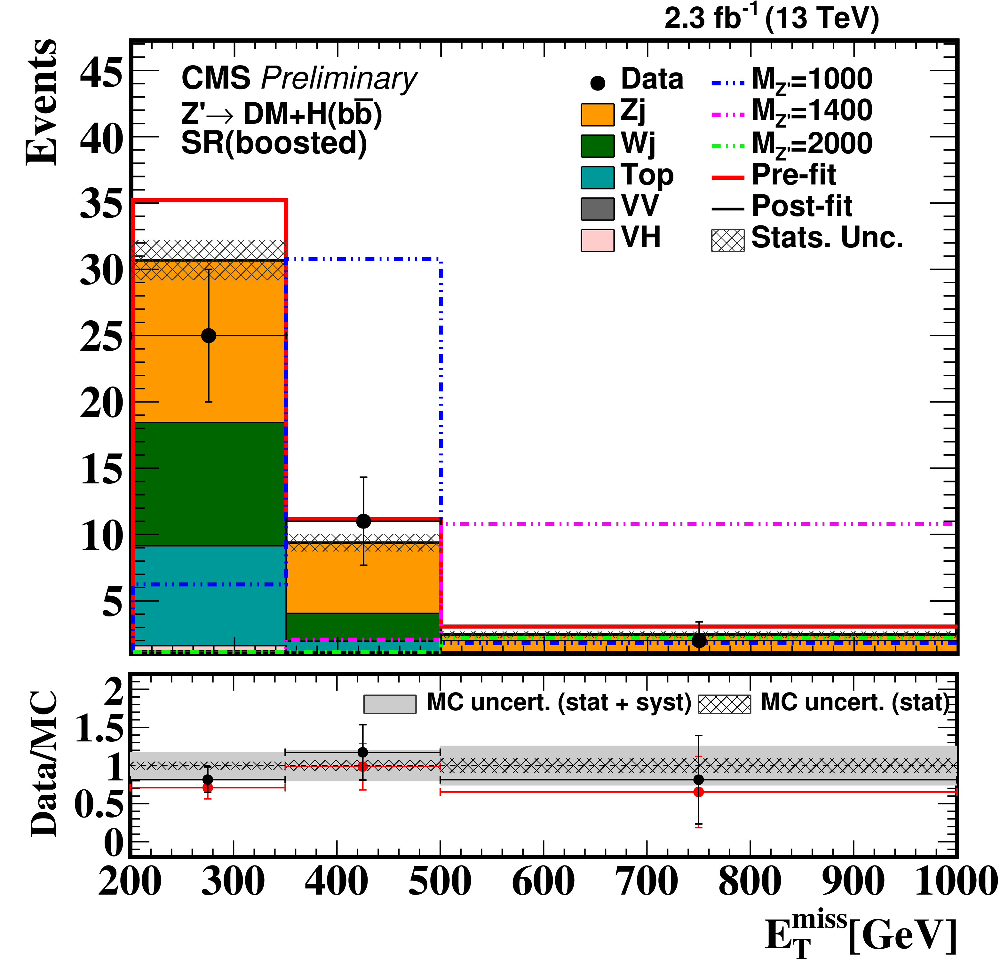
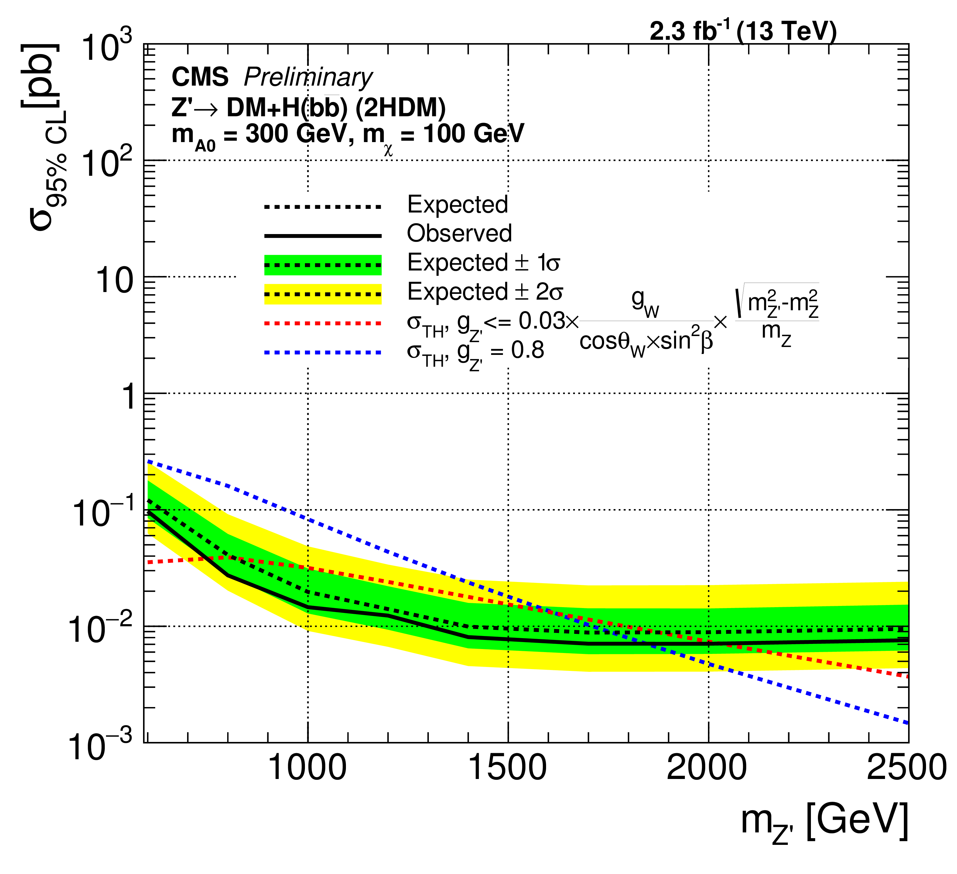
Dark Matter in association with H -> bb
CMS-PAS-EXO-16-012
2H-doublet-model with invisibly decaying pseudoscalar A⁰
doi:10.1007/JHEP06(2014)078
Event selection dependent on p_{T}: H reconstructed from 2 small- or 1 large-radius jet – resolved and boosted topologies.
Notes:
Higgs boson ISR is highly suppressed, which implies that the observation of a mono-Higgs signal would probe directly the structure of the DM-SM coupling.
A Z` boson is produced resonantly. The search is performed by extracting the signal through a simultaneous fit of signal- and BKG-enhanced control regions, separately for resolved and boosted regimes. The Z’ mass range is excluded from 600 to 1863 GeV.

Slide 10
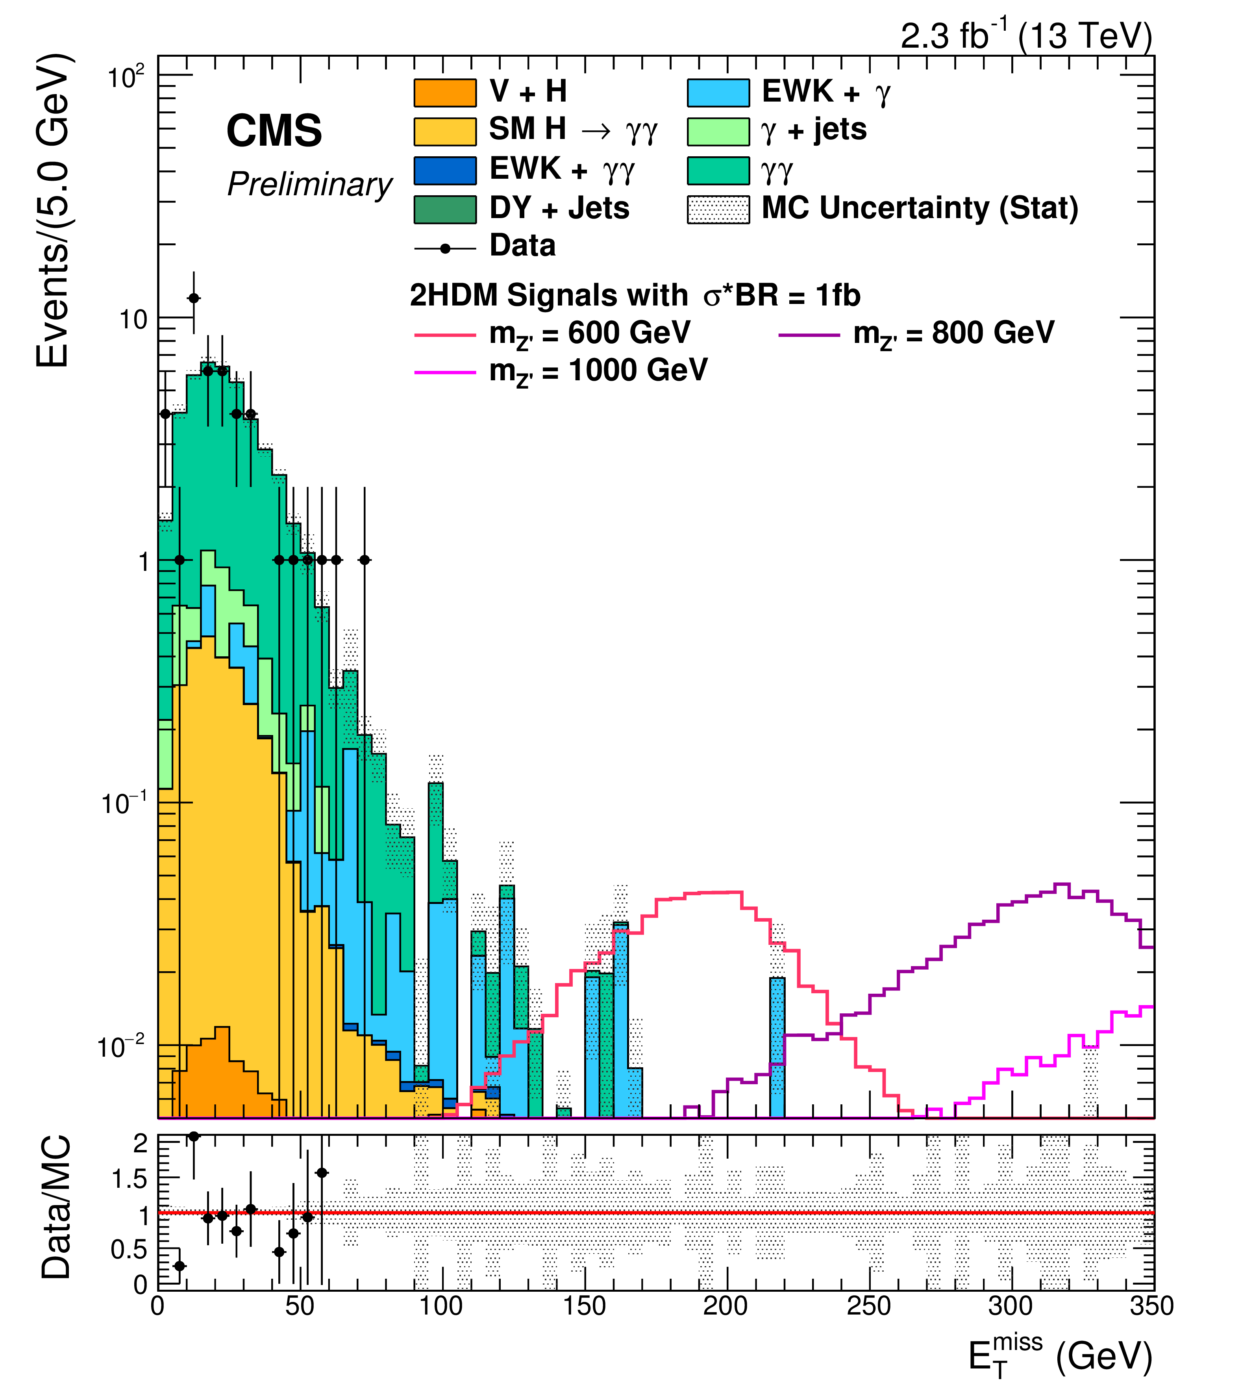
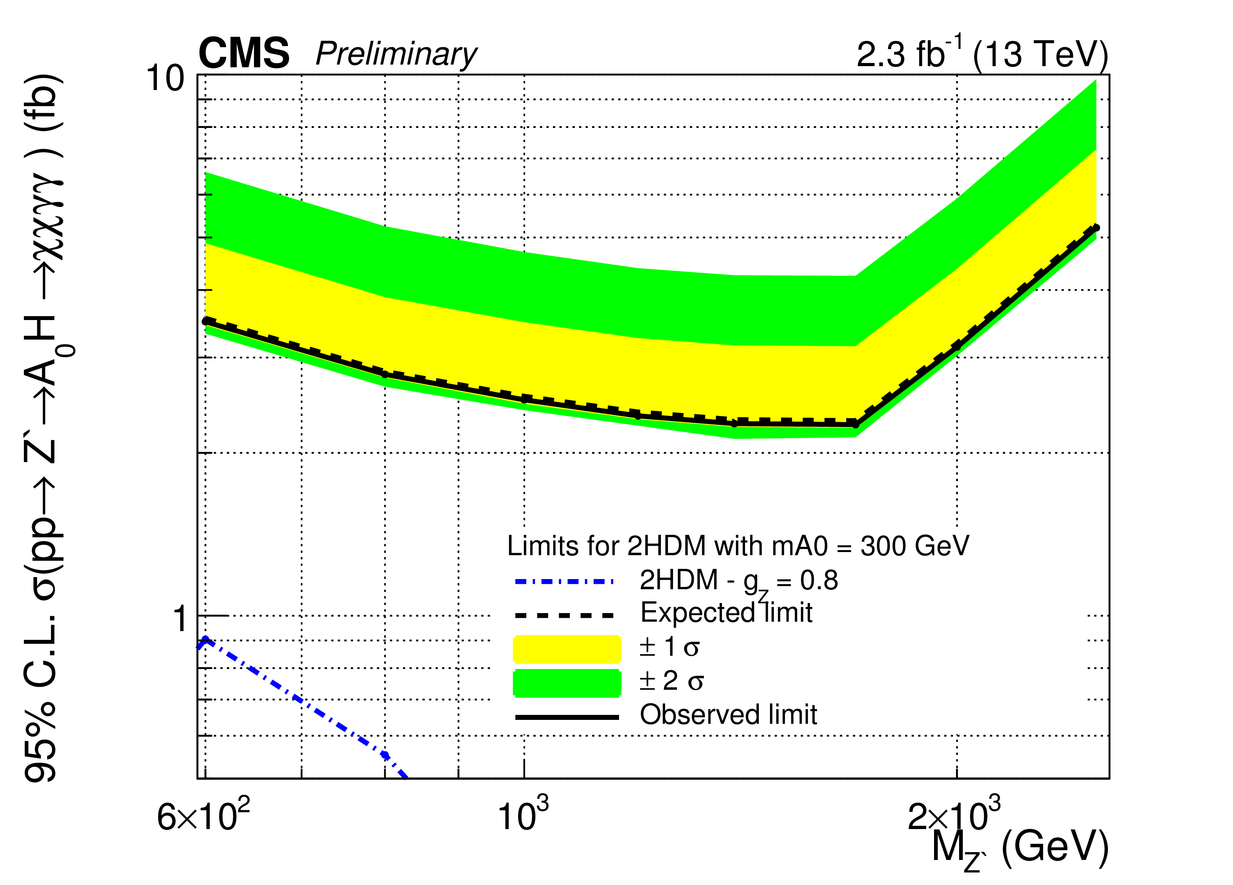
Dark Matter in association with H -> γγ
Same 2-HDM as for H -> bb.
Event selection:
2 photon candidates with kinematic requirements on p_{T}/m_{γγ}, m_{γγ}, E_{T}^{miss}
CMS-PAS-EXO-16-011
x
Notes:
For the benchmark model, limits on the cross section times branching ratio for dark matter production are placed at approximately 2 to 5 fb for the Z′ mass range of 600 to 2500 GeV.

Slide 11
Dark Matter Mass Limits

Slide 12
Conclusions
CMS has recently studied dark matter signatures with √s = 13 TeV data and has derived limits as no excesses have been found.
Simplified models are replacing EFT approach for Run 2 searches.
If WIMP dark matter is not confirmed soon other scenarios such as SIMP dark matter might also be studied.
In any case, we have to be open to all kinds of dark matter searches (WIMP, SIMP, axions, …) across different types of experiments – colliders, direct detection, indirect detection, and specialized experiments.
Lots of data are still to come before the next LHC shutdown, so stay tuned!
Feb. 2017

Slide 13
BACKUP

Slide 14
Dark Matter Bibliography
  Monojets: EXO-16-037, EXO-15-003 (√s = 13 TeV), EXO-12-048 (√s = 8 TeV)
  Dijets: EXO-16-013?, EXO-16-032, EXO-14-004 (8 TeV, razor)
  Monophotons: EXO-16-039, EXO-12-047 (8 TeV)
  Mono-Z: EXO-16-010, EXO-16-038, EXO-12-054 (8 TeV)
  Mono-W: EXO-16-013, EXO-16-037, EXO-12-060 (8 TeV)
  MET + top: EXO-16-017, EXO-16-040, B2G-14-004, B2G-13-004, B2G-12-022 (8 TeV)
  MET + tt: EXO-16-005, EXO-16-028
  MET + Higgs: EXO-16-011, EXO-16-012
  - Associated b quarks: B2G-15-007 (13 TeV)
http://cms-results.web.cern.ch/cms-results/public-results/publications

Slide 15
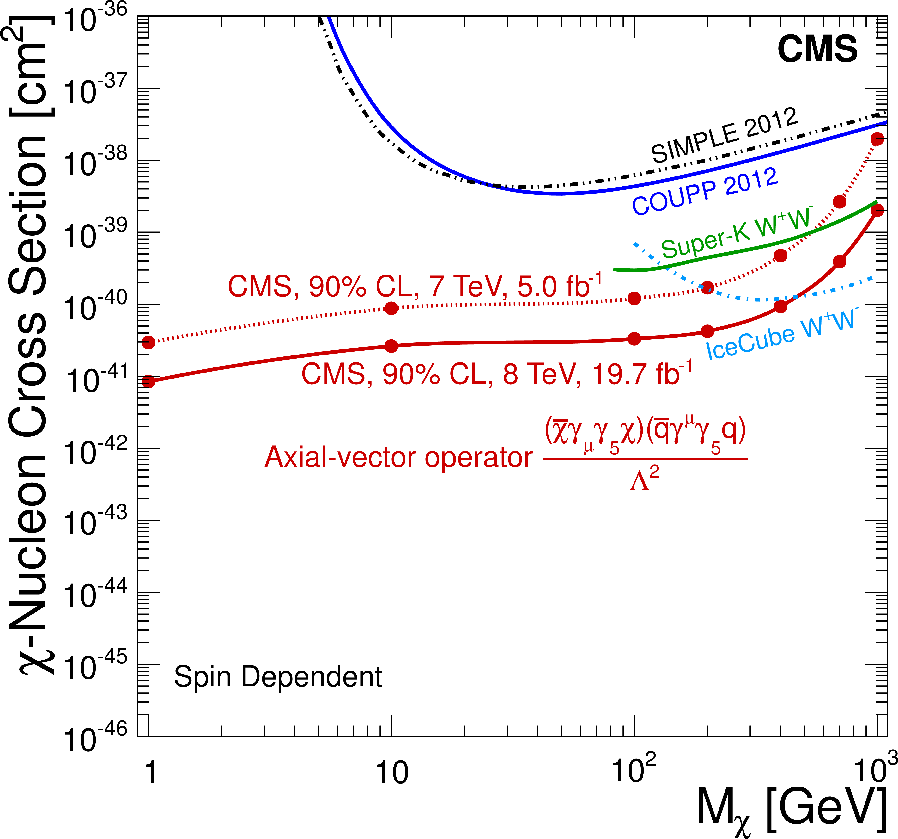
Dark Matter Searches – Monojets
CMS-EXO-12-048, EPJC 75 (2015) 235
Data sample:
19.7 fb⁻¹ at √s = 8 TeV, 5.0 fb⁻¹ at √s = 7 TeV
Background:
Z(νν) estimated from Z(μμ) control sample,
tt and QCD multijets removed by excluding events with more than 2 jets with p_{T} > 30 GeV
-
Notes:
We studied scalar, vector, and axial-vector interactions for Dirac DM particle. The solid and hatched yellow contours show the 68% and 90% CL contours respectively for a possible signal from CDMS. Top right plot: Should EFT not be valid, we consider case of an s-channel mediator with vector interactions. The resonant enhancement in the production cross section, once the mass of the mediator is within the kinematic range and can be produced on-shell, can be clearly seen.

Slide 16
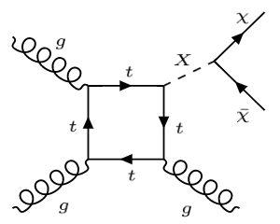
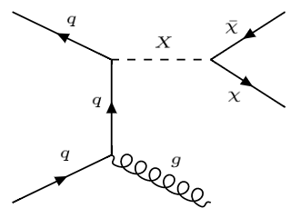
Dark Matter Searches – Monojets
CMS-EXO-15-003
Spin-1 mediator X
(vector or axial-vector
current)
Spin-0 mediator X (scalar or pseudoscalar current)
Event selection: ≥ 1 jets with E_{T} > 100 GeV, E_{T}^{miss} > 200 GeV
Data sample: 2.1 fb⁻¹ at √s = 13 TeV
DM signal
extracted by fit to E_{T}^{miss}
m_{MED} > 1.3 TeV
8 TeV: m_{MED} > 1.6 TeV
16
March 2016
Notes:
2 types of simplified models were considered. DM signal is extracted by a fit to Etmiss distribution (before and after simultaneous fit to the different control regions), assuming vector mediator. The expected distributions are evaluated after fitting to the observed data in the control and signal regions simultaneously. LUX is most sensitive down to 6 GeV. Left bottom plot: The green line denotes the best bound from direct detection experiments. The excluded region is to the bottom-left of the contours shown in all cases except for that from the relic density as indicated by the shading. Mediator masses up to the range of 1.3 TeV are excluded at 90% CL. The exclusion limits are less stringent than the current best bounds from the 8 TeV studies, which reach up to 1.6 TeV of vector mediator mass. The analysis differs from the previous CMS DM analyses in that new electron control regions are added and the single lepton control regions are used to predict both the W boson background and the Z boson background.

Slide 17
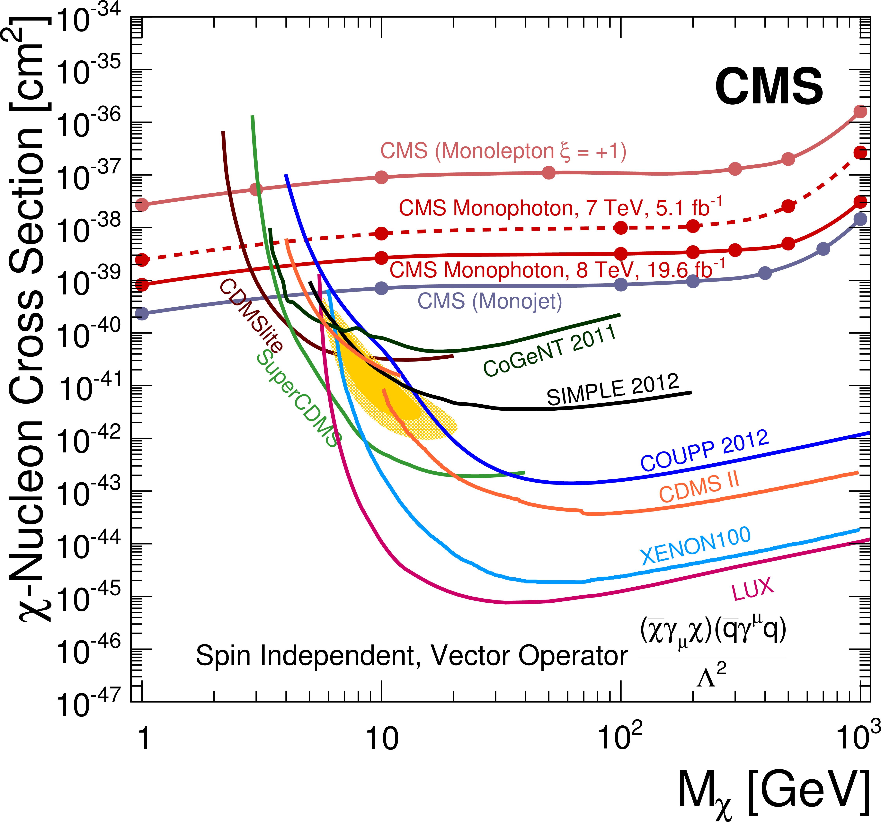
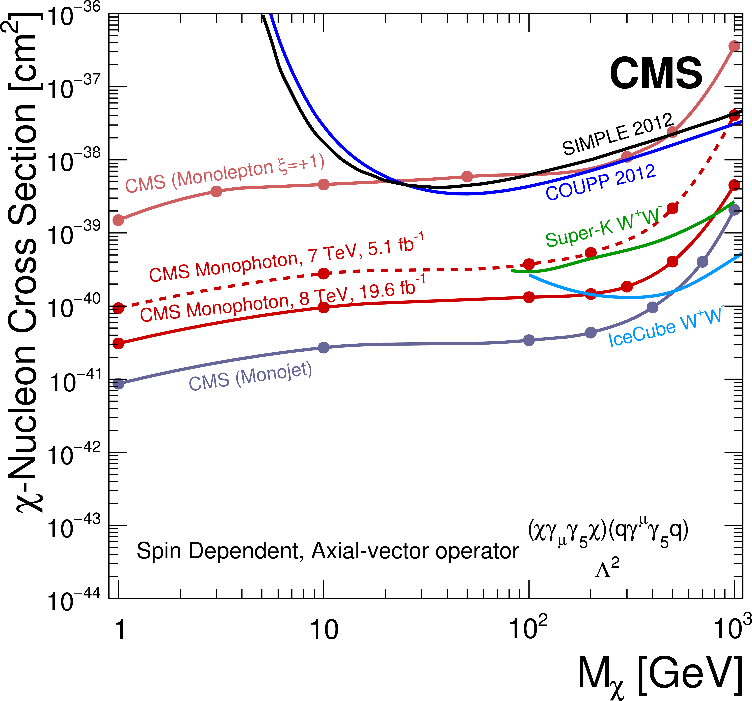
Dark Matter Searches – Monophotons
CMS-EXO-12-047, PLB 755 (2016)102
Data sample: 19.6 fb⁻¹ at √s = 8 TeV, 5.1 fb⁻¹ at √s = 7 TeV
Event selection: single photon with E_{T} > 145 GeV and IηI ≤ 1.44, E_{T}^{miss} > 140 GeV

Slide 18
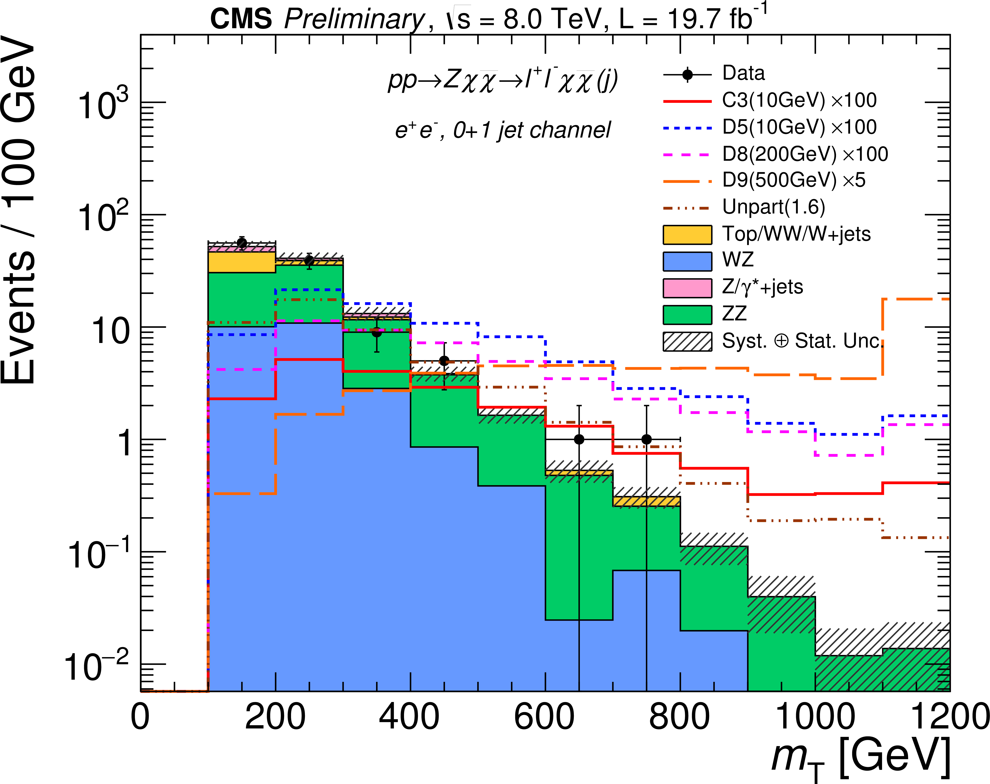
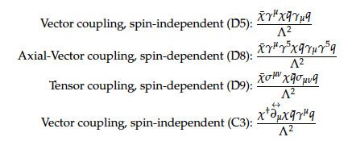
Dark Matter Searches – Mono-Z
Event selection: 2 isolated, opposite-charge e/μ each with p_{T} > 20 GeV and invariant mass compatible with Z, no additional e/μ with p_{T} > 20 GeV, dilepton p_{T} > 50 GeV, no b-tagged jet
CMS-EXO-12-054
Operators for Dirac fermion (D) or complex scalar (C) DM coupling to SM quarks, Λ being the coupling scale of interactions between DM and quarks:

Slide 19
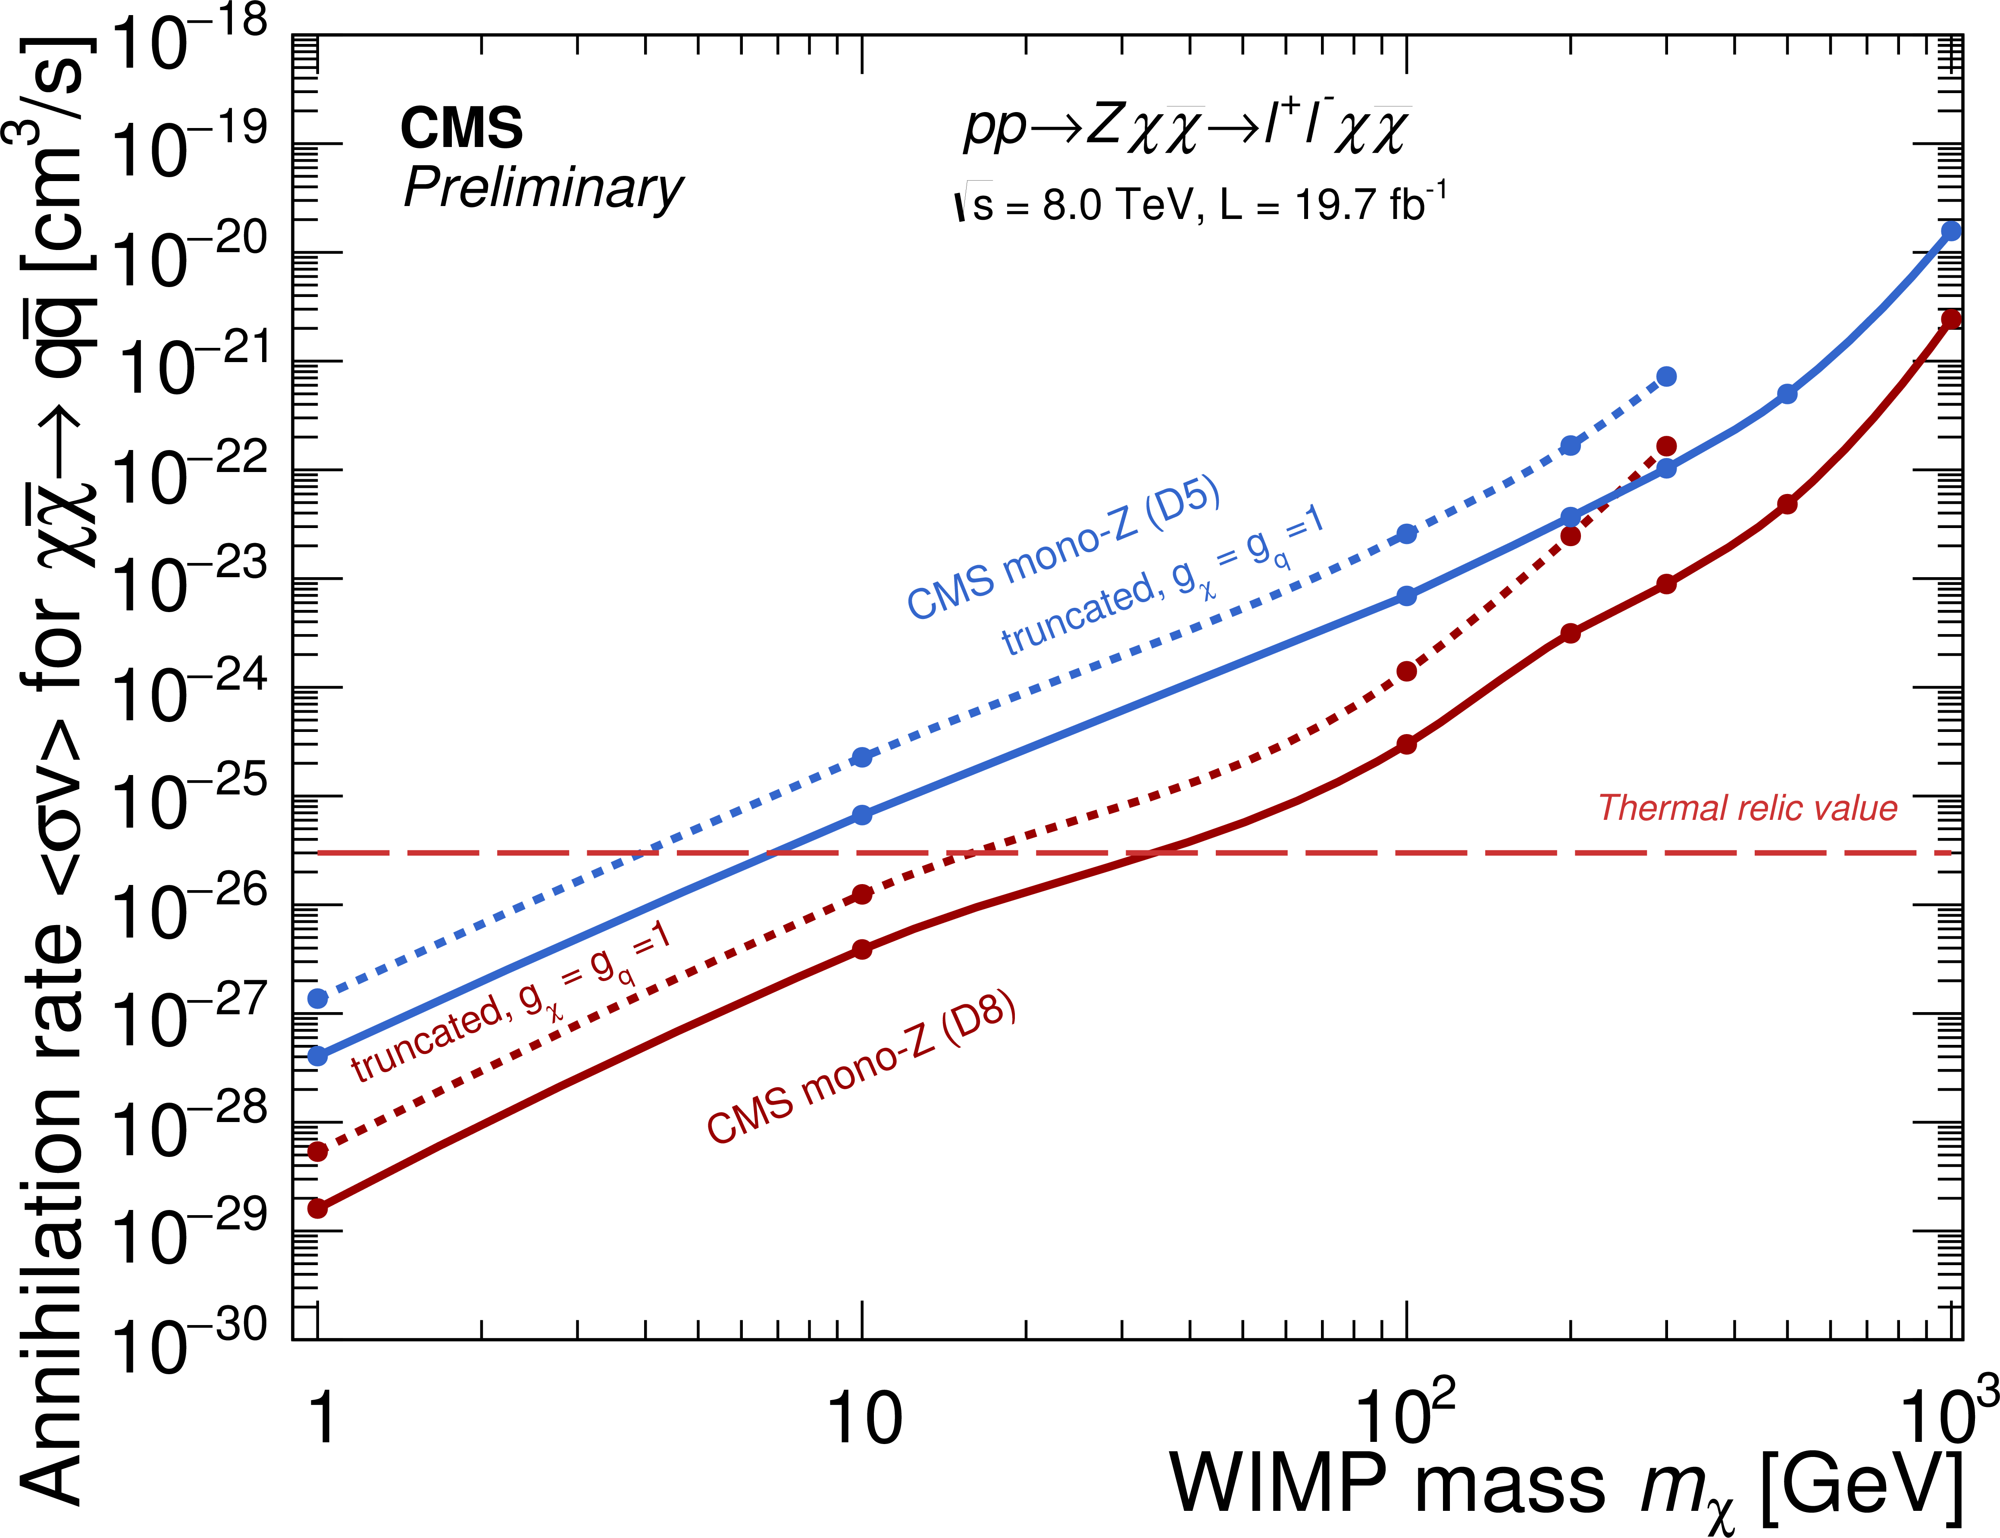
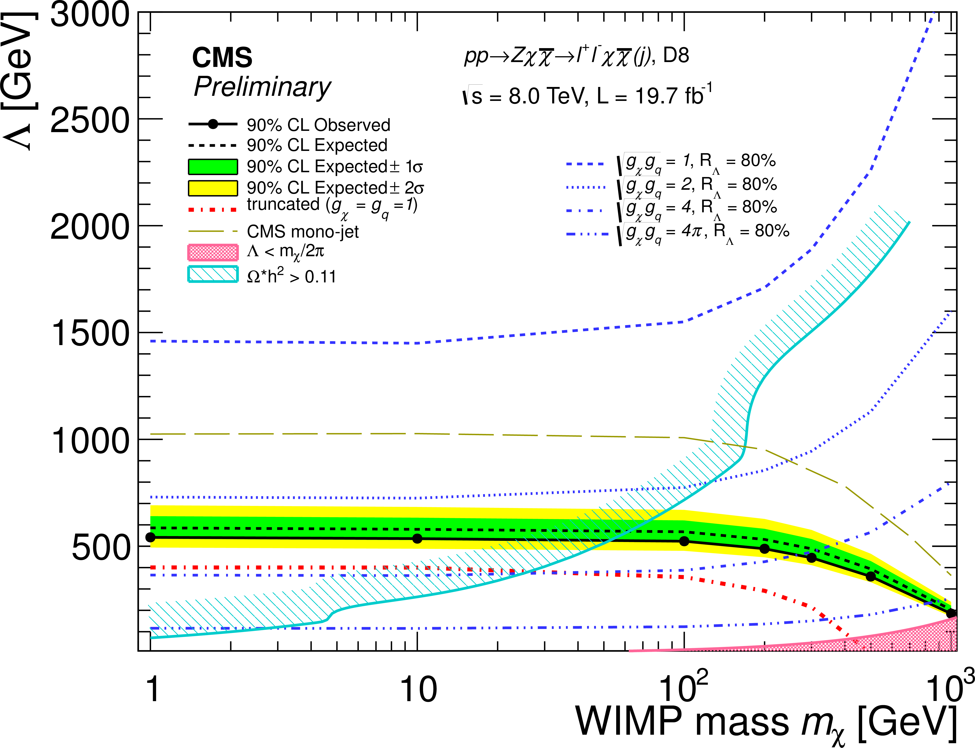
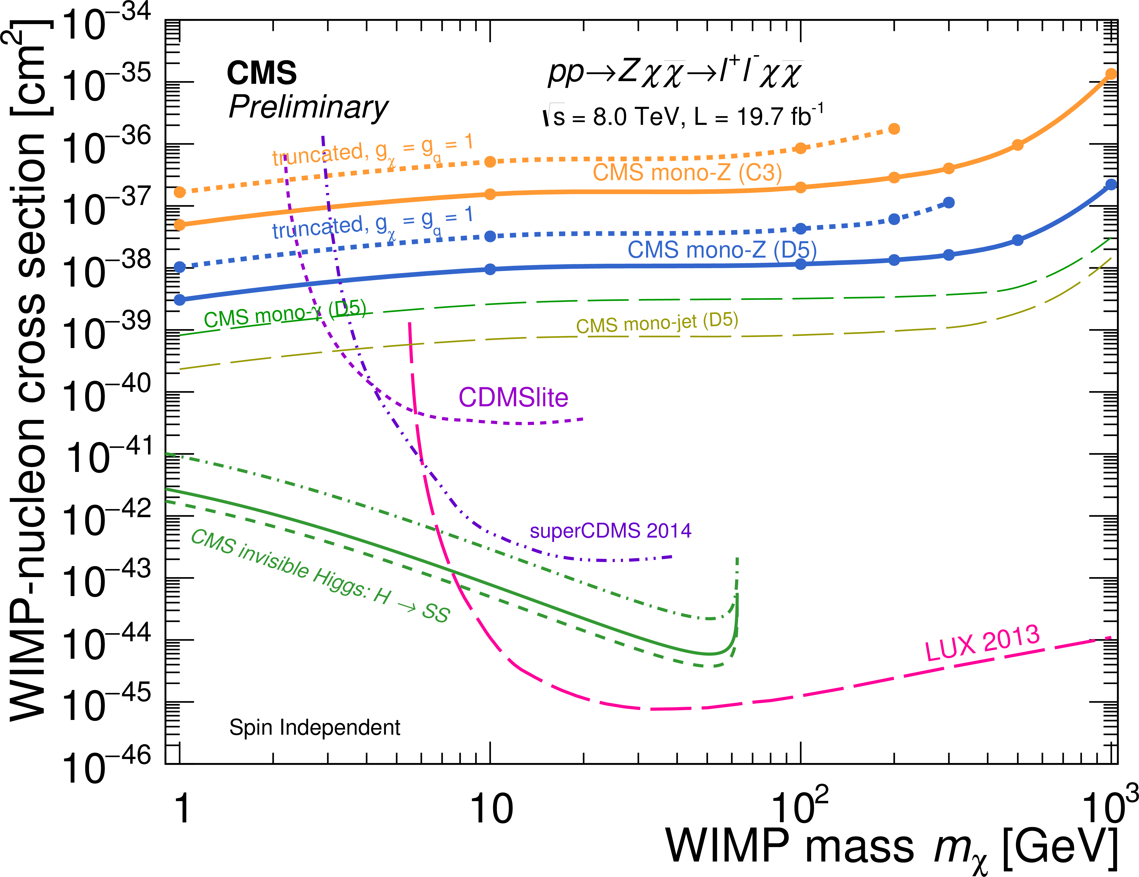
Dark Matter Searches – Mono-Z
D8
CMS monojet
CMS-EXO-
12-054
Annihilation rate
Notes:
The annihilation rate of Dirac fermion DM is ruled out at 90% CL for mχ < 7 GeV in case of vector coupling and mχ < 32 GeV in case of axial-vector coupling.

Slide 20
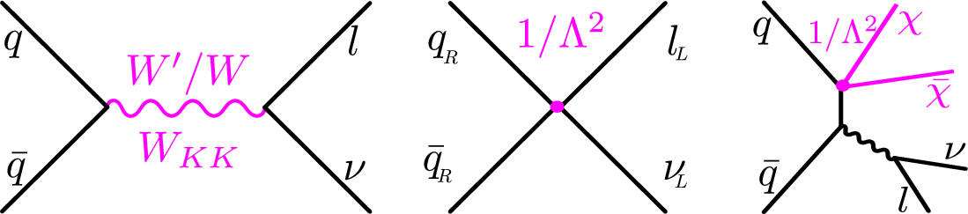
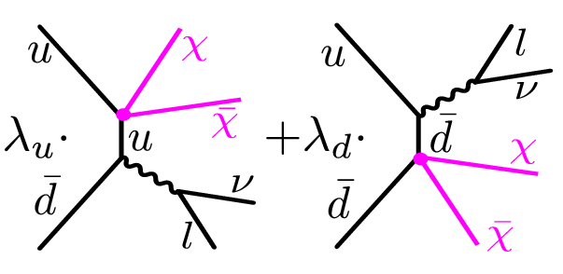
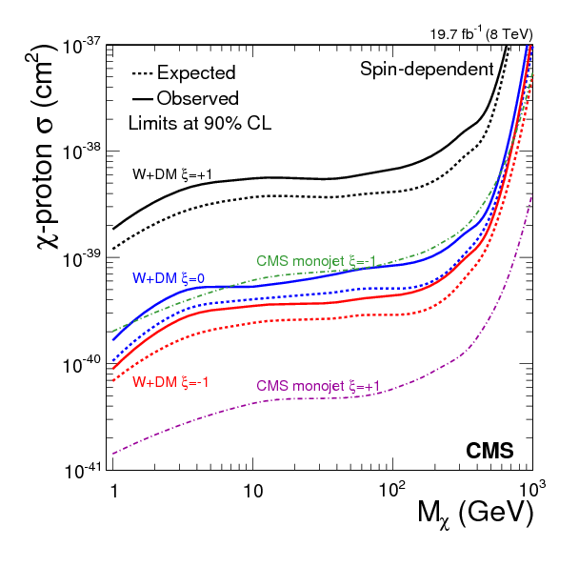
Dark Matter Searches – Mono-W
Dark matter interpretation of W’ analysis
Data sample: 19.7 fb⁻¹ at √s = 8 TeV
Event selection: prompt or non-prompt
(from τ) single e or μ and E_{T}^{miss}
Advantages over monojet and mono-γ channels: lower SM background and trigger lepton
DM interference
W
W
W
Signal shapes
ξ = λ_{u}λ_{d}
AV couplings
CMS-EXO-12-060, PRD 91 (2015) 092005
Notes:
The choice of the interference parameter changes the total cross section and the shape of the MT spectrum. Xi = ±1 maximizes the interference.
Lambda: relative coupling strength, which could be different for each quark flavour. The excluded cross section is flat as a function of Mχ, as expected since the signal kinematics do not change appreciably for different Mχ. For high Mχ the phase space to produce two heavy particles and a W boson is small, therefore the signal cross section is reduced and its shape more consistent with the background.

Slide 21
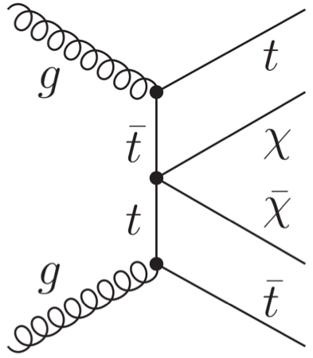
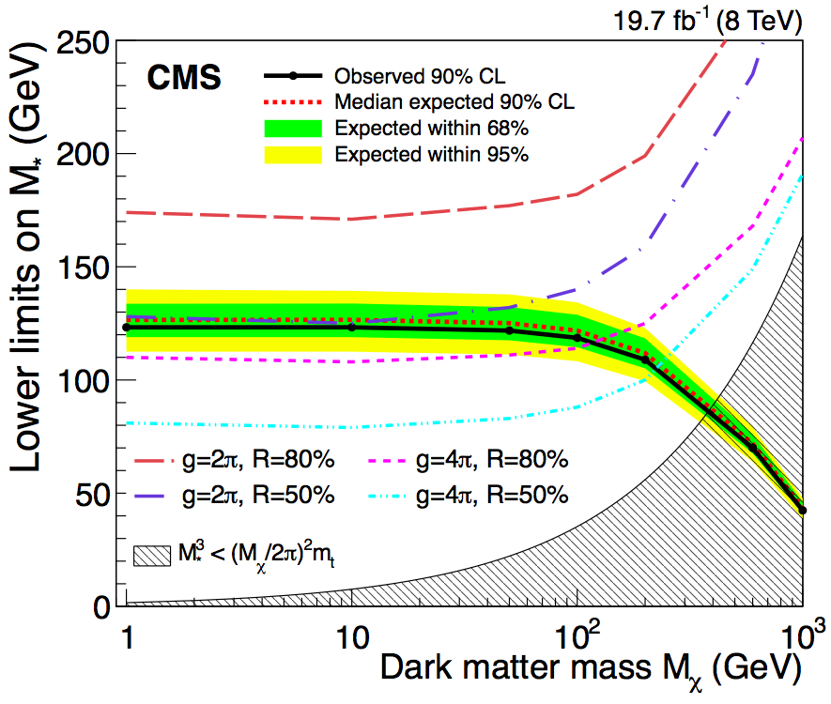
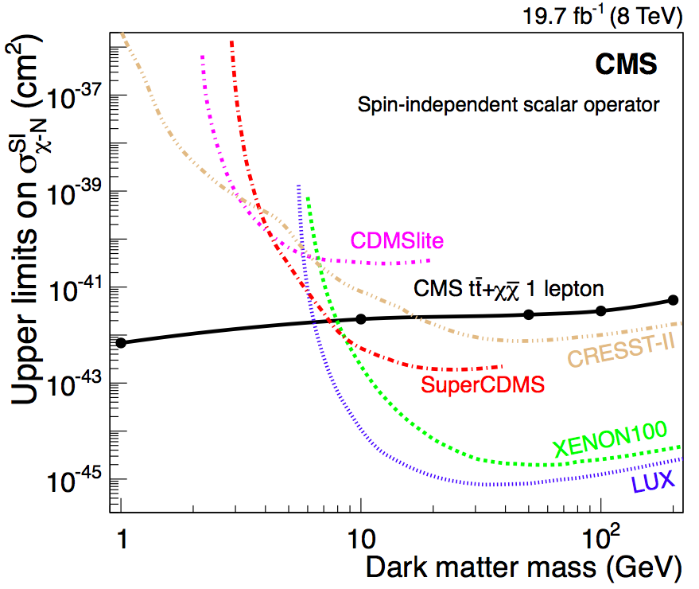
Dark Matter Searches – Top Pairs
q-χ couplings for heavy flavors enhanced in scalar interactions
JHEP 06 (2015) 121
CMS-B2G-14-004
tt + E_{t}^{miss} signature:
single lepton with jets, at least 1 b-tagged
M*: scale of the interaction
Notes:
Cross sections larger than 20 to 55 fb are excluded at 90% CL for dark matter particles with the masses ranging from 1 to 1000 GeV. Interpreting the findings in the context of a scalar interaction between dark matter particles and top quarks in the framework of an effective field theory, lower limits on the interaction scale are set. Assuming a dark matter particle with a mass of 100 GeV, values of the interaction scale below 118 GeV are excluded at 90% CL A lower bound of the validity of the EFT is indicated by the upper edge of the hatched area. The four curves, corresponding to different g and R values, represent the lower bound on M∗ for which 50% and 80% of signal events have a pair of DM particles with an invariant mass less than g√M∗ **3/mtop, where g = 4π and g = 2π respectively. These curves indicate further restrictions on the applicability of EFT.

