Slide 1
Questions without answers
….. for the moment ….
Geneva, 12 Nov. 2011
Claudia-Elisabeth Wulz
Austrian Academy of Sciences and CERN

Slide 2
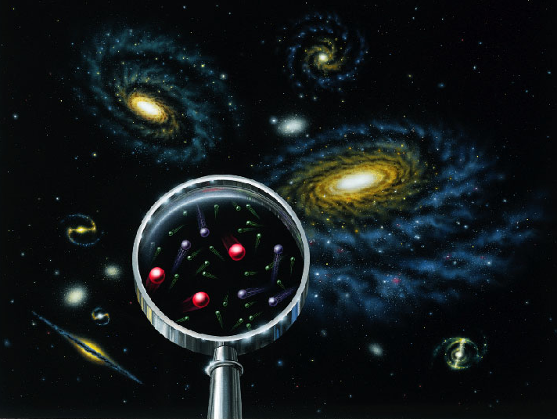
What are you made of? … Sugar and spice, and all things nice?
What is the entire universe made of?
What holds the universe together? Why can we exist?
Has the universe always been as it is today?
Will the universe change?
How can particle accelerators like the LHC (Large Hadron Collider) at CERN contribute to find answers to these questions?
EYH 2011

Slide 3
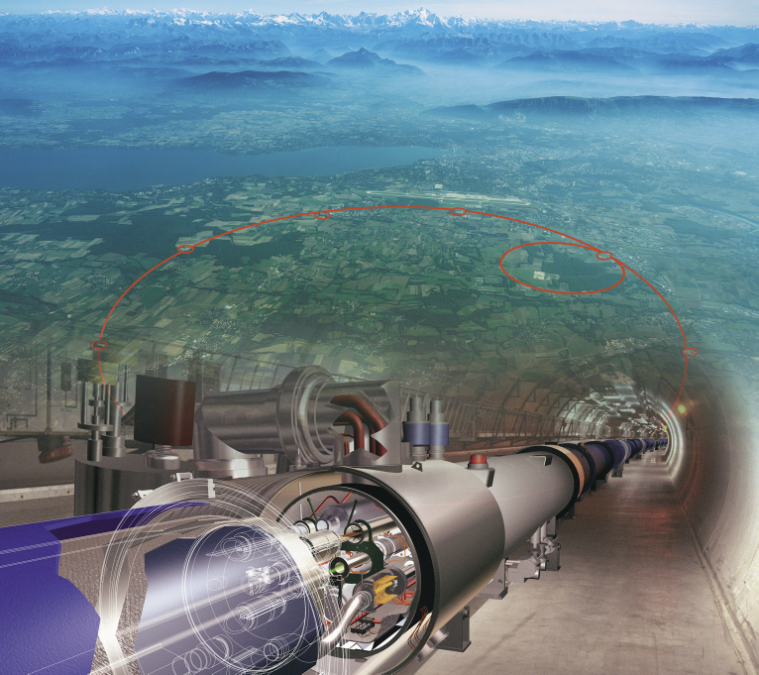
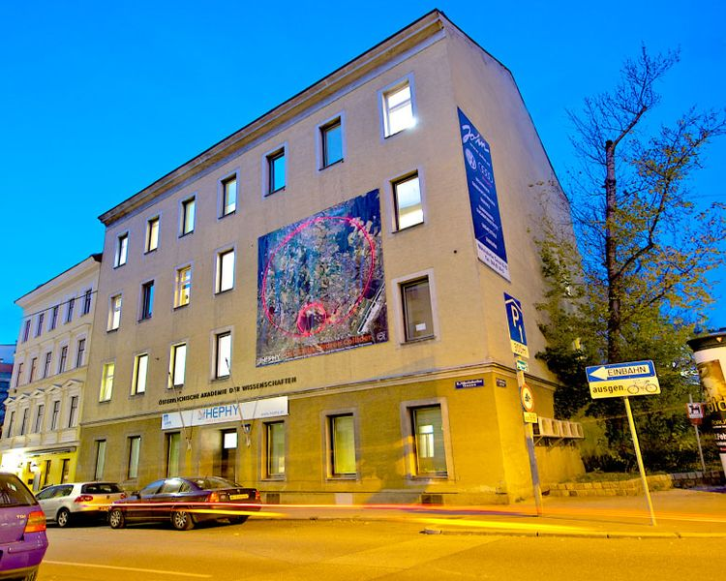
May I present myself?
Physicist
at CERN at the LHC experiment CMS
employed by the Institute of High Energy Physics of the Austrian Academy of Sciences
Professor at the Vienna University of Technology
C.-E. Wulz
3

Slide 4
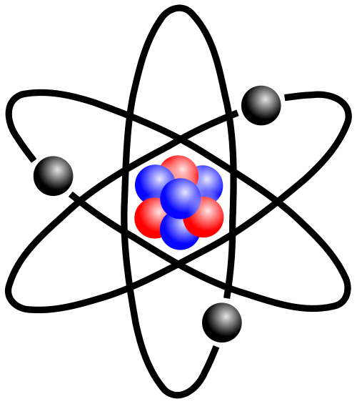
Constituents of matter
All known matter is made of ATOMS
The atoms are made of protons, neutrons and électrons
Protons and neutrons are made of quarks
Protons and neutrons belong to hadrons
protons
neutrons
electrons
Notes:
Gr.: hadros = dick, stark (Hadronen haben starke Wechselwirkung)

Slide 5
How can we find these constituents? Can we see them?

Slide 6
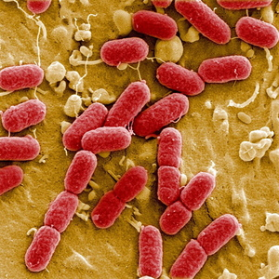
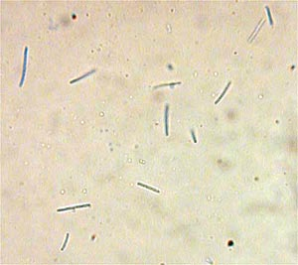
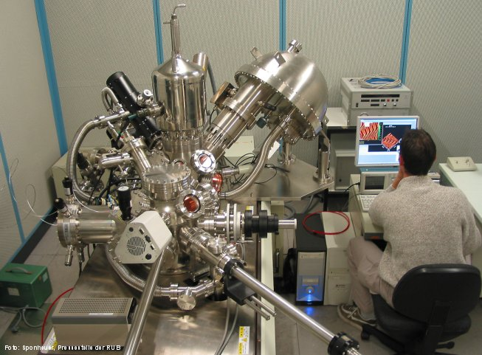
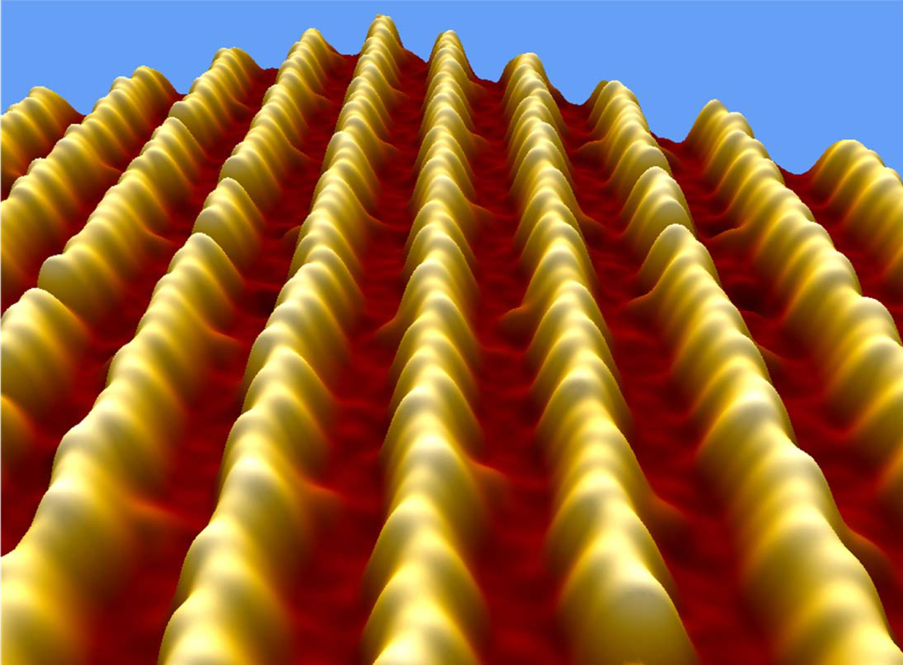
Microscope
Electron microscope
Yoghurt bacteria
EHEC bacteria
Gold atoms
Scanning tunneling microscope
Notes:
Objekt stört Lichtwelle, je nach seiner Größe. Wenn das Objekt sehr klein im Vergleich zur Wellenlänge des Lichts ist, erfolgt praktisch keine Störung – man sieht das Objekt nicht!
Erklärung Teilchen – Welle – Dualismus.

Slide 7
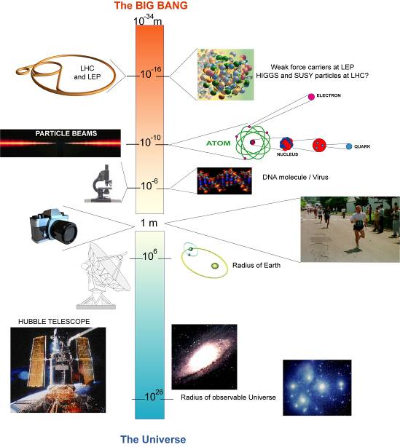
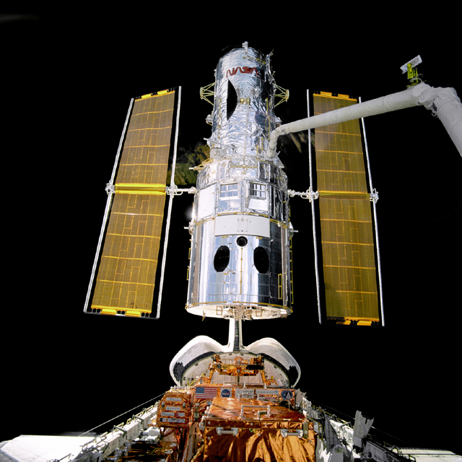
Microscopes for the infinitely small: Accelerators
BIG BANG
LHC
We need different tools to observe the different scales of things.
Accelerators can explore the smallest components of the universe.
C.-E. Wulz
7

Slide 8
Do you have a particle accelerator at home?
protons
protons
C.-E. Wulz
8
EYH 2011

Slide 9
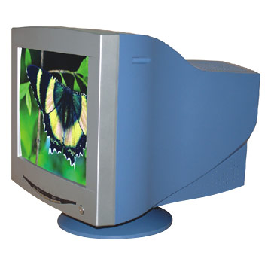
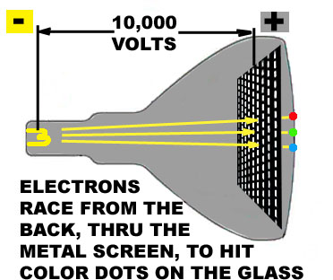
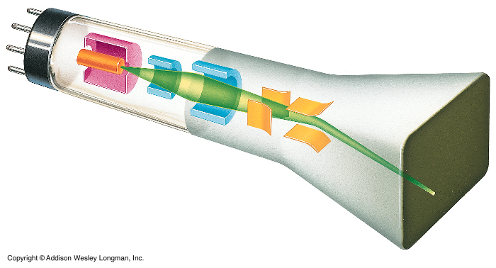
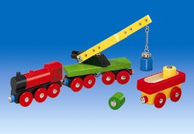
From the television tube to the LHC
Electrons are emitted from a heated wire and are attracted by the positive pole (grid). Some go through the holes and hit a fluorescent screen. The picture is thus created.
Magnets deflect the particle beam and focus it.
C.-E. Wulz
9
EYH 2011

Slide 10
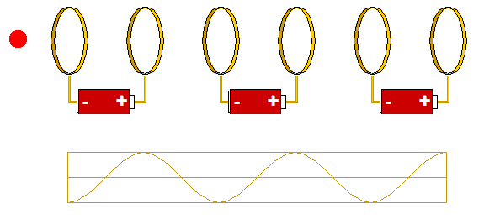
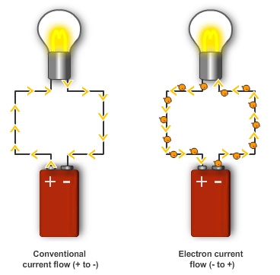
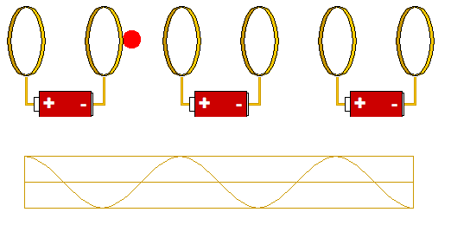
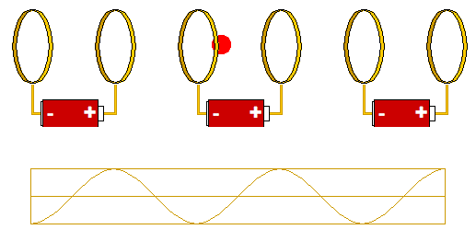
Battery
proton
(+)
In order to accelerate it one must change the polarity of the batteries at the right moment!
Battery accelerator
http://microcosm.web.cern.ch/microcosm/RF_cavity/ex.html
EYH 2011
Notes:
Protonen kann man als Strom in einer Batterie sehen. Der fliesst aber nur, wenn die Batterie richtig gepolt ist.

Slide 11
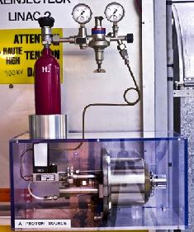
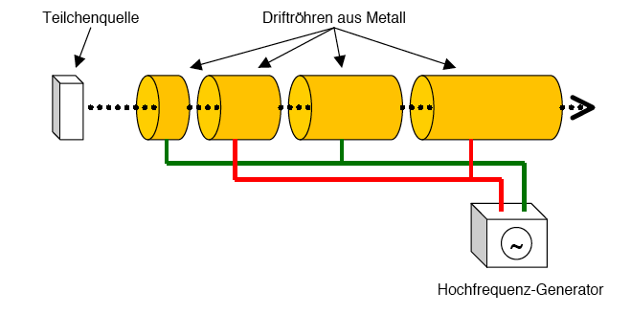
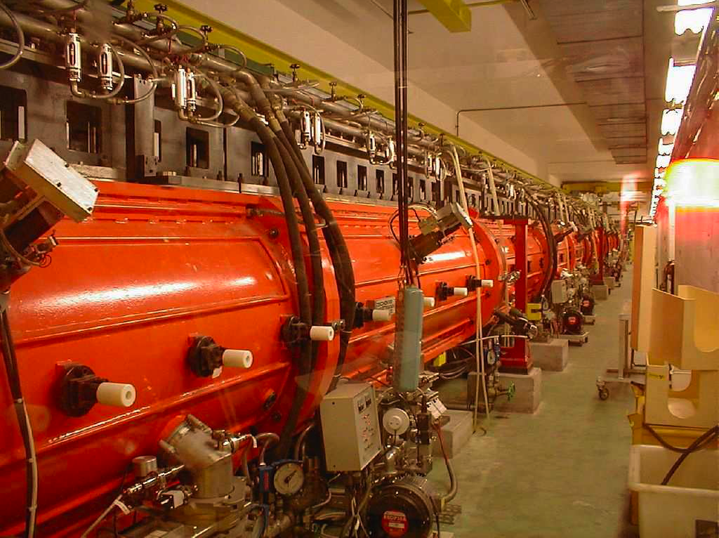
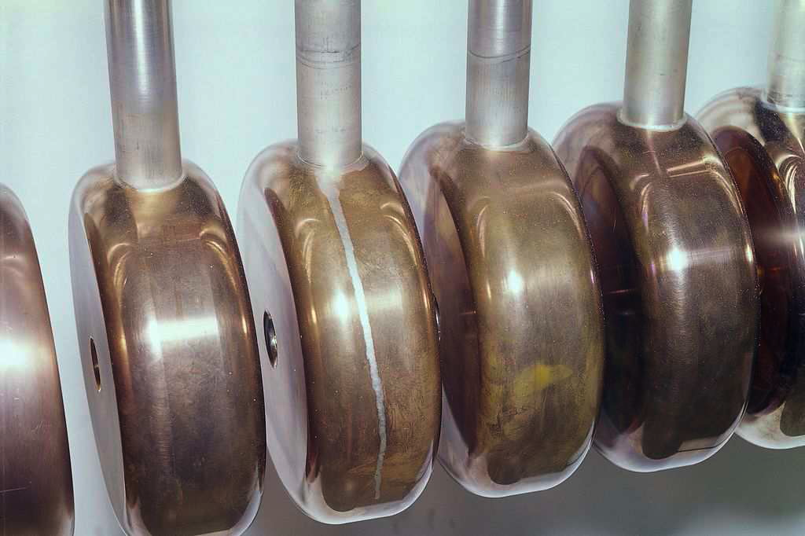
CERN – Linac 2
Particle source
Metal drift tubes
Proton source of the LHC
High frequency generator
C.-E. Wulz
11
EYH 2011

Slide 12
High frequency cavity of the LHC
“Battery”

Slide 13
LHC magnets
red: focussing
blue: circular orbit

Slide 14
LHC control centre
http://microcosm.web.cern.ch/microcosm/LHCGame/LHCGame.html
EYH 2011

Slide 15
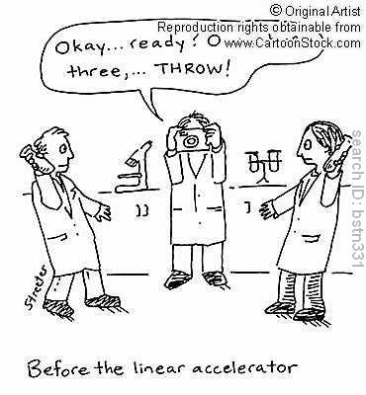
Detector
or
experiment
Digital camera:
Proton
Proton
EYH 2011
Notes:
Digitalkamera: 100 Millionen Pixel, macht 40 Millionen Bilder pro Sekunde, speichert aber nur ein paar Hundert der “schönsten” Bilder.

Slide 16
ATLAS Detector

Slide 17
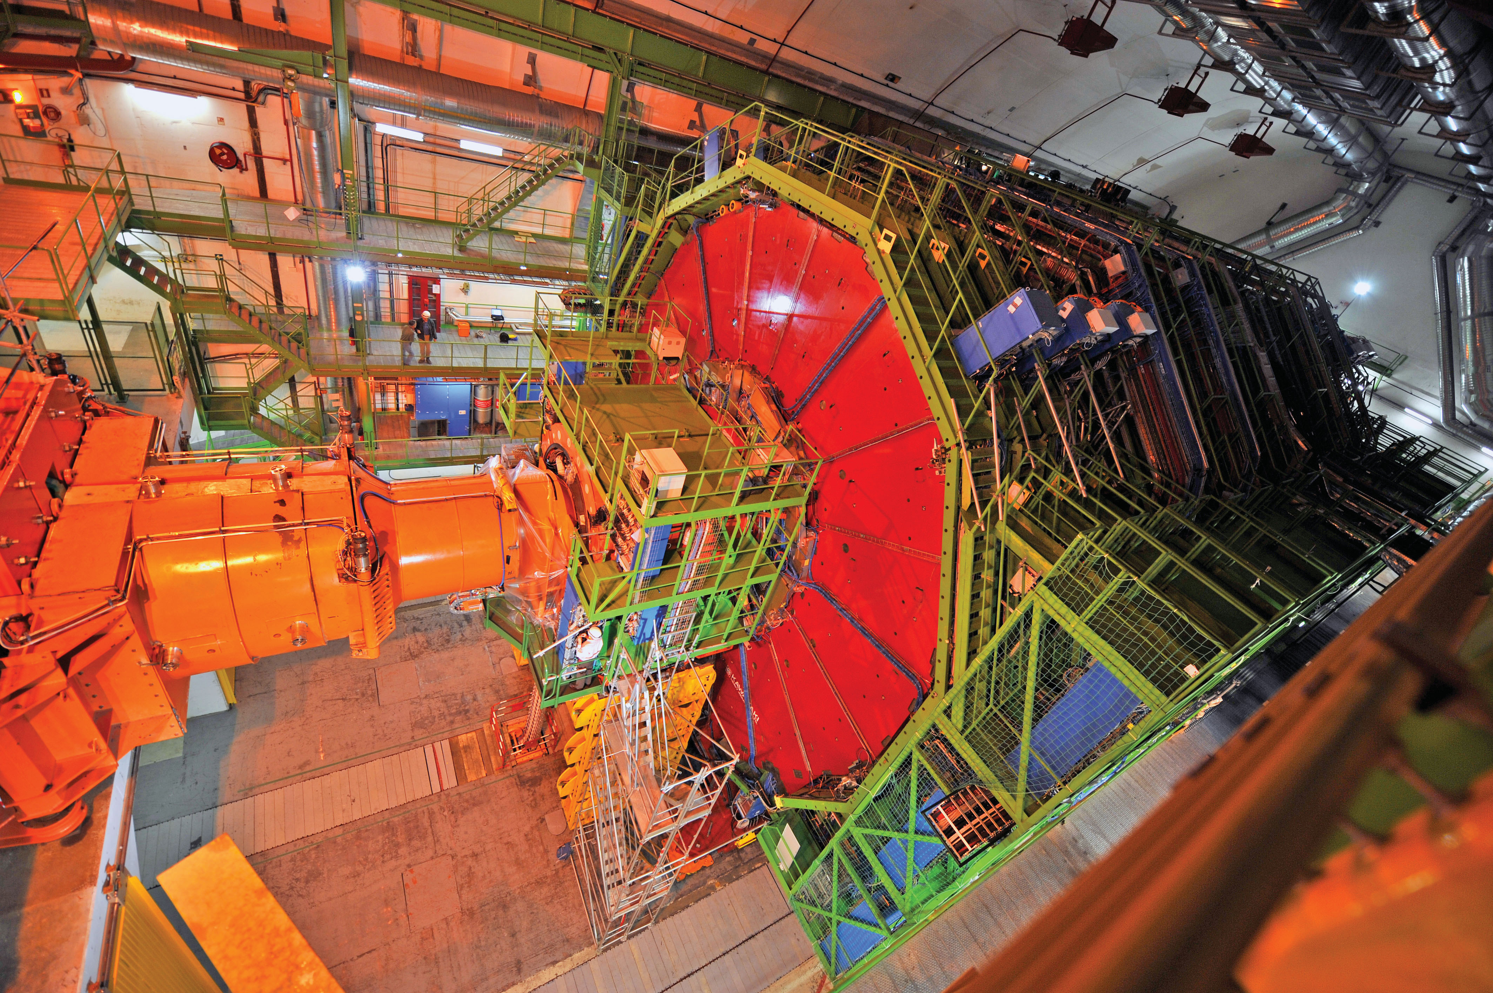
CMS Detector
EYH 2011

Slide 18
“Event” at the CMS experiment
Particle tracks created in collisions at the LHC
EYH 2011

Slide 19
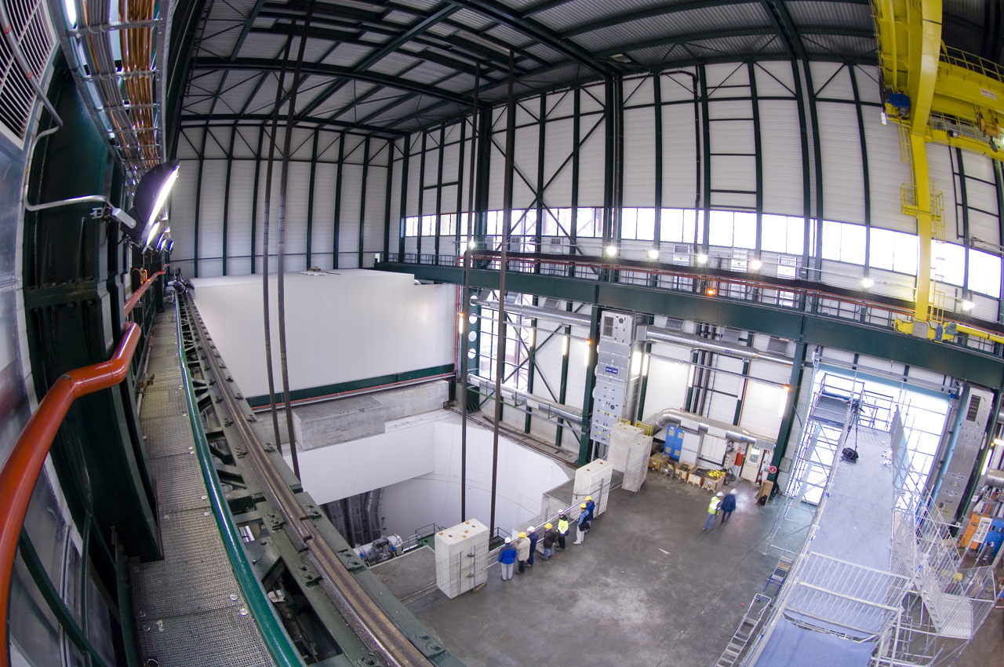
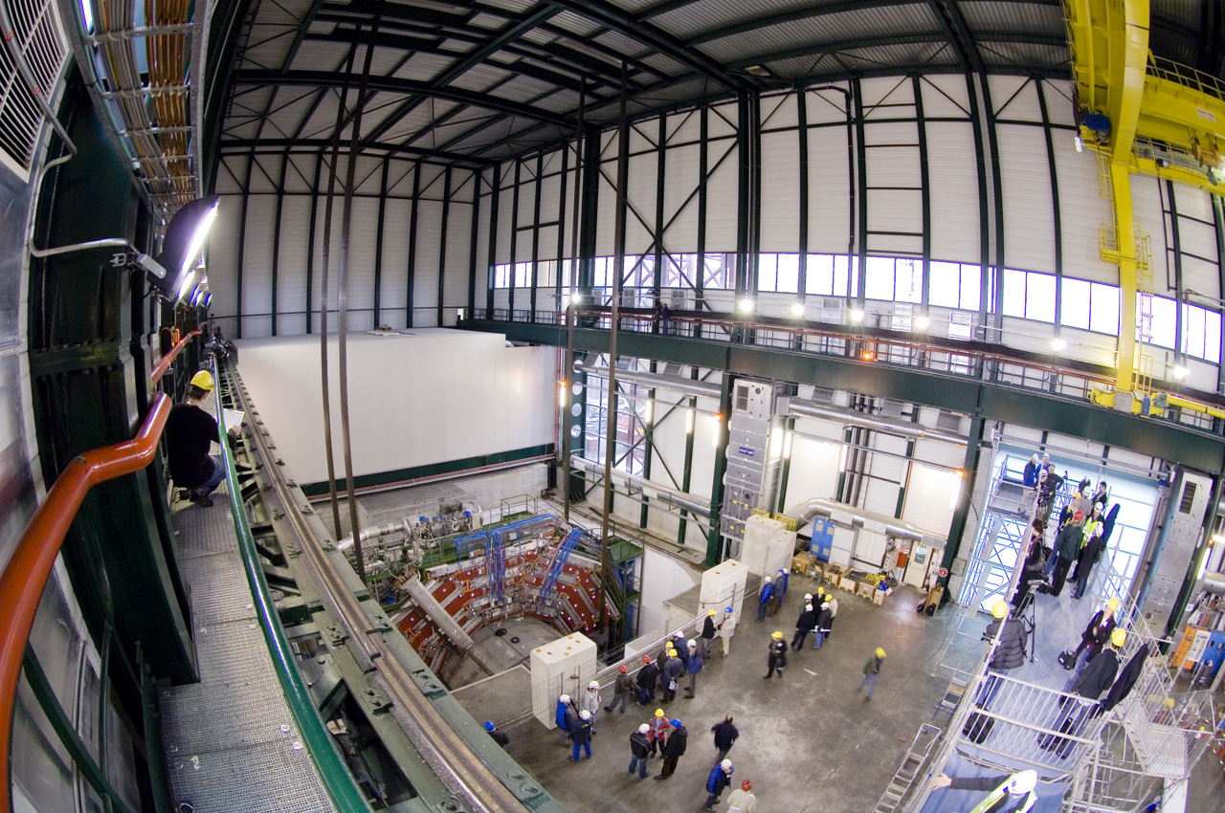
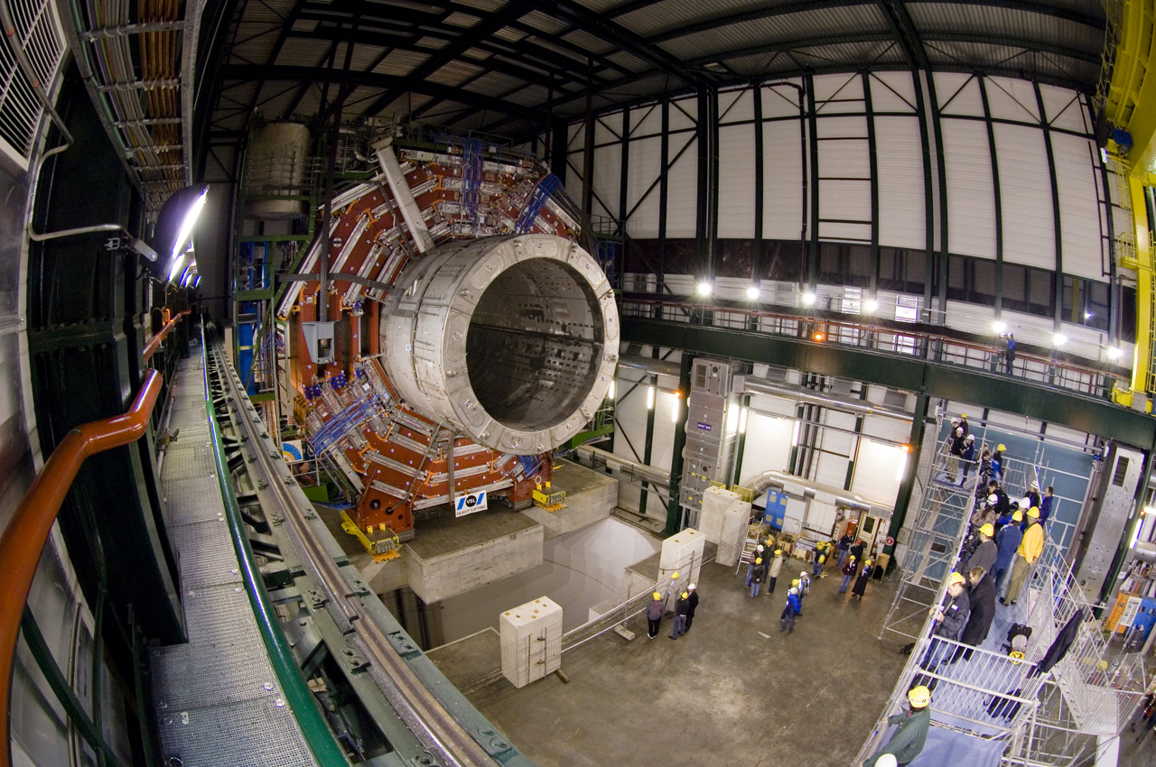
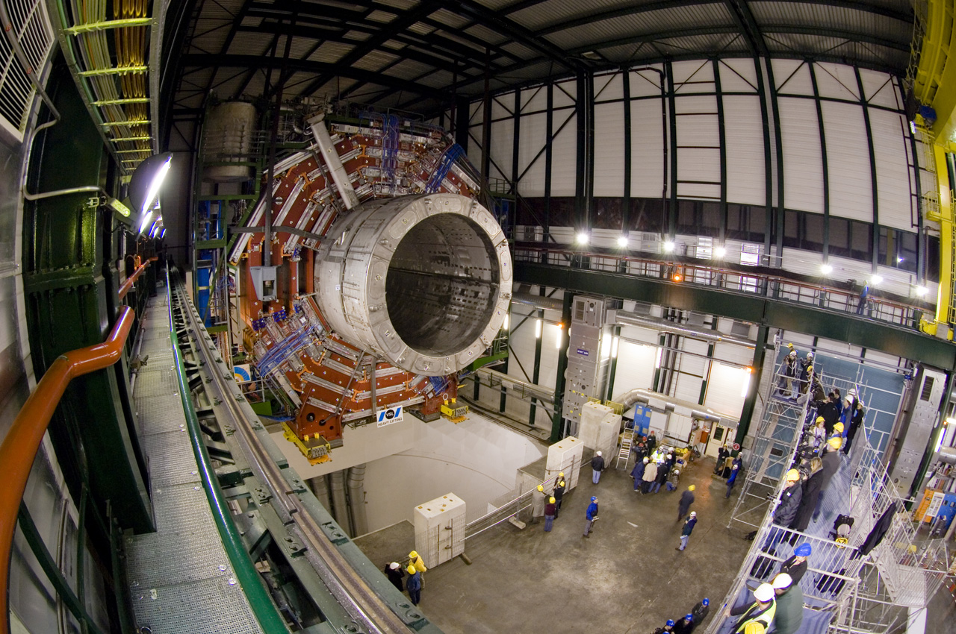
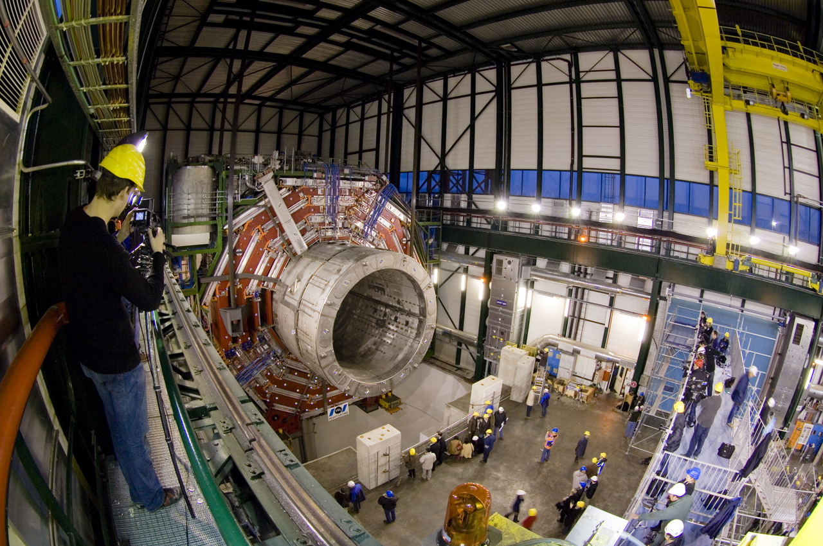
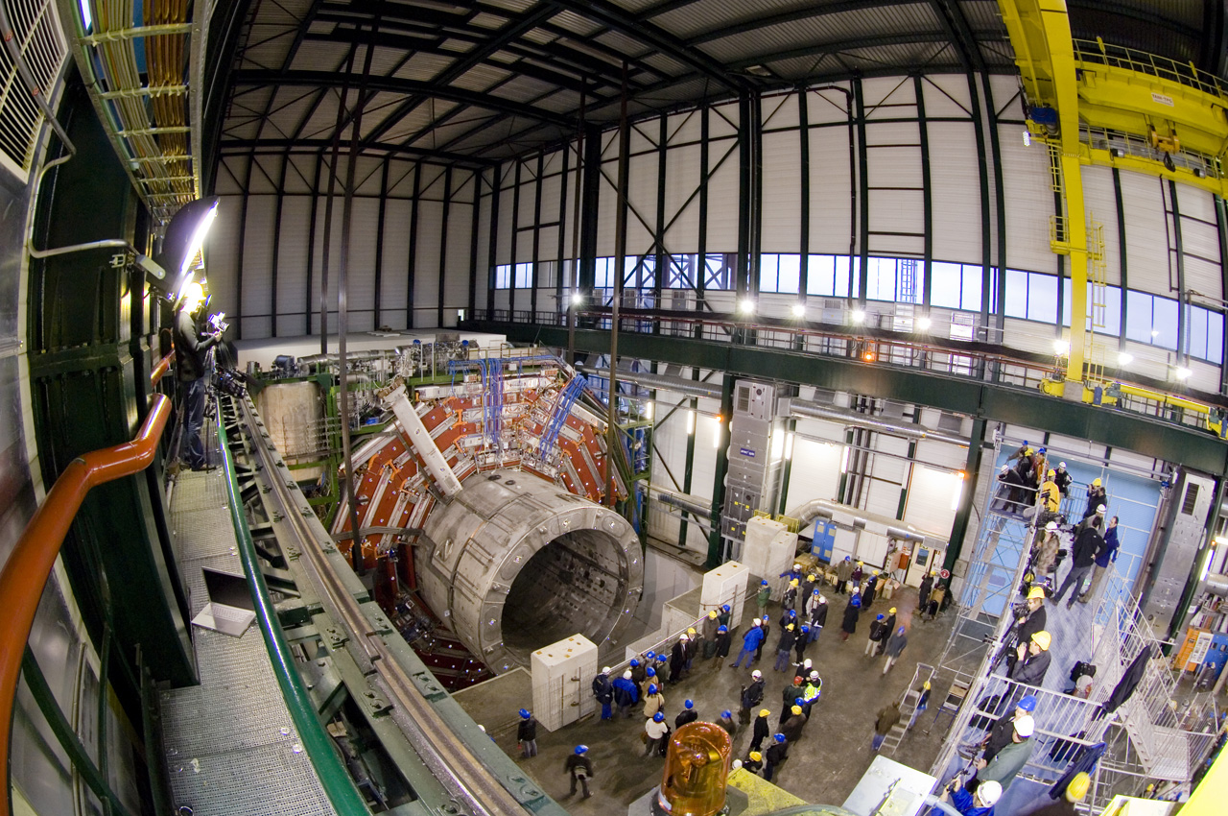
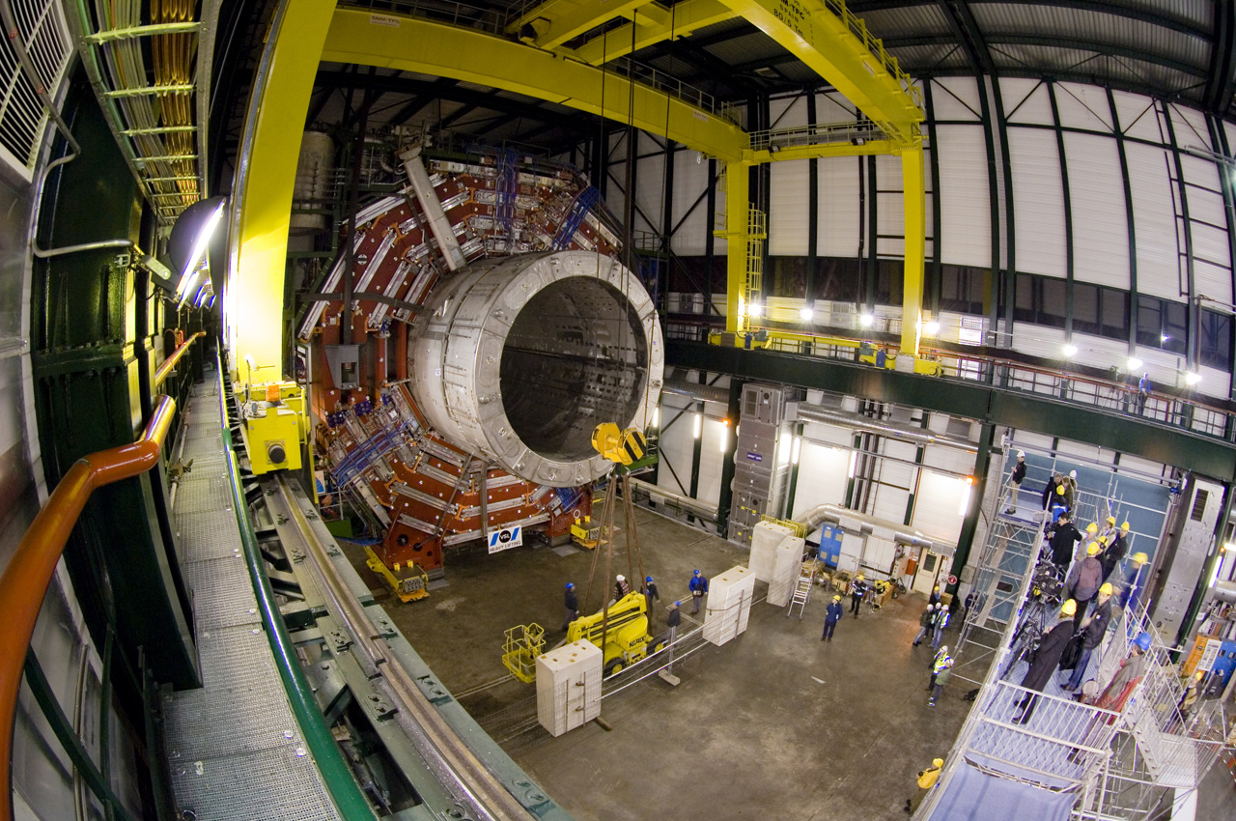
100 meters below ground …
C.-E. Wulz
EYH 2011

Slide 20
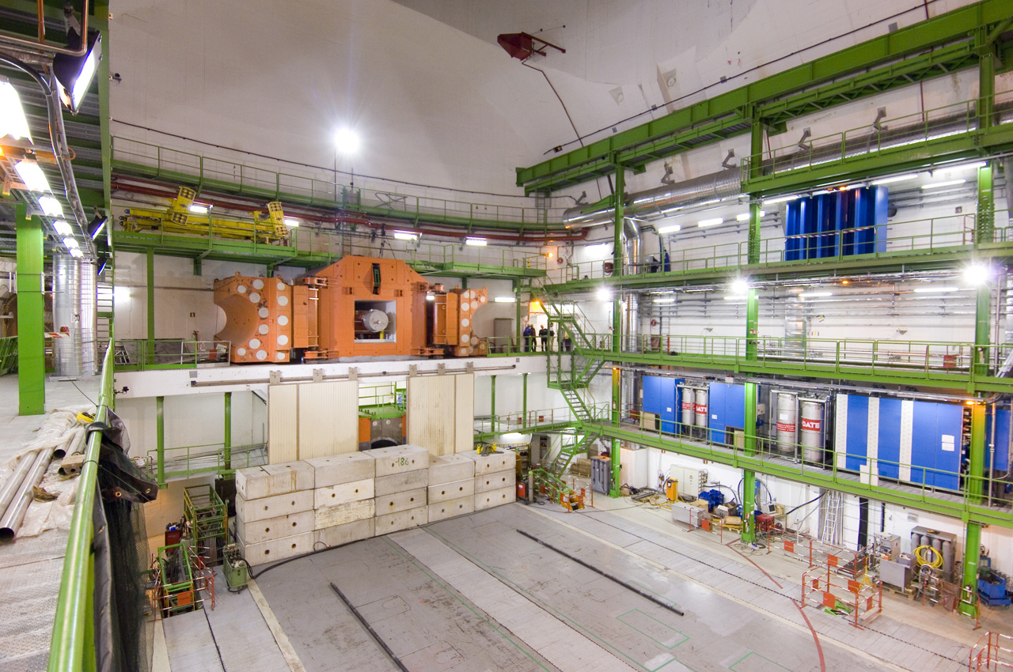
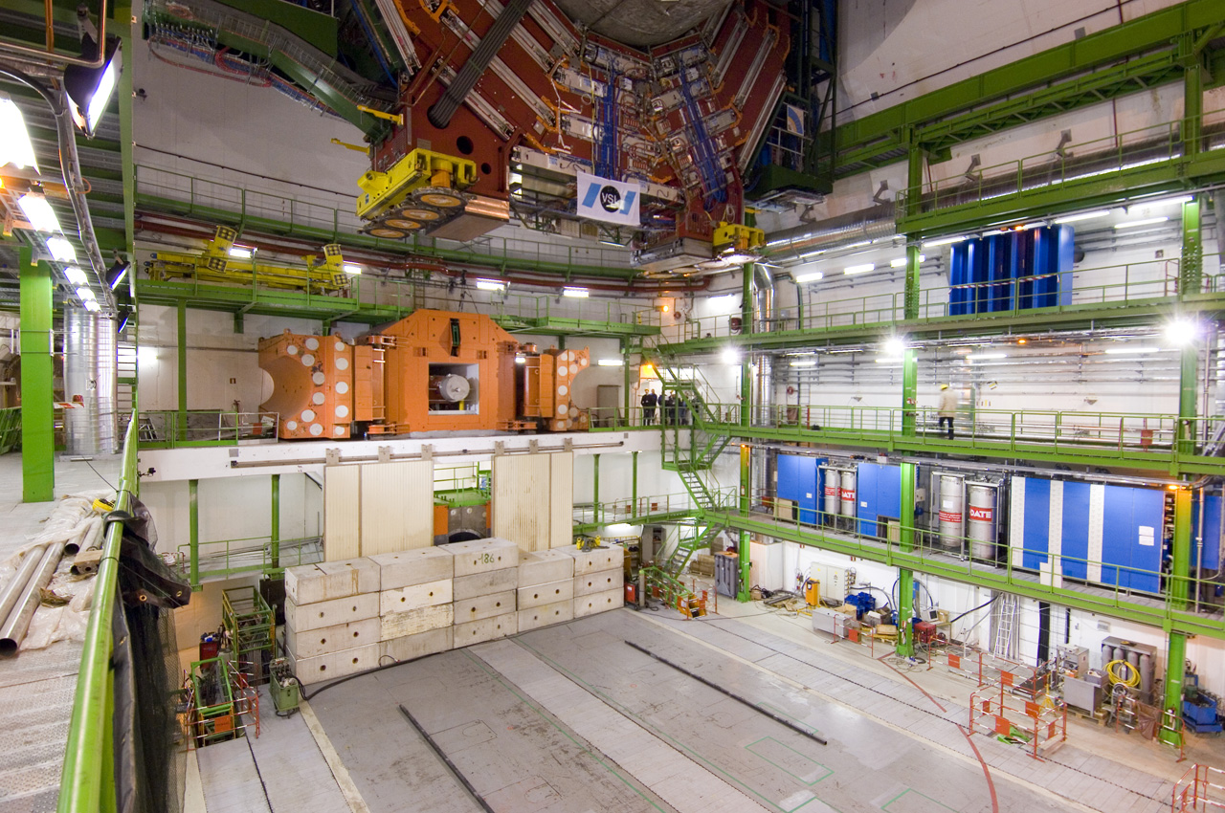
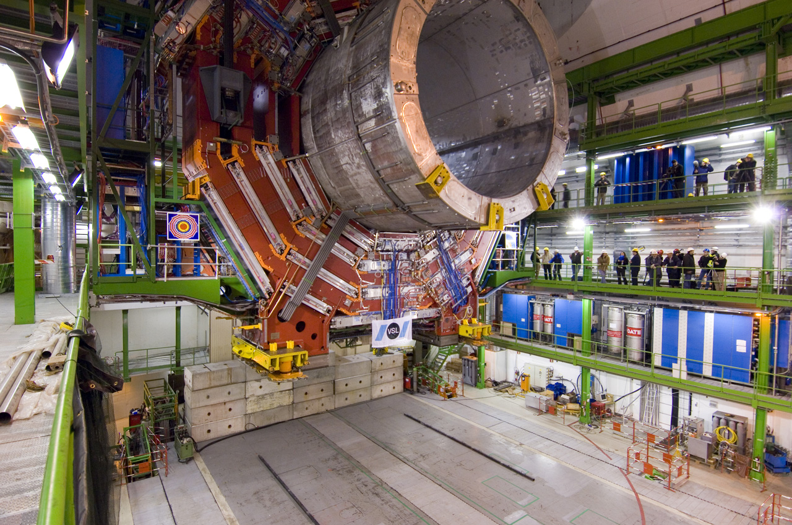
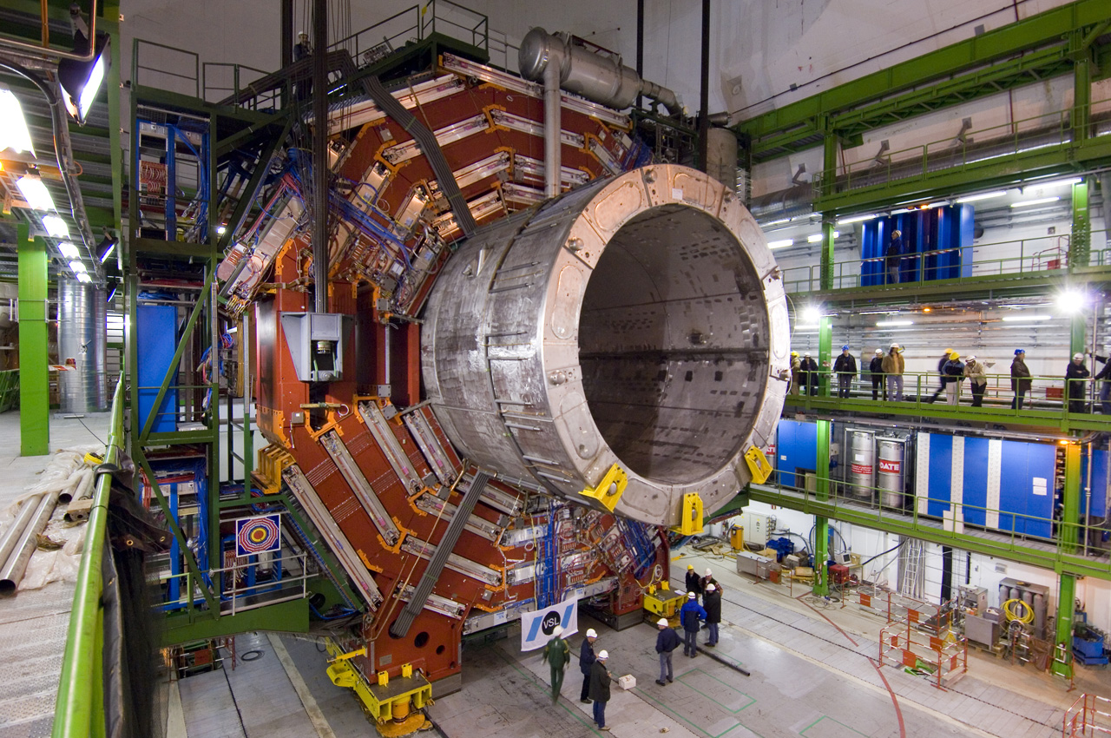
EYH 2011

Slide 21
The components of everything we know for example, humans, stars, planets, …
quarks
lepton
up
electron
down
uud = proton
udd = neutron
EYH 2011
Notes:
Frage: schauen diese Teilchen wirklich so aus? Antwort: das können wir nicht wissen! Of course the answer is that we don’t know, and will never know! Show how combinations of quarks make bigger objects – so now we start to go backwards, from the smallest back to the biggest….

Slide 22
We build an atom
electrons
Helium atom
protons
neutrons
Multiply billions and billions and billions and billions …
EYH 2011
Notes:
At this point can ask the audience what they see – older ones will understand that they see the constituents of helium. Again this shows how we use the basic “Lego” bricks to build bigger things.

Slide 23
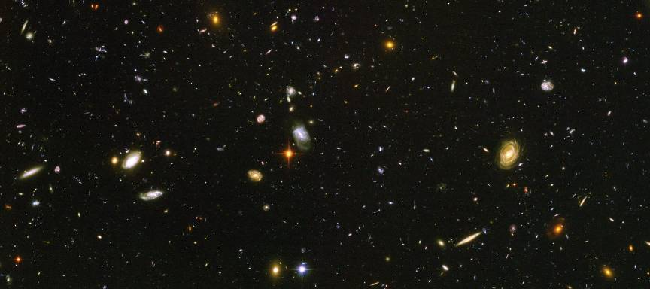
The result – the universe!
C.-E. Wulz
23
EYH 2011

Slide 24
But this is not the end of the story …
EYH 2011

Slide 25
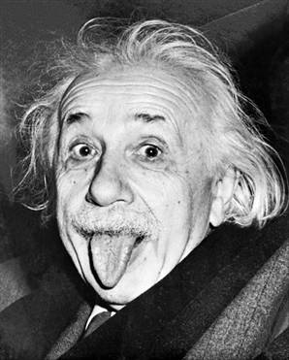
E=mc²
The collision energy was used to create something new, that *did* exist but does not any more!
Accelerator energy
EYH 2011
Notes:
Now it gets really interesting! Ask again what they think will happen with even higher collision energy/speed. Most will say “even smaller pieces” but some may be more cautious.
But they never expect the dinosaurs! Emphasize that this is just an illustration – we don’t really make dinosaurs (sounds obvious but 10-11 year olds can take things literally!).
Can ask if they recognise the equation and ask them what it means – even a lot of the 10-11 year olds do know!
Another reason why dinosaurs are appropriate: CERN is at the foot of the Jura mountains – the origin of the “Jurassic” period due to the number of dinosaur bones found in the mountains. And what CERN is doing goes WAY back further in time than the dinosaurs.

Slide 26
The LHC is a time machine!

Slide 27
13.7 billion years ago there were more particles in the universe than today …
Quarks
Leptons
up
electron
muon
tau
charm
top
electron
neutrino
muon
neutrino
tau
neutrino
down
strange
bottom
EYH 2011
Notes:
To explain that we now know what the Universe was like, and that effectively the LHC (and particle physics in general) is like building a time machine.

Slide 28
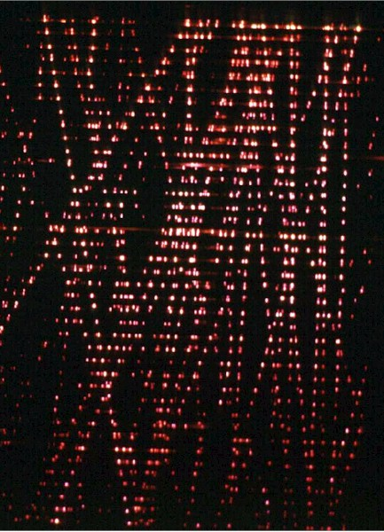
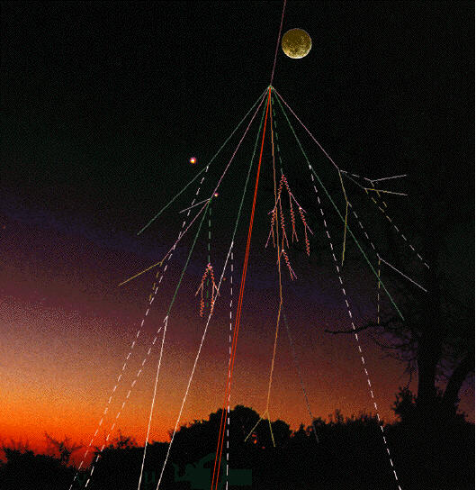
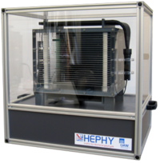
Particles from space
Muon tracks
Spark chamber
C.-E. Wulz
28
EYH 2011

Slide 29
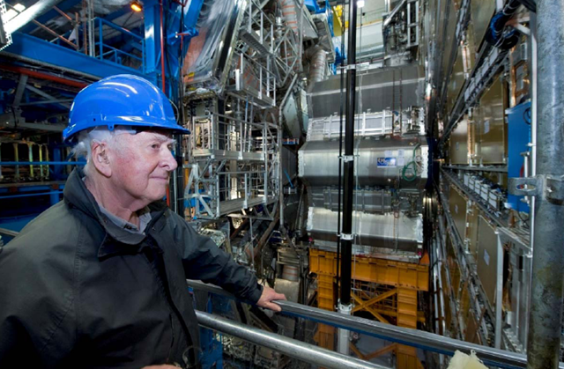
The secret of mass
Why are some particles heavy, and others not?
The explanation may com from a new particle, the Higgs boson.
EYH 2011

Slide 30
What keeps the protons, the neutrons and the atomic nuclei together?

Slide 31
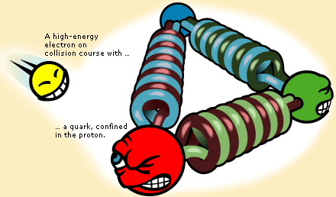
What keeps the protons, the neutrons and the atomic nuclei together?
The strong force. It is transmitted by the exchange of GLUONS!
THE EXCHANGE OF PARTICLES IS
THE ORIGIN OF A FORCE!
PROTON
Notes:
Je stärker das Mikroskop, desto mehr Gluonen und sogar Quark-Antiquarkpaare sieht man.
Sowohl abstoßende (Ball) als auch anziehende (Bumerang) Kräfte werden durch Teilchenaustausch vermittelt.

Slide 32
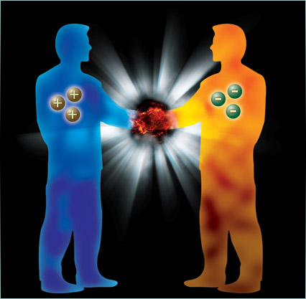
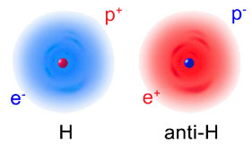
Matter - antimatter
At the Big Bang the same amounts of matter and antimatter were created. But they should have annihilated upon contact, emitting radiation.
We should therefore not exist!
There must be an obvious asymmetry which we still have to explore.
Theoretically the universe could consist of antimatter instead of matter.

Slide 33
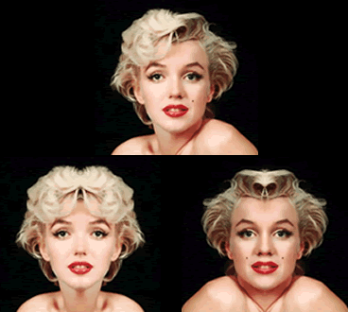
An exact symmetry is unnatural!

Slide 34
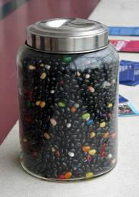
Dark matter
EYH 2011
Notes:
Brauchen wir, um gewisse Eigenschaften von Galaxien zu erklären. Analogie: Hund bricht beim Spaziergang aus (anderer Hund hinter Gartenzaun, den wir aber nicht sehen können).

Slide 35
Dark matter (23%)
Known matter (4%)
Dark energy
(73%)
C.-E. Wulz
35
EYH 2011

Slide 36
The universe is expanding
C.-E. Wulz
36
EYH 2011
Notes:
Analogie: Galaxien aufgeklebt auf Ballon, nicht aufgemalt! Gravitation hält Galaxien trotz des Expansion des Raumes zusammen.

Slide 37
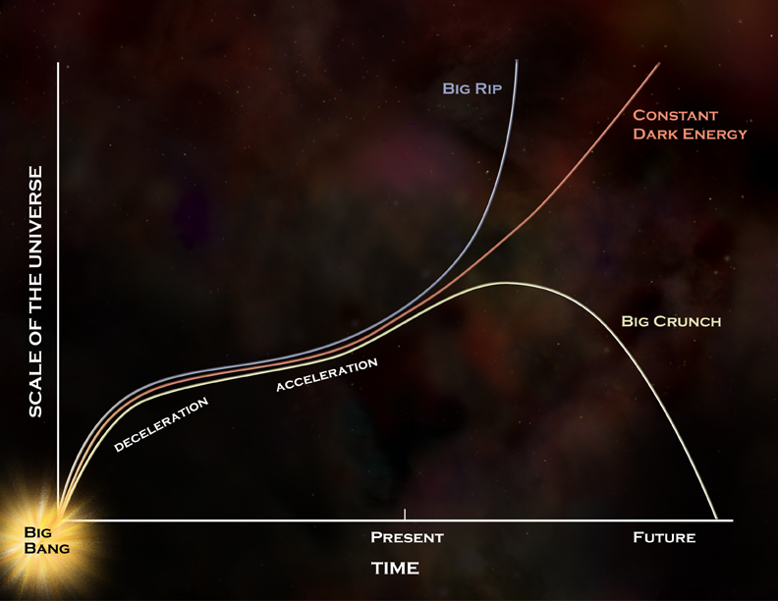
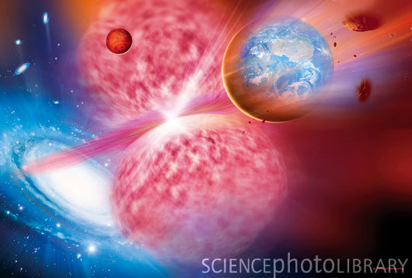
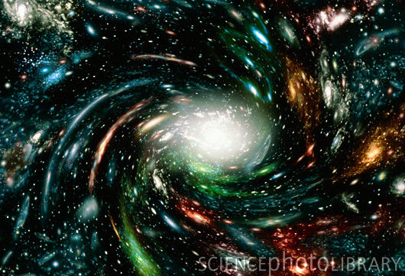
The fate of the universe
EYH 2011

Slide 38
Have fun!
EYH 2011

