Slide 1
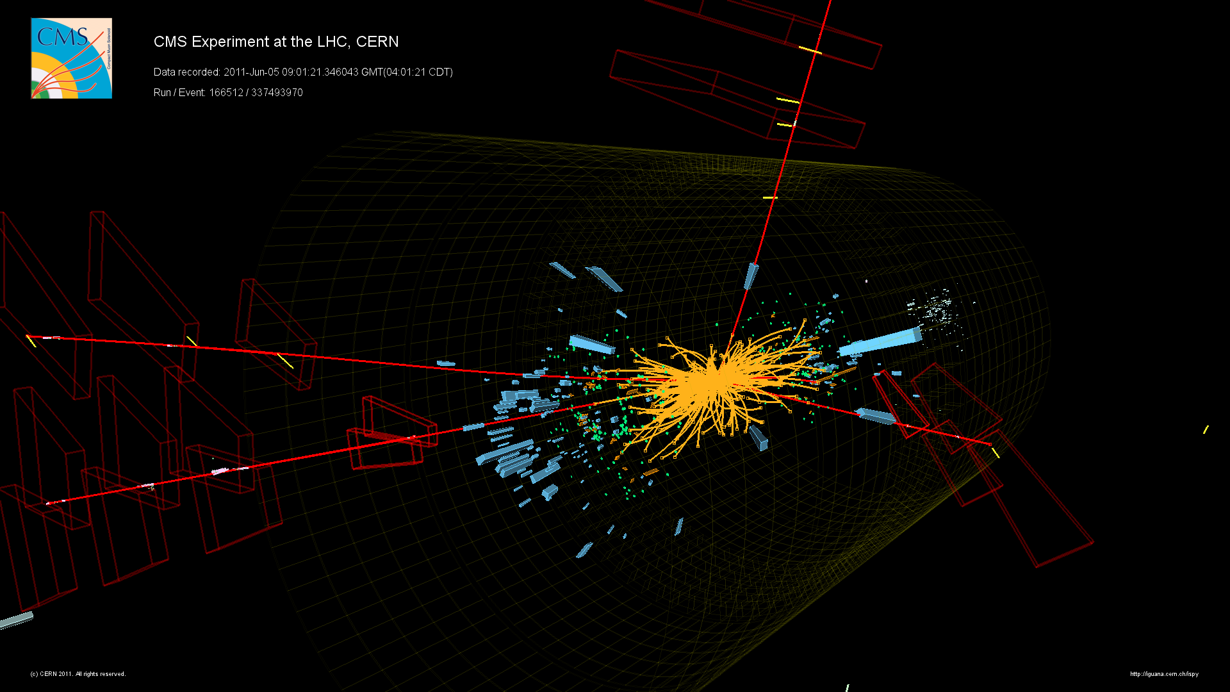
Discoveries
at the Large Hadron Collider
Claudia-Elisabeth Wulz
Institute of High Energy Physics, Vienna
c/o CERN, Geneva
ESA-estec
Noordwijk
21 Sep. 2012

Slide 2
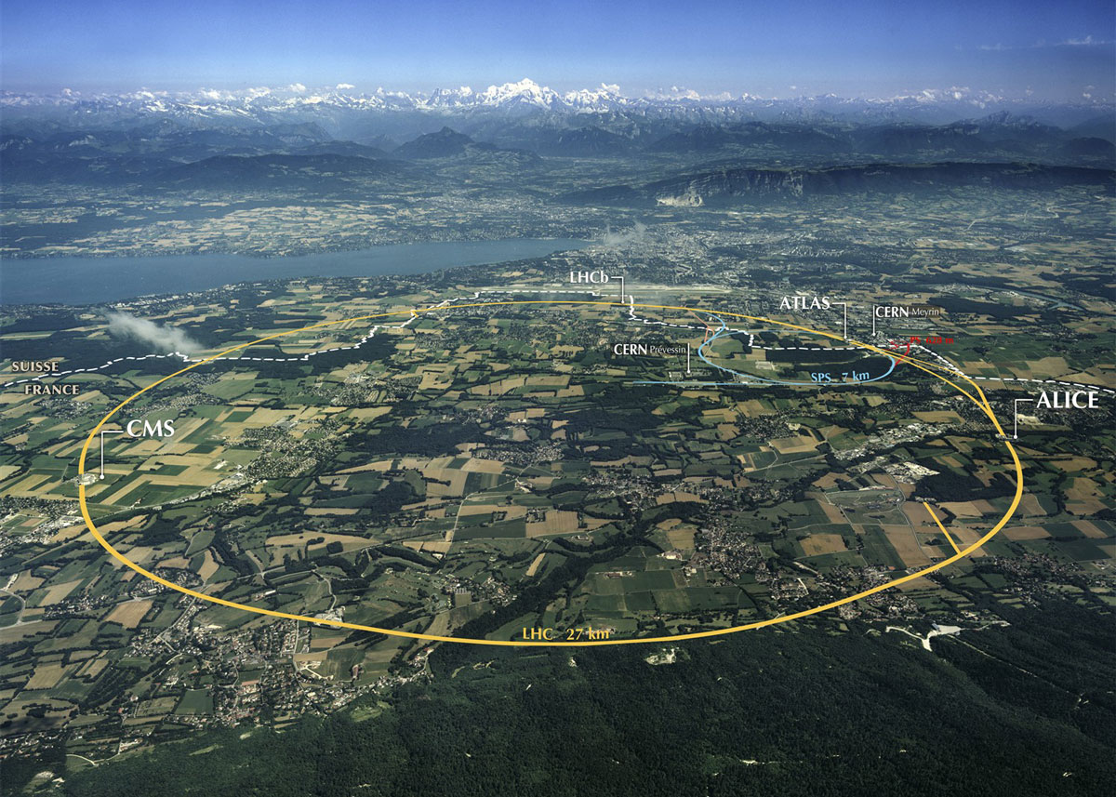

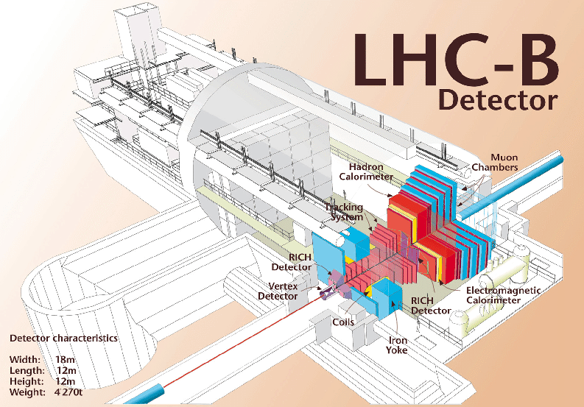
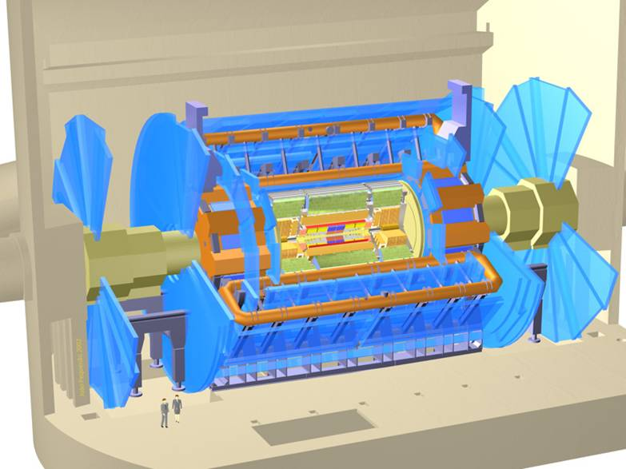

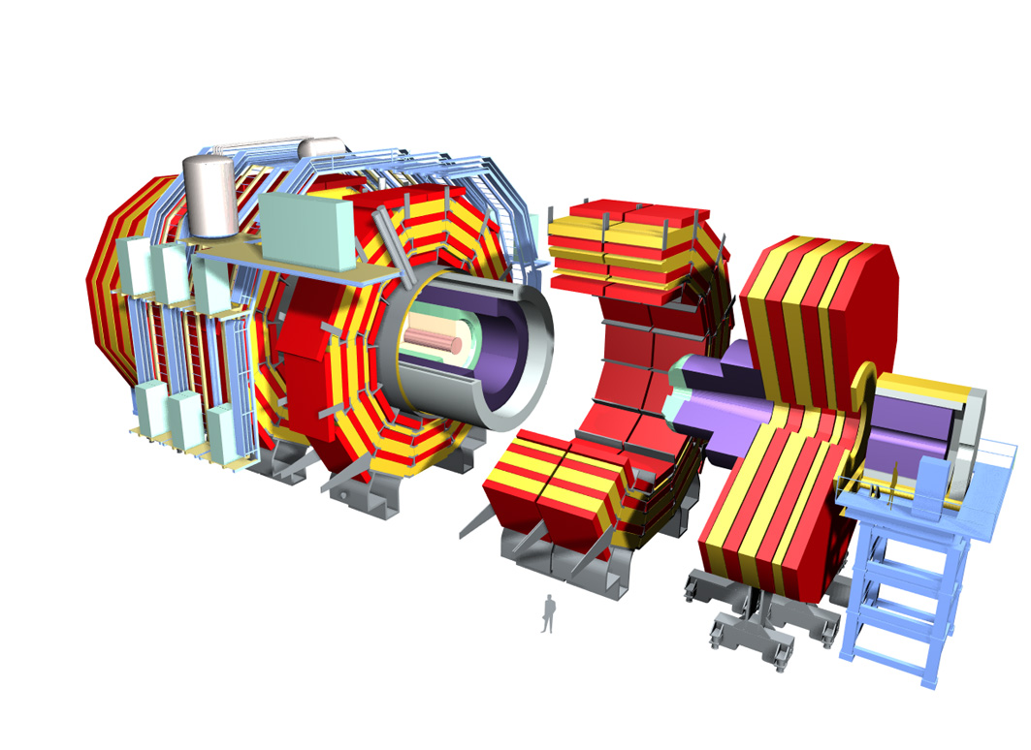
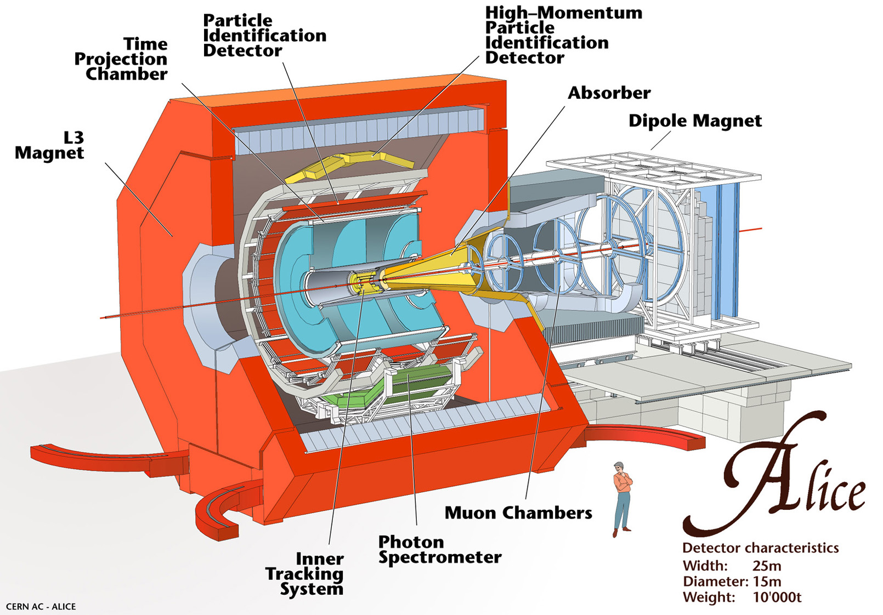
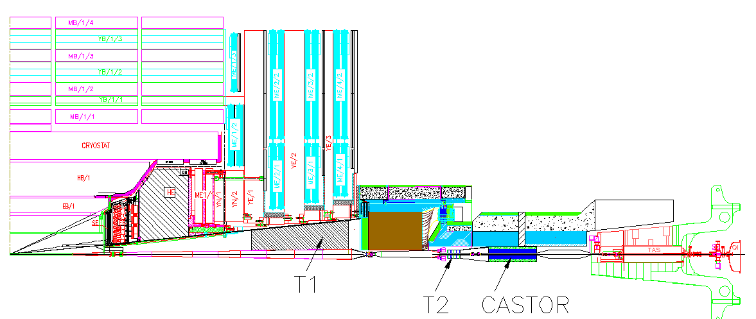


ATLAS
CMS
LHC and its experiments
TOTEM
Graz, June 2016
Notes:
Moedal: approved in 2010, monopole search.

Slide 3
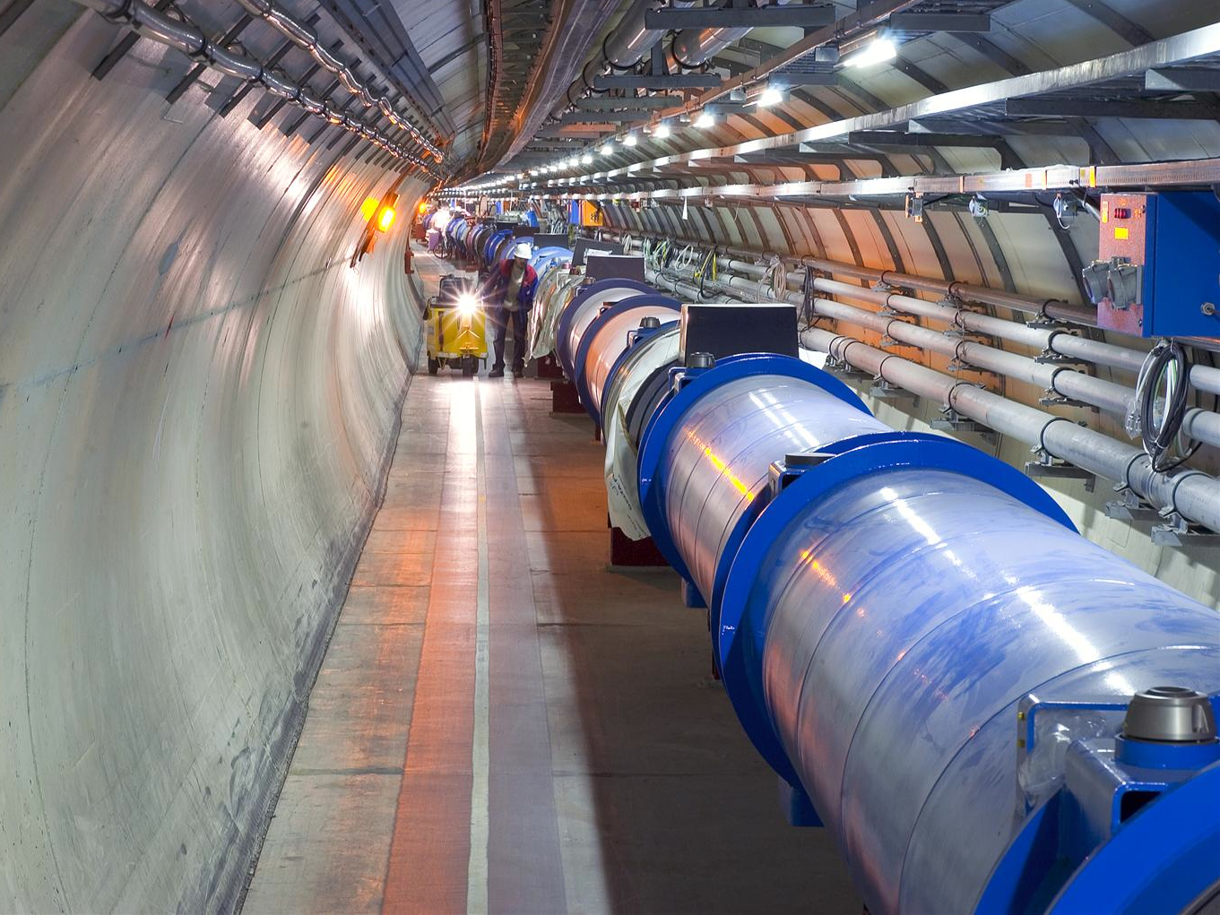
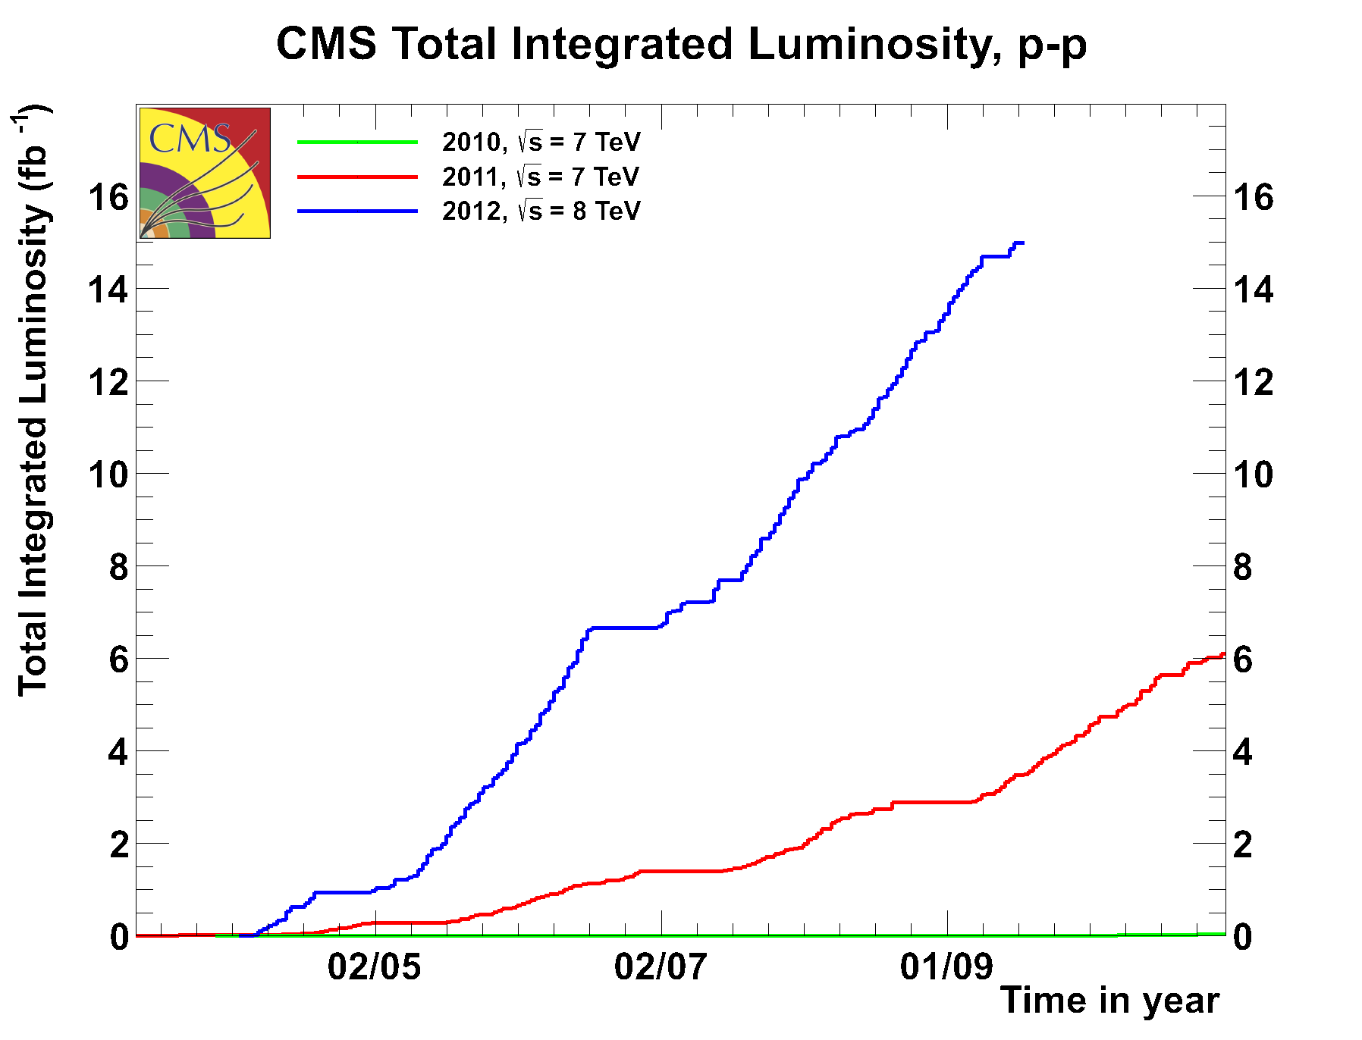
LHC milestones and performance
10 Sep. 2008: First proton beam
20 Nov. 2009: Restart after accident
23 Nov. 2009: First proton collisions at 900 GeV
30 Nov. 2009: World record energy 2.36 TeV
30 March 2010: New world record energy 7 TeV
8 Nov. 2010: First collisions of lead ions at 2.76 TeV per nucleon pair (NN)
March 2011: Restart with protons at 7 TeV
March – Dec. 2011: protons at 7 TeV, lead ions at 2.76 TeV per NN
March 2012 – Feb. 2013: protons at 8 TeV, lead ions at 2.76 TeV per NN
March 2013 – autumn 2014: Shutdown for magnet interconnection reinforcement
Autumn or late 2014: Restart at 13 - 14 TeV
2015 or 2016: Shutdown for luminosity upgrade
Notes:
2x10**32 is already nominal luminosity for LHCb, and double the design luminosity for 2010!
Design energy per beam 350 MJ. 1 fb-1 had been planned for 2011. CMS prefers 25 ns, but lower lumi.

Slide 4


ATLAS experiment
ESA, Sep. 2012

Slide 5


CMS experiment
ESA, Sep. 2012

Slide 6
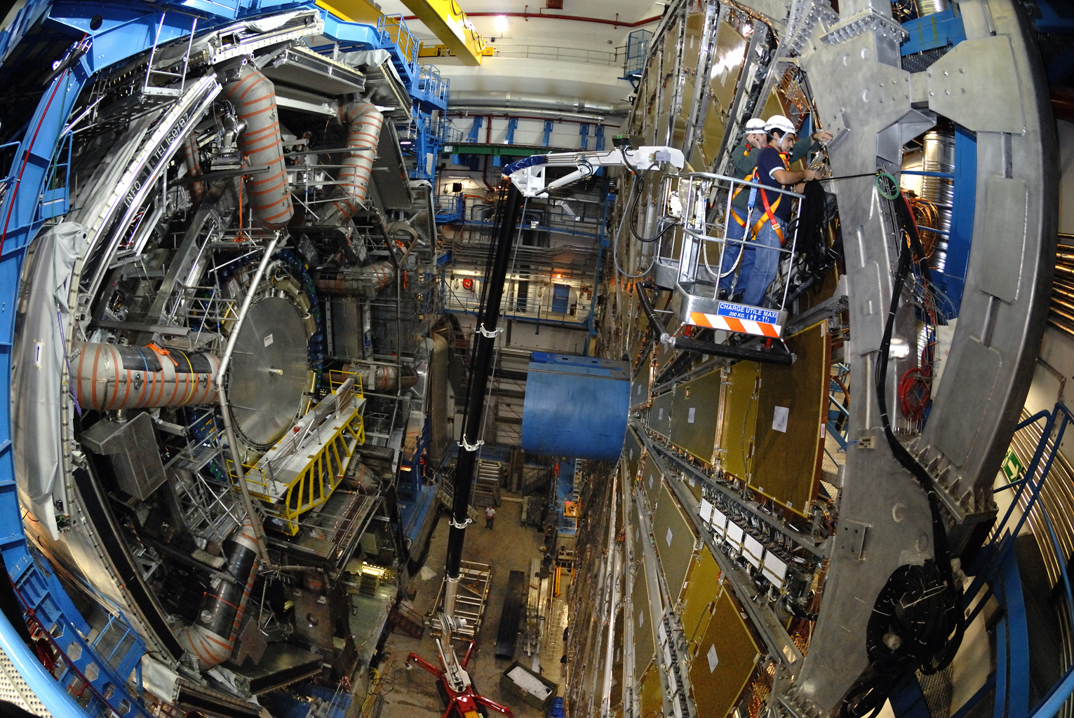
ATLAS experiment
ESA, Sep. 2012

Slide 7
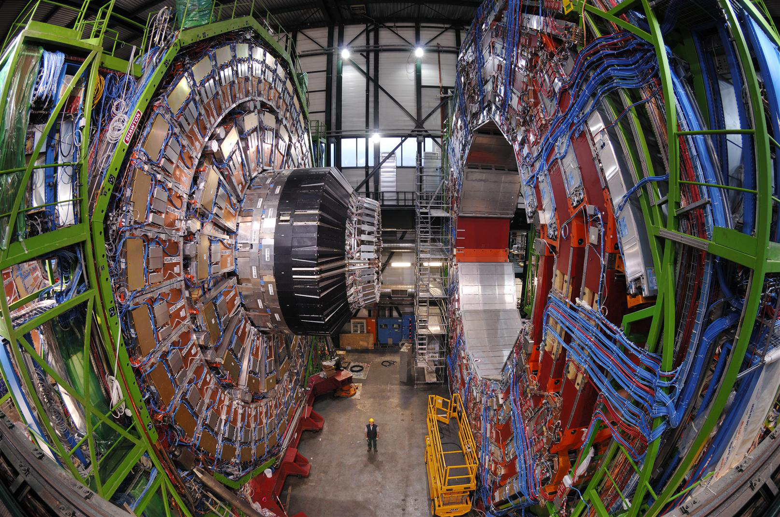
CMS experiment
ESA, Sep. 2012

Slide 8
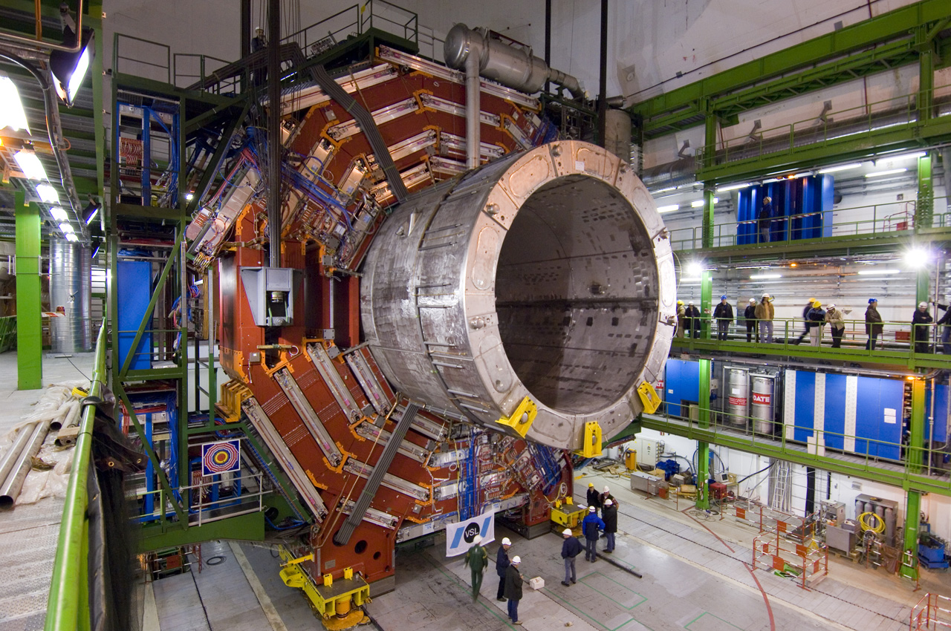
CMS experiment
CMS experiment
ESA, Sep. 2012
ESA, Sep. 2012

Slide 9
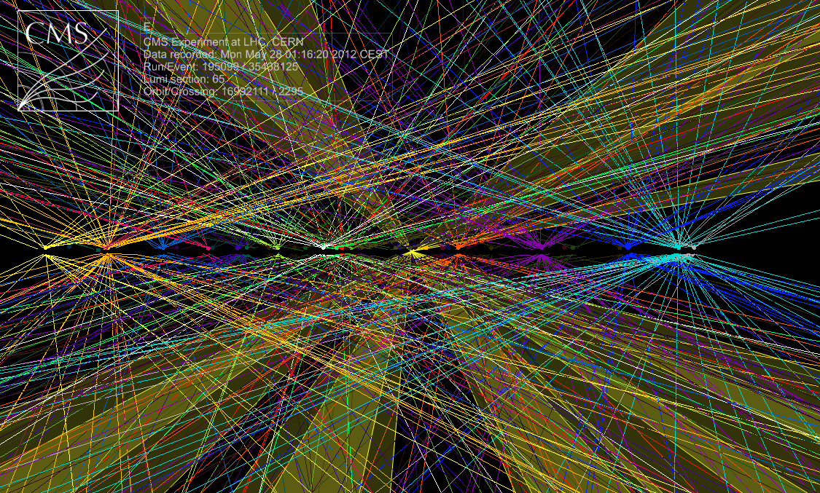
Challenge: pileup
Multiple vertices (mean number is 33 for highest luminosity in 2012), many tracks (a few thousand)
-> challenges for event selection (trigger) and computing!
Vertex resolution better than ~200 μm, vertices a few cm apart, beam spot size 16 μm at collision point.
ESA, Sep. 2012

Slide 10

Quarks
Force carriers
Standard Model
Leptons

Slide 11
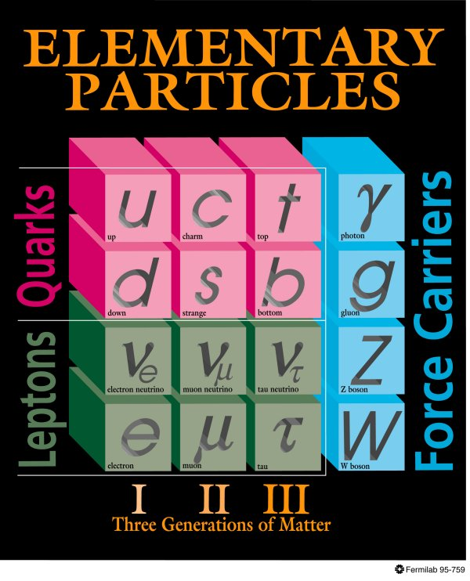
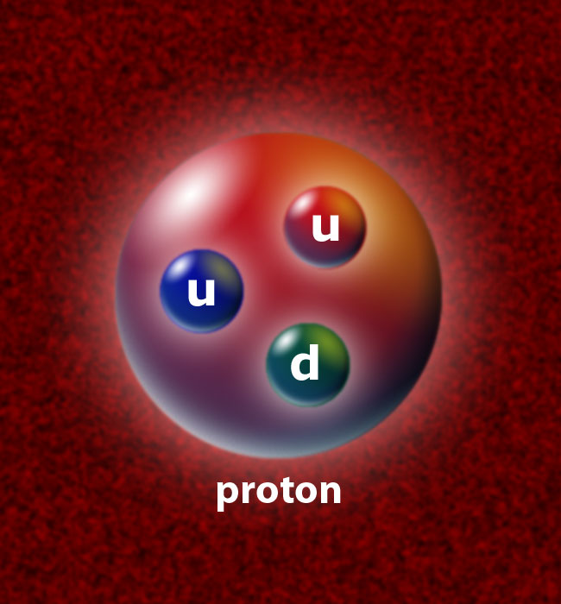
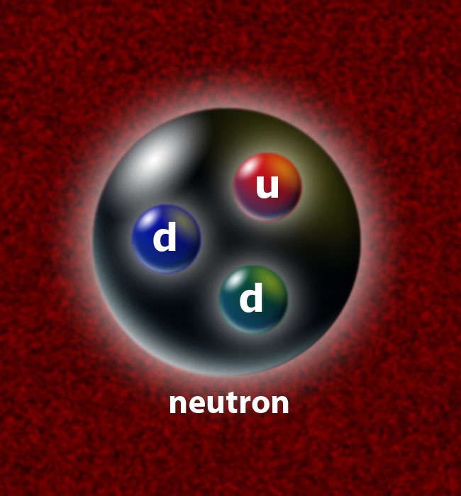
What is matter made of?
Only the first generation of quarks and leptons makes up ordinary matter. The other generations existed only shortly after the Big Bang. Today they are only present in cosmic rays or are briefly recreated in accelerators.
ELEMENTAR-
TEILCHEN
Proton
3 generations of matter particles (leptons, quarks, which
are “fermions”: particles with half-integer spin)
C.-E. Wulz
11
ESA, Sep. 2012

Slide 12

The LHC is a time machine, just like telescopes and space probes!
ESA, Sep. 2012

Slide 13
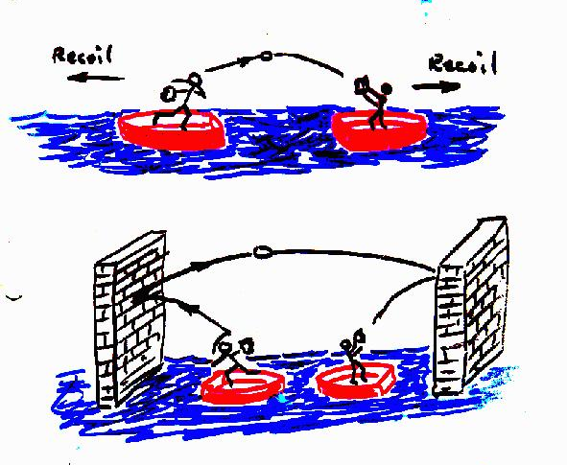
Force carrier particles
Gauge bosons
L.J. Curtis
Forces are created by the exchange of particles.
C.-E. Wulz
13
ESA, Sep. 2012

Slide 14

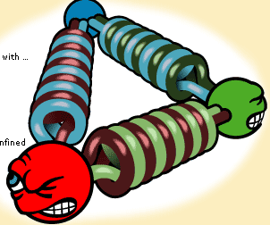
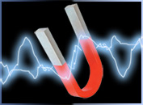
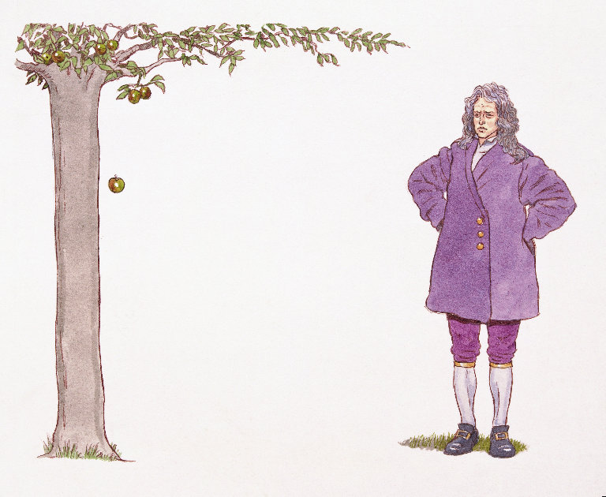

The fundamental forces
FORCE | RELATIVE STRENGTH | REACH | MEDIATOR
Strong | 1 | 10⁻¹⁵ m | gluons
Weak | 10⁻⁶ | 10⁻¹⁸ m | W, Z
Electromagnetic | 10⁻² | infinite | photon
Gravitational | 10⁻³⁸ | infinite | graviton
Notes:
Das Standardmodell ist eine Theorie der starken, schwachen und elektromagnetischen Kräfte, formuliert in der Sprache von Quantenfeldtheorien, und der Elementarteilchen, die an diesen Wechselwirkungen teilnehmen. Die Gravitation ist jedoch nicht eingeschlossen. Wechselwirkungen werden durch den Austausch von virtuellen Teilchen vermittelt.

Slide 15
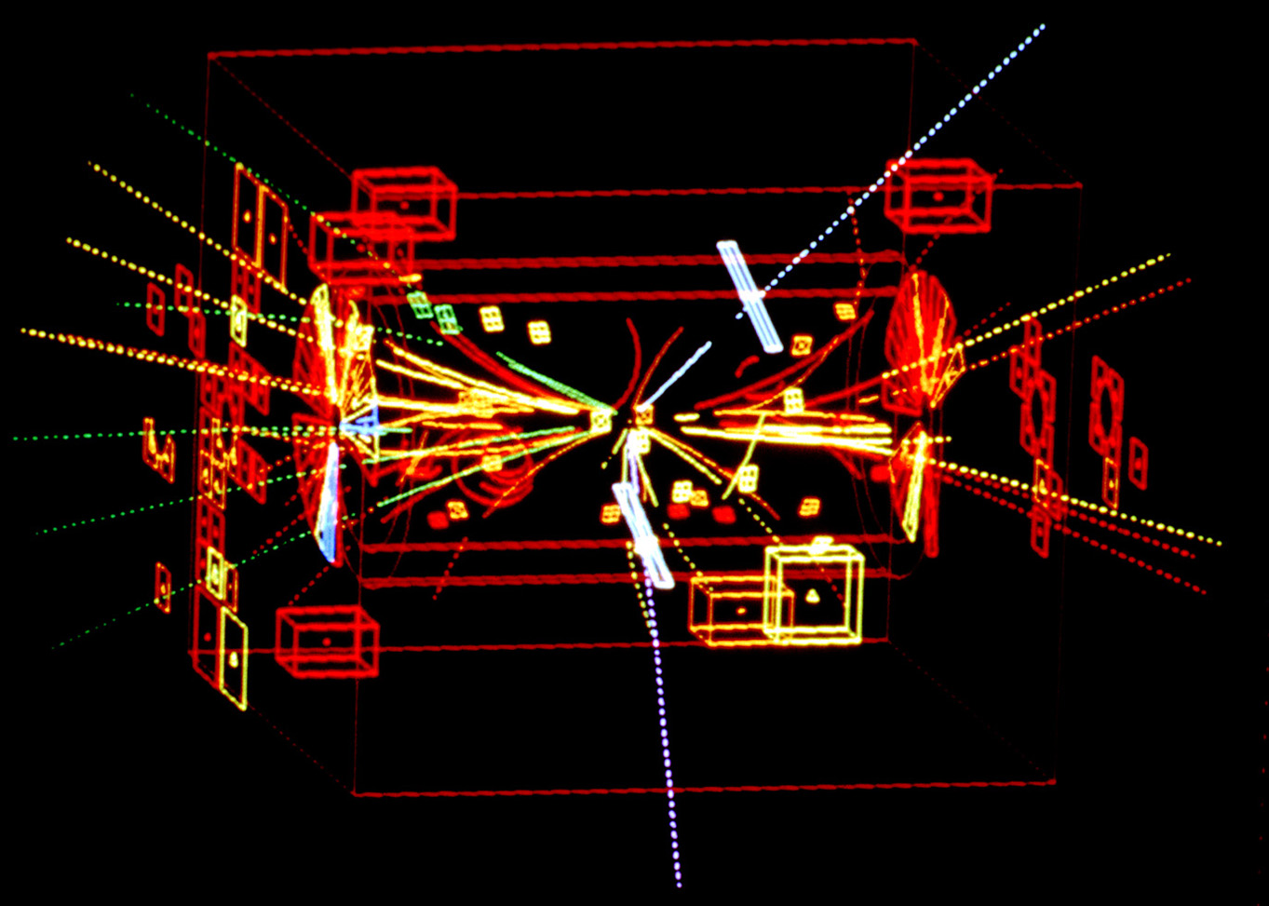
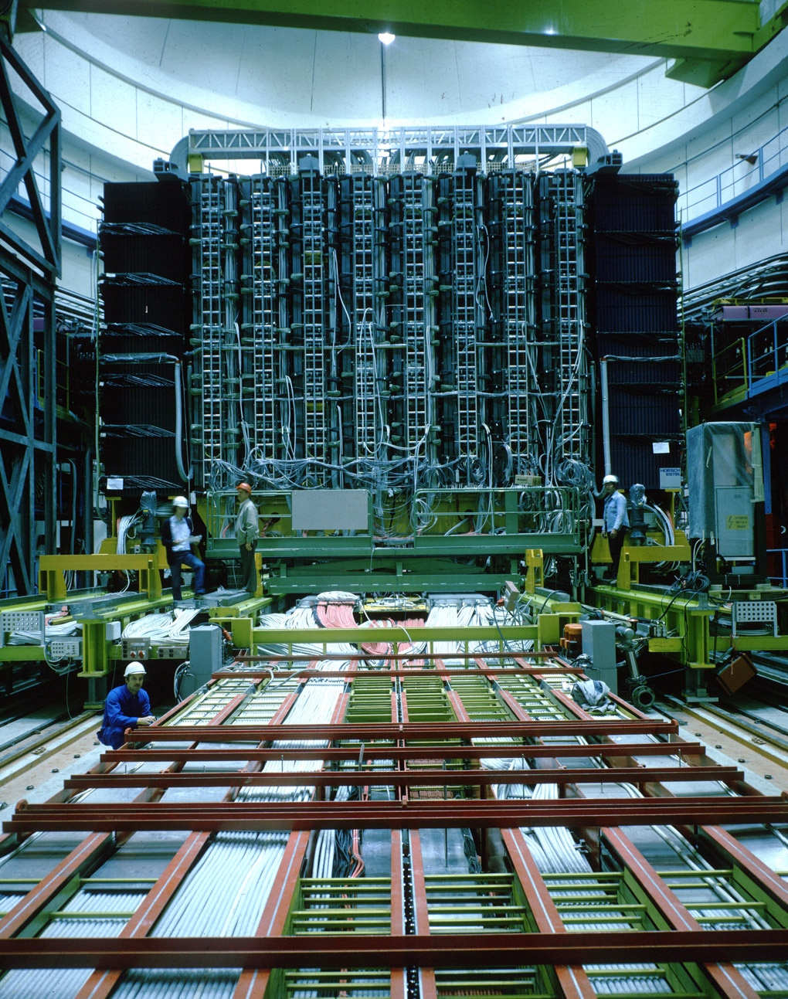
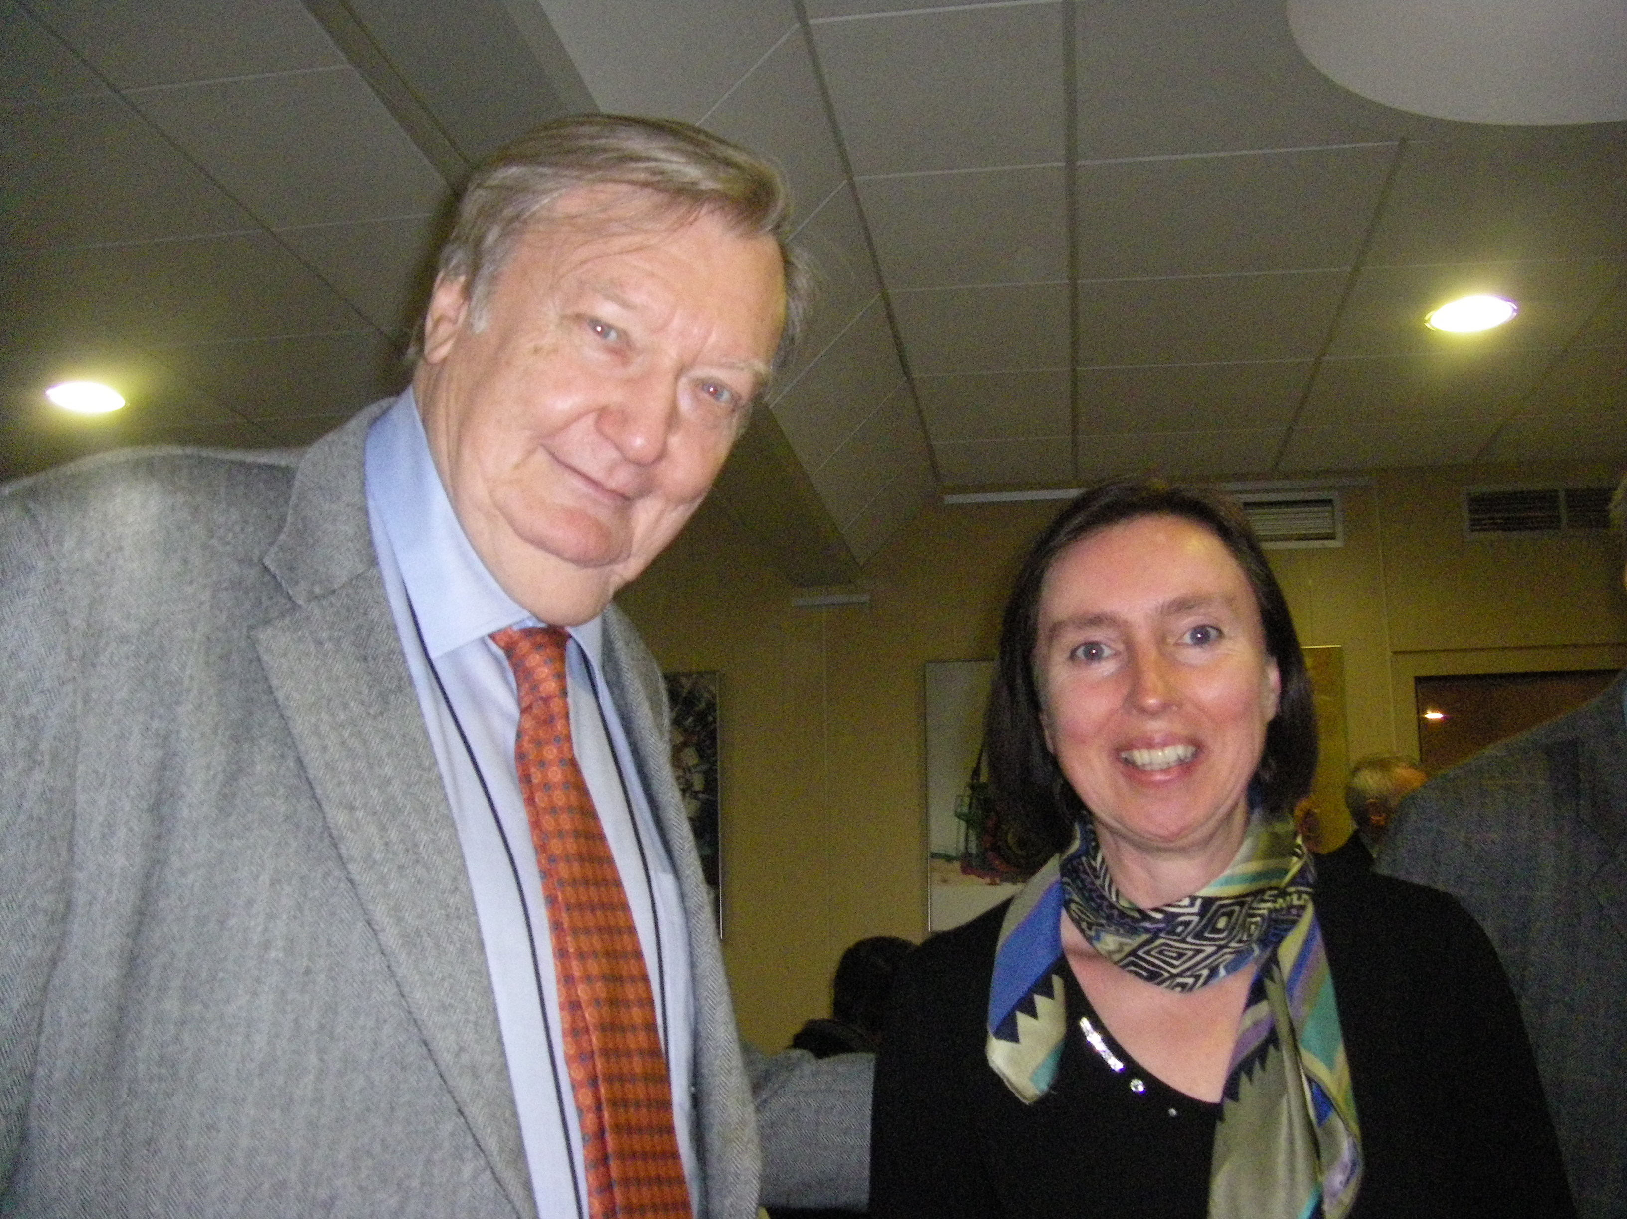
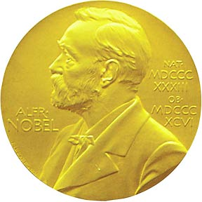
Discovery of the W and Z at the CERN SPS
Decay of a Z particle into 2 electrons
UA1 Experiment
1984
Carlo Rubbia
C.-E. Wulz
ESA, Sep. 2012

Slide 16
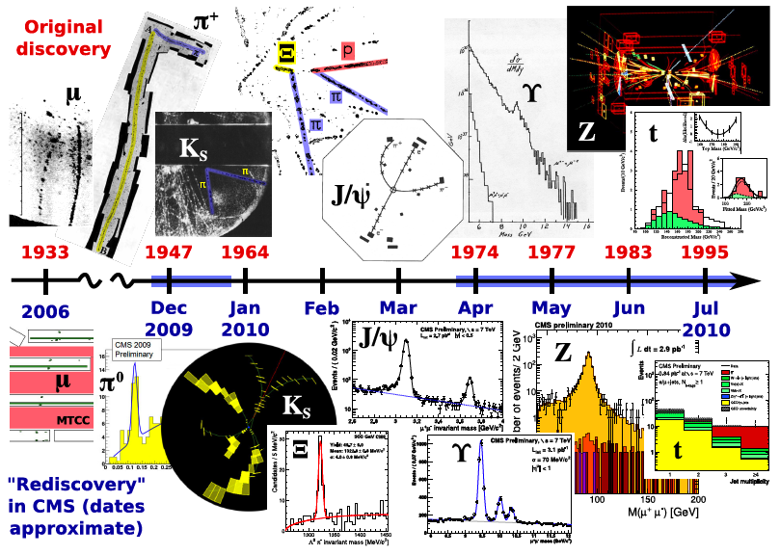
Rediscovery of the Standard Model at the LHC
J. Pivarski
C.-E. Wulz
ESA, Sep. 2012

Slide 17
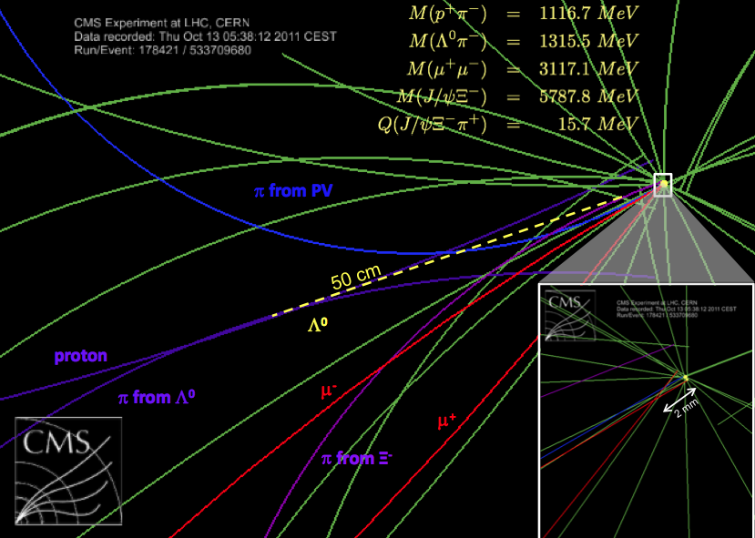
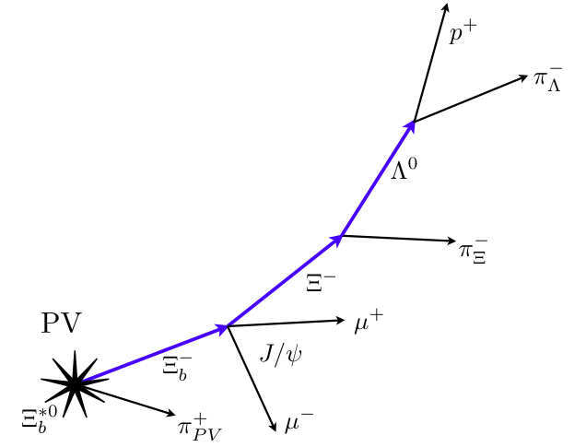
A new particle state made of quarks bsu: Ξ_{b}*⁰
Excited b baryon
hep-ex 1204.5955
Phys.Rev.Lett. 108.252002
C.-E. Wulz
ESA, Sep. 2012
Notes:
excited b baryon via its strong decay into Xi(b)^- pi^+ (plus charge conjugates)

Slide 18
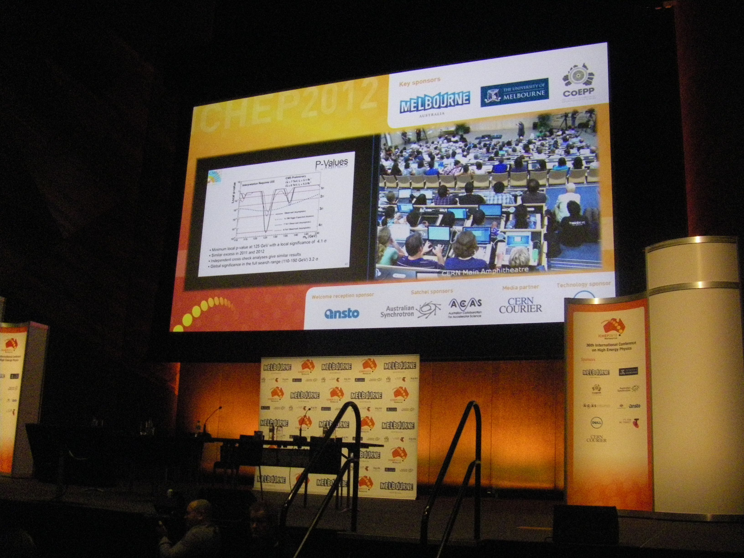
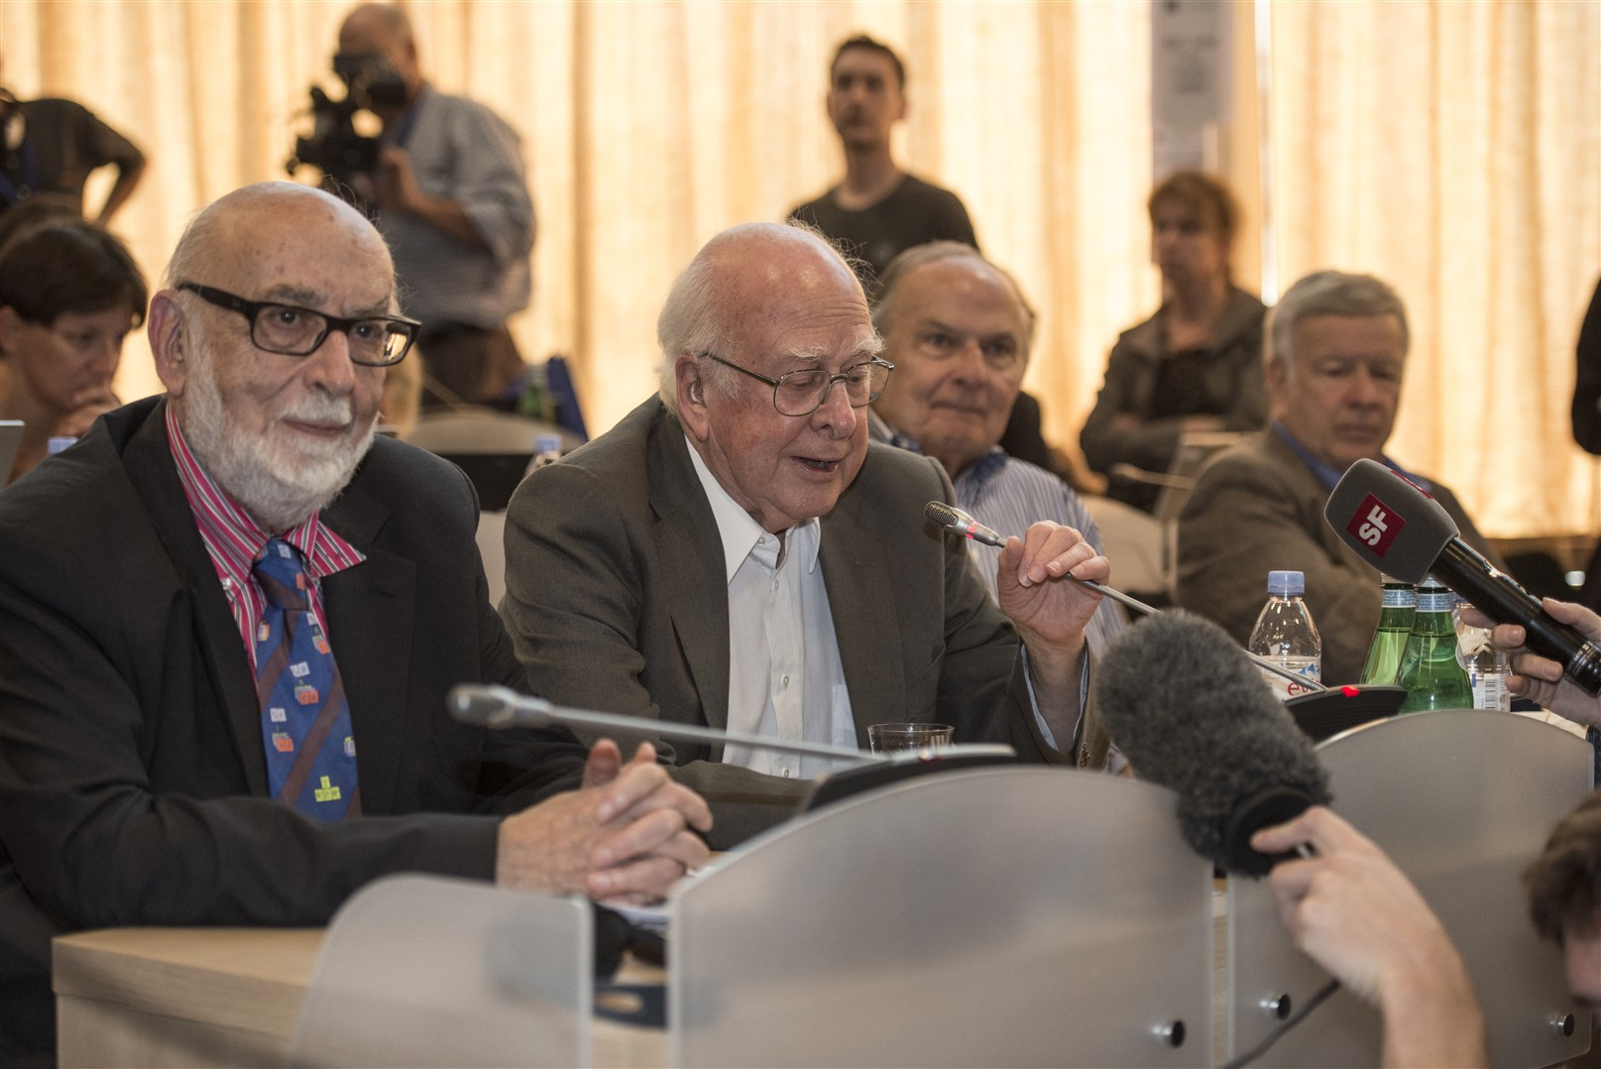

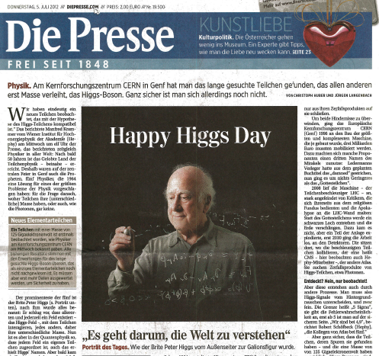
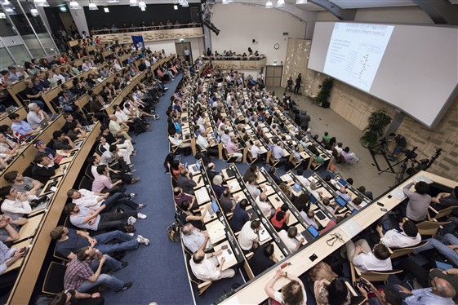
C. Hagen
ICHEP Melbourne
P. Higgs
G. Guralnik
F. Englert
4 July 2012
ESA, Sep. 2012
Notes:
Missing: Kibble, Brout (deceased)

Slide 19
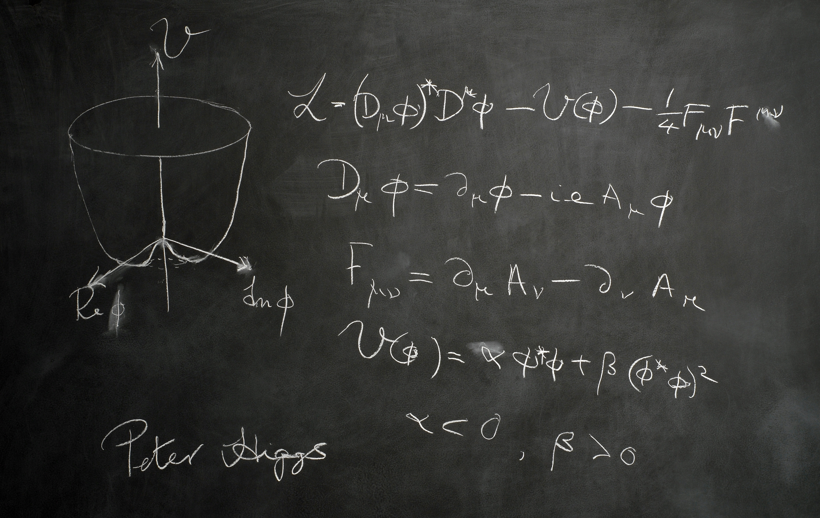
Generation of mass by the Higgs mechanism
Without the Higgs mechanism all particles of the standard model would be massless.
Mass is generated through interaction with a (hypothetical) Higgs field. Particles that should get mass are “slowed down” in this field.
The entire universe is filled by this Higgs field. Because it is uniform and ubiquitous, one does not feel it.
„Excitations“ (local density fluctuation) of this field appear as a Higgs particle, which has probably been discovered at the LHC. The mass of that particle was a priori not known, but everything pointed to the hypothesis that it had to be relatively light.
ESA, Sep. 2012
Notes:
Analogie mit Schwimmen im Wasser oder in Honig. Higgsfeld überall im Universum: wie Luft bei Windstille. Higgs-Teilchen: man verdichtet das Feld lokal, analog Wind.

Slide 20
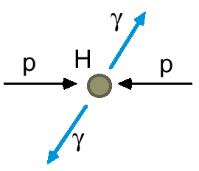
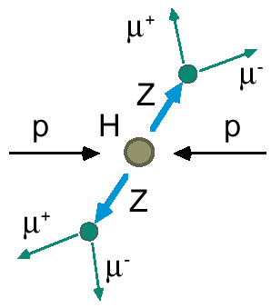
How does one look for the Higgs particle?
Since the Higgs particle has an extremely short lifetime, it decays in the detector, to known particles such as photons (γ), Z, W, taus (τ), b quarks, etc. These decay channels have so far been studied:
Other particles may leave the same traces as a Higgs boson in the detector and therefore mimic a “signal” → background.
H → γγ
H → ZZ → 4e or 4μ or 2e+2μ
H → WW → 2e2ν or 2μ2ν
H → bb
H → ττ
C.-E. Wulz
20
ESA, Sep. 2012
Notes:
Golden channels: γamma gamma and ZZ

Slide 21
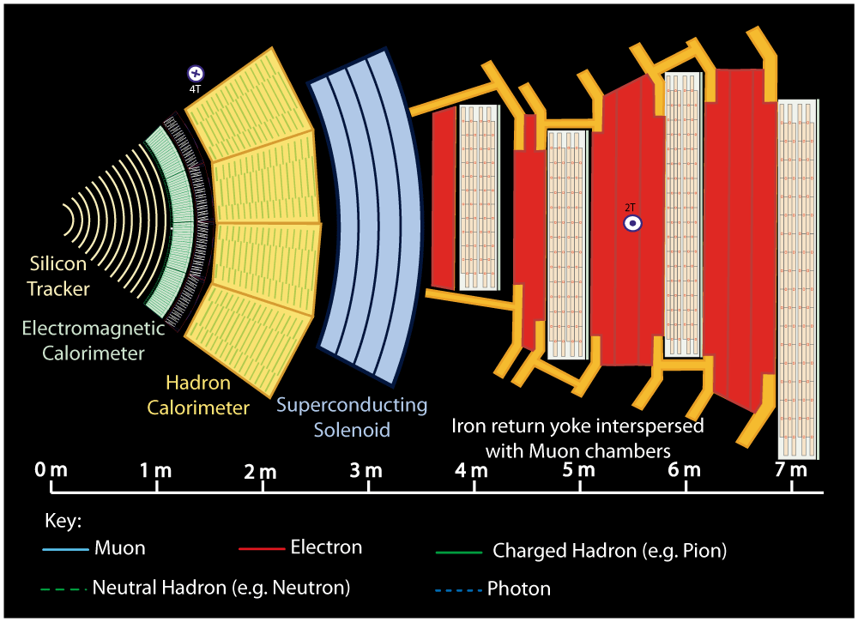
C.-E. Wulz
21
ESA, Sep. 2012
Notes:
Buttons. Click on any particle type to display the relevant slide with animations. Clicking again will return to this slide.
Recommend putting this slide in the middle of your presentation and putting the other 5 slides at the end.
If you have any difficulties, contact David.Barney@cern.ch

Slide 22
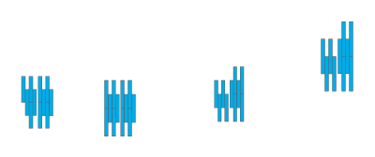


C.-E. Wulz
22
ESA, Sep. 2012
Notes:
Muon: passing through CMS, bending in the field (both ways, depending on when it is inside or outside of the solenoid) leaving hits in the Tracker layers and the muon chambers before escaping completely

Slide 23
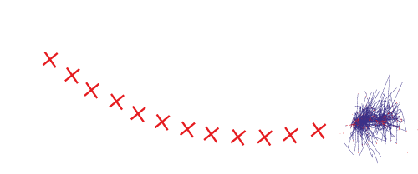
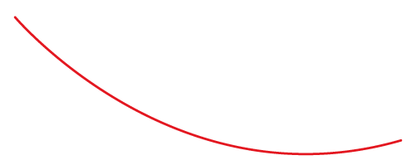

C.-E. Wulz
23
ESA, Sep. 2012
Notes:
Electron: Bending in the magnetic field, leaving hits in the tracker layers and being “stopped” by the electromagnetic calorimeter

Slide 24
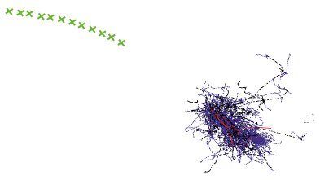


C.-E. Wulz
24
ESA, Sep. 2012
Notes:
Charged hadron: Bends in the magnetic field and leaves signals in the tracker layers; passes through the electromagnetic calorimeter leaving essentially no signal, and is “stopped” by the hadron calorimeter

Slide 25
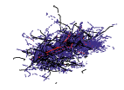

C.-E. Wulz
25
ESA, Sep. 2012
Notes:
Neutral hadron: Does not bend in the magnetic field and does not leave any signal in the tracker layers; passes through the electromagnetic calorimeter leaving essentially no signal, and is “stopped” by the hadron calorimeter

Slide 26



C.-E. Wulz
26
ESA, Sep. 2012
Notes:
Photon: passes through the tracker without bending in the magnetic field or leaving hits, is “stopped” by the electromagnetic calorimeter

Slide 27
Mass of the new particle ( ≈ 125 GeV )
H → γγ

Slide 28
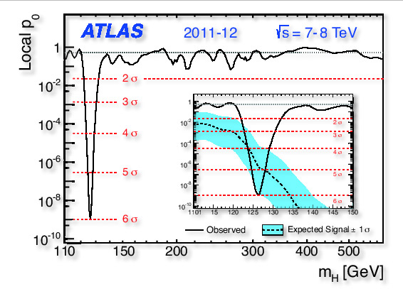
Significance of the results
p-value:
Probability for the background to fluctuate upwards to give the same number of events as seen in the data.
5.9 sigma (σ) corresponds to probability of 1 : 600 millions.
C.-E. Wulz
28
ESA, Sep. 2012
Notes:
Kein Signal bei anderen Massen als 126 GeV.

Slide 29
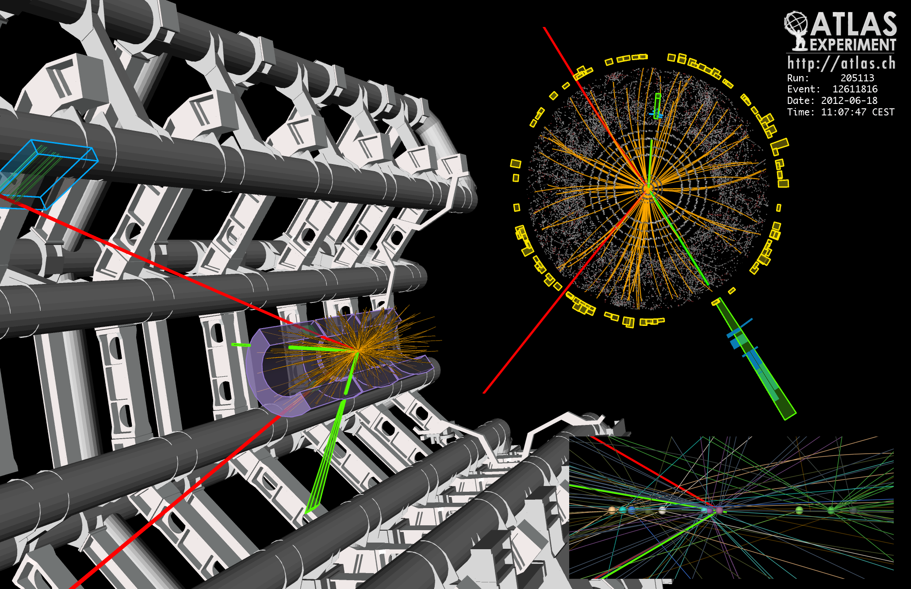
H → ZZ → 2μ + 2e
C.-E. Wulz
29
ESA, Sep. 2012

Slide 30
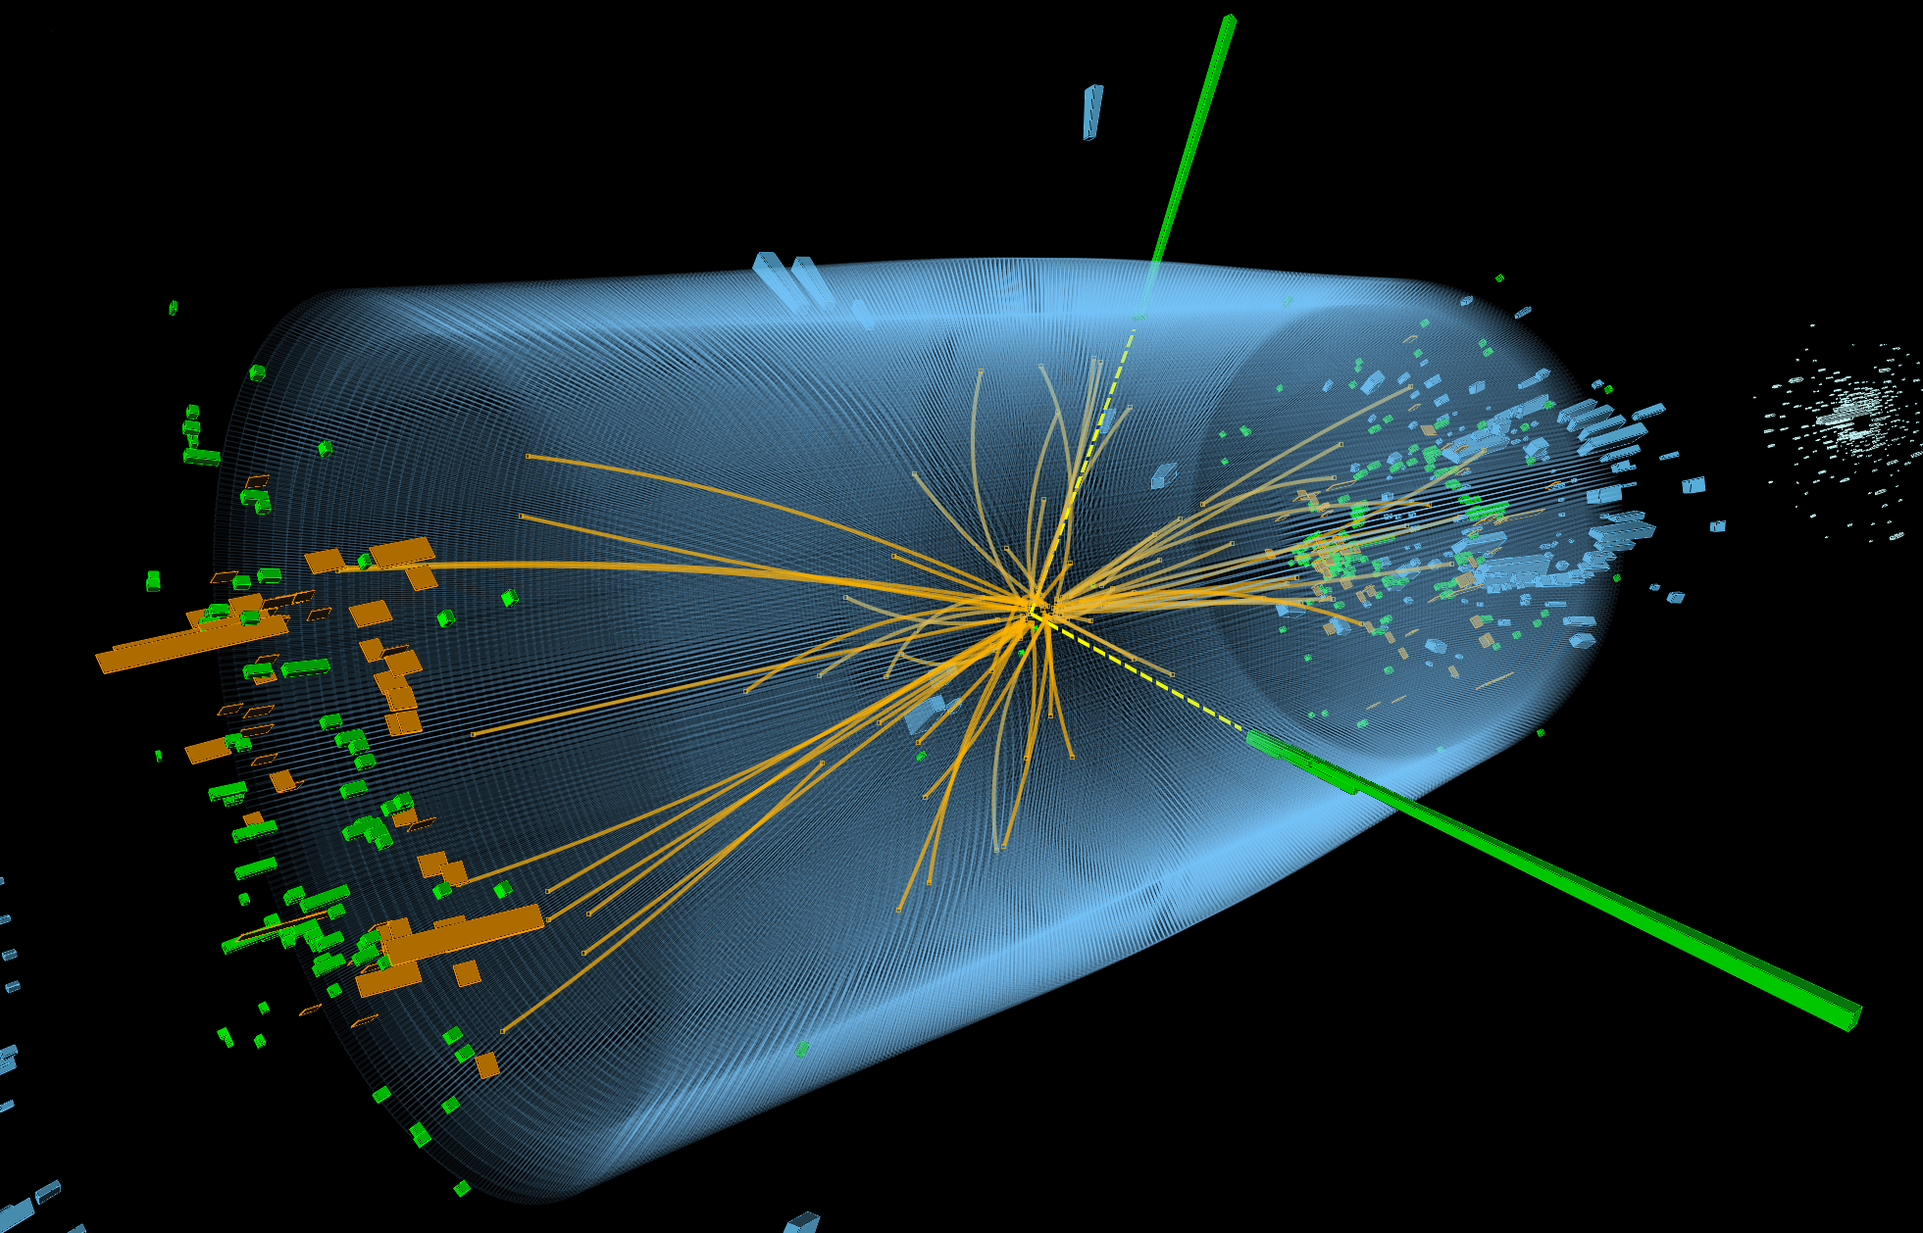

H → 2γ
C.-E. Wulz
30
ESA, Sep. 2012

Slide 31
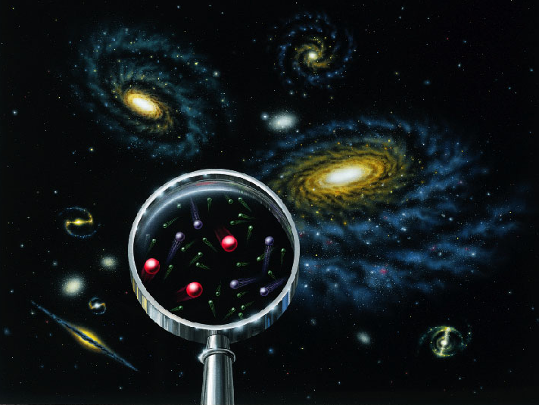
How can we tell if what was found at the LHC is really the Higgs particle of the Standard Model?
- Decays to all predicted channels must be found at the predicted rates
- Its spin must be zero
ESA, Sep. 2012

Slide 32
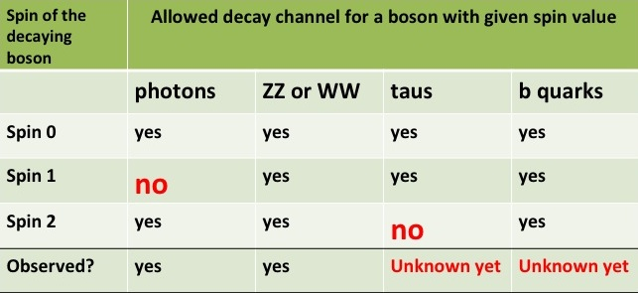
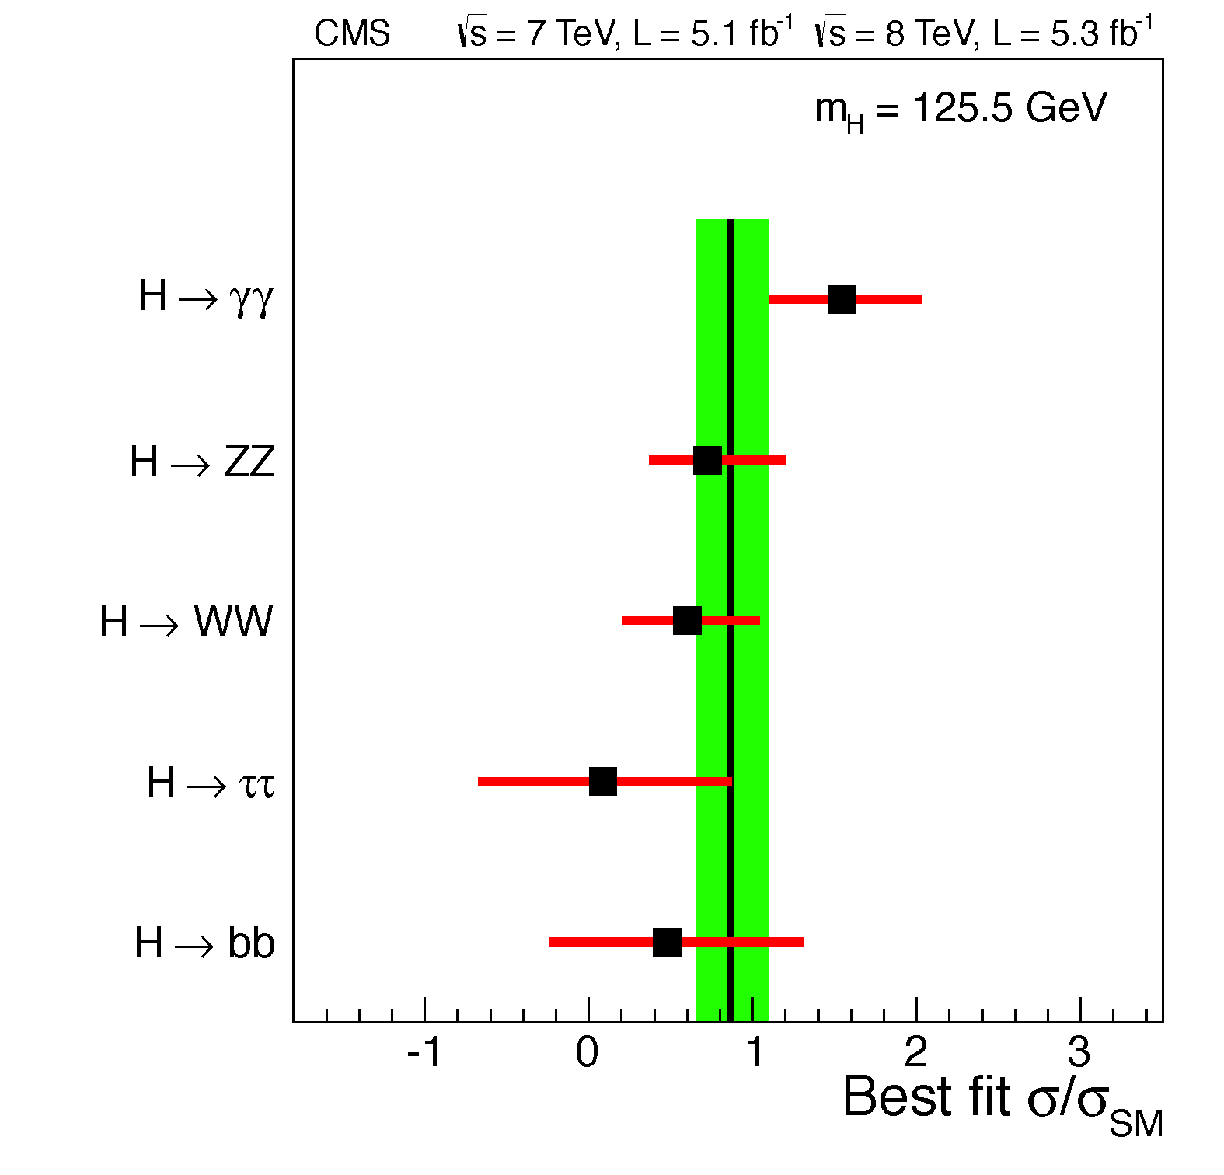
Impostor or not?
- If the new particle is the Higgs boson, the “signal strength” should be one.
- No decays to taus have been found yet. Interesting, but it is too early to be excited yet!
C.-E. Wulz
32
ESA, Sep. 2012
Notes:
Kein Signal bei anderen Massen als 126 GeV.

Slide 33
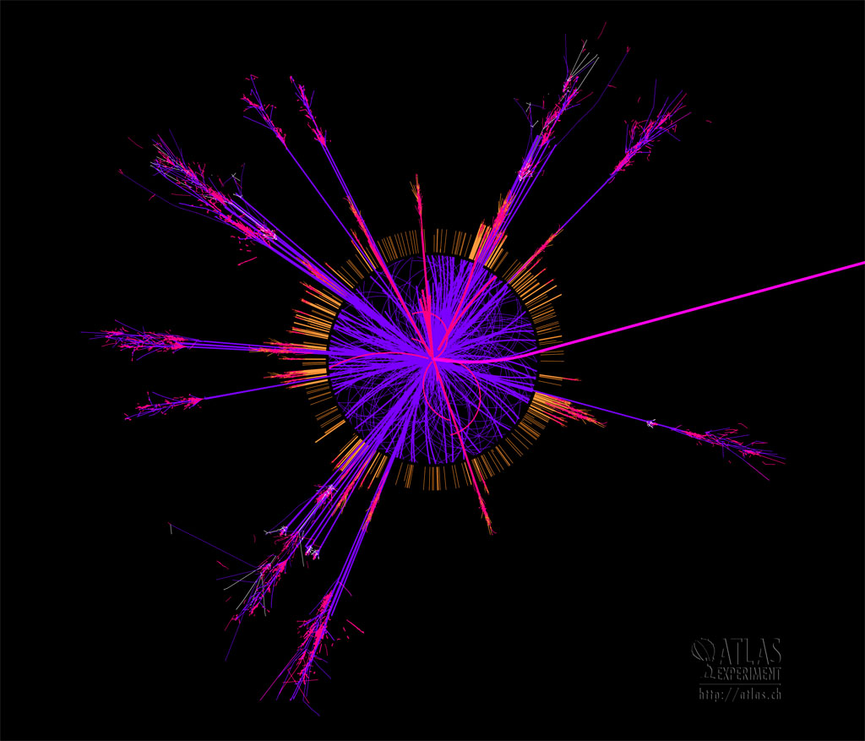
Unsolved (and maybe one solved) puzzles
? Why does the Universe have substance? -> Higgs field
What is the Universe made of? -> We only know 4% (atoms), the rest is dark matter and dark energy.
How must the Standard Model be extended? -> supersymmetry, string theory?
Can all forces be unified -> is there a “world formula”?
Are there extra dimensions? -> gravity (not included in the Standard Model)
Many of these questions could be answered by the LHC!
Connection between particle physics, astrophysics and cosmology!
ESA, Sep. 2012

Slide 34
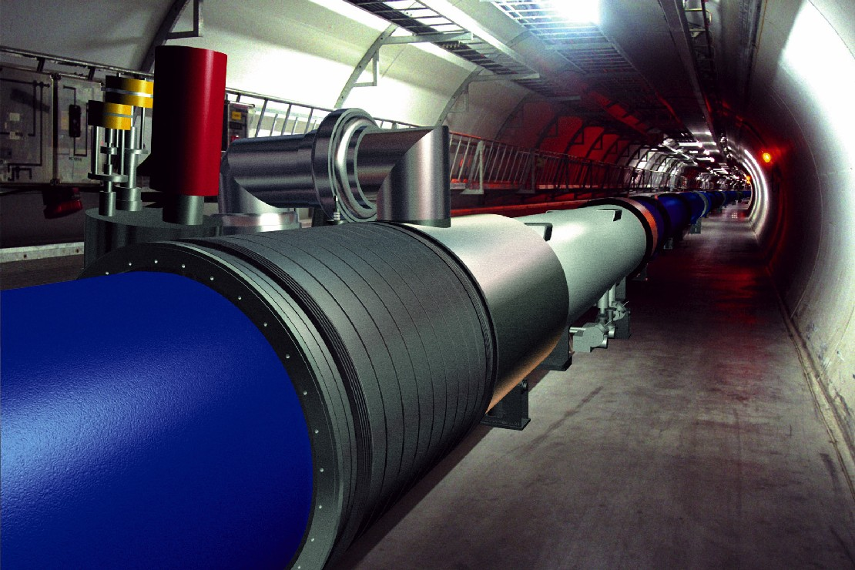
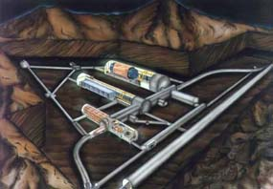
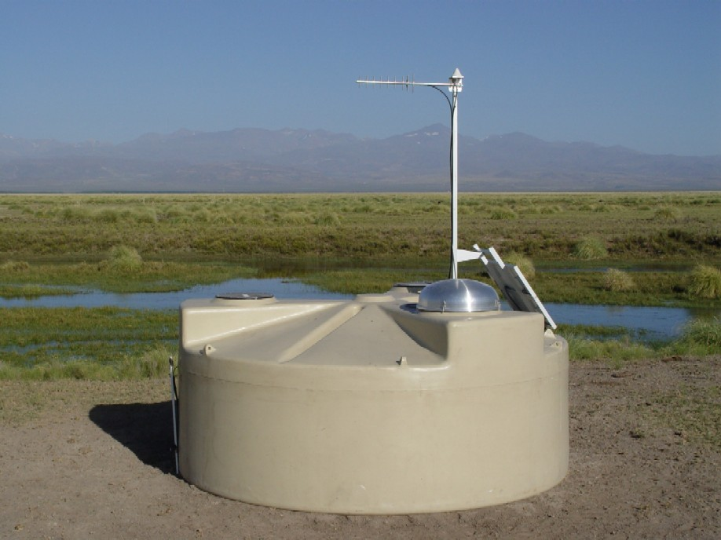



Facilities to answer open questions about the Universe
Particle accelerators
e.g. LHC, RHIC, KEK-B
Underground laboratories and
experiments
e.g. Gran Sasso, Kamiokande, IceCube
Experiments with cosmic rays
e.g. Auger, balloons
Gran Sasso
LHC
Auger
Experiments at nuclear reactors or with radioactive sources
e.g. KamLAND, Double-CHOOZ,
Katrin
Very Large Telescope (VLT)
Planck
KamLAND
Space probes
e.g. FERMI, Hubble, Planck
Terrestrial telescopes
e.g. ALMA, VLT

Slide 35


Supersymmetry
SUSY
We know that the Standard Model must be extended at high energies.
Supersymmetry is a candidate theory for this extension, which predicts five physical Higgs particles.
For each fermion of the Standard Model there is a supersymmetric boson partner and vice versa.
-> stability of Higgs mass
-> unification of forces
-> candidate for dark matter
Now highest priority LHC search topic!
C.-E. Wulz
ESA, Sep. 2012

Slide 36


Examples of supersymmetry signatures
SUSY
Neutralino
(dark matter, WIMP)
- Complicated decay chains
- Different SUSY models with many parameters
- No SUSY signals seen so far, but mass value of the Higgs-like particle hints that SUSY may be a realistic model.
C.-E. Wulz
ESA, Sep. 2012

Slide 37


Extra dimensions
Funambulist: 1 dimension
Ant: 2 dimensions (2nd dimension rolled up)
Gravity seems to be 10⁻³⁸ times weaker than the strong interaction -> difficult to unify with other forces! A possible solution of this hierarchy problem are extra dimensions.
C.-E. Wulz
ESA, Sep. 2012

Slide 38

Models with extra dimensions
There are several models, which have the following in common:
There is a 3+1-dimensional (sub)space (brane, membrane)
The brane is embedded in an 3+1+d dimensional space (bulk)
The d extra dimensions have the same size R
All particles and fields living in the bulk are replicated in Kaluza-Klein-towers.
O. Klein 1926: Extra dimensions are rolled up, i.e. a particle, which moves in these dimensions, comes back to the starting point. Standing waves emerge.
Differences between the
models:
Size and geometry of
the bulk
Kinds of particles that are
allowed to move around in the bulk
Gravity
Gravitation
our 3+1 dimensional
universe
unser 3+1-dimensionales
Universum
Gravity
Gravitation
extra dimension
Extra-Dimension
C.-E. Wulz
ESA, Sep. 2012
Notes:
Deviations from Newton’s Law at short distance: torsion-balance “Cavendish” experiments.
There are standing waves in the extra compactified dimension(s). If a spatial extra dimension is of radius R, the invariant mass of such standing waves would be M_{n} = nh / Rc with n an integer, h being Planck's constant and c the speed of light.

Slide 39

Black holes
Black Holes
Definition:
Object, whose gravitation is so strong that even light cannot escape from it.
The Schwarzschild radius R_{S} defines the size of a black hole:
If gravity becomes strong at small distances through extra dimensions, the LHC could also produce microscopic black holes (Ø 10⁻¹⁸ m). The colliding quarks and gluons must come closer than a distance of 2 R_{S}. The black holes should very quickly (~10⁻²⁶ s) evaporate through Hawking radiation (T_{H} ~1/M_{BH}), producing all possible kinds of Standard Model particles. Signature at the LHC: many jets, leptons and photons with high energies.
M_{BH} > 3.8 – 5.3 TeV … results up to now.
C.-E. Wulz
ESA, Sep. 2012
Notes:
Schwarzschilrradius: distance from the center of an object such that, if all the mass of the object were compressed within that sphere, the escape speed from the surface would equal the speed of light. extradim_vest.pdf. Genaue Formel fuer Schwarzschildradius: R_{S} = 2 M_{BH}G_{N} /c^{2.} Naїvely, black holes would only grow once they are formed.
In 1975 Steven Hawking showed that this is not true, as the black hole can evaporate by emitting pairs of virtual photons at the event horizon, with one of the pair escaping the BH gravity
These photons have a black-body spectrum (Planck) with the Hawking temperature. G_{N} = 6.67300 × 10⁻¹¹ m³ kg⁻¹ s⁻²
See Sven_Black_Holes_with_ATLAS.ppt
Masse eines schwarzen Lochs mindestens 3mal so gross wie die Sonnenmasse (mSonne = 2x10*30 kg).
1/GeV = 0.2 . 10⁻¹⁵ m. Planckmasse = 2 x 10*-8 kg.
Wenn ein Objekt einer bestimmten Masse auf ein Kugelvolumen mit einem kleineren Radius als dem Schwarzschildradius komprimiert wird (und damit einen kritischen Schwellwert in der Dichte überschreitet), kollabiert es in ein Schwarzes Loch.

Slide 40

Conclusions
The LHC has already found new particles. One of these is fundamentally new. It could be the long-sought Higgs boson. If it is not, this will be another even more surprising discovery!
The LHC was not only built to discover the Higgs particle.
Its main purpose is actually to point the way to the physics of the future.
Spectacular discoveries such as supersymmetry or extra dimensions may be just round the corner.
Thank you, and stay tuned!
C.-E. Wulz
40
ESA, Sep. 2012

