Slide 1
Standard Model
http://wulz.home.cern.ch/wulz/Vorlesung/StandardModel_Mar2010.pdf
TU: 142.101, University: 260.025
Claudia-Elisabeth Wulz
Institute of High Energy Physics of the Austrian Academy of Sciences
c/o CERN/PH, E26310, CH-1211 Geneva 23
Tel. 0041 76 487 0919
E-mail: Claudia.Wulz@cern.ch
http: //home.cern.ch/~wulz
Advanced Seminar Series Particles and Interactions
3 March 2010, Erwin Schrödinger Auditorium, University of Vienna

Slide 2
The Standard Model of Particle Physics
The Standard Model is a theory of the strong, weak and electromagnetic forces, formulated in the language of quantum gauge field theories, and of the elementary particles that take part in these interactions. It does, however, not include gravity. Interactions are mediated by the exchange of virtual particles.
FORCE | RELATIVE STRENGTH | RANGE
Strong (nuclear) | 1 | 10⁻¹⁵ m
Weak (radioactive decay) | 10⁻⁶ | 10⁻¹⁸ m
Electromagnetic | α (10⁻²) | infinite
Gravitational | 10⁻³⁸ | infinite
Notes:
Weakness of gravity: magnet can hold a pin against the gravitational pull of the whole earth
Exact value for gravitational strength: 6 x 10**-39. Gravitational constant: G = 6.67 x 10**-11 N m**2 kg**-2
Virtual particles: A virtual particle is one that does not precisely obey the m²c⁴ = E² − p²c² relationship for a short time. Virtual particles of larger mass have more limited range.
Uncertainty relation: Delta E x Delta t > h quer, h quer = 6.6 x 10**-22 MeVs

Slide 3
Particle Content
Matter particles:
Fermions (half-integer spin, s = ½ħ) and their antiparticles.
There are 3 families (generations) of fermion fields, which are identical except for their masses. Fermions come as leptons and quarks.
Mediator particles:
Gauge bosons (integer spin, s = 1ħ).
There are 3 types of gauge bosons, corresponding to the 3 interactions described by the Standard Model.
Higgs particle:
Needed to explain that the symmetries of the electroweak theory are broken to the residual gauge symmetry of QED. Particles that interact with the Higgs field cannot propagate at the speed of light and acquire masses through coupling to the Higgs boson (s = 0ħ).
Notes:
Spin: intrinsic angular momentum. ħ: reduced Planck constant, 1.054 x 10**-34 Js = 6.6 x 10*-16 eVs. Fermions respect the Pauli exclusion principle.
One should not imagine particles actually spinning. What is meant is that additive quantum numbers similar to the laws for spin are involved.
Spin was originally conceived as the rotation of a particle around some axis. This picture is correct in so far as spins obey the same mathematical laws as do quantized angular momenta. On the other hand, spins have some peculiar properties that distinguish them from orbital angular momenta:
Spin quantum numbers may take on half-integer values;
The spin of a charged particle is associated with a magnetic dipole moment with a g-factor differing from 1. This is incompatible with classical physics, assuming that the charge and mass of the particle are distributed evenly in spheres of equal radius.
Acquisition of mass through the Higgs field: refraction slows down a photon traversing matter.

Slide 5
History of the Standard Model
1964 Quarks (u,d,s) are proposed by M. Gell-Mann and G. Zweig.
1964 The Higgs mechanism is developed by R. Brout, F. Englert, P. Higgs,
G. Guralnik, C. Hagen, T. Kibble
1965 Color is proposed by O. W. Greenberg, M. Y. Han, Y. Nambu.
1967 S. Weinberg, Sh. Glashow and A. Salam create the electroweak theory, unifying the electromagnetic and weak nuclear forces (Nobel prize in 1979), and incorporate the Higgs mechanism to generate mass.
1969 J. Friedman, H. Kendall, R. Taylor find substructure of the proton
(first evidence of quarks) in a deep elastic scattering experiment.
1970 GIM mechanism: fourth quark (c) allows a theory that suppresses
flavor-changing neutral currents, mediated by the Z boson.
1970 Formulation of a quantum theory of the strong interaction
(Quantum Chromodynamics, QCD) by H. Fritzsch and M. Gell-Mann.
1971 Renormalizability of Yang-Mills theories with spontaneous symmetry
breaking (G. t’Hooft, M. Veltman)
1973 Asymptotic freedom by D. Politzer, D. Gross, F. Wilczek.
Notes:
Murray Gell-Mann and George Zweig tentatively put forth the idea of quarks. They suggested that mesons and baryons are composites of three quarks or antiquarks, called up, down, or strange (u, d, s) with spin 1/2 and electric charges 2/3, -1/3, -1/3, respectively (it turns out that this theory is not completely accurate). Since the charges had never been observed, the introduction of quarks was treated more as a mathematical explanation of flavor patterns of particle masses than as a postulate of actual physical object. Later theoretical and experimental developments allow us to now regard the quarks as real physical objects, even though they cannot be isolated.
1964: Since leptons had a certain pattern, several papers suggested a fourth quark carrying another flavor to give a similar repeated pattern for the quarks, now seen as the generations of matter. Very few physicists took this suggestion seriously at the time. Sheldon Glashow and James Bjorken coin the term "charm" for the fourth (c) quark.
1974: In a summary talk for a conference, John Iliopoulos presents, for the first time in a single report, the view of physics now called the Standard Model.
FCNC: z.B. s   d + Z

Slide 6
History of the Standard Model
1974 The Standard Model of particle physics is presented in its modern form by
J. Iliopoulos.
1974 The charm quark is observed at SLAC (B. Richter et al.) and at
Brookhaven (S. Ting et al.), through the discovery of the J/ψ.
1975 Evidence of the tau lepton is found at SLAC (M. Perl et al.).
1977 Evidence of the bottom quark (proposed in 1973 by M. Kobayashi,
T. Maskawa) is found at Fermilab (L. Lederman et al.).
1983 The W and Z bosons, mediators of the weak-force, are discovered at
CERN (C. Rubbia et al.).
1995 Evidence for the top quark, the final undiscovered quark, is found at
Fermilab.
2000 The tau neutrino, the last missing lepton, is observed at Fermilab’s DONUT experiment.
Today The search for the Higgs particle (and violations of the Standard Model…)
is on!

Slide 7
Leptons
There are six leptons (and their antiparticles), classified according to their lepton number (L_{e}, L_{μ}, L_{τ}) and their electric charge (Q).
Lepton | L_{e} | L_{μ} | L_{τ} | Q | Mass
e⁻ | +1 | 0 | 0 | -1 | 0.511 MeV
ν_{e} | -1 | 0 | 0 | 0 | < 3 eV
e⁺ | -1 | 0 | 0 | +1 | 0.511 MeV
ν_{e} | +1 | 0 | 0 | 0 | < 3 eV
μ⁻ | 0 | +1 | 0 | -1 | 105.7 MeV
ν_{μ} | 0 | -1 | 0 | 0 | < 0.19 MeV
μ⁺ | 0 | -1 | 0 | +1 | 105.7 MeV
ν_{μ} | 0 | +1 | 0 | 0 | < 0.19 MeV
τ⁻ | 0 | 0 | +1 | -1 | 1.777 GeV
ν_{τ} | 0 | 0 | -1 | 0 | < 18.2 MeV
τ⁺ | 0 | 0 | -1 | +1 | 1.777 GeV
ν_{τ} | 0 | 0 | +1 | 0 | < 18.2 MeV
_
_
_
Notes:
James Bjorken coin the term "charm" for the fourth (c) quark.

Slide 8
Quarks
There are six quarks (and six antiquarks), in three “colors” (and “anticolors”), with baryon number B = ±1/3 and fractional electric charges.
Quark | B | Q | Mass
u | 1/3 | 2/3 | 1.5 - 3.3 MeV
u | -1/3 | -2/3 | 1.5 - 3.3 MeV
d | 1/3 | -1/3 | 3.5 - 6 MeV
d | -1/3 | 1/3 | 3.5 - 6 MeV
c | 1/3 | 2/3 | 1.27 ^{+ 0.07} _{– 0.11} GeV
c | -1/3 | -2/3 | 1.27 ^{+ 0.07} _{– 0.11} GeV
s | 1/3 | -1/3 | 105 ⁺ ²⁵ _{– 35} MeV
s | -1/3 | 1/3 | 105 ⁺ ²⁵ _{– 35} MeV
t | 1/3 | 2/3 | 171.3 ± 1.1 ± 1.2 GeV
t | -1/3 | -2/3 | 171.3 ± 1.1 ± 1.2 GeV
b | 1/3 | -1/3 | 4.20 ^{+ 0.17} _{– 0.07} GeV
b | -1/3 | 1/3 | 4.20 ^{+ 0.17} _{– 0.07} GeV
_
_
_
_
_
_

Slide 9
Quark Model
S: Strangeness (S = - 1 for s quark)
Mesons are made of quark-antiquark pairs, baryons consist of 3 quarks.
Notes:
Weak isospin: to do

Slide 10
Strong Isospin
Proton and neutron have about the same mass. Therefore it was convenient to order them into a doublet:
In other words, they are the same particle with respect to the strong interaction (same “strong isospin” I) but with a different third component of strong isospin (I₃).
Going to quarks, isopin is a quantum number that distinguishes flavor. Each of the 3 lighter quarks has a different orientation of I₃:
I₃(u) = ½, I₃(d) = -½, I₃(s) = 0
Many particle properties can be related to specific symmetries.
Notes:
Ισοσπιν: Ιντροδυχεδ βψ Ηεισενβεργ, ναμε γιϖε βψ Ωιγνερ

Slide 11
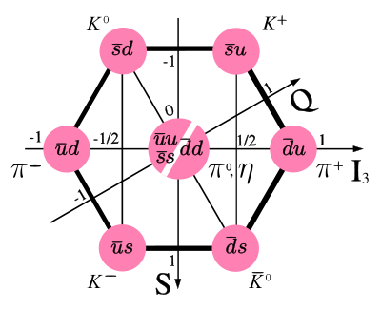
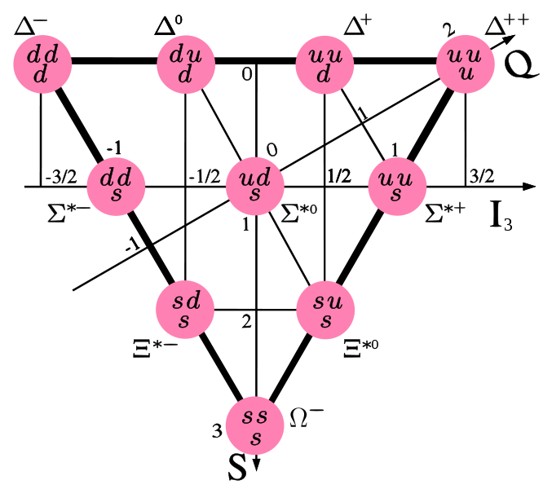
Hadrons: Mesons and Baryons
Examples: Meson nonet (octet plus singlet) and baryon decuplet.
-
Quarks: spin 1/2!
Pauli principle
-> COLOR
(O.W. Greenberg et al.)
-
I₃: Strong isospin
(3rd component),
S: Strangeness
Notes:
πι0: Ωενν μαν ιν ειν Πιον ηινεινσχηαυεν κ⎞νντε, ω™ρε εσ μιτ Ωαηρσχηεινλιχηκειτ ⏐ υ υ, υνδ μιτ Ωαηρσχηεινλιχηκειτ ⏐ δ δ.
Δελτα⁺ hat gleichen Quarkgehalt wie Proton, aber verschiedenes Energieniveau, analog H-Atom in verschiedenen Anregungszuständen.
Color: red, green, blue. Visible particles are colorless.
Teilchen in einem Multiplett haben in etwa die gleiche Masse.

Slide 12
Interactions
Interaction | Mediator | Mass | Acts on
Electromagnetic | γ Photon | 0 | Particle with electric charge
Weak | W⁺, W⁻, Z⁰ Intermediate vector bosons | 80 GeV 90 GeV | Left-handed particle or right-handed antiparticle with flavor
Strong | g₁, …, g₈ Gluons | 0 | Particle with color
Neutrinos have only weak interactions, charged leptons experience weak and electromagnetic interactions, quarks have strong, weak and electromagnetic interactions.
In the classical Standard Model, neutrinos are massless.
Fermions come in left-handed weak isospin doublets and right-handed singlets, quarks come in color triplets.
Notes:
Χαρεφυλ: ονλψ λεφτ−ηανδεδ λεπτονσ/θυαρκσ ανδ ριγητ−ηανδεδ αντιλεπτον/αντιθυαρκσ ηαϖε ωεακ ιντεραχτιονσ !

Slide 13
Left-handed doublets, right-handed singlets
Left-handed chiral fermion doublets and right-handed singlets:
If neutrinos are massless, as in the classical Standard Model, we would only have R = l_{R}.
T₃ … 3rd component of weak isospin
Similarly for quarks:
Only left-handed chiral particle states (or right-handed chiral antiparticle states) take part in the weak interaction.
L = R = l_{R} , (n_{l} )_{R} (l = e, m, t )
, u_{R}, d_{R} , c_{R}, s_{R} , b_{R}, t_{R}

Slide 14
Weak Isospin
Leptons and quarks have another quantum number: weak isospin.
Weak isospin connects quark and lepton doublets of left-handed particles, in each generation. Left-handed fermions (fermions with negative chirality) have T = ½ and can be grouped into doublets with T₃ = ± ½ that behave the same under the weak interaction.
T₃(u_{L}) = T₃(c_{L}) = T₃(t_{L}) = ½, T₃(d_{L}) = T₃(s_{L}) = T₃(b_{L}) = -½
T₃(e⁻_{L}) = T₃(μ⁻_{L}) = T₃(τ⁻_{L}) = -½, T₃(ν_{eL}) = T₃(ν_{μL}) = T₃(ν_{τL}) = ½
In analogy to the Gell-Mann-Nishijima formula (Q = I₃ + Y/2; Y = B+S):
Y_{W} … weak hypercharge
Y_{W} = 2 (Q-T₃)
Notes:
Ισοσπιν: Ιντροδυχεδ βψ Ηεισενβεργ, ναμε γιϖε βψ Ωιγνερ

Slide 15
Helicity
Helicity (h) corresponds to the sign of the projection of spin onto the direction of motion. It is, however, not Lorentz invariant. This can be seen if the inertial system in the right-handed case moves at a speed faster than : h changes from +1 to -1.
For a massless particle there is no inertial system that can move faster than the speed of light, therefore for such particles h is Lorentz invariant. For massless particles, helicity is also the same as chirality.
v
v
s
s
v ||
s
: h = +1 (“right-handed”) h = - 1 (“left-handed”)
Notes:
Ισοσπιν: ναμε γοεσ βαχκ το Ηεισενβεργ

Slide 16
Spinors, Dirac Equation
Dirac equation for a free fermion with mass m: (iγ^{μ}∂_{μ} – m) ψ (x) = 0
ψ (x) ... 4-component Dirac spinor, x = (t,x,y,z)
4 fundamental solutions:
u₁, u₂ describe a particle, v₁, v₂ an antiparticle.
The spin of u₁, v₁ is in +z-direction, the spin of u₂, v₂ in -z-direction.
Notes:
Διραχ εθυατιον δεσχριβεσ φρεε σπιν ⏐ παρτιχλεσ: Μοριι Σ. 252
Λοηρμανν Σ. 72
Πλανε ωαϖε σολυτιονσ

Slide 17
Chirality
The eigenstates of the chirality operator γ⁵ are defined as left-handed
(u_{L}, v_{L}) and right-handed (u_{R}, v_{R}) chiral states:
Projection operators project out the chiral eigenstates:
P_{R} projects out right-handed particle states and left-handed antiparticle states.
We can write any spinor in the form of its chiral components:
Notes:
Χηιραλιτψ: ηττπ://πιβετα.ωεβ.πσι.χη/δοχσ/πυβλιχατιονσ/κετεϖι_δισσ/νοδε6.ητμλ
Λοηρμανν: Σ.71 υνδ Σ.184.
Γριφφιτησ: Σ. 331

Slide 18
Dirac and Pauli Matrices
Dirac (γ ) matrices (4 x 4)
Pauli matrices (2 x 2)
Notes:
Λαστ παγε οφ Γριφφιτησ
Χοϖαριαντ ανδ χοντραϖαριαντ 4−ϖεχτορσ: ξ _{μυ} (συβσχριπτ) = γ _{μυ νυ} ξ ^{μυ}...... γ _{μυ νυ} μετριχ τενσορ

Slide 19
Group Structure of the Standard Model
In a gauge theory there is a group of transformations of the field variables (gauge transformations) that leaves the physics of the quantum field unchanged. This condition is called gauge invariance.
The Standard Model is a gauge theory. It is based on the symmetry group:
The gauge symmetry is broken by the vacuum. The electroweak group is broken down to the electromagnetic subgroup through Spontaneous Symmetry Breaking (SSB) to:
SSB generates the masses of the weak gauge bosons, and gives rise to a scalar particle, the Higgs particle. The fermion masses are also generated through SSB.
Notes:
Also the fermion mixings are generated through SSB.

Slide 20
Group Theory
Let us consider the transformation U of a wave function y:
y¢=Uy
If U is a continuous transformation, U has the form:
U=e^{i☹} ☹ … operator
If ☹ is a hermitian operator (☹= ☹⁺= ☹^{*T}), U is a unitary transformation:
U=e^{i☹} U⁺=(e^{i☹})^{*T}= e^{-i☹*T} = e^{-i☹    }Þ   UU⁺= e^{i☹} e^{-i☹} =1
Remark: U is not a hermitian operator since U¹U⁺
☹ is called a generator of U.
The following four properties define a group:
1) Closure: If A and B are elements of the group, AºB is also an element.
2) Identity: For all group elements A: IºA=A.
3) Inverse: For each group element there is an inverse element such that AºA⁻¹=I.
4) Associativity: If A,B,C are group elements, Aº(BºC)=(AºB)ºC are also elements.
The group is abelian if the commutativity relation holds: AºB= BºA
The group is special if the determinant is det U = 1.
Remarks: Transformation with only one parameter ☹ yields the unitary abelian group U(1).
The group SU(2) is an example of a non-abelian group.
Notes:
Griffiths S. 106

Slide 21
Symmetries
Interactions among fundamental particles are described by symmetry principles. Every symmetry of nature yields a conservation law, every conservation law reveals an underlying symmetry (Noether’s theorem). Examples:
All fundamental interactions are invariant under local gauge transformations.
Dynamics among fundamental particles are described by a “Lagrange density” or “Lagrangian”, which depends on the field and its derivative.
Lagrangian of a free fermion with mass m:
Symmetry | Conservation law
Translation in time | Energy
Translation in space | Momentum
Rotation | Angular momentum
Gauge transformation | Charge
Notes:
Griffiths S. 105. Morii S. 37, Pich S. 2
Lagrangian in classical mechanics: L = T - V

Slide 22
Global and Local Gauge Transformations
Transformation:
U: Group of all unitary matrices. Simplest case: U(1), U = e ^{iθ}, θ = real constant.
L₀ is invariant under global U(1) transformation:
If one allows the phase transformation to depend on space-time (θ =θ(x)), L₀ is no longer invariant under this local transformation, because:
This means that once a given phase convention has been adopted at a reference point, the same convention must be taken at all space points -> unnatural!
The gauge principle is the requirement that the U(1) phase invariance should hold locally.
Notes:
Griffiths S. 105. Morii S. 37, Pich S. 2
Unitär: U⁺U = 1

Slide 23
Covariant Derivative
Try to add extra piece to the Lagrangian, a new spin-1 field A_{μ} (x), transforming as:
One also defines the covariant derivative:
The covariant derivative transforms just like the field itself:
We achieve a Langrangian invariant under local gauge transformations:
Notes:
Pich S. 2
Spin-1 field: since d_{μυ} theta has a Lorentz index
e: electric charge of the bispinor field

Slide 24
Quantum Electrodynamics (QED)
The gauge principle has generated an interaction between the Dirac spinor and the gauge field A_{μ}.
To get the complete Langrangian for QED we have to add a kinetic term and in principle a mass term:
electromagnetic field strength (tensor)
This term violates gauge invariance, therefore the photon mass must be 0!
Maxwell equations
J^{ν} … fermion electromagnetic current
Notes:
Morii S. 37, Pich S. 2

Slide 25
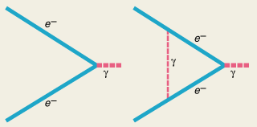
Lepton Anomalous Magnetic Moments
The most stringent experimental tests of QED come from the high-precision measurements of the electron (and muon) magnetic moments:
“Anomaly” of the magnetic moment:
a_{e} arises entirely from virtual electrons and photons. These contributions are fully known to O(α⁴); α = e²/4π ≈ 1/137 is the QED coupling constant (fine structure constant).
a_{e} = ( 1 159 652 180.85 ± 0.76 ) . 10⁻¹²
a_{e} provides also the most accurate determination of α:
α⁻¹ = 137.035 999 719 ± 0.000 000 096
… Bohr’s Magneton
9 . 10⁻²⁴ JT⁻¹
Notes:
Lohrmann: S. 100

Slide 26
Quantum Chromodynamics
Besides the electric charge quarks also have a color charge. Gluons also have color charges, which are however not pure but mixed. The theory of the strong interaction is called quantum chromodynamics.
q
q
Color | Anticolor
RED | CYAN
BLUE | YELLOW
GREEN | MAGENTA
u
q
q
d
q
Baryons
Mesons

Slide 27
Introduction of Color
In order to satisfy Fermi-Dirac statistics, Quarks have 3 color degrees of freedom: N_{C} = 3 “(red, blue, green)”.
q(r) = q(b) = q(g) =
Example D⁺⁺ = | u u u  J^{P} = 3/2⁺
Angular momentum J
Parity P: symmetry under spatial (mirror) transformations
The wave function of the D⁺⁺ is totally symmetric without color:
_{qqq} =  _{space}  _{spin}  _{flavor}
Restore asymmetry by introducing _{color}, which is totally antisymmetric:
_{qqq} =  _{space}  _{spin}  _{flavor}  _{color}
Notes:
Griffiths S. 280

Slide 28
Color and Confinement
For baryons and mesons (quarks q_{α}, α = 1,2,3 for red, green, blue) the color term can be expressed as:
ε^{αβγ} (Levi-Civita symbol) is +1 for even permutations of α,β,γ (1,2,3; 2,3,1; 3,1,2), -1 for odd permutations (1,3,2; 3,2,1; 2,1,3) , and 0 for α=β or β=γ or γ=α.
δ^{αβ} (Kronecker delta) is 1 for α=β, and 0 for α≠β.
Summation over equal indices is implied.
Baryons and mesons appear only in color-singlet combinations.
We observe no free particles with non-zero color.
Free quarks can therefore not be observed, they are confined inside the hadrons, just like the gluons.
Notes:
Pich S. 4

Slide 29
Gluons
b
g
Gluons can have mixed colors:
The red quark turns into a blue quark, emitting a red-antiblue gluon.
Are there 9 gluons? :
In terms of color SU(3)_{C} symmetry, these 9 states constitute a color
octet (|1> … |8>) and a singlet (|9>):
-
rb
-
r
“ r  b + rb ”
Confinement requires that all naturally occurring particles are color singlets (color invariant), therefore the octet never appears as free particles. However, |9> is a singlet! Could it be the photon or another particle giving rise to a long-range force with strong coupling?
NO! Our world would be different…
Notes:
Griffiths S. 280
Gluons 3 and 8 are colorless, but they are not singlets. Analogous to spin, we can have Sz = 0, but this does not mean that S = 0.
If 9 were the photon, there would be a beautiful unification of the electromagnetic and the strong interactions.
Explain probability interpretation for r antib + ….

Slide 30
Experimental Proof of Color
Measurement of the ratio of the total cross sections for e⁺e annihilation into hadrons and muons:
f … quark flavors u, d, s, c, b, t
N_{C} … number of color charges
Since the 3 color states have identical electric charges, the cross section for the production of quark pairs of a certain flavor type should be proportional to the number of color charges.
Taking into account higher orders (e.g. 3-jet events) yields:
Q² … momentum transfer
s (e⁺e   hadrons)
R = _____________________________
s (e⁺e   m⁺ m)
Notes:
Martin S.171

Slide 31
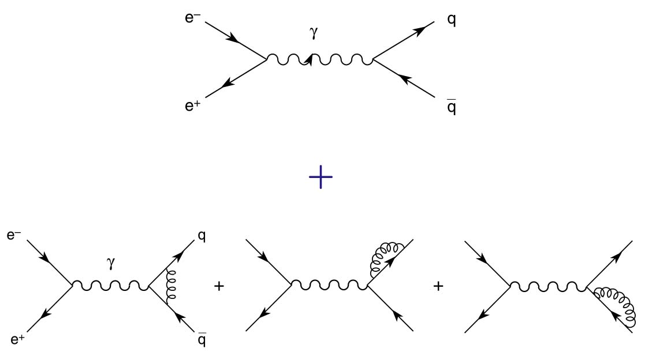
-
-
-
-
-
s (e⁺e   hadrons) = s (e⁺e   qq + qqg + qqgg + qqqq + … )
-
qq
s (e⁺e   Hadronen)
R = _____________________________
s (e⁺e   m⁺ m)
-
R is almost constant, as e⁺e   qq dominates.
qq-
-
qqg

Slide 32
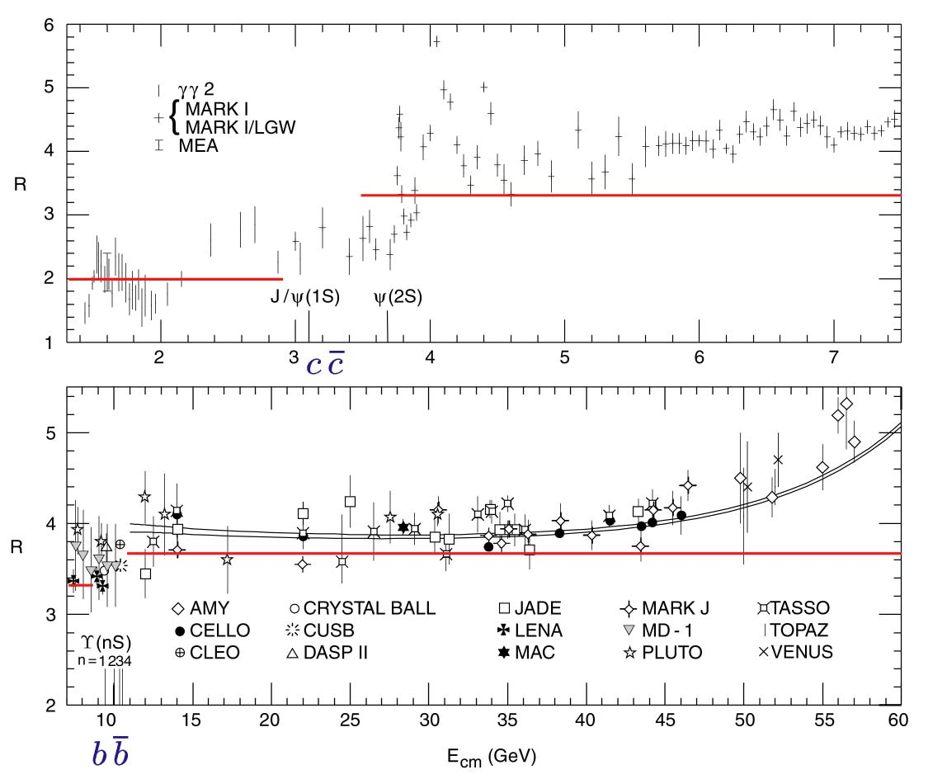
u, d, s: R₀ =  (q_{u}² + q_{d}² + q_{s}²) = 2
u, d, s, c: R₀ =  (q_{u}² + q_{d}² + q_{s}² + q_{c}²) = 10/3 = 3.3
u, d, s, c, b: R₀ =  (q_{u}² + q_{d}² + q_{s}² + q_{c}² + q_{b}²) = 11/3 = 3.7
u, d, s, c, b, t: R₀ =  (q_{u}² + q_{d}² + q_{s}² + q_{c}² + q_{b}² + q_{t}²) = 5

Slide 33
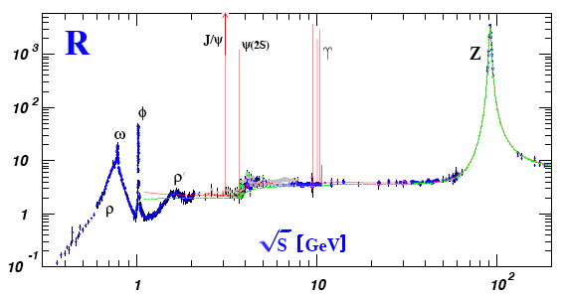
World Average on R
N_{C} = 3
W.-M. Yao et al., Rev. Part. Phys., J. Phys. G33 (2006) 1

Slide 34
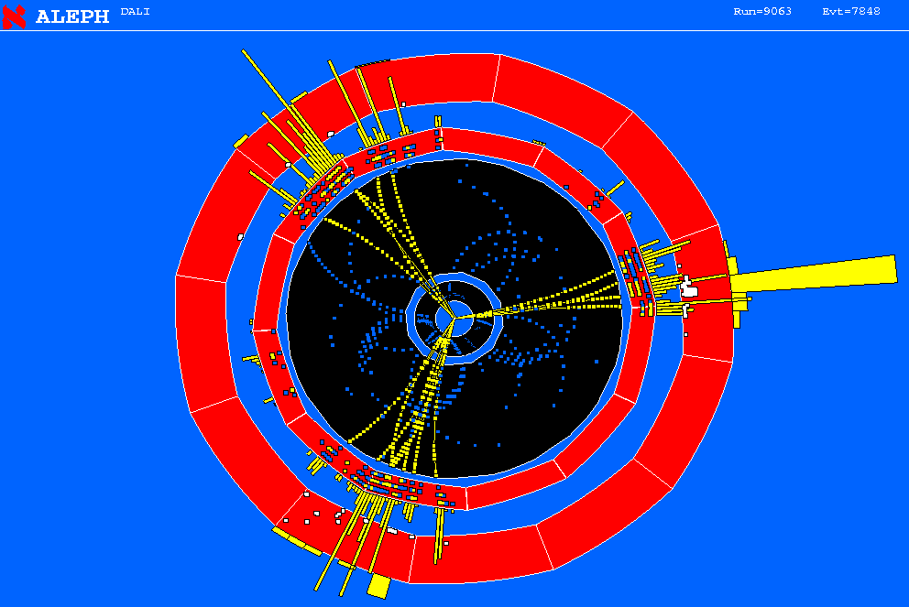
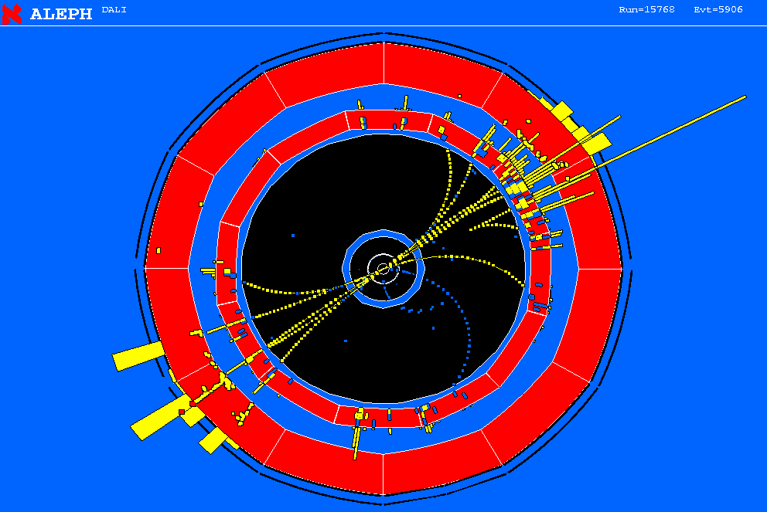
2-Jet and 3-Jet Events, α_{s}
The ratio between 3-jet and 2-jet events can be used to measure a_{s} = g_{s} /4π.
e⁺
 _{s}
q
Z
g
-
e⁻
q
e⁺
q
Z
-
e⁻
q

Slide 35
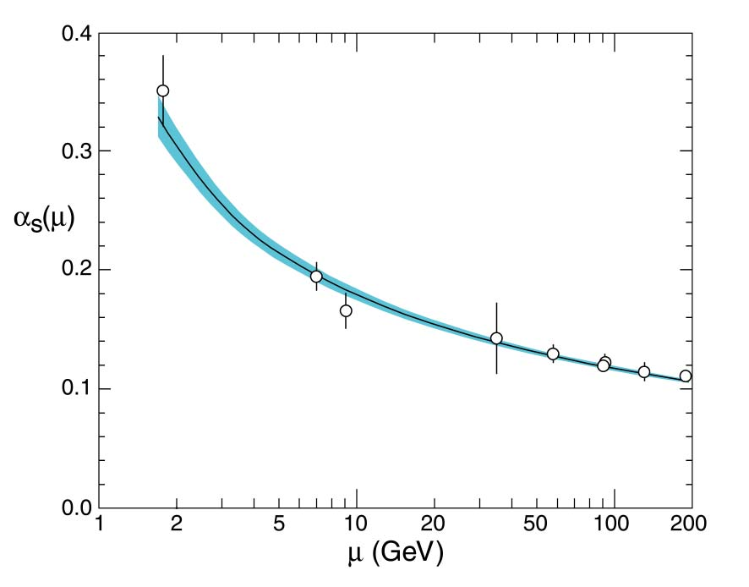
Running Coupling Constant
a _{s} (m_{Z}²) = 0.118 ± 0.002

Slide 36
QCD Non-Abelian Gauge Symmetry
Global SU(3)_{C} transformations in color space for q_{f}^{α}, a quark field of flavor f and color α :
The SU(3)_{C} matrices can be written in the form:
θ ª … arbitrary parameters
λª/2 (a = 1, …, 8) … generators of the fundamental representation of SU(3)_{C}
λª … 3-dimensional Gell-Mann matrices
Similar to QED, we require that the QCD Lagrangian be also invariant under local SU(3)_{C} transformations θ ª = θ ª (x) by using covariant derivatives:
g_{s} is the strong coupling constant.
Since there are 8 gauge parameters, we need 8 gluon fields (a=1,..,8):
f ^{abc} … structure constants
(real, antisymm.)
Notes:
Pich S. 5
Structure constants: Griffiths S. 282

Slide 37
QCD Gauge Transformations
The gauge transformation of the gluon fields is more complicated than the one obtained in QED for the photon, as the non-commutativity of the SU(3)_{C} matrices gives rise to an additional term involving the gluon fields themselves.
Introduce field strengths, to build the gauge invariant kinetic term for the gluon fields:
Notes:
Pich S. 6

Slide 38
Decomposition of the QCD Lagrangian
We can decompose L_{QCD} into its different pieces:
(a)
(b)
(c)
(a) Kinetic terms for the gluon and quark fields
(b) Color interaction between quarks and gluons
(c) Cubic and quartic gluon self-interactions
Notes:
Pich S. 5

Slide 39
Electroweak Interaction
Low-energy information was sufficient to determine the structure of modern electroweak theory. The W and Z were introduced, and their masses correctly estimated before their experimental discovery.
f
f … fermion
(quarks, leptons -
including neutrinos)
Neutral currents:
Z
f
Charged currents:
n_{l}
q_{j}
(+ 2/3)
l … e, m, t
q … quark
n … neutrino
W±
W⁻
l
±
q_{i}
(- 1/3)

Slide 40
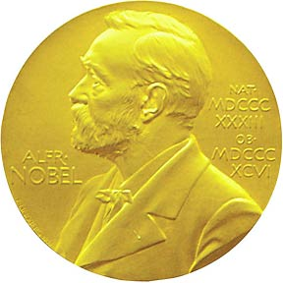
Charged Currents
Only left-handed fermions and right-handed antifermions couple to the W. Therefore, parity P and charge conjugation C (particle <-> antiparticle) are maximally violated. CP is still conserved.
The W couple to the fermion doublets, where the electric charges of the two fermion partners differ by one unit. The decay channels of the W⁻ are then:
All fermion doublets couple to the W with the same universal strength.
The doublet partners of the u, c and t appear to be mixtures of the three charge -1/3 quarks, related through the unitary Cabibbo-Kobayashi-Maskawa matrix:
The weak eigenstates are different from the mass eigenstates. V characterizes flavor mixing, e.g. V_{ud} specifies coupling of u to d (d   u +W⁻).
M. Kobayashi
T. Maskawa
2008
Notes:
W -> b’ anti top is kinematically forbidden, due to the high mass of the top quark.
V matrix elements are only measured in experiments. The matrix elements are not independent. There is small mixing of the 3rd generation with the others.

Slide 41
SU(2)_{L} x U(1)_{Y}
Gauge invariance was crucial for determining the right QED and QCD Lagrangians. For weak interactions it is more complicated, since we have several fermionic flavors and different properties for left- and right-handed fields. Moreover, the left-handed fields should appear in doublets, and the gauge bosons W and Z should be massive, since the weak interaction is of short range. If we want to include also electromagnetic interactions, we need an additional U(1) group. The obvious group to accommodate all this is:
L refers to left-handed fields, Y_{(W)} is the weak hypercharge (naïve identification with electromagnetism does not work). For left-handed leptons Y_{W} = -1, and for right-handed leptons Y_{W} = -2.

Slide 42
Leptonic Sector of SU(2)_{L} x U(1)_{Y}
SU(2)_{L} doublet:
Singlet:
Transformation under SU(2)_{L} : (a = 1,2,3)
and under U(1)_{Y}:
Global transformations under in flavor space:

Slide 43
Leptonic Sector of SU(2)_{L} x U(1)_{Y}
We require the Lagrangian to be invariant under local gauge transformations [α_{i} = α_{i} (x), β = β (x)] and introduce covariant derivatives as in QED. Since there are 4 gauge parameters, 4 different gauge bosons are needed:
Explicitly for L and R lepton states:
We have the correct number of gauge bosons, since we need the photon and 3 intermediate vector bosons W±, Z.
Notes:
Pich S. 9-10

Slide 44
Lagrangian of SU(2)_{L} x U(1)_{Y}
The complete electroweak Lagrangian is actually quite complicated, impossible to derive in the timeframe of this lecture.
Kinetic term for the gauge fields, which also includes self-interactions of the gauge bosons:
Field strengths:
Note: No mass term allowed, since it would violate gauge symmetry by mixing left- and right-handed fields.
Example for fermionic mass term:
Absence of mass is fine for the photon, but we need heavy vector bosons in order to get short-range weak interactions!
L_{G} pure gauge-field, L_{F} fermion-gauge field, L_{S} scalar,
L_{Y} fermion-scalar (Yukawa), L_{fix} gauge fixing, L_{gh} ghosts
Notes:
Pich A.17

Slide 45
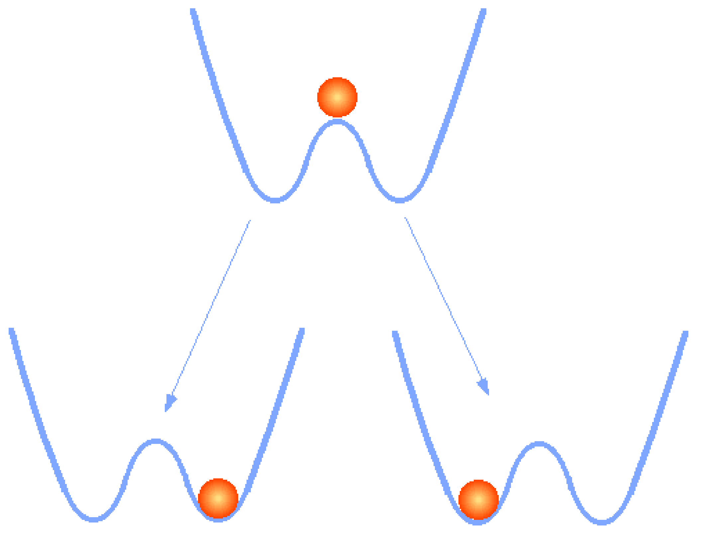
Spontaneous Symmetry Breaking
In order to generate masses, we need to break the gauge symmetry. How is this possible with a symmetric Lagrangian (which is also needed to preserve renormalizability of a theory)?
-> By choosing a Lagrangian that is invariant under a group of transformations, and that has a degenerate set of states with minimal energy.
The particle has to choose a state with minimal energy -> symmetry is broken (actually hidden).
Y. Nambu 2008

Slide 46
Goldstone Theorem
Consider a complex scalar field φ(x), with a Lagrangian invariant under global phase transformations of φ(x) and with potential V:
In order to have a ground state, the potential should be bounded from below, i.e. h > 0. For the quadratic term there are 2 possibilities:
μ² > 0: The potential has only the trivial minimum φ(x) = 0. It describes a massive scalar particle with mass μ and quartic coupling h.
μ² < 0: The minimum is obtained for those field configurations with:

Slide 47
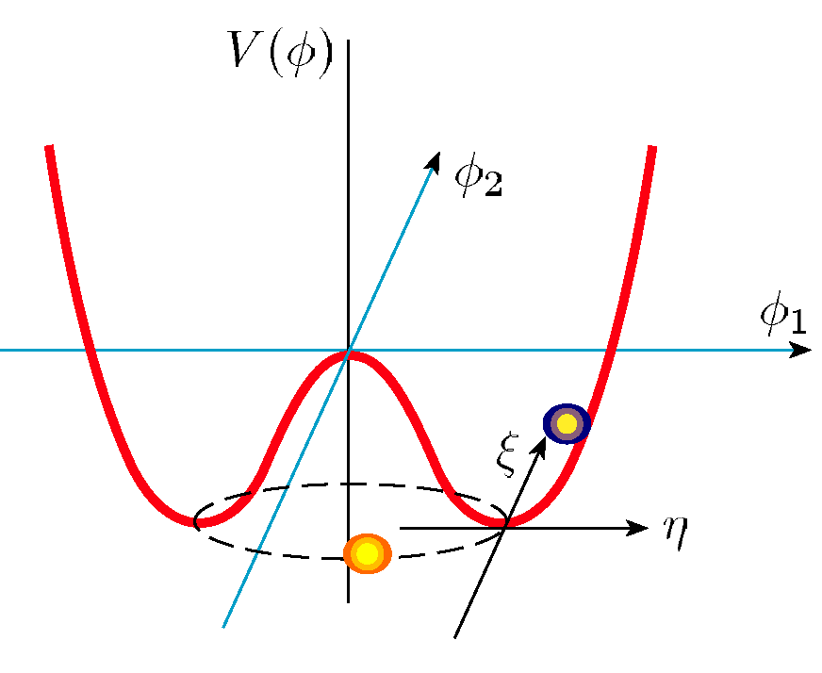
Goldstone Theorem
Due to the U(1) phase invariance of the Lagrangian, there is an infinite number of degenerate states of minimum energy:
If we choose a particular solution as the ground state, e.g. θ = 0, the symmetry gets spontaneously broken. We can parameterize the excitations over the ground state as:
η describes a massive state of mass -2μ²,
ξ a massless state.
Goldstone theorem: SSB of a continuous global
symmetry is always accompanied by one or more
massless scalar (spin 0) particles (Goldstone bosons).
Notes:
Pich S. 15
Massless state xi: easy to understand, since the field xi describes excitations around a flat direction in the potential, which costs no energy, and therefore correspond to a massless state.

Slide 48
The Higgs Sector
Obviously, the Goldstone theorem did not solve our problem of massive gauge bosons. However, what happens if we have a local gauge symmetry?
We try to introduce a new doublet of complex, scalar fields with weak hypercharge Y_{Φ} = 1 to accomplish the breaking of electroweak symmetry, leaving the electromagnetic gauge subgroup U(1)_{em} unbroken:
It is coupled to the gauge fields through the scalar Lagrangian, which is invariant under local transformations:
The potential V(Φ) is constructed in such a way that Φ has a non-vanishing vacuum expectation value:
Notes:
Pich S. 16
Hypercharge must be 1, because of the requirement for the correct couplings between Phi(x) and Amu(x),i.e. photon does not couple to Phi0, and Phi+ has the right electric charge.

Slide 49
Higgs-Kibble Mechanism
Φ(x) can be written in the form:
The components φ⁺(x), H, χ have vacuum expectation values 0. The local SU(2)_{L} invariance of the Lagrangian allows to rotate away (“unitary gauge”) any dependence on φ⁺ and χ. This means that these are unphysical, they correspond to 3 “ghosts” or Goldstone bosons (remember, φ⁺ is complex, with 2 real parameters).
In this particular gauge, the Higgs field has the simple form:
The real field H(x) describes physical, neutral particles with mass
Vacuum expectation value: = 246 GeV.
.
Notes:
Hollik. S. 9.

Slide 50
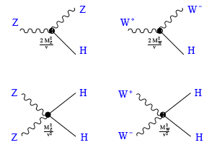
The Higgs Boson
The scalar Lagrangian has introduced a new scalar particle, the Higgs boson H. In terms of the physical fields, in the unitary gauge, L_{s} takes the form:
Higgs couplings to the gauge bosons:
Notes:
Hollik. S. 9.

Slide 51
Higgs in CMS
Higgs in CMS

Slide 52
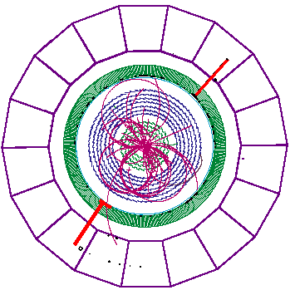
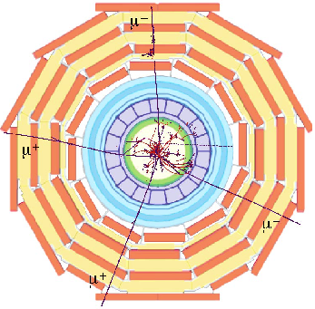
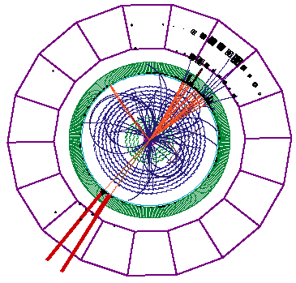
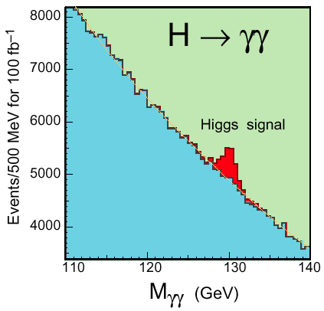
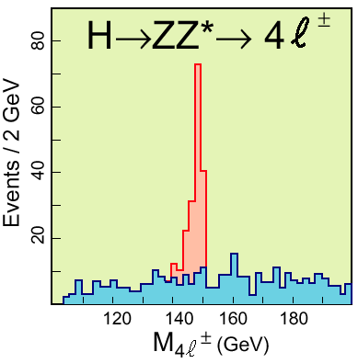
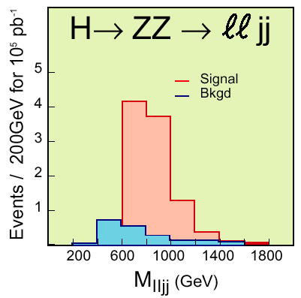
Higgs Boson at LHC (CMS Experiment)
Notes:
Hollik. S. 9.

Slide 53
Higgs Boson Mass Limits
Direct search at LEP ended 2000. Result: m_{H} > 114.4 GeV/c² @ 95% c.l.
From ‘precision electroweak fits’
(LEP, SLD, CDF, D0):
Preferred value:
m_{H} = (87 +35 - 26) GeV/c²
m_{H} < 157 GeV/c² @ 95% c.l.
Notes:
In Wmu+ Wmu sind das W+ und das W- versteckt, deshalb der Faktor ¼, im Vergleich zum 1/8 beim Z.

Slide 54
W, Z, Photon, Electroweak Unification
The covariant derivative couples the scalar doublet to the gauge bosons. In the unitary gauge the kinetic part of the scalar Lagrangian takes the form:
with the following transformation from the fields W_{μ}ª, B_{μ} to the physical W± and Z fields:
The vacuum expectation value of the neutral scalar has generated a quadratic term for the W and Z, these bosons have acquired mass:
W⁻, W⁺
Photon γ
Z⁰
θ_{W} … Weinberg angle (θ_{W} ≈ 28⁰, sinθ_{W} ≈ 0.23)
Notes:
In Wmu+ Wmu sind das W+ und das W- versteckt, deshalb der Faktor ¼, im Vergleich zum 1/8 beim Z.

Slide 55
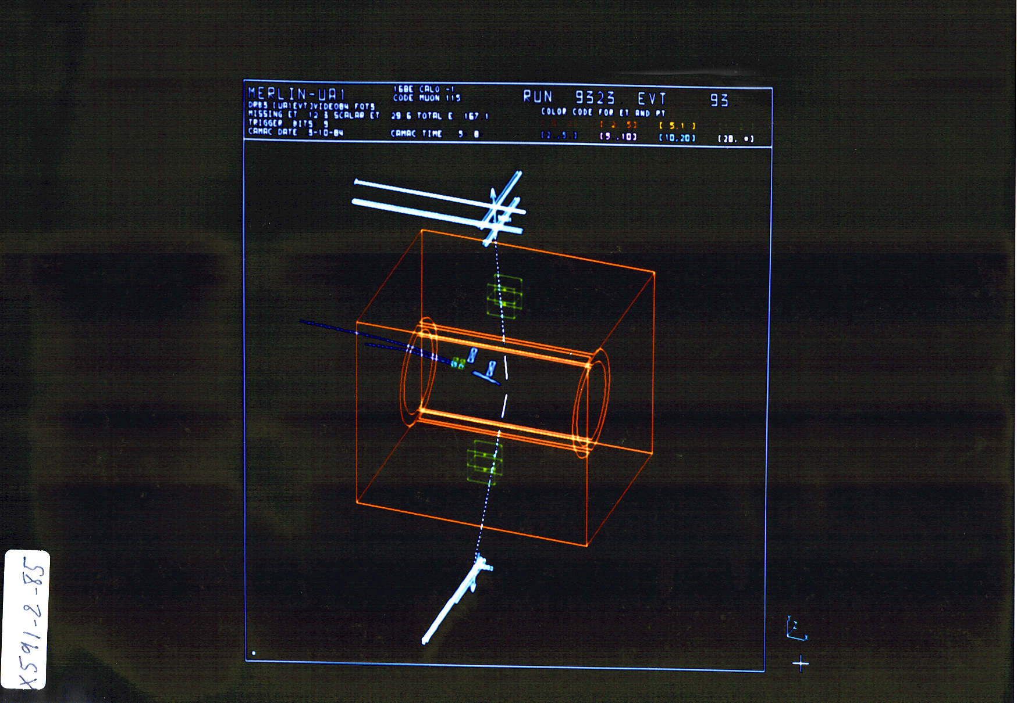
Discovery of the W and Z 1983
Experiments UA1 and UA2 at the CERN Super-Proton-Antiproton Collider.
Nobel Prize for C. Rubbia and S. van der Meer 1984.
Z  mm  
UA1

Slide 56
Z -> e⁺e⁻ in UA1

Slide 57
Fermion Masses
We need not only masses for the W and Z, but also fermion masses (at least for the charged fermions in the classical Standard Model). A fermionic mass term of the form is not allowed since it violates gauge symmetry. Since we have introduced an additional scalar doublet into the model, we can write the following gauge-invariant Yukawa Lagrangian describing fermion-scalar coupling (f = u, d, e, …):
Yukawa interactions between the massive fermions and the physical Higgs field occur with coupling constants proportional to the fermion masses.
g_{f} … Yukawa couplings
Notes:
Hollik S.10
Can leave this transparency out if no time.

Slide 58
Conclusions
The Standard Model works remarkably well, up to O(100 GeV).
Some quantities are determined at the 0.1% level!
Nevertheless:
Neutrino masses are not accommodated in the classical Standard Model.
There is the hierarchy problem (stability of the mass of the Higgs particle).
There is no unification of coupling constants at very high energies.
Gravitation is not included at all.
There is no explanation for dark matter or dark energy.
We do not know what happened just after the Big Bang.
Therefore:
Particle physicists, astrophysicists and cosmologists need to collaborate in the near future to find the proper extensions to the Standard Model. We have excellent tools, such as accelerators, space probes, ground-based telescopes, underground laboratories. and event nuclear reactors. Precision experiments at ultra-low energies can also contribute.

Slide 59
Literature
A. Pich: The Standard Model of Electroweak Interactions,
http://arxiv.org/abs/0705.4264
W. Hollik: Electroweak Theory,
http://dx.doi.org/10.1088/1742-6596/53/1/002
T. Morii, C.S. Lim, S.N. Mukherjee: The Physics of the Standard Model and Beyond, World Scientific Publishing Co. (2004)
W. Majerotto (ed. S. Kraml, can be obtained from the website of H. Eberl):
Skriptum “Einführung in die Modelle der Elementarteilchenphysik (WS / SS)”
http://wwwhephy.oeaw.ac.at/helmut/skriptWS.ps
http://wwwhephy.oeaw.ac.at/helmut/skriptSS.ps
M. Treichel: Teilchenphysik und Kosmologie, Springer-Verlag (2000)
D. Griffiths: Introduction to Elementary Particles, Wiley VCH, (2008)

