Slide 1
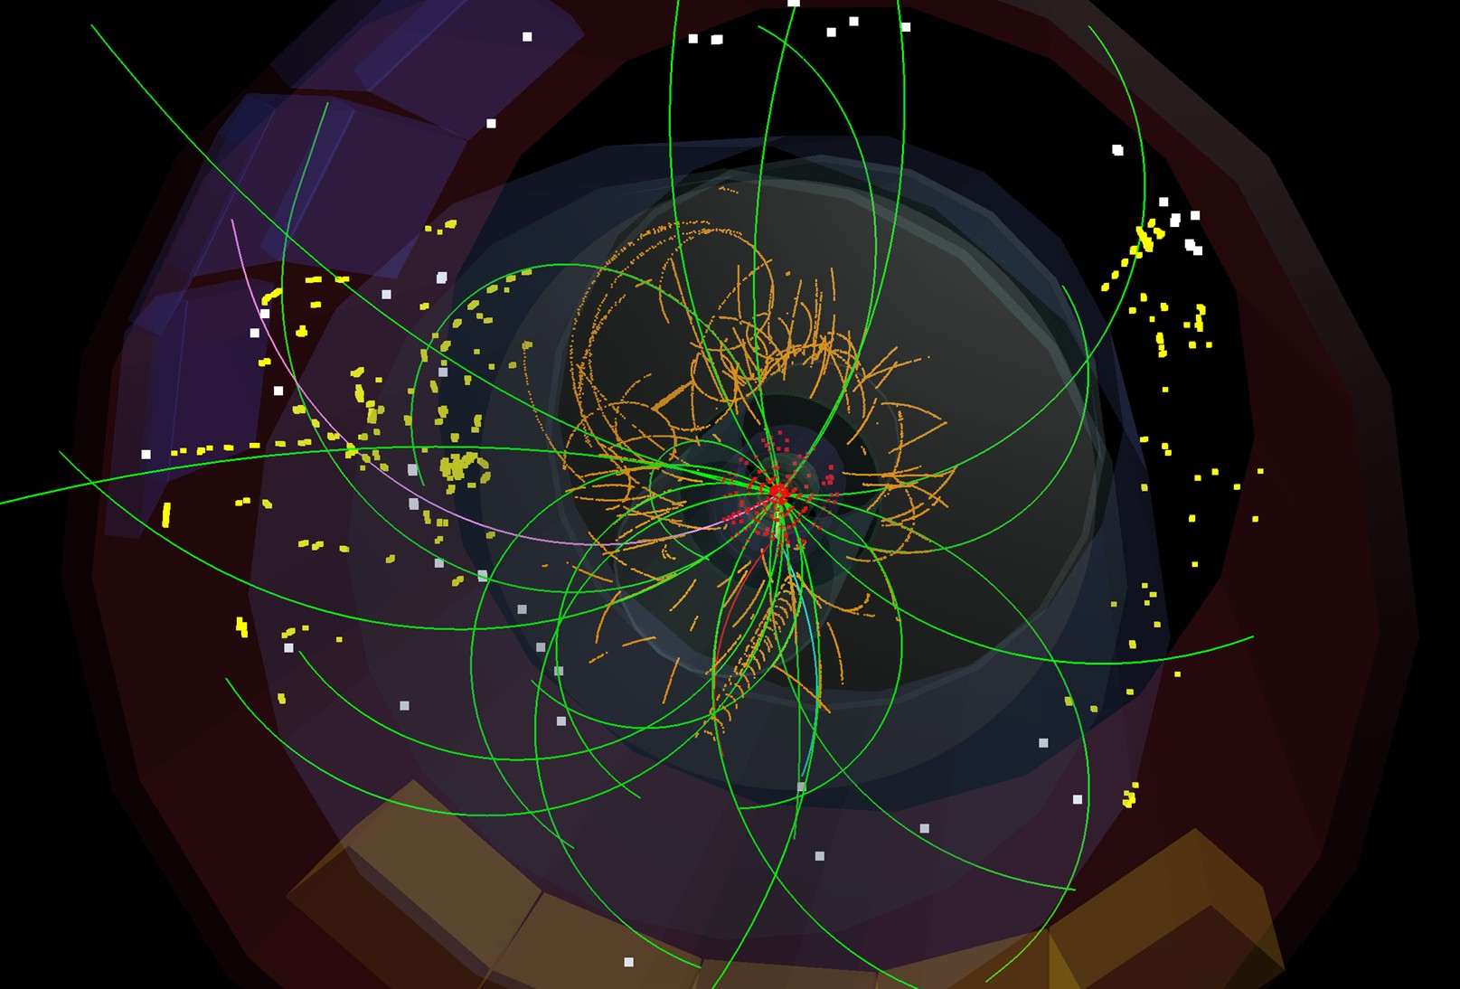


Exploring the Energy Frontier
Latest Results from the LHC
Claudia-Elisabeth Wulz
Institute of High Energy Physics, Vienna
HEPHY-SMI Seminar
20 June 2012

Slide 2
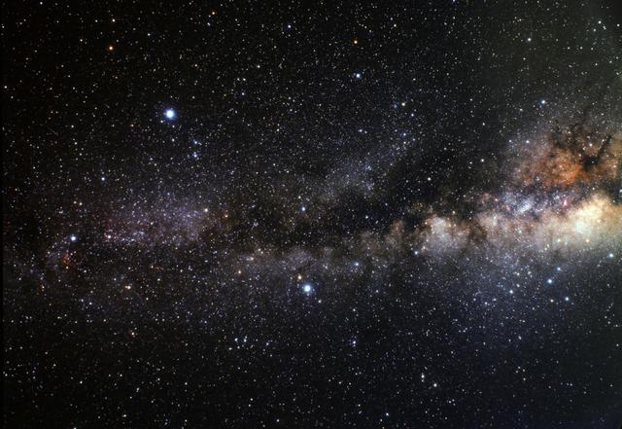
Important open questions
What is the origin of electroweak symmetry breaking?
Is it the simplest Higgs mechanism?
How must the Standard Model be extended?
Supersymmetry, Grand Unified Theories, …
What are dark matter and dark energy?
What are the last secrets of neutrinos?
Can we unify all forces?
Can we include gravity?
Are there extra dimensions?
Are quarks and leptons fundamental particles?
Are there more than three generations?
Why is there asymmetry between matter and antimatter?
Do we understand dense and hot matter?
Quark-gluon plasma
C.-E. Wulz
2
HEPHY-SMI Seminar, June 2012

Slide 3
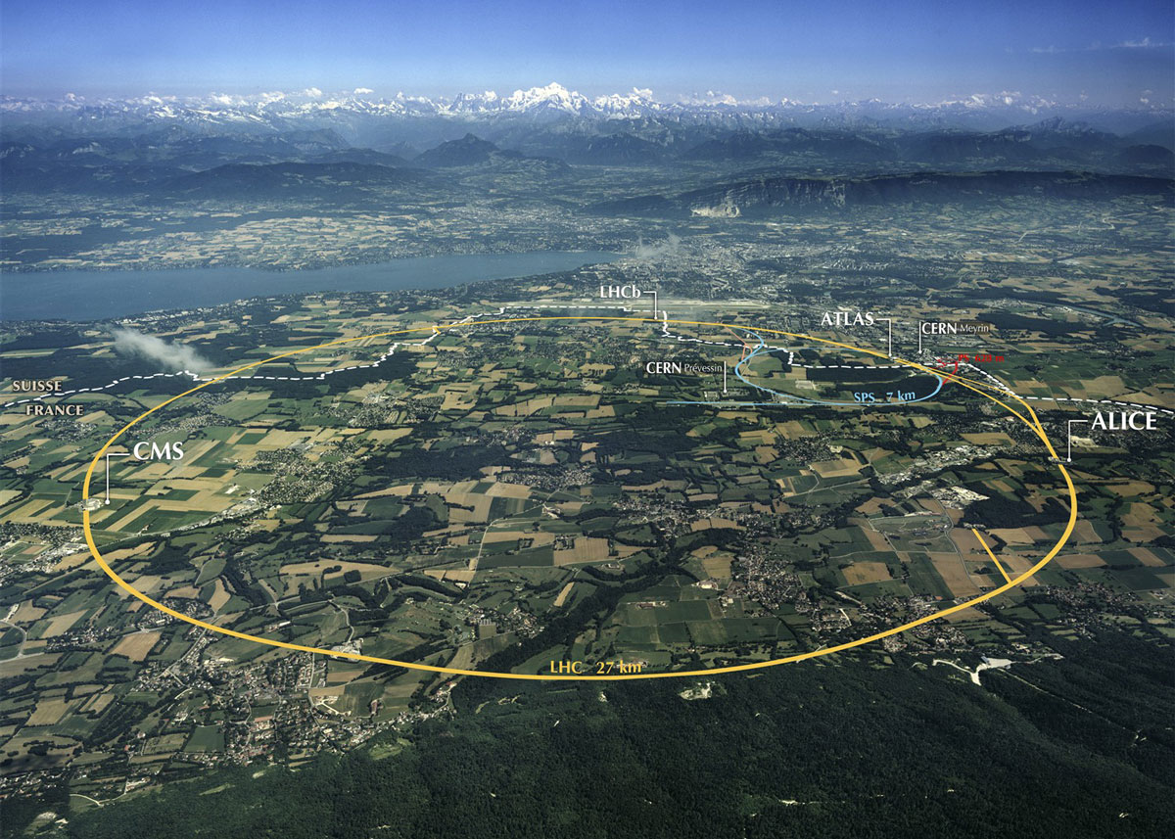

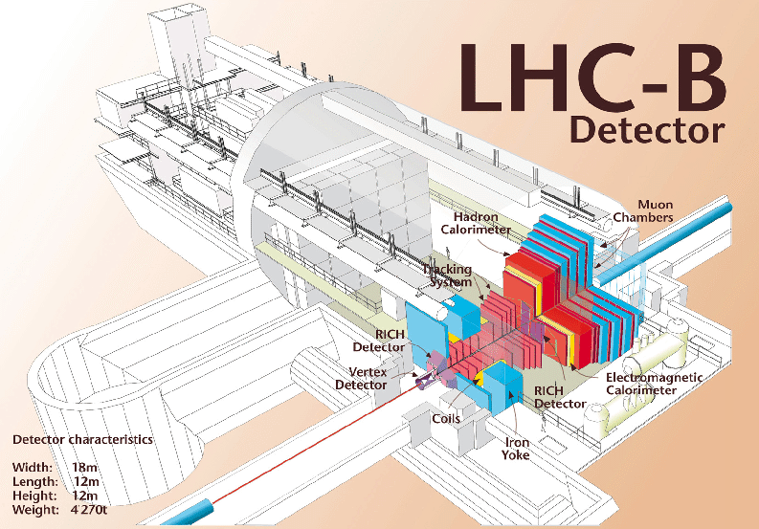
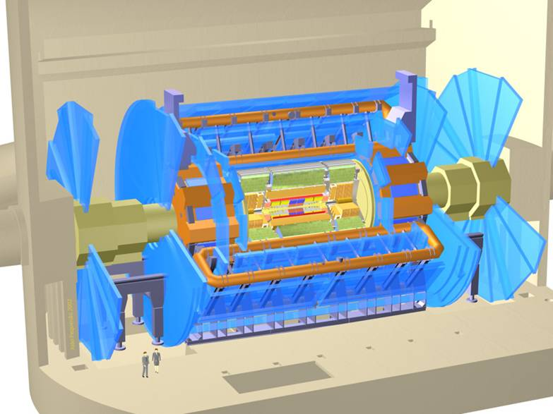

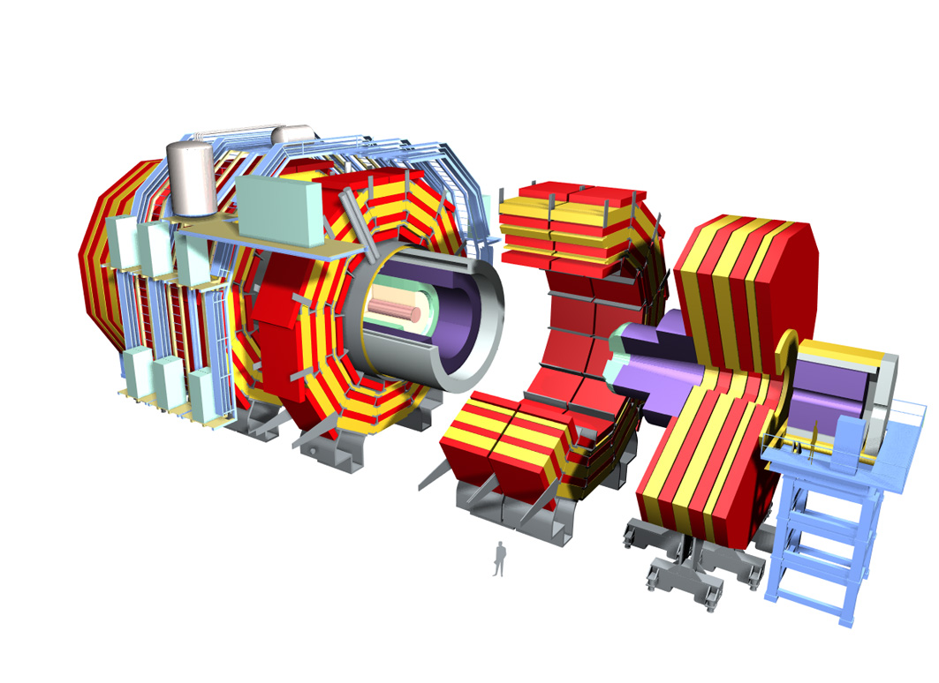
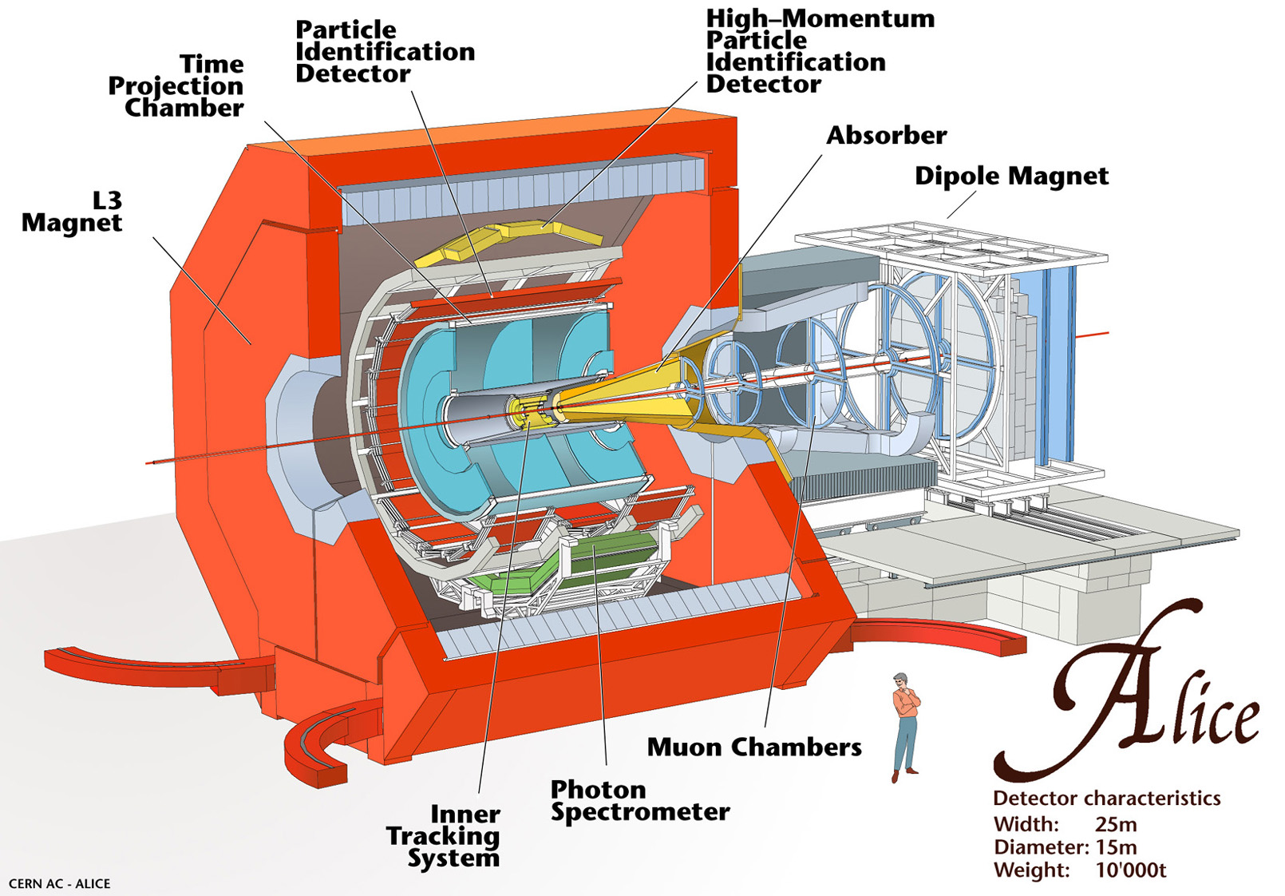
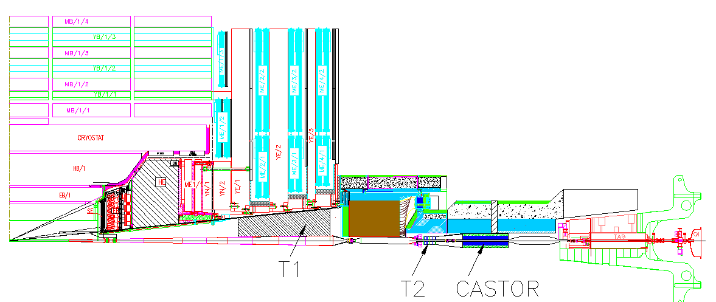


ATLAS
CMS
LHC and its experiments
TOTEM
HEPHY-SMI Seminar, June 2012
Notes:
Moedal: approved in 2010, monopole search.

Slide 4
LHC milestones
http://lpcc.web.cern.ch/LPCC/index.php?page=luminosity_charts
10 Sep. 2008: First proton beam
20 Nov. 2009: Restart after accident
23 Nov. 2009: First proton collisions at 900 GeV
30 Nov. 2009: World record energy 2.36 TeV (Tevatron ran at 1.96 TeV)
30 March 2010: New world record energy 7 TeV
8 Nov. 2010: First collisions of lead ions at 2.76 TeV per nucleon pair
6 Dec. 2010: Last day of LHC running in 2010
March 2011: Restart with protons at 7 TeV … then maybe go to 8 TeV
2012: Shutdown for magnet interconnection reinforcement … OR keep running!
2013: Restart at 13 or 14 TeV
2015 or 2016: Shutdown for luminosity upgrade
Peak luminosity
6.8 x 10³³ cm⁻²s⁻¹
(nominal: 10³⁴ cm⁻²s⁻¹)
Bunch spacing
50 ns
Number of bunches per beam
1380 (nominal 2808)
Notes:
2x10**32 is already nominal luminosity for LHCb, and double the design luminosity for 2010!
Design energy per beam 350 MJ. 1 fb-1 had been planned for 2011. CMS prefers 25 ns, but lower lumi.

Slide 5
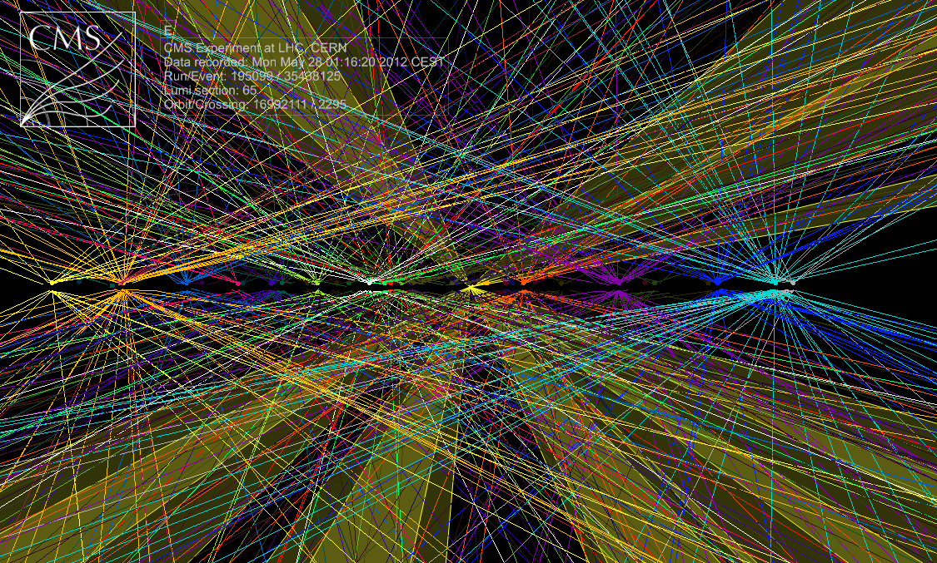
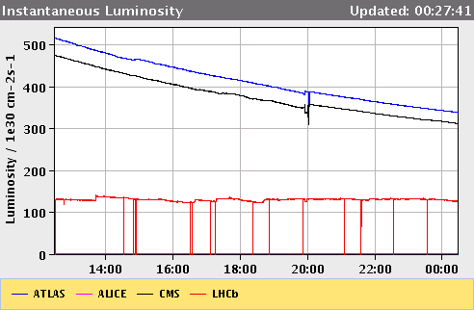
Challenge: in-time pileup
Multiple vertices, many tracks: <n>≈33 for highest luminosity in 2012
-> challenges to trigger and computing!
-> LHC explores luminosity leveling for ATLAS and CMS
Vertex resolution better than ~200 μm, vertices a few cm apart, beam spot size 16 μm at collision point. Average number of interactions at nominal LHC luminosity and 25 ns bunch spacing: 23.
HEPHY-SMI Seminar, June 2012

Slide 6


ATLAS experiment
Steel, polystyrene
Absorber: Lead in stainless steel
Notes:
TRT: Elektronidentifikation durch Xe-Gas

Slide 7
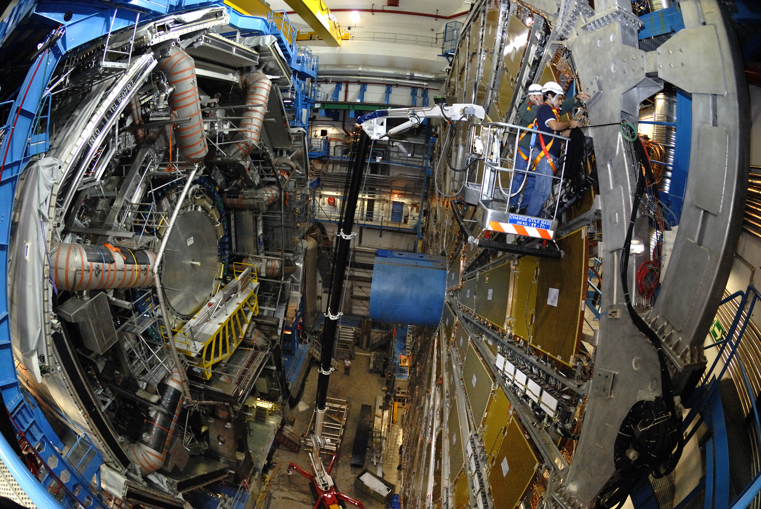
ATLAS experiment
HEPHY-SMI Seminar, June 2012

Slide 8
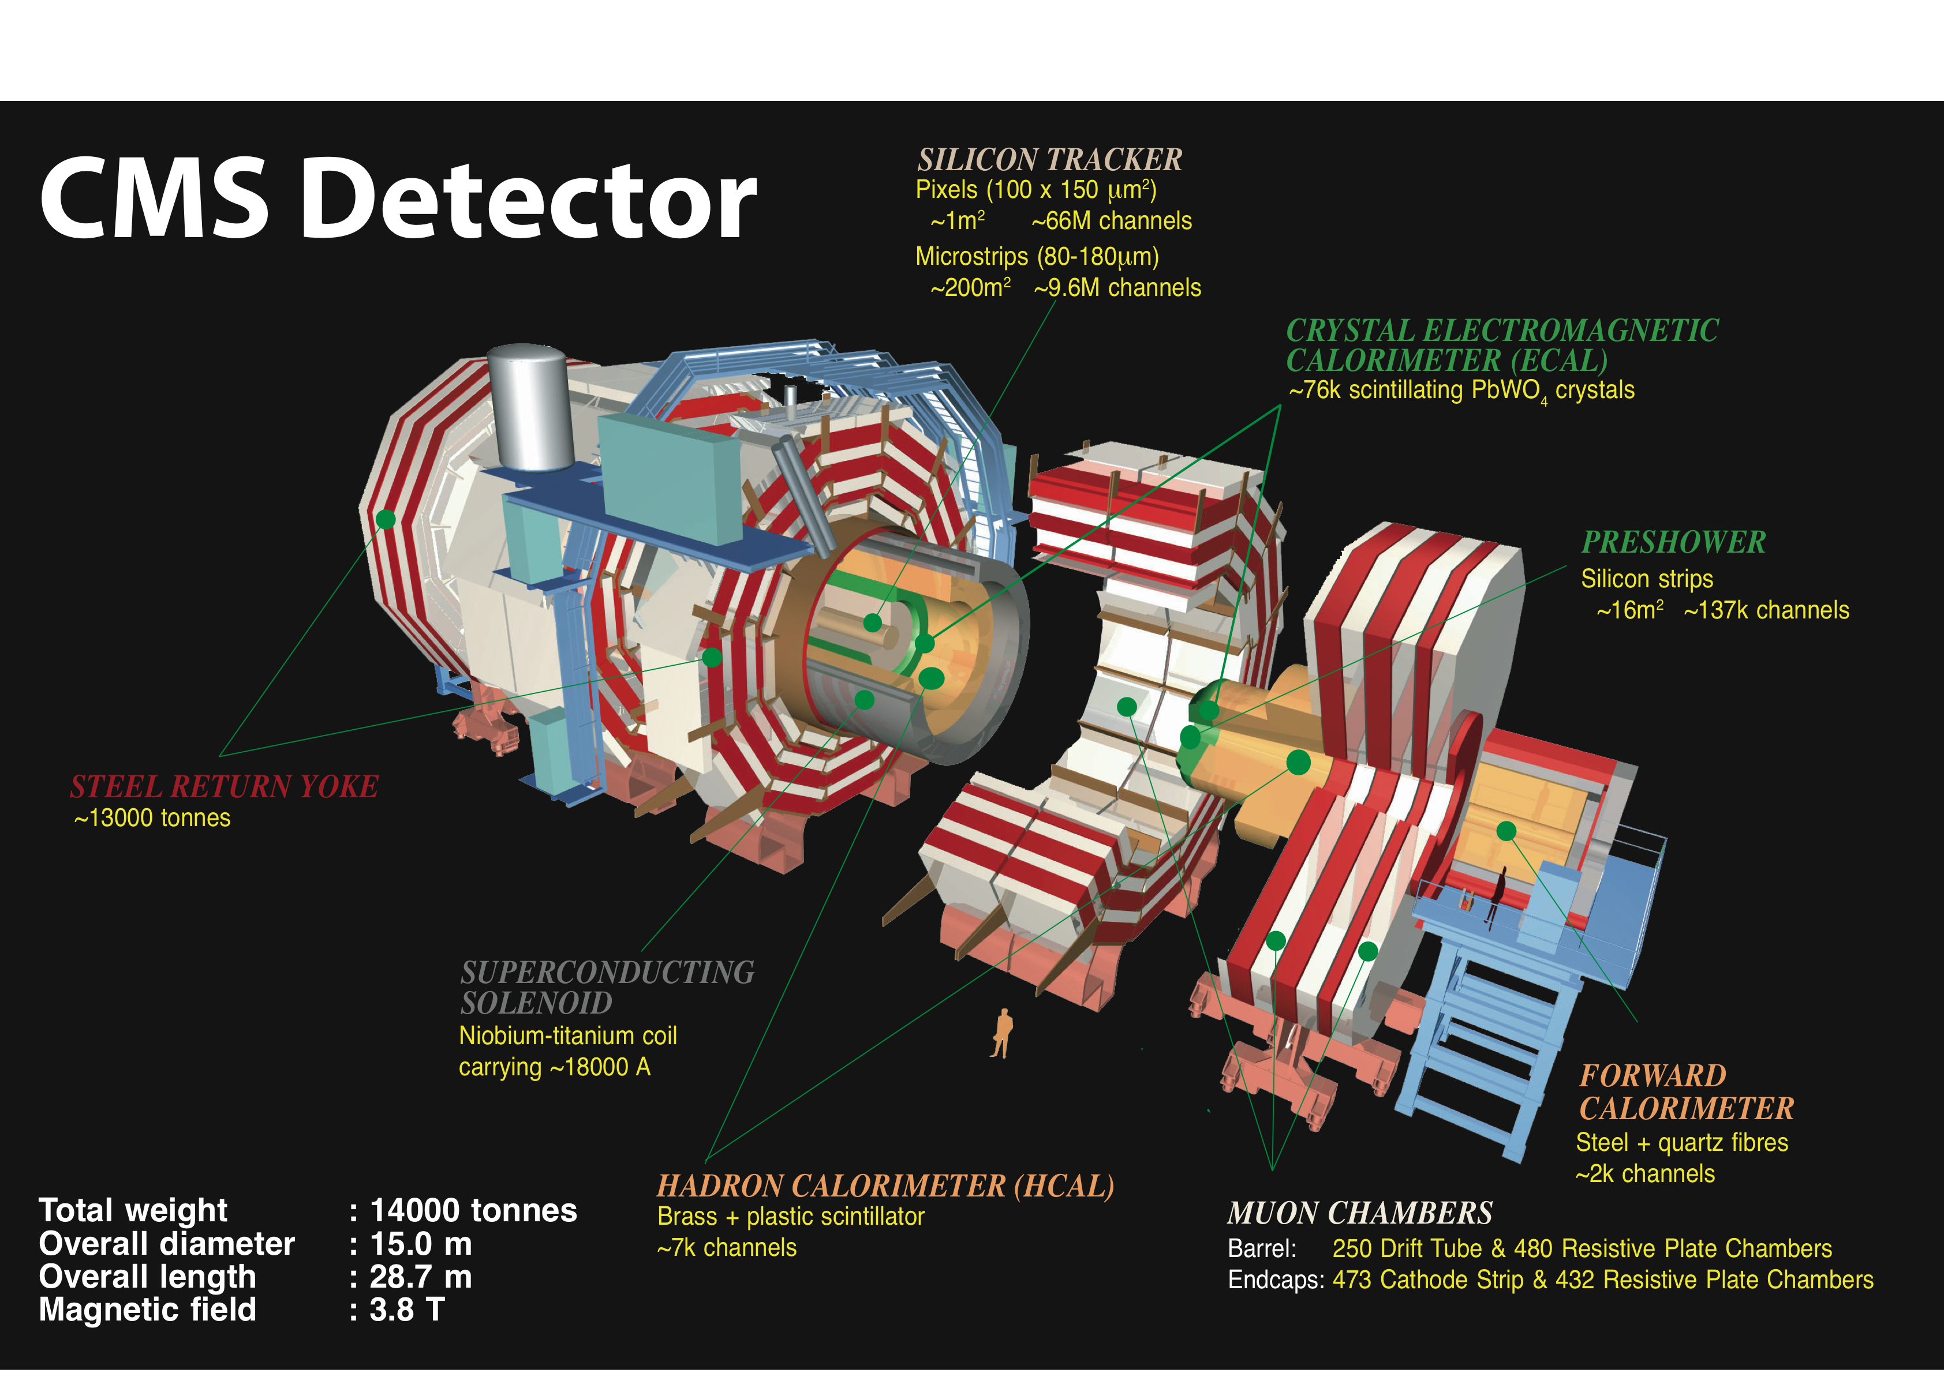

HEPHY-SMI Seminar, June 2012

Slide 9
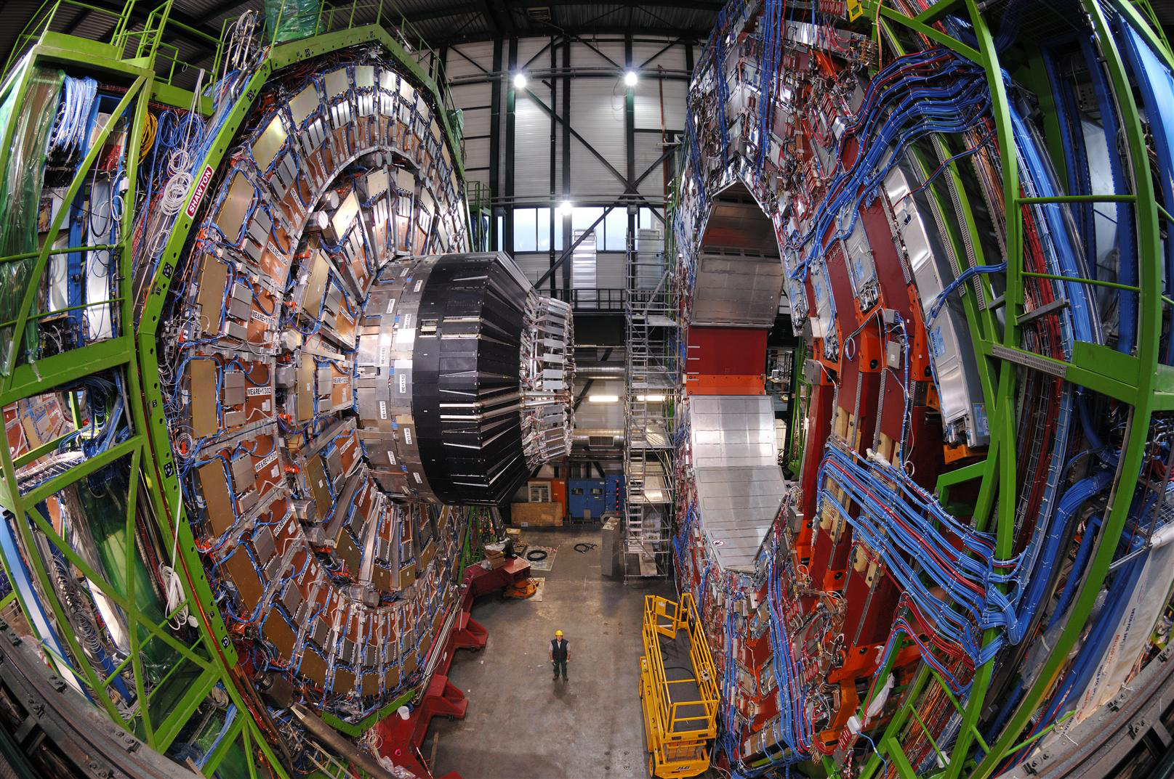
CMS experiment
HEPHY-SMI Seminar, June 2012

Slide 10
Physics outline
Cross-sections
- elastic, inelastic and total cross-sections
Standard Model physics
- particle production (soft physics, resonances, correlations)
- QCD and top physics
- electroweak physics (W, Z)
- Higgs boson search
Beyond the Standard Model physics
- fourth generation quarks
- leptoquarks, compositeness
- Supersymmetry, long-lived particles
- extra dimensions and heavy resonance states
Remarks
Only selected results are presented. Heavy-ion physics is not covered in this talk.
More details:
https://twiki.cern.ch/twiki/bin/view/AtlasPublic
https://twiki.cern.ch/twiki/bin/view/CMSPublic/PhysicsResults

Slide 11
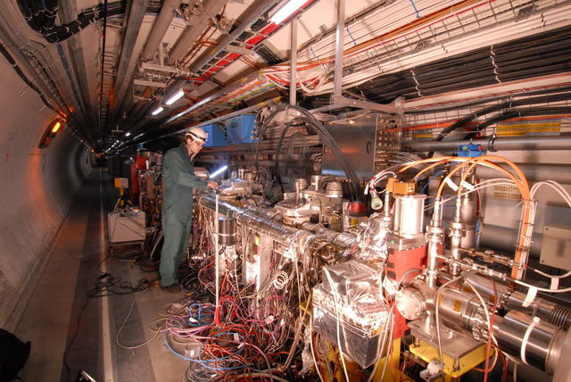
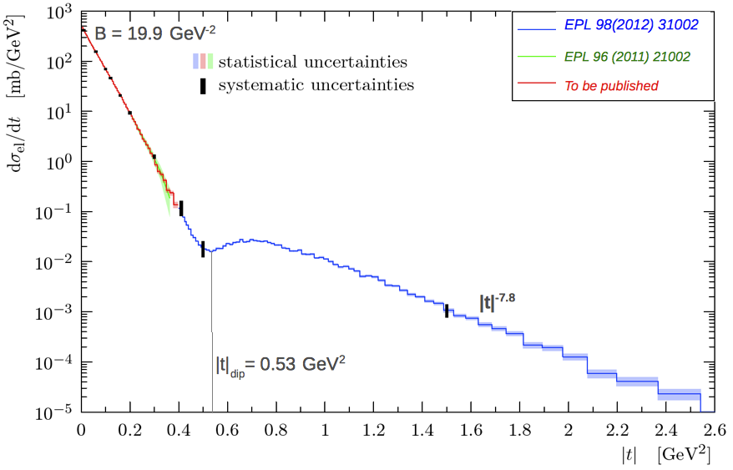


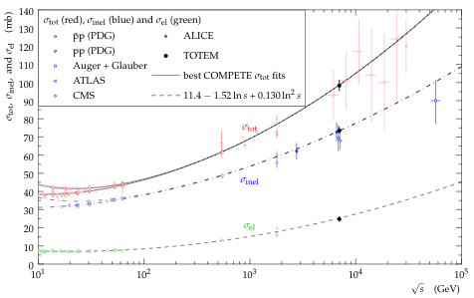
Cross-sections
Elastic cross-section
measured by TOTEM (detectors up to ±220m from CMS centre)
as function of 4-momentum transfer squared |t|
Inelastic and total cross-sections
measured by particle and astrophysics experiments
Notes:
Increasing t means looking deeper into the proton. Exponential is valid below t = 0.47 GeV².
Total cross section: At high energy protons behave as if they become larger. Points above 7 TeV come from cosmic ray experiments.

Slide 12
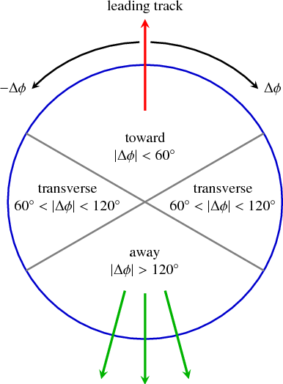
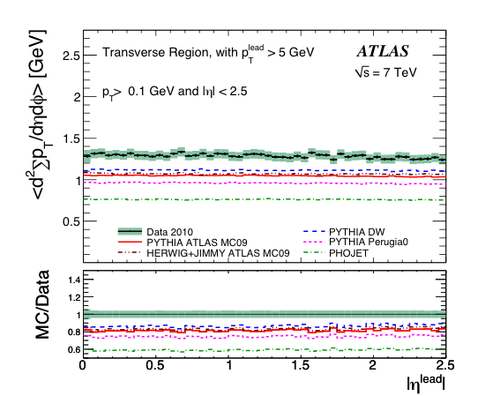
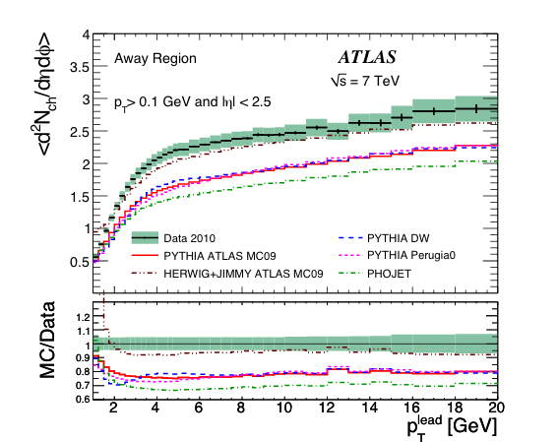
Underlying event characteristics
Study charged particle multiplicity, p_{T} density, <p_{T}> in the transverse regions, which are most sensitive to the underlying event -> tune Monte Carlo models.
Data show higher underlying event activity than Monte Carlo data!
Scalar Σp_{T} density
Charged particle density
hep-ex 1012.0791, PRD 83 (2011) 112001

Slide 13
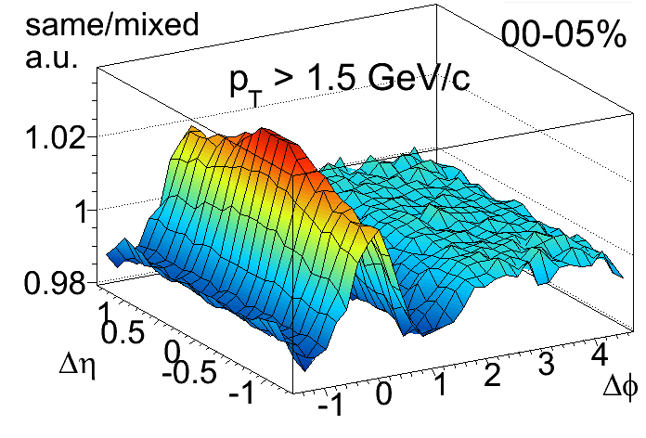
Near-side long-range correlations
hep-ex 1009.4122, JHEP 09 (2010) 091
ALICE 2.76 TeV/nn
Central Pb-Pb collisions
First surprise in LHC data!
CMS pp 7 TeV
T_{AA} *
Pronounced structure (ridge) in high-multiplicity events for
2.0 < |Δη|< 4.8 and Δφ ≈ 0
C.-E. Wulz

Slide 14
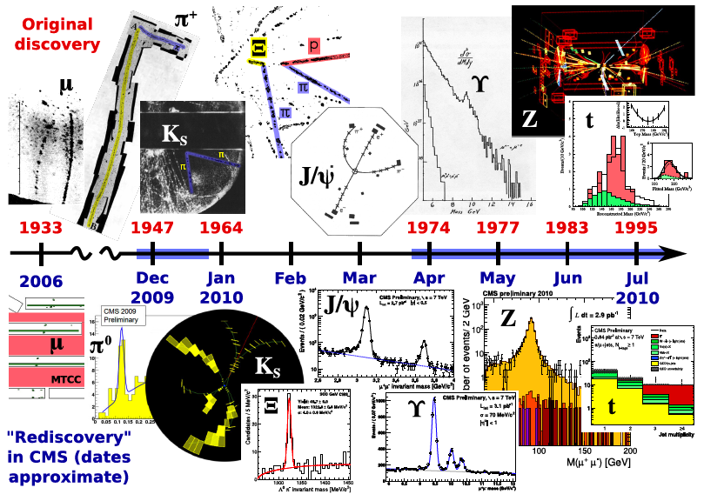
Rediscovery of the Standard Model
J. Pivarski

Slide 15
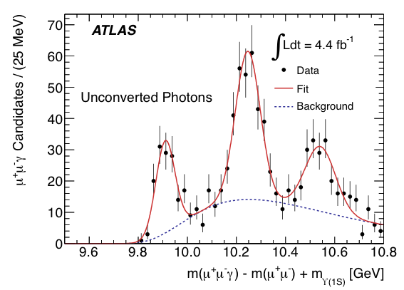
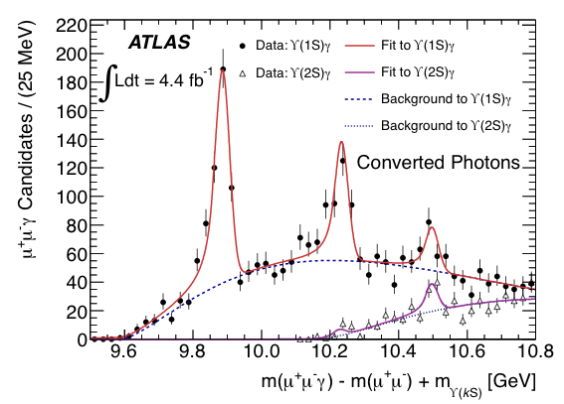

^{χ}_{b}(3P)
_
Bound state of bb, a QCD analogue of the hydrogen atom.
Transitions are observed through the emission of a photon.
Mass slightly larger than predicted: 10.539 ± 0.004 (stat.) ± 0.008 (syst.) GeV
hep-ex 1112.5154, PRL 108 (2012) 152001
Notes:
Unconverted in ECAL, converted photons: measured in tracker. Only the Chi_{b}(3P) peak appears distinctly in the lower spectrum because it is the only Chi_{b} state with decays involving enough energy to be detected in this study. Predicted mass: 10.52 GeV.

Slide 16
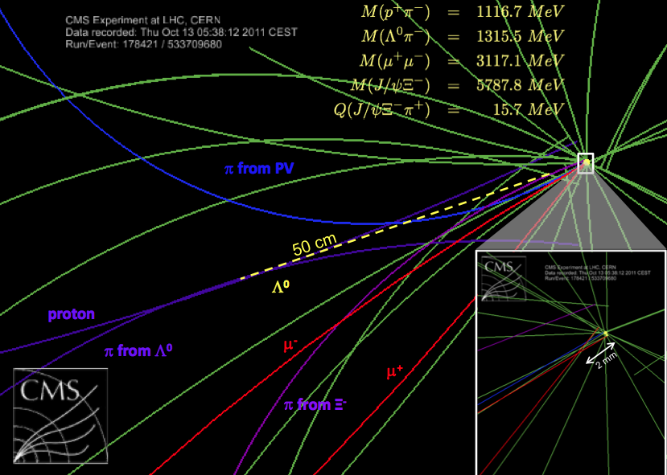
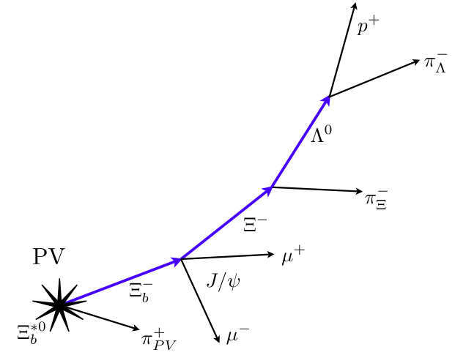
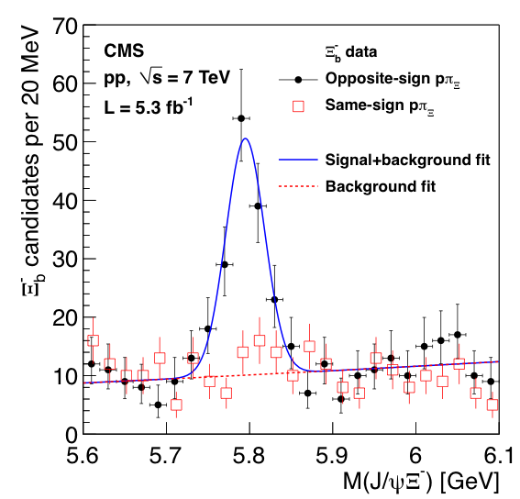
Ξ_{b}*⁰
Excited b baryon
hep-ex 1204.5955
submitted to PRL
HEPHY-SMI Seminar, June 2012
Notes:
excited b baryon via its strong decay into Xi(b)^- pi^+ (plus charge conjugates)

Slide 17


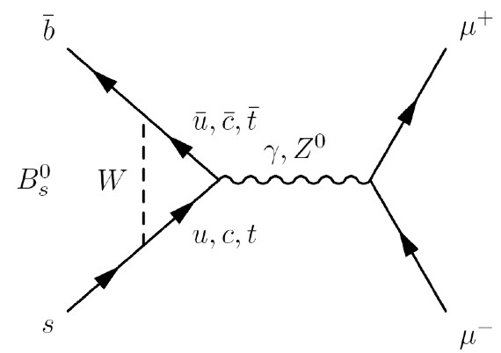
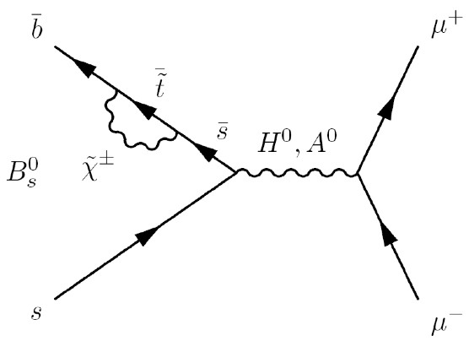
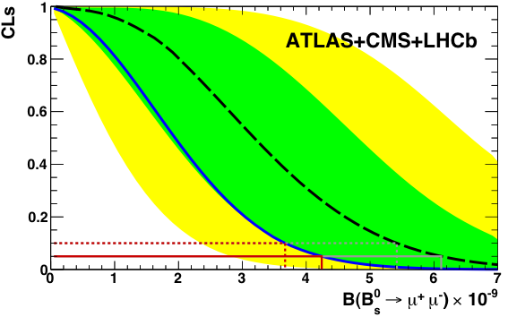



ATLAS/CMS/LHCb combination for BR(B_{s} -> μμ)
Standard Model value:
SM FCNC
MSSM
hep-ex 1107.2304,
PRL 107 (2011) 191801
CDF value:
ATLAS/CMS/LHCb combined value:
_ observed CL_{S}
90% C.L.
95% C.L.
Green area contains the ±1sigma interval of possible results compatible with the expected value when only (background+SM is observed.
The excess over background is at the level of 2σ. Compatibility with the SM is within 1σ. But there is still room for new physics!
ATLAS CONF-2012-061
CMS-PAS-BPH-12-009
LHCb-CONF-2012-017
Notes:
Rare decay in the SM is only allowed via FCNC.
The green shaded area contains the ±1sigma interval of possible results compatible with the expected value when only background+SM signal is observed.
There remains, however, room for a contribution from physics beyond the SM, including destructive interference between NP and SM which could still cause Bs -> mumu to be significantly smaller than the SM prediction.

Slide 18

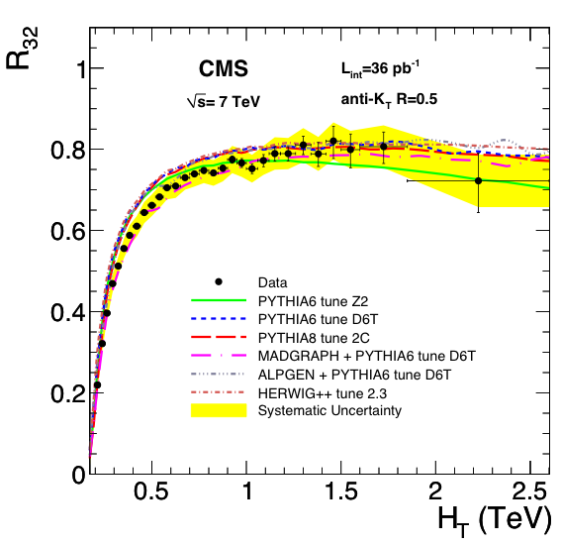
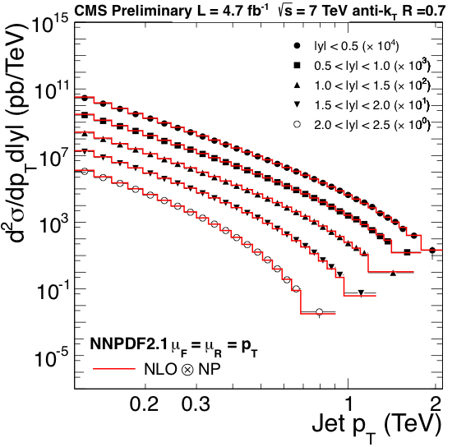
Inclusive jet cross-sections, 3-jet/2-jet ratio R₃₂
CMS-PAS-QCD-11-004
hep-ex 1106.0647, PLB 702 (2011) 336
Experimental uncertainties are comparable to theoretical ones. NP (non-pertubative): correction for multiparton interactions.
Agreement with NLO pQCD cross-section predictions (with non-perturbative corrections) is good in general.
Notes:
pT and HT regions never exploited before! Left plot: inclusive jet double-differential Xsec in different regions of rapidity. Mention multiplication factors in left plot.
The size of the experimental uncertainties is comparable to the theoretical uncertainties, and in particular at the limits of the phase space, which allows for these data to be used in the global PDF fits and constrain their uncertainties.
R32 allows test of models in HT regions never accessed before. Ratio rises with increasing HT due to the opening of the phase space for a 3rd jet, reaches plateau at 0.8. MADGRAPH, which generates tree-level helicity amplitudes, shows agreement everywhere

Slide 19
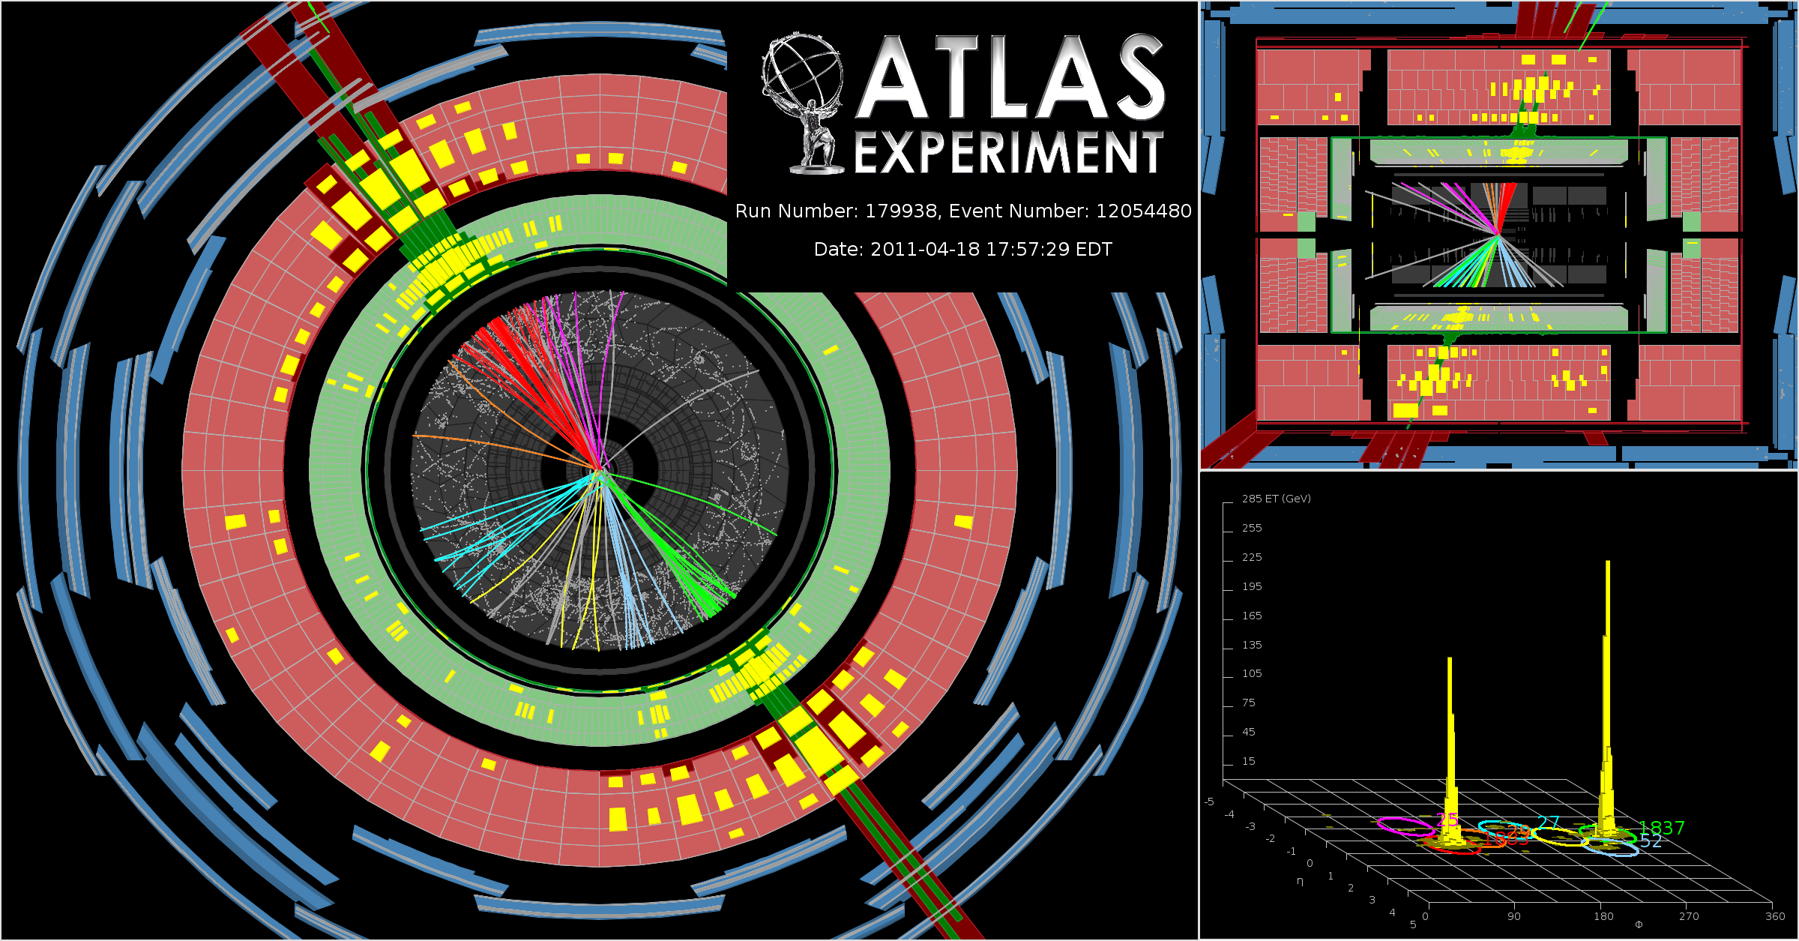
High-mass dijet events
m_{JJ} = 4 TeV
p_{T1} = 1.8 TeV
p_{T2} = 1.8 TeV
HEPHY-SMI Seminar, June 2012
XMAS2010
Notes:
Die höchsten Dijet-Massen sind viel höher als √s des Tevatron!

Slide 20
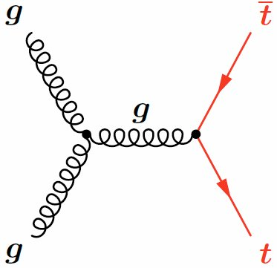
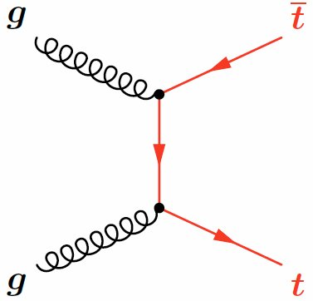
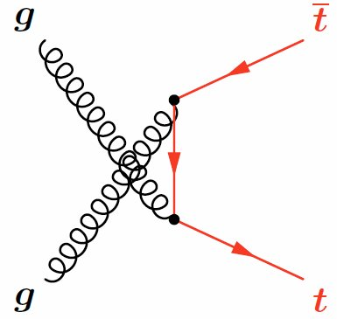
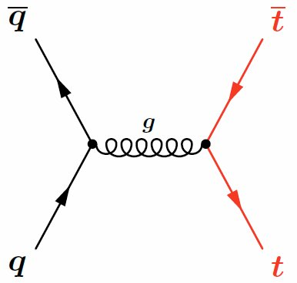

Top
“When top is measured, the experiment is ready for discovery phase”
P. Jenni, 2009
_
_
tt production at LHC stems from 87% gluon fusion, 13% qq annihilation
Interesting in itself since t decays before hadronizing
Decay products of new particles
Background to new particle searches
Top decays weakly as t -> Wb almost exclusively.
Event classes according to decay of W:
All-hadronic
lepton + jets
dilepton (e⁺e⁻, μ⁺μ⁻, e±μ )
b-jet
ν
p
b
W⁺
l⁺
t
q’
p
W⁻
q
b-jet
±

Slide 21
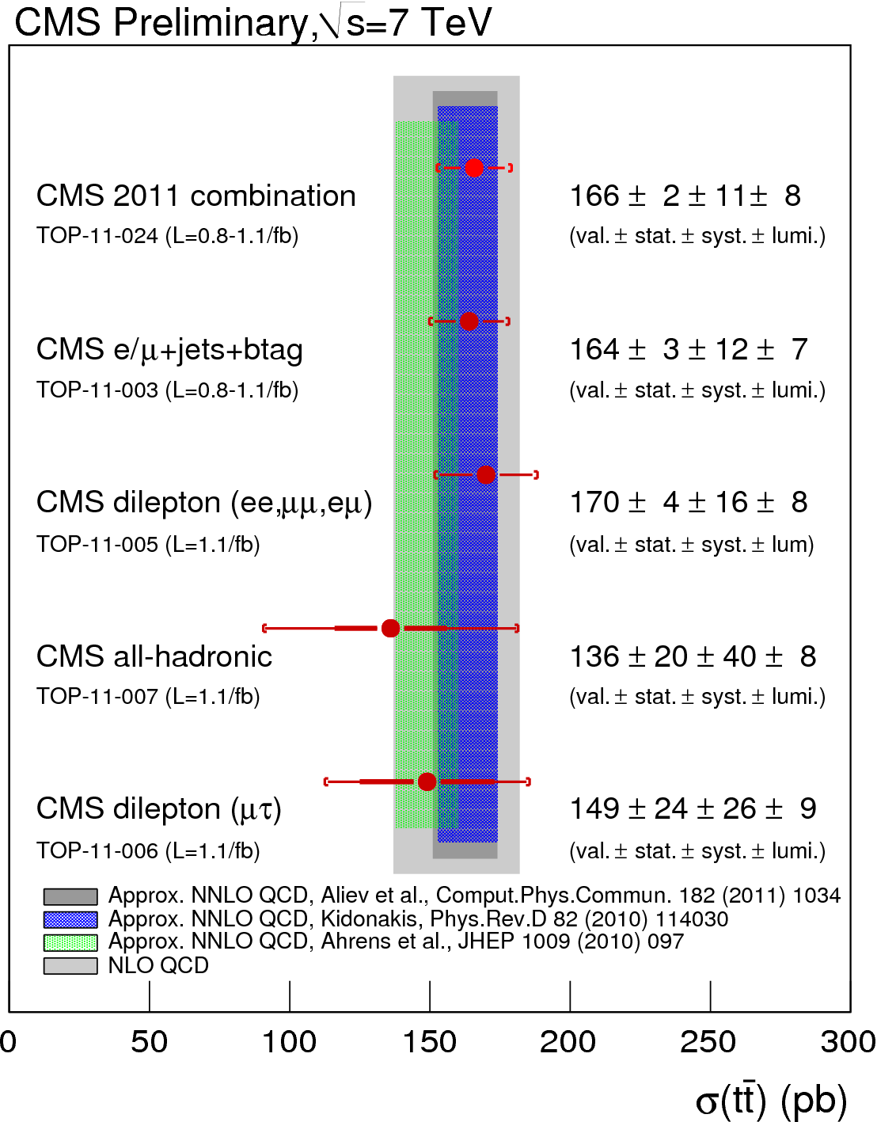
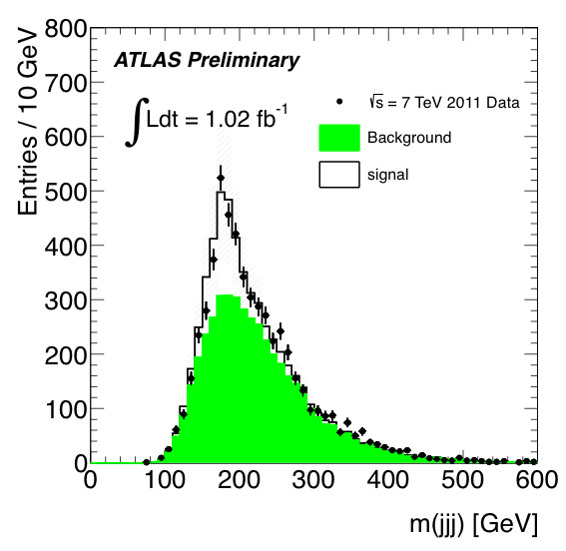
-
tt cross section
CMS PAS TOP-2011-024
ATLAS CONF-2011-140
All-hadronic channels:
Measurements of charge, charge asymmetry and spin correlations are ongoing.
Consistent with NLO SM predictions

Slide 22
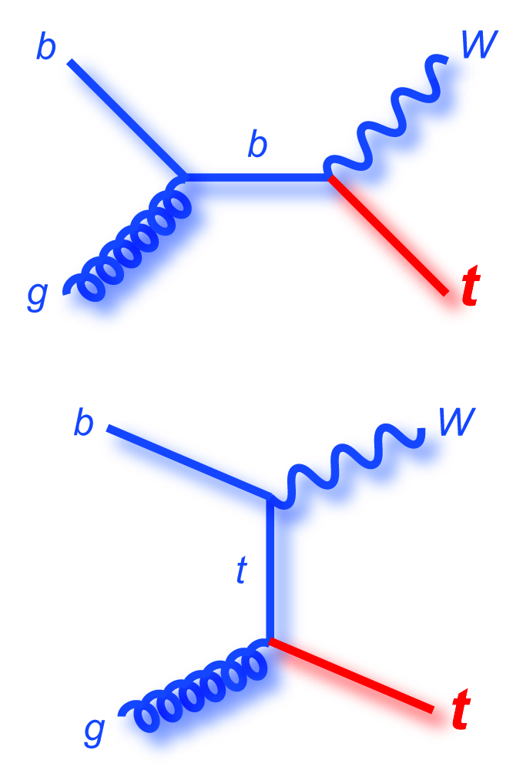
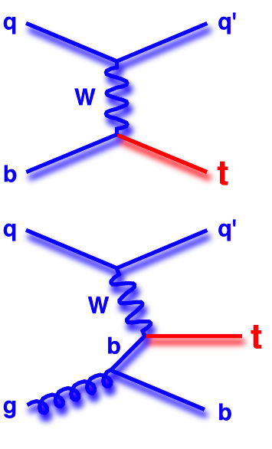
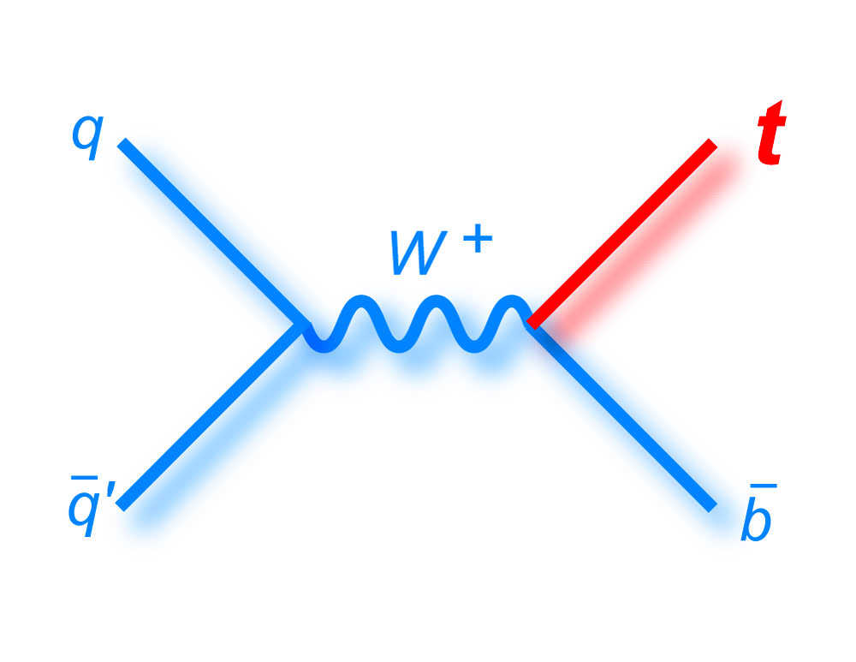
Single top
Electroweak production of single tops (announced 2009 at Tevatron, 2011 at LHC) occurs with smaller cross-sections compared to production of top pairs. Analysis is difficult, but cut-based procedures become viable in addition to the initially used multivariate techniques.
Wt-channel
Small at
Tevatron,
significant
at LHC
t-channel
Dominant at Tevatron
and LHC
s-channel Drell-Yan
Small at Tevatron and LHC
22

Slide 23
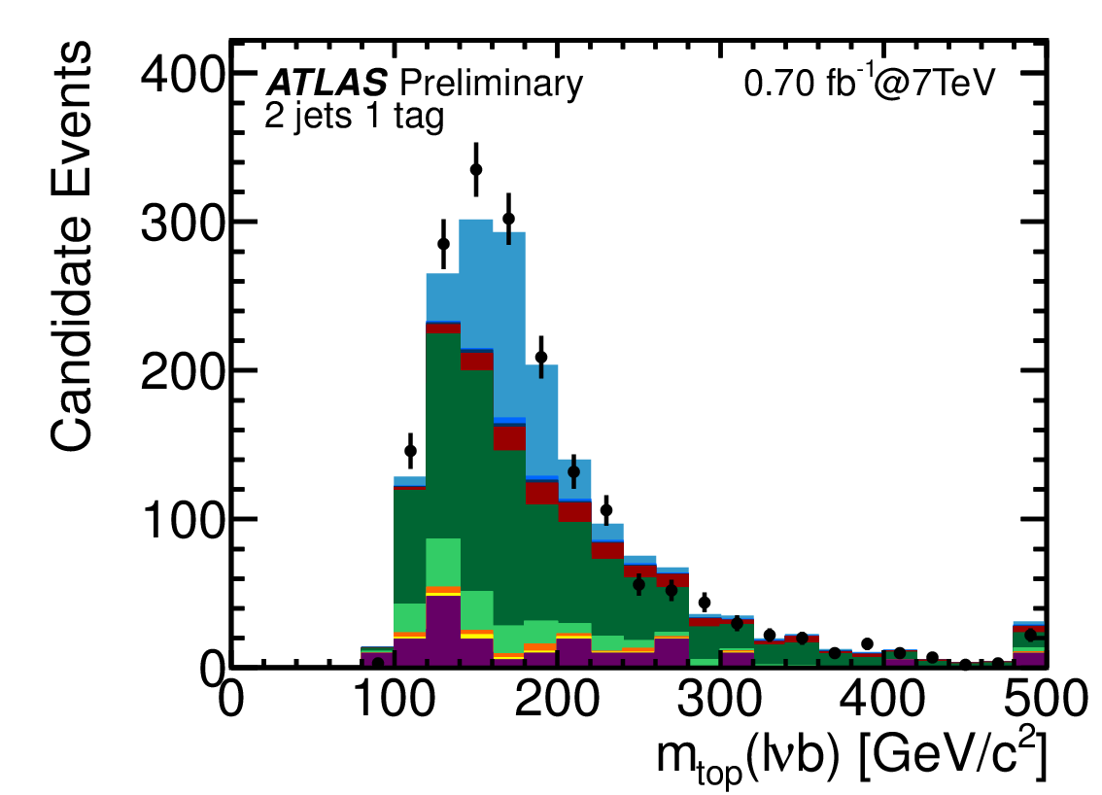
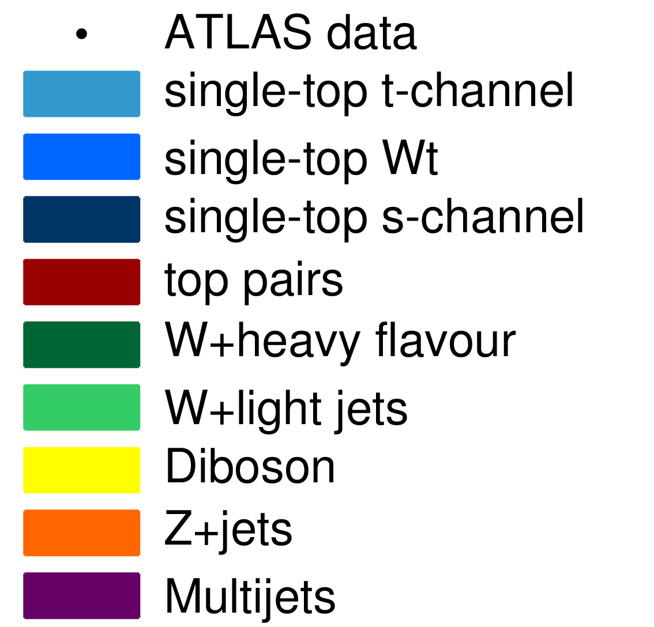
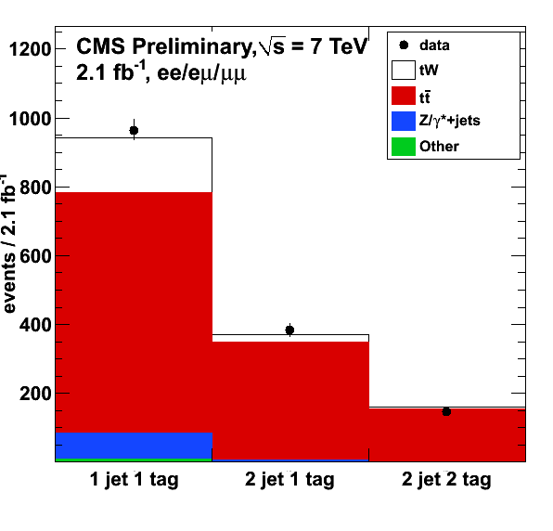
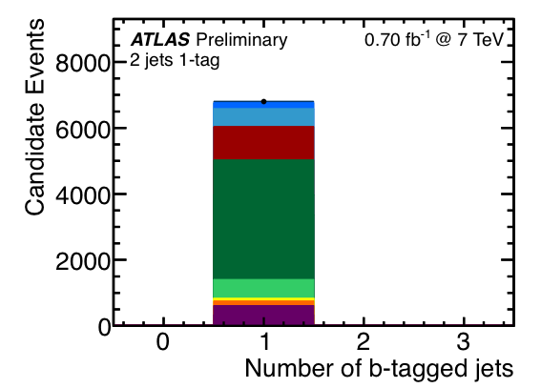
Single top results
t-channel
σ_{t} = (90 + 32 – 22) pb
LHC prediction: σ_{t} = (64.6 + 3.3 – 2.6) pb
Wt-channel
σ_{Wt} = (22 + 9 – 7) pb
LHC prediction: σ_{t} = (15.7 ± 1.4) pb
s-channel
σ_{s} < 26.5 pb
LHC prediction:
σ_{t} = (4.6 ± 0.3) pb
ATLAS CONF-2011-101
CMS PAS TOP-2011-022
Wt channel
CMS PAS TOP-2011-024
ATLAS CONF-2011-118
CERN Winter School, Feb. 2012
Notes:
Wt channel measured for the first time.

Slide 24
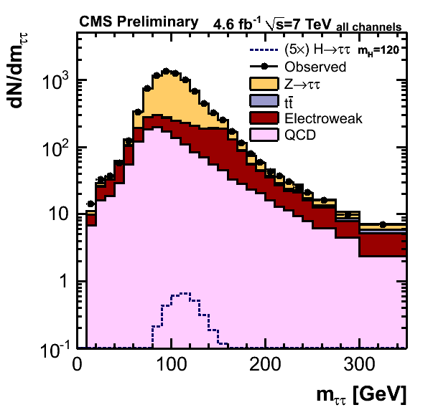
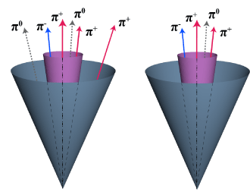
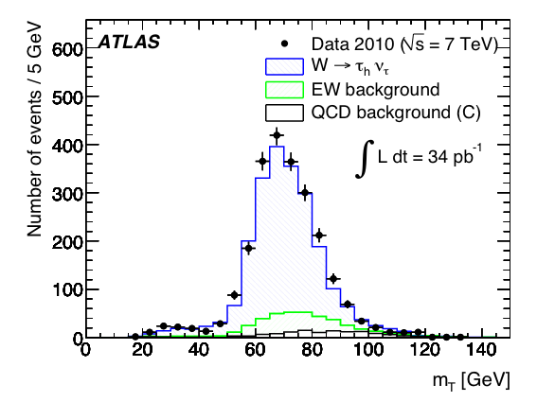
W and Z
Initial studies with electrons and muons, now also with taus.
hep-ex 1108.4101, PLB 706 (2011) 276
CMS PAS HIG-11-029
hep-ex 1104.1617, JHEP 08 (2011) 117
Notes:
siehe EWK presentation. Bottom left: cleanest channel, top left highest branching ratio. Visible mass: reconstructed mass of the lepton – hadronic tau (τ_{h}) system

Slide 25
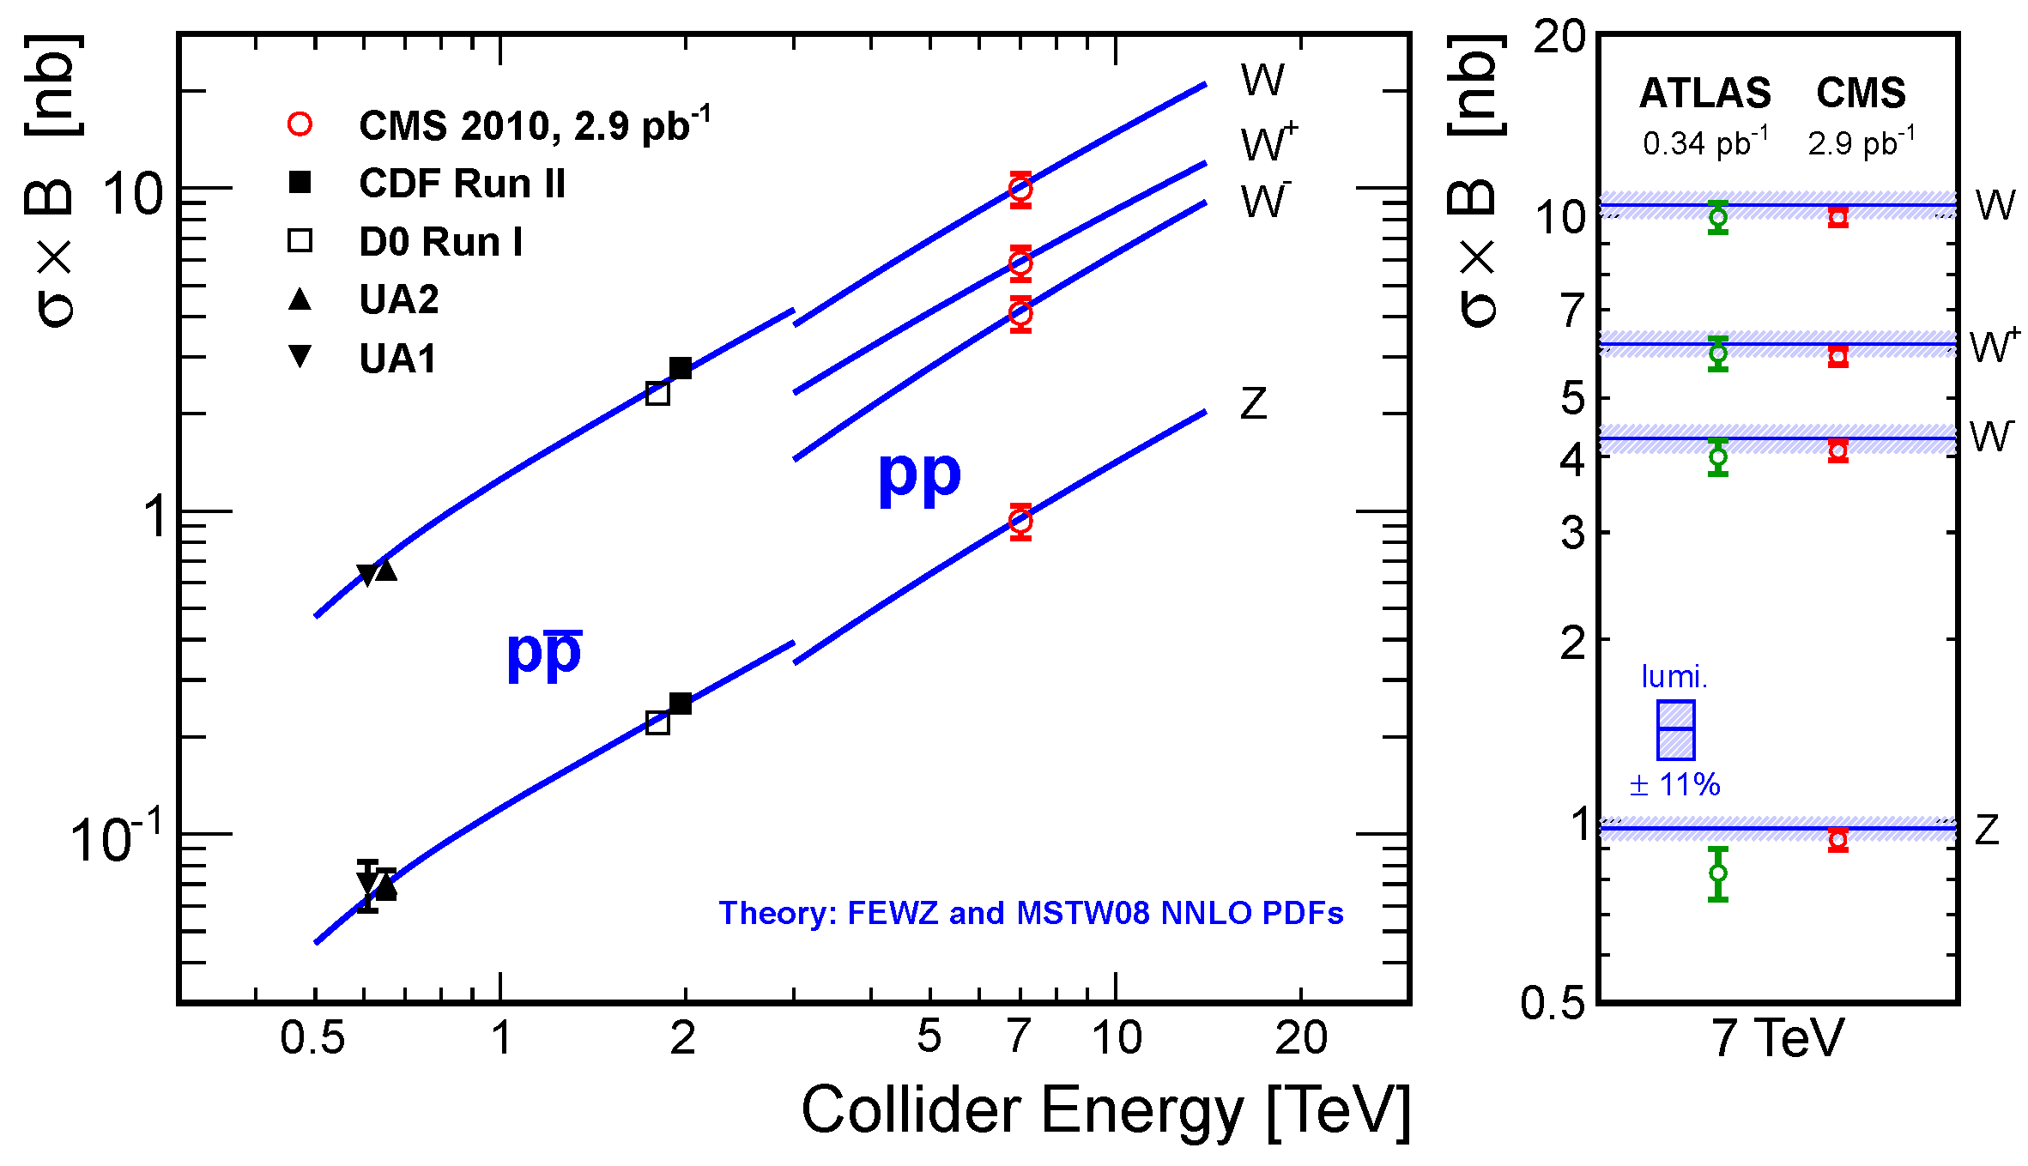
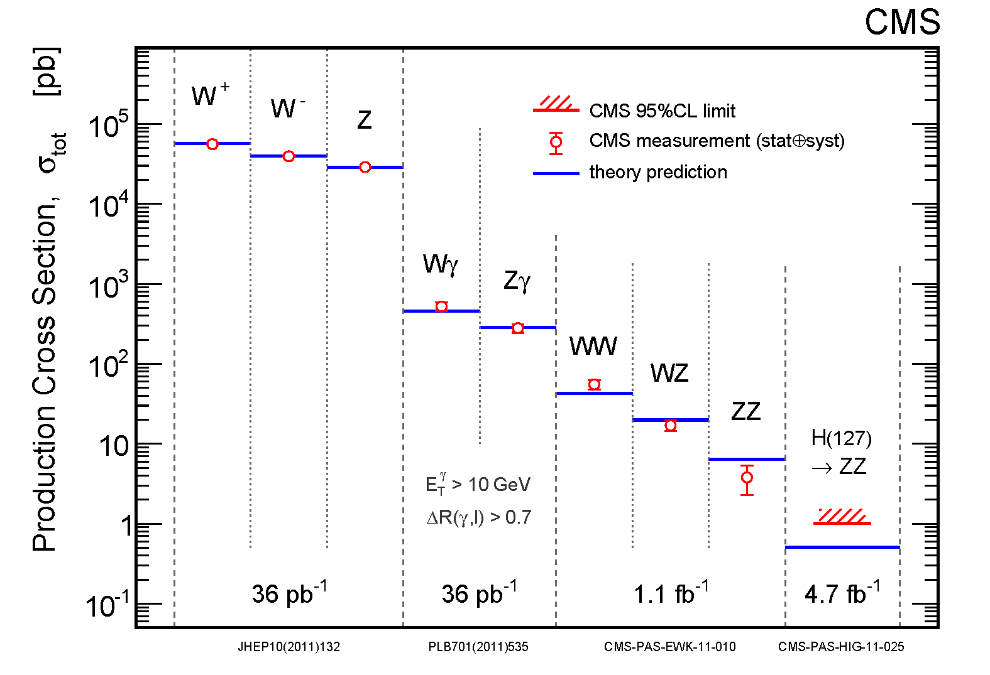
W and Z cross sections
W and Z (e and μ channels) are the first electroweak processes measured at LHC
Tests for perturbative QCD and PDF’s (W charge asymmetry)
Detector calibration with Z
Luminosity measurement
Background for new physics
hep-ex 1107.4789
JHEP 10 (2011) 132
CMS PAS SMP-12-005
hep-ex 1012.2466, JHEP 01 (2011) 080
Notes:
FEWZ: Melnikow und Petriello
MSTW: Martin-Stirling-Thorne-Watt Parton Distribution Functions

Slide 26



W⁺/W⁻ charge asymmetry
Asymmetry is sensitive to valence quark PDF’s.
hep-ex 1103.3470, JHEP 04 (2011) 050
Notes:
MSTW: Martin-Stirling-Thorne-Watt Parton Distribution Functions. XI: modified isolation variable. Data suggest flatter eta dependence than models studied.

Slide 27




Higgs boson production
Production modes:
gg → H
dominant, as at the Tevatron, but σ 10 times larger
qq → Hqq
2nd most important mode at the LHC (vector boson fusion)
qq → HW, HZ
2nd most important mode at the Tevatron, but σ about 100 times larger at the LHC

Slide 28

Higgs boson searches
Several search channels can be used, depending on branching fraction and background. The mass range up to about 600 GeV has been studied.
110 GeV < m_{H} < 150 GeV
H → γγ (BR ≈ 0.001-0.002)
H → bb (in association with W/Z due to
QCD background, up to m_{H} ≈ 130 GeV)
H → ττ (QCD background → VBF production, needs high luminosity)
110 GeV < m_{H} < 600 GeV
H → ZZ → 4l
H → ZZ → 2l2ν (from m_{H} ≈ 200 GeV)
H → ZZ → 2l2q (from m_{H} ≈ 200 GeV)
H → WW → 2l2ν
H → WW → lν qq’ (from m_{H} ≈ 300 GeV)
_
In high resolution channels (σ_{mH} ≈ 1-2%) one searches for a narrow mass peak (γγ,
ZZ → 4l), in others one looks for a broad excess (channels with neutrinos and jets).
Notes:
Direct H → bb search is hopeless, since bb cross section is 0.5 mb at 14 TeV!

Slide 29




H → γγ
CMS-HIG-2012-001
hep-ex 1202.1414, PRL 108 (2012) 111803
Largest excess: around 125 GeV
CMS significances (ATLAS similar):
Local significance: 2.9 σ
Global significance: 1.6 σ (LEE 100-150 GeV)
CMS has added a multivariate analysis method to the previous cut-based one.
Notes:
The largest excess of events above the expected standard model background is observed for a Higgs boson mass hypothesis of 125 GeV with a local significance of 2.9 sigma. The global significance of observing an excess with a local significance greater than 2.9 sigma anywhere in the search range 100-150 GeV is estimated to be 1.6 sigma. The p-value is the probability of obtaining a test statistic at least as extreme as the one that was actually observed, assuming that the null hypothesis is true.

Slide 30



H → ττ
Production by vector boson fusion allows use of the rapidity gap between the “Tagging Jets” with high p_{T} in forward direction -> jet veto in central region:
H decay products
τ identification:
ττ → ll, lh, hh
Tagging
Jets
H mass reconstruction:
Make use of collinear approximation of l-ν (high mass results in strong boost along the original flight direction of the τ) and the angle between the two τ’s
Tagging
Jets
Notes:
http://www.iktp.tu-dresden.de/~jana/analyse_alt/koll/koll.html

Slide 31



H → ττ
3 independent channels: eτ_{h}, μτ_{h}, eμ
SM search
MSSM search
Significant probability that b-jet is produced in association with H
hep-ex 1202.4083, subm. to PLB
No excess seen yet.
Notes:
SM: We exclude a Higgs boson with mH = 115 GeV with a production cross section 3.2 times of that predicted by the standard model.
MSSM: Stringent new bounds in the parameter space, excluding at 95% CL values of tan b as low as 7.1 at mA =160 GeV.

Slide 32




H → bb
Select events with 2 b-tagged jets and either Z → ll, W → lν, or Z → νν.
ATLAS-CONF-2012-015
No excess seen.
Notes:
Higgs produced in association with W or Z.

Slide 33




H → ZZ^{(*)} → 4 leptons
“Golden” channel! Need excellent tracker, electromagnetic calorimeter and muon system. High efficiency for all leptons is important, as four of them are involved. Efficient lepton reconstruction down to low p_{T} is also necessary.
Background:
Irreducible: ZZ
Reducible: tt, Zbb
Suppression mainly through lepton isolation and b-tagging (impact parameter)
Notes:
ZZ: Untergrund zeigt in etwa doppelte Z-Masse
Fayard-Higgs-2008-Split.ppt

Slide 34



H → ZZ^{(*)} → 4 leptons
Event selection: pair of leptons close to Z mass
SM Higgs boson is excluded at 95% CL in the mass ranges 134–156 GeV, 182–233 GeV, 256–265 GeV and 268–415 GeV. The largest upward deviations from the background-only hypothesis are observed for m_{H} = 125 GeV, 244 GeV and 500 GeV with local significances of 2.1, 2.2 and 2.1 standard deviations, respectively. Once the look-elsewhere effect is considered, none of these excesses are significant.
3 events near
125 GeV:
2 with 2e2μ
1 with 4μ
In total: 71 events
62±9 background
ATLAS-CONF-2012-169
Notes:
Lookelsewhere effect takes into account that such an excess (or a larger one) can appear anywhere in the search range as a result of an upward fluctuation of the background.

Slide 35



H → WW → lν qq’
Event selection: Selections to discriminate between the signal and background events are based on kinematic and topological quantities including the angular spin correlations of the decay products.
No evidence for the Higgs boson is found, and at 95% confidence level the SM Higgs boson production in the mass range 327-415 GeV is excluded.
CMS-PAS-HIG-2012-003
Notes:
Likelyhood analysis technique.

Slide 36



Standard Model Higgs combination in ATLAS
H → γγ, bb, ττ, WW, ZZ
ATLAS-CONF-2012-019
High mass resolution channels (blue)
Low mass resolution channels (red)
All channels
All channels

Slide 37



Standard Model Higgs combination in CMS
H → γγ, bb, ττ, WW, ZZ
CMS-PAS-HIG-2012-008

Slide 38


Higgs boson discovery prospects
CMS-NOTE-2010-008
What’s
your
bet?
8 TeV instead of 7 TeV centre-of-mass energy saves about 25% of the data taking time.

Slide 39





Fourth generation quarks
Top- and bottom-like quarks: b’, t’ -> tW
Signatures for b’: trileptons or same-sign dileptons plus at least one b-jet
Signatures for t’: opposite-sign dileptons
hep-ex 1204.1088
M_{b’} > 611 GeV at 95% CL
hep-ex 1203.5410
Minimum value of four possible M_{lb} combinations
M_{t’} > 557 GeV at 95% CL

Slide 40




Leptoquarks
Leptoquarks are color-triplet bosons with fractional charge arising e.g. in GUT theories.
Assumption: LQ couple only to quarks and leptons of the same SM generation.
2 scenarii for first generation:
β = B(LQ -> eq)
hep-ex 1112.4828,
PLB 709 (2012) 158
β = 1
2e + 2jets
β = 0.5
1e + 2jets + E_{T}^{miss}
3rd generation
CMS-PAS EXO-11-030
LQ -> bν_{τ}
m(LQ) > 660 GeV for BR=1, 607 GeV for BR=0.5
m(LQ) > 350 GeV for BR=1
Notes:
1st gen.: m(LQ) > 660 GeV for BR=1, 607 GeV for BR=0.5. Scalar 3rd generation leptoquarks with BR to b nutau = 100% excluded below 350 GeV.

Slide 41








Compositeness, contact interactions
New
interaction
Q << Λ_{C}
Q << Λ_{C}
Contact
interaction
Q >> Λ_{C}
ATLAS-CONF-2012-038
Dijet
angular
distribution
Λ_{C} > 7.6 TeV (95% CL)
Notes:
F is defined as the ratio of the number of events in the first four χ bins to the number in all χ bins.

Slide 42




Excited leptons
Excited lepton production via 4-fermion contact interactions can be described by an effective Lagrangian:
Clean final state: l l γ
ATLAS-CONF-2012-008
Notes:
Compositeness model addresses the mass hierarchy and generational structure of quarks and leptons, which are the lowest-energy bound states of preons.
3 final state particles are well separated from each other and isolated.

Slide 43


Dijet resonances
Observed 95% CL upper limit of
σ x branching fraction x acceptance
Highest JJ mass event:
m_{JJ} = 3.8 TeV
Exclusion limits:
String: 4.00 TeV
Excited quarks: 2.49 TeV
hep-ex 1107.4771, PLB 704 (2011) 123
Notes:
Mention JES, explain W’Z’ couplings, axigluon SU(3)L x SU(3)R. Coloron: color octet

Slide 44



Search for new physics with pairs of dijets
Pair production of narrow dijet resonances, for example colorons.
Colorons: color octet scalars or vectors
CMS PAS EXO-11-016
Event selection: at least 4 jets,
jet pairs with equal mass
Largest fluctuation at 625 GeV, 1.5 sigma with look elsewhere effect.
Pair production of colorons is excluded for:
320 GeV < m(C) < 580 GeV
Notes:
Largest fluctuation at 625 GeV, 1.5 sigma with look elsewhere effect.

Slide 45


W’ → lν
Exclusion limits for several W’ models have been derived:
- left-handed W’ with Standard Model couplings
- right-handed W_{R}’ with W-W’ interference
- Kaluza-Klein W_{KK}’ states in split universal extra dimensions framework
hep-ex 1204.4764, submitted to JHEP
Notes:
mü: Dirac type mass term in 5 dimensions
Mass exclusion limits at 95% CL for a range of W' models are determined, including a limit of 2.5 TeV for right-handed W' bosons with standard-model-like couplings and limits of 2.43--2.63 TeV for left-handed W' bosons, taking into account their interference with the standard model W boson.

Slide 46


Z’ → l⁺l⁻
Several Z’ models have been studied:
- sequential Standard Model
- Z’_{ψ} model (superstring inspired E₆ model)
- Z’_{st} Stückelberg extension
Kaluza-Klein Graviton G_{KK} search is also possible in this channel.
hep-ex 1206.1849, submitted to PLB
Notes:
The resulting mass limits at 95% confidence level are 2330 GeV for the Z' in the Sequential Standard Model, 2000 GeV for the superstring-inspired Z'(psi) resonance, 890 (540) GeV for the Stueckelberg extension Z'(St) with the mass parameter epsilon=0.06 (0.04), and 2140 (1810) GeV for Kaluza-Klein gravitons with the coupling parameter k/Mbar(Pl) of 0.10 (0.05). These limits are the most stringent to date.

Slide 47


Supersymmetry
SUSY
For each fermion of the Standard Model there is a supersymmetric boson partner and vice versa.
-> stability of Higgs mass
-> unification of forces
-> candidate for dark matter
Up to now no SUSY partners with the same mass as SM particles have been found, therefore SUSY must be broken:
m ≠ m
~

Slide 48
Exploration of SUSY models
SUSY is not a single theory, but a framework of models.
The minimal supersymmetric Standard Model (MSSM) has 105 parameters -> difficult to explore.
We can study benchmark MSSM models with fewer parameters, and NMSSM’s as well as R-parity [R = (-1)^{2S+L+3B}] violating scenarios. New and sometimes more unusual experimental signatures will arise.
Examples:
CMSSM (constrained MSSM): m_{1/2}, m₀, A₀, tanβ, sign(μ)
mSUGRA (minimal supergravity model): m_{1/2}, m₀, A₀, sign(μ)
NUHM (non-universal Higgs mass models; Higgs mass not unified with sfermion mass):
m_{1/2}, m₀, m_{H} (or m_{Hu}, m_{Hd}), A₀, tanβ, sign(μ)
mGMSB (minimal gauge-mediated SUSY breaking):
M_{messenger}, Λ (visible sector soft SUSY breaking scale), tanβ, c_{gravitino}, N_{messenger}
RPV MSSM (R-parity violating): m_{1/2}, m₀, A₀, tanβ, sign(μ), Λ
Notes:
NUHM: Higgs mass is not unified with sfermion masses
Nmessenger: nr. of SU(5) representations of the mediating fields, cgrav = factor for the gravitino mass. LAMBDA = visible-sector soft SUSY breaking scale
Justification for RP conservation was stability of proton and candidate for dark matter.

Slide 49




SUSY searches
Initial generic searches are performed with a number of inclusive final states.
Signatures can contain (b)-jets, missing transverse energy, leptons or photons. Specific searches have begun, for example for third generation squarks.
Interpretations can be made either through constrained (e.g. mSUGRA, GMSB) or simplified models (phenomenological, defined by an effective Lagrangian describing interactions of a small number of new particles).
New signatures are starting to be exploited (e.g. long-lived particles).
Examples
1 lepton,
jets + E_{T}^{miss}
multijets + E_{T}^{miss}
Notes:
Simplified models assume mass hierarchy and decay chain.

Slide 50
Examples of new signatures
mGMSB:
The NLSP plays an important role since cascade decay chains of sparticles typically end in the NLSP. This is often a stau, which decays to tau and gravitino or neutralino, which can decay to a photon and a gravitino (missing energy in the detector).
RPV MSSM:
Lepton number violation or baryon number violation is allowed, the proton is still stable. The LSP (not necessarily a neutralino) decays to Standard Model particles. For a neutralino LSP the signatures are the same as for R-parity conserving models, except that there is no missing energy. If the RPV coupling is very small, decays are delayed, leading to displaced vertices. For stau LSP there are taus in the final state.
Notes:
Justification for RP conservation was stability of proton and candidate for dark matter.

Slide 51

CMSSM limits
https://twiki.cern.ch/twiki/bin/view/CMSPublic/PhysicsResultsSUS
51
Notes:
Large gain in coverage since 2010! Razor has largest exclusion for m0 up to about 1000 GeV. Curves are observed limits.

Slide 52


MSSM direct sbottom pair production
~
~
In the MSSM q_{R} and q_{L} can mix to form 2 mass eigenstates. Mixing is proportional to the mass of the corresponding SM fermion, therefore it is important for the 3rd generation. Large mixing can yield sbottom and stop mass eigenstates that are much lighter than other squarks.
Exclusive decay mode:
Event selection:
Large E_{T}^{miss} + 2 b-jets
R-parity conservation
hep-ex 1112.3832,
PRL 108 (2012) 041805
Sbottom masses are excluded below 390 GeV for neutralino masses below 60 GeV.
Notes:
MSSM scenarios where the sbottom1 is the lightest squark, all other squarks are heavier than the gluino, and m˜ g > m˜b1 > m neutralino1, such that the branching ratio (BR) for
gluino to sbottom1 bquark decays is 100%. Sbottoms are produced via gluino-gluino or by direct pair production sbottom1 sbottom1 and are assumed to decay exclusively via sbottom1 -> b neutralino1 , where neutralino 1 mass is set to 60 GeV. Exclusion limits are presented in the (mgluino, msbottom) plane.

Slide 53




Sbottom and stop production from gluinos
Event selection:
no leptons, large E_{T}^{miss} + ≥ 3 b-jets
1 lepton plus b-jets or 2 SS leptons
ATLAS-CONF-2012-058
Gluino-sbottom model
Gluino-stop model
A gluino mass below 1 TeV is excluded for sbottom masses up to 870 GeV.
A gluino mass below 820 GeV is excluded for stop masses up to 640 GeV.
Notes:
MSSM scenarios where the sbottom1 is the lightest squark, all other squarks are heavier than the gluino, and m˜ g > m˜b1 > m neutralino1, such that the branching ratio (BR) for
gluino to sbottom1 bquark decays is 100%. Sbottoms are produced via gluino-gluino or by direct pair production sbottom1 sbottom1 and are assumed to decay exclusively via sbottom1 -> b neutralino1 , where neutralino 1 mass is set to 60 GeV. Exclusion limits are presented in the (mgluino, msbottom) plane.
In the Gtt model, gluino masses below 940 GeV are excluded for mneutralino1 < 50 GeV while neutralino masses below 320 GeV are excluded for mgluino = 800 GeV.

Slide 54



Search for a very light scalar top
Event selection: 2 opposite-sign leptons, large E_{T}^{miss} + ≥ 1 jet
ATLAS-CONF-2012-059
Stop masses are excluded up to at least 130 GeV for neutralino 1 masses up to 65 GeV.

Slide 55


Heavy “stable” charged particles
HSCP may be a long-lived NLSP, e.g. in Split-SUSY or GMSB.
If mass greater than about 100 GeV: β = v/c < 0.9.
Nuclear interactions may lead to charge exchange.
Signature: high-momentum particle with anomalously large energy loss dE/dx through ionization and an anomalously long time-of-flight.
Tracker (high dE/dx) + μ system (long TOF)
Tracker only (charge exchange)
Notes:
if long-lived gluinos would be produced they would hadronize into “R-hadrons”, which are gluino-gluon, gluino-qqbar, gluino-qqq states. Jet-like energy deposit in ATLAS, could be even weeks later!!

Slide 56


Heavy long-lived charged particles
Data are consistent with background, estimated from data.
Mass limits for several models:
M(gluino) > 1091 GeV, M(stop) > 735 GeV, M(stau) > 232 GeV
hep-ex 1205.0272, submitted to PLB

Slide 57


Extra dimensions
Our well known universe: 3 space dimensions + 1 time dimension
String theory: minimum 6 extra dimensions
Funambulist: 1 dimension
Ant: 2 dimensions (2nd dimension rolled up)
Gravity seems to be 10⁻³⁸ times weaker than the strong interaction -> difficult to unify with other forces! A possible solutions of this hierarchy problems are extra dimensions.

Slide 58

Models with extra dimensions
There are several models, which have the following in common:
There is a 3+1-dimensional (sub)space (brane, membrane)
The brane is embedded in an 3+1+d dimensional space (bulk)
The d extra dimensions have the same size R
All particles and fields living in the bulk are replicated in Kaluza-Klein-towers.
O. Klein 1926: Extra dimensions are rolled up, i.e. a particle, which moves in these dimensions, comes back to the starting point. Standing waves emerge.
Differences between the
models:
Size and geometry of
the bulk
Kinds of particles that are
allowed to move around in the bulk
Gravity
Gravitation
our 3+1 dimensional
universe
unser 3+1-dimensionales
Universum
Gravity
Gravitation
extra dimension
Extra-Dimension
Notes:
V17_Bodendorfer_extraDimensionen.pdf, ExtraDim_Collard.pdf
Deviations from Newton’s Law at short distance: torsion-balance “Cavendish” experiments.
There are standing waves in the extra compactified dimension(s). If a spatial extra dimension is of radius R, the invariant mass of such standing waves would be M_{n} = nh / Rc with n an integer, h being Planck's constant and c the speed of light.

Slide 59





ADD model – large extra dimensions
hep-ph 9803315, Phys. Lett. B 429, 263 (1998)
Arkani-Hamed, Dimopoulos, Dvali
Not the effective 4-dim. Planck scale, but the quantum gravity scale of the higher-dimensional theory M_{D} is relevant. The only fundamental scale should be the electroweak scale M_{EW} ≈ M_{D} ≈ 1 TeV!
Known particles live in the
3+1-dimensional brane
The graviton can also move in the bulk
There are d≥2 extra dimensions
Extra dimensions are rolled up in a
torus with compactification radius R
d = 2: R ≈ 1 mm, d = 3: R ≈ 1 nm Newton’s law of gravity is tested down to about 0.1 mm.
The graviton corresponds to a
KK-tower with 3+1 mass spectrum
M_{l} = l/R (l = 0,1,2, …).
Gravitational force in world with 4 spacial dimensions
Gravitational force
(arbitrary units)
Newton’s law
of gravity
Notes:
Arkani-Hamed Paper. Bei Abständen < 1 mm hat das Gravitationsgesetz statt der 1/r²-Abhängigkeit eine 1/r³-Abhängigkeit für d=2.
PLANCKSKALA: (Gravitation wird gleich stark wie die Eichwechselwirkungen)
FIXME: Warum ist d=1 ausgeschlossen?
O. Klein hat vorgeschlagen, dass Extradimensionen aufgerollt sind, d.h. ein Teilchen,das sich entlang dieser Dimension bewegt, kommt wieder an den Ausgangsort zurück.

Slide 60






Randall-Sundrum Model (Warped ED)
5D-model with warped metric:
L. Randall, R. Sundrum, PRL 83 (1999) 3370
Non-equidistant KK-towers
_
c = k/M_{P}
η_{μν} … graviton field
k …… curvature
r_{c} …. . distance between branes
G₁
Bulk
G₂
Davoudiasl, Hewett Rizzo, PRD63, 075004
Signature (examples):
G₁ -> γγ, e⁺e⁻, μ⁺μ⁻
Planck Brane
y = 0
SM Brane
y = r_{c}
Notes:
Wenn kr_{c} ca. 12 ist das Hierarchieproblem gelöst.

Slide 61






Direct search for large extra dimensions
Direct search:
Signature (e.g.): monojet, E_{T}^{miss}
M_{D} > 4.58 TeV (δ=2)
M_{D} > 3.54 TeV (δ=3)
M_{D} > 3.00 TeV (δ=4)
M_{D} > 2.72 TeV (δ=5)
M_{D} > 2.52 TeV (δ=6)
CMS PAS EXO-11-059
Notes:
For the spin-independent model, these are the best limits for dark matter particles with mass below 3.5 GeV, a region as yet unexplored by the direct detection experiments. For the spin-dependent model, these limits represent the most stringent constraints over the 1-200 GeV mass range. Previous mass limits were around 1 TeV.

Slide 62



Search for large ED with diphotons and dileptons
Indirect search:
Signature (e.g.) : enhancement of the Drell-Yan cross section
hep-ex 1112.2194, PLB 710 (2012) 538
2 models studied: ADD and RS

Slide 63

Black holes
Definition:
Object, whose gravitation is so strong that even light cannot escape from it. From the event horizon the escape velocity is larger than the speed of light.
The Schwarzschild radius defines the size of a black hole
(M_{BH} > M_{P}):
If gravity becomes strong at small distances through extra dimensions (M_{P} -> M_{D}), LHC could also produce microscopic black holes (Ø 10⁻¹⁸ m). The colliding partons must come closer than a distance of 2 R_{S}. The black holes should very quickly (~10⁻²⁶ s) evaporate through Hawking radiation (T_{H} ~1/M_{BH}), producing all possible kinds of Standard Model particles. Signature at the LHC: many jets, leptons and photons with high p_{T}.
HEPHY-SMI Seminar, June 2012
Notes:
Schwarzschilrradius: distance from the center of an object such that, if all the mass of the object were compressed within that sphere, the escape speed from the surface would equal the speed of light. extradim_vest.pdf. Genaue Formel fuer Schwarzschildradius: R_{S} = 2 M_{BH}G_{N} /c^{2.} Naїvely, black holes would only grow once they are formed.
In 1975 Steven Hawking showed that this is not true, as the black hole can evaporate by emitting pairs of virtual photons at the event horizon, with one of the pair escaping the BH gravity
These photons have a black-body spectrum (Planck) with the Hawking temperature. G_{N} = 6.67300 × 10⁻¹¹ m³ kg⁻¹ s⁻²
See Sven_Black_Holes_with_ATLAS.ppt
Masse eines schwarzen Lochs mindestens 3mal so gross wie die Sonnenmasse (mSonne = 2x10*30 kg).
1/GeV = 0.2 . 10⁻¹⁵ m. Planckmasse = 2 x 10*-8 kg.
Wenn ein Objekt einer bestimmten Masse auf ein Kugelvolumen mit einem kleineren Radius als dem Schwarzschildradius komprimiert wird (und damit einen kritischen Schwellwert in der Dichte überschreitet), kollabiert es in ein Schwarzes Loch.

Slide 64



Black holes
Democratic and isotropic decay.
Signature: Events with large transverse energy sum S_{T}, high multiplicity of jets, leptons and photons.
M_{BH} > 3.8 – 5.3 TeV
N_{Jets} = 10,
S_{T} = 1.1 TeV
ADD model
hep-ex 1202.6396 JHEP 04 (2012) 061
Notes:
S_{T}: linear sum of transverse momenta of all reconstructed particles in the final state and the missing transverse energy in an event.
The limits on the minimum semiclassical and quantum black hole and string-ball masses are in the range 3.8 to 5.3TeV for a wide range of model parameters.

Slide 65

Conclusions
The LHC has operated very successfully.
The physics of the last decades has been redone.
The experiments have performed a large range of analyses, including on subjects that were not even known a decade or so ago.
Discoveries may be just round the corner!
HEPHY-SMI Seminar, June 2012

