Slide 1
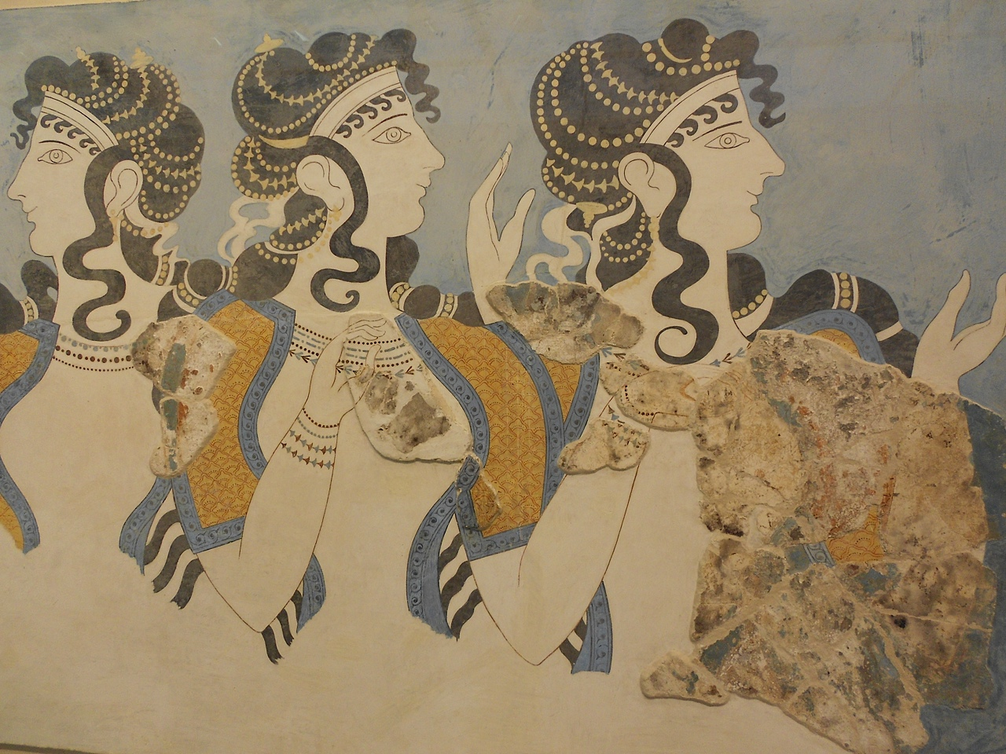

B Physics and Quarkonia at CMS
ICNFP 2014
Kolymbari, Crete
6 August 2014
Claudia-Elisabeth Wulz
CMS Collaboration
Institute of High Energy Physics, Vienna

Slide 2
Overview
Selected recent results:
CP-violating phase ϕ_{s} and decay width difference ΔΓ_{s} of B_{s} with B_{s} -> J/ψ φ(1020)
Production cross sections
  J/ψ and ψ(2S) prompt double-differential
Polarization
  J/ψ, ψ(2S),ϒ(1S), ϒ(2S),ϒ(3S)
CMS PAS BPH-13-012
CMS PAS BPH-14-001
PLB 727 (2013) 381
PRL 110 (2013) 081802
All CMS public B physics results:
https://twiki.cern.ch/twiki/bin/view/CMSPublic/PhysicsResultsBPH

Slide 3
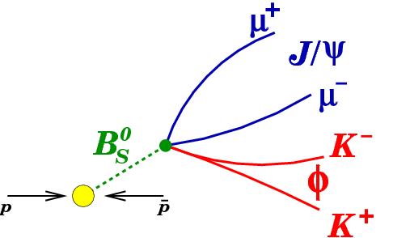
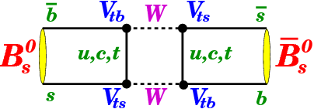
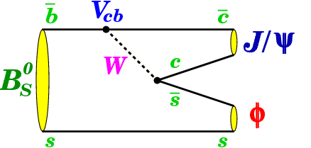
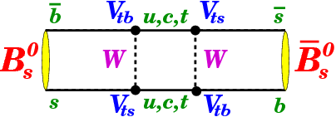
B_{s} -> J/ψ(μ⁺μ⁻) Φ(K⁺K⁻)
Decay channel: B_{s} -> J/ψ(μ⁺μ⁻) Φ(K⁺K⁻)
B_{s}-B_{s} mixing -> time-dependent, flavour-tagged analysis
Data: √s = 8 TeV, L_{int} = 20 fb⁻¹, 49000 reconstructed B_{s} decays
Weak phase from interference of direct decays and decays from mixing, and decay width difference of light and heavy B_{s} mass eigenstates:
_
+ new
physics?
+ new
physics?
φ_{D}
B_{s}
J/ψ Φ
φ_{M}
_
−φ_{D}
B_{s}
Notes:
Prediction for phi_s from global fit
Diagrams from CDF: inspirehep.net/record/1080489/plots

Slide 4
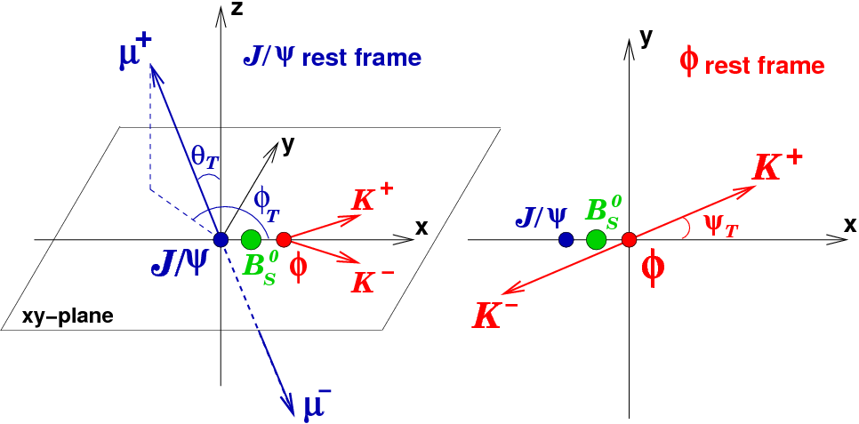
Angular analysis
Time-dependent, angular analysis to disentangle CP-odd and CP-even final states:
Measure decay angles Θ(θ_{T},φ_{T},ψ_{T}) and proper decay length ct of B_{s}
Signal model
φ
α parameter set: ΔΓ_{s}, ϕ_{s}, cτ, IA₀I², IA_{II}I², IA_{T}I², IA_{S}I², δ_{II}, δ_{T}, δ_{ST}
b_{i} and d_{i} depend on ϕ_{s}
Extended maximum likelihood fit with signal model used to extract parameters.
PRD 87 (2013) 112010 - LHCb
Notes:
Diagrams from CDF: inspirehep.net/record/1080489/plots. Variables as in LHCb paper. Angles in the transversity basis. A … decay amplitudes

Slide 5
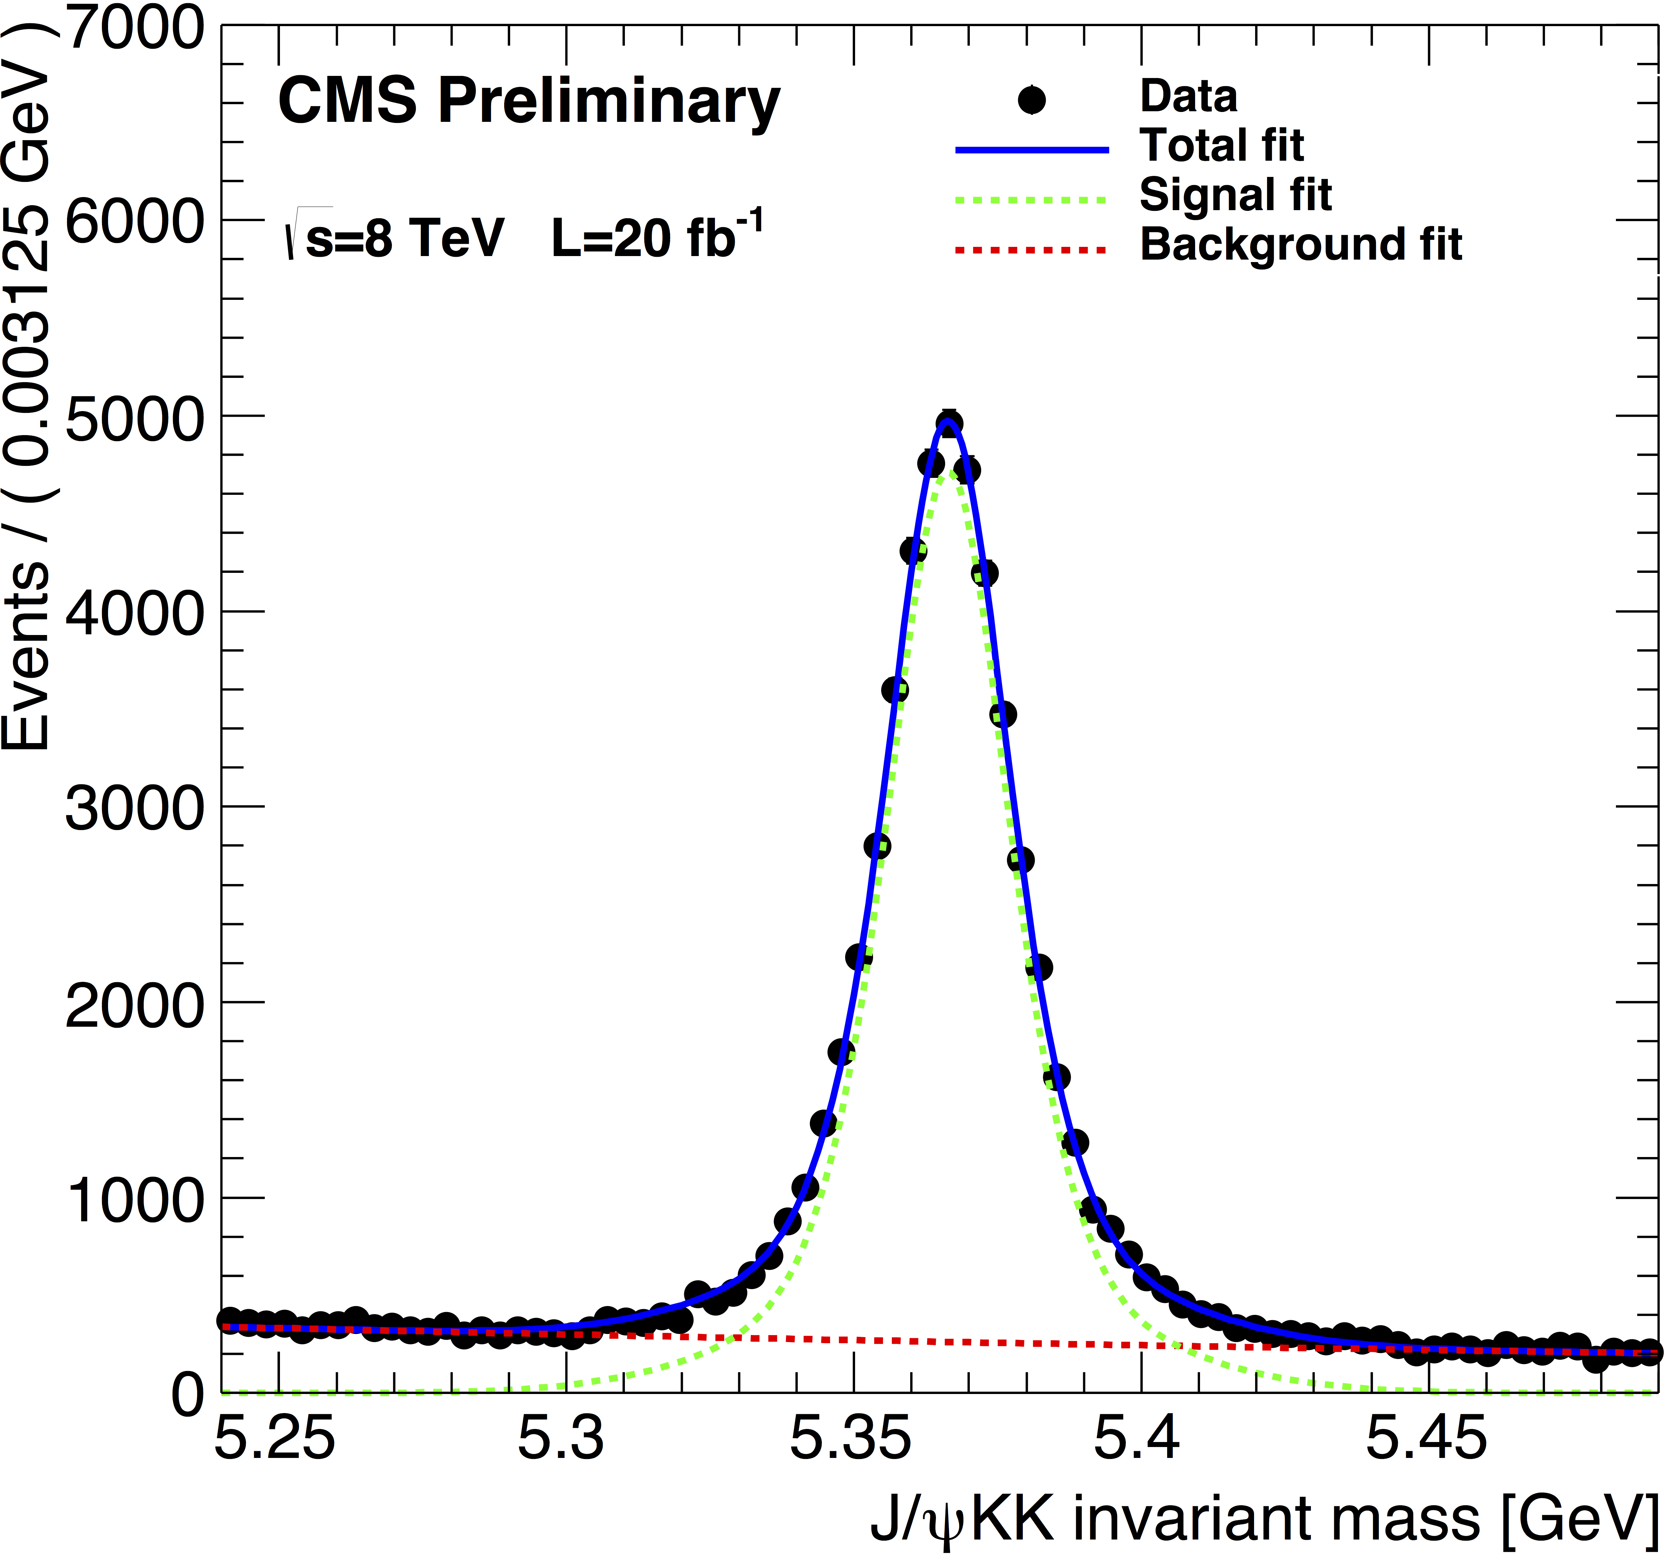
Event selection and B_{s} reconstruction
Trigger: displaced J/ψ, optimized for b hadrons
2 muons with p_{T}(μ) > 4 GeV, p_{T} (μμ) > 6.9 GeV
Mass window for μμ : [2.9,3.3] GeV
Common decay vertex, L_{xy}/σ_{xy} > 3, d_{ca3D} < 0.5 cm
χ² vertex fit probability > 15%
Offline selection:
p_{T}(μ⁺), p_{T}(μ⁻) > 4 GeV, Iη_{μ}I < 2.1
Dimuons from common vertex from Kalman fit
J/ψ mass constraint: Im_{μ+μ-}– M_{J/ψ}I < 150 MeV
p_{T}(K⁺), p_{T}(K⁻) > 0.7 GeV
ϕ mass constraint: Im_{K+K-}– M_{Φ}I < 10 MeV
B_{s} (μμKK) reconstruction by combined kinematic and vertex fit:
χ² vertex fit probability > 2%
Mass within [5.24, 5.49] GeV
Selected primary vertex in case of multiple primary vertices: closest to B_{s}
CMS PAS BPH-13-012
Notes:
Lxy: distance between PV and SV in xy plane

Slide 6
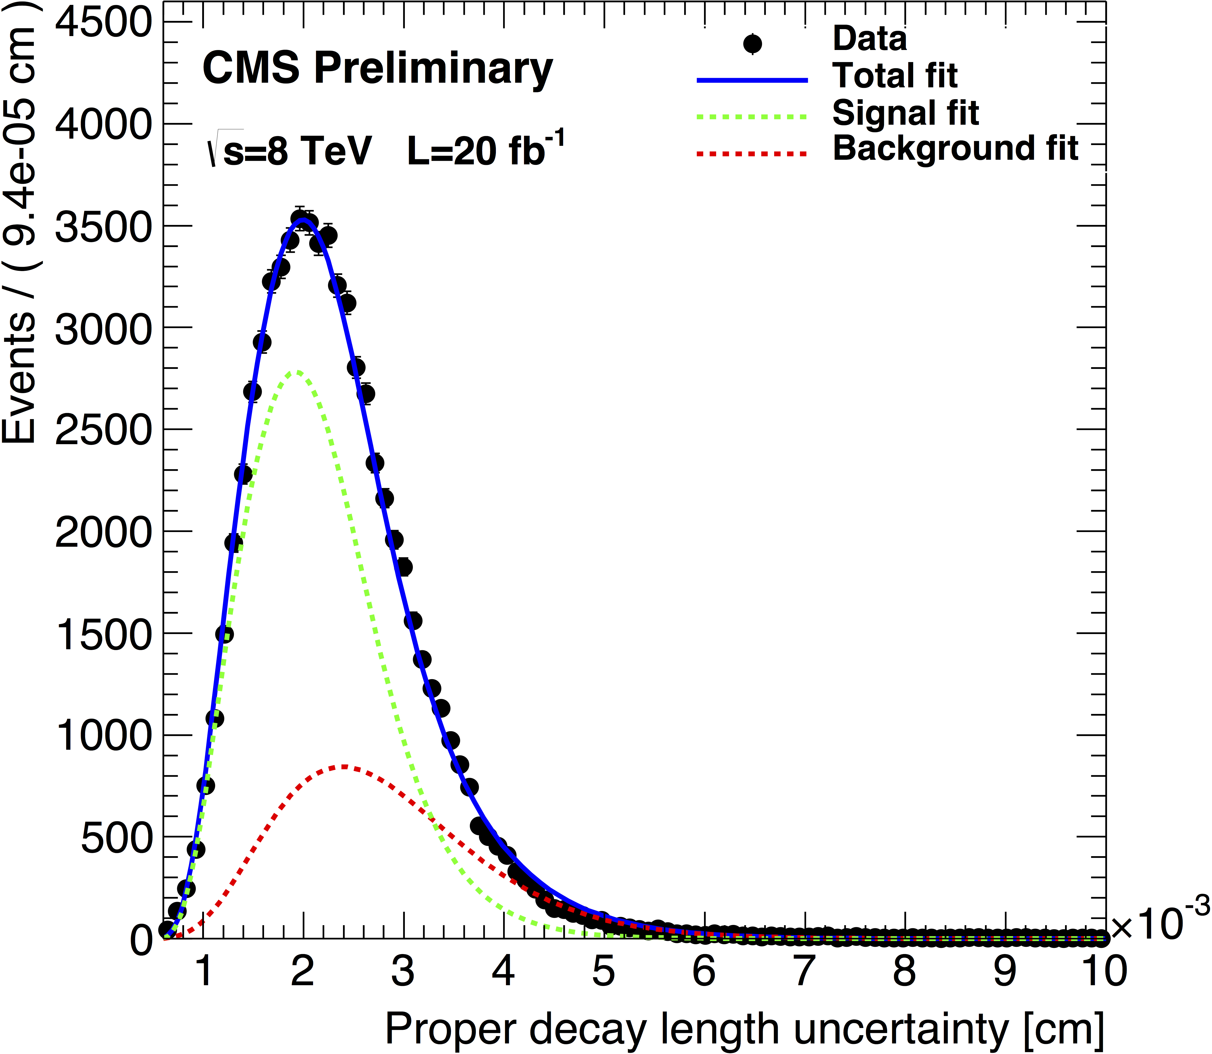
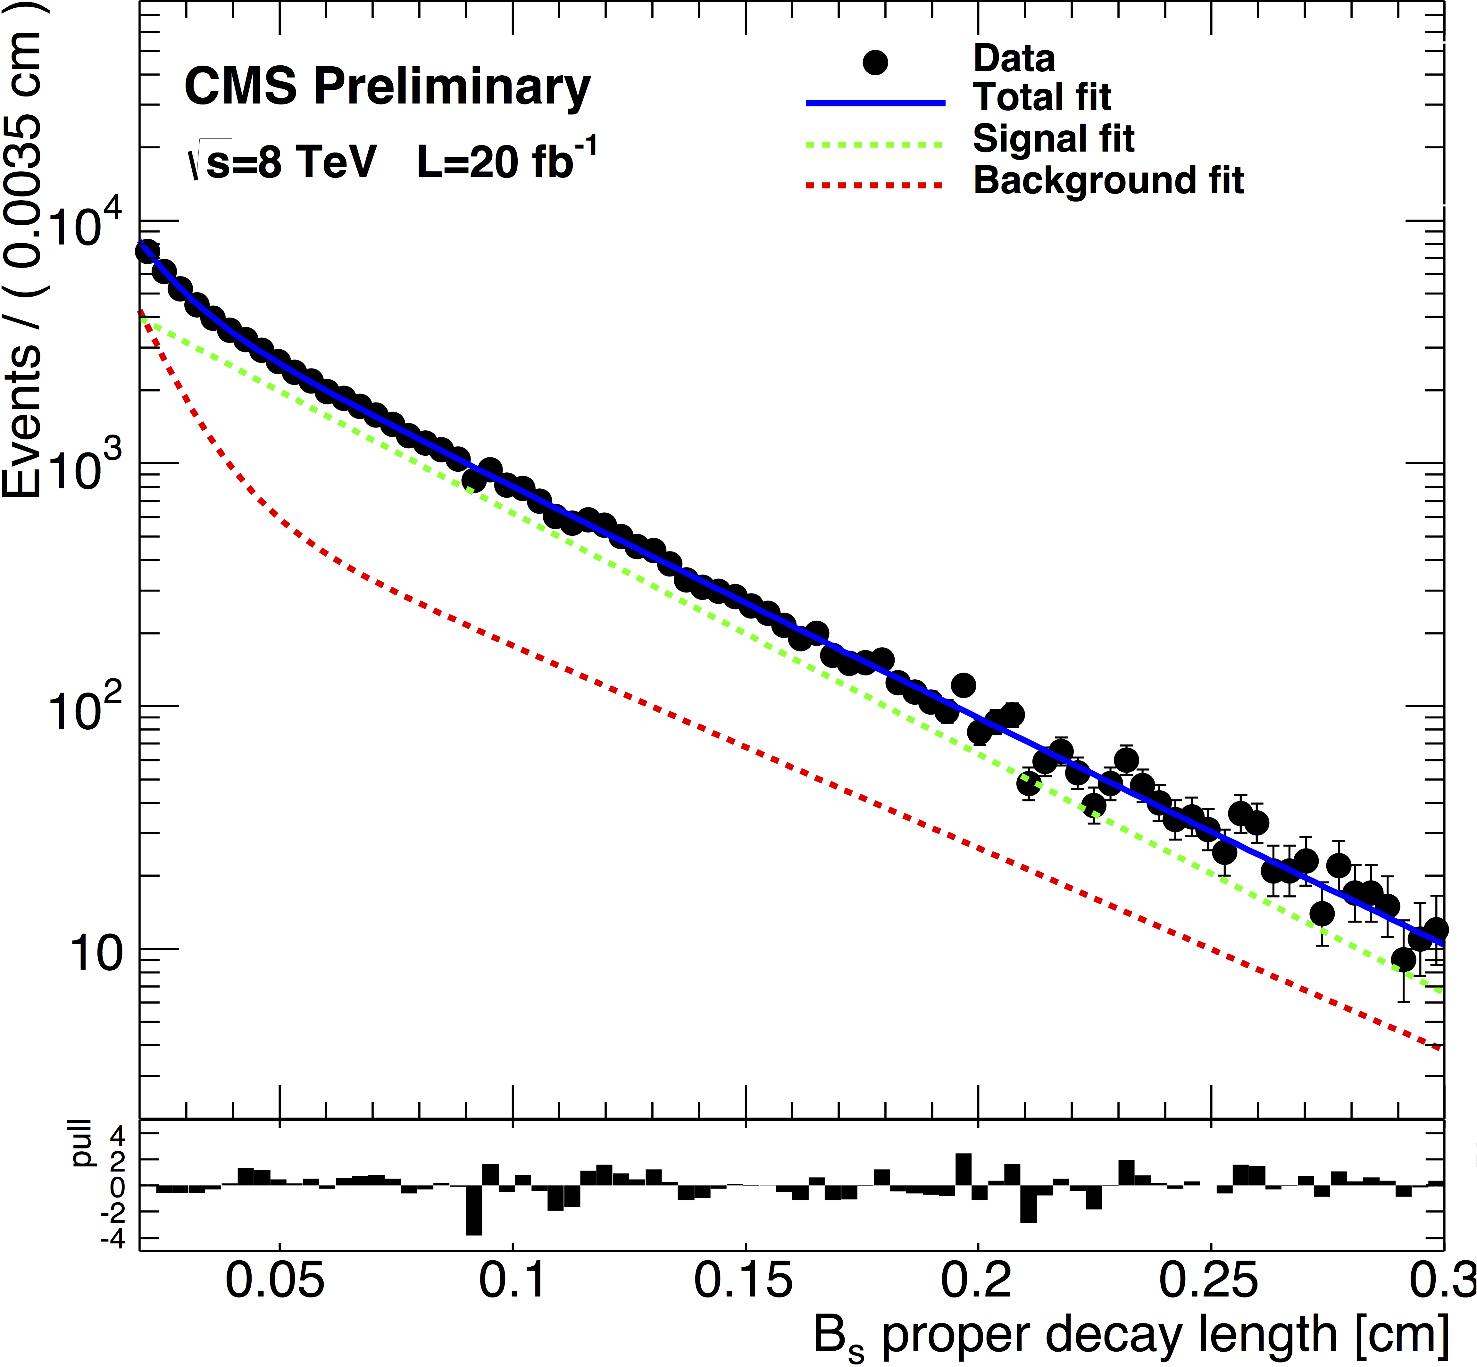
Background, efficiencies, resolution
Main background: non-prompt J/ψ from b hadrons
Lifetime and angular resolution and efficiencies: from simulation
Angular efficiency: modeled by 3D-function of decay angles
Angular resolution: not in nominal fit, but included as systematic uncertainty
Proper decay time efficiency: not in nominal fit, flat in fitting range [0.02,0.3] cm, variations included as systematic uncertainty
Proper decay time resolution (70 fs or 21 μm): per-event uncertainty from B_{s} vertex finding + scale factor κ(cτ) taking into account the difference with respect to the actual resolution
CMS PAS BPH-13-012

Slide 7
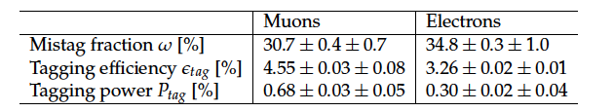
Flavor tagging
Flavor of B_{s} at production time determined by tagging e or μ from opposite side B and considering its charge
Tagging performance optimized by maximizing tagging power
P_{tag} = ε_{tag}(1-2ω)² separately for e and μ (ω … mistag fraction)
ε_{tag} measured from data, using channel B⁺ -> J/ψ K⁺, and checked by simulation with B⁺ -> J/ψ K⁺ and B_{s} -> J/ψ K*⁰ events
Combined average tagging performance:
ω = (32.3 ± 0.3)%, ε_{tag} = (7.67 ± 0.04)%, P_{tag} = (0.97 ± 0.03)%
CMS PAS BPH-13-012

Slide 8
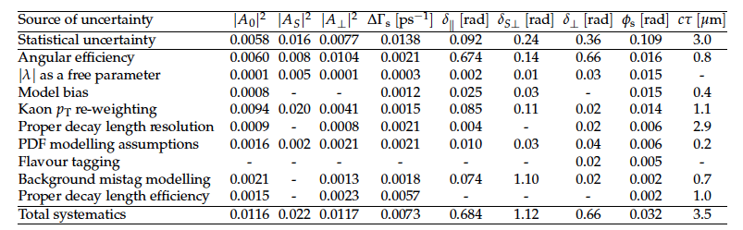
Systematic uncertainties
CMS PAS BPH-13-012

Slide 9
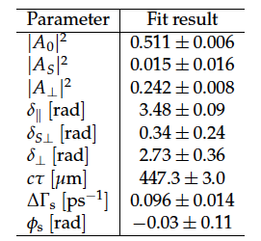
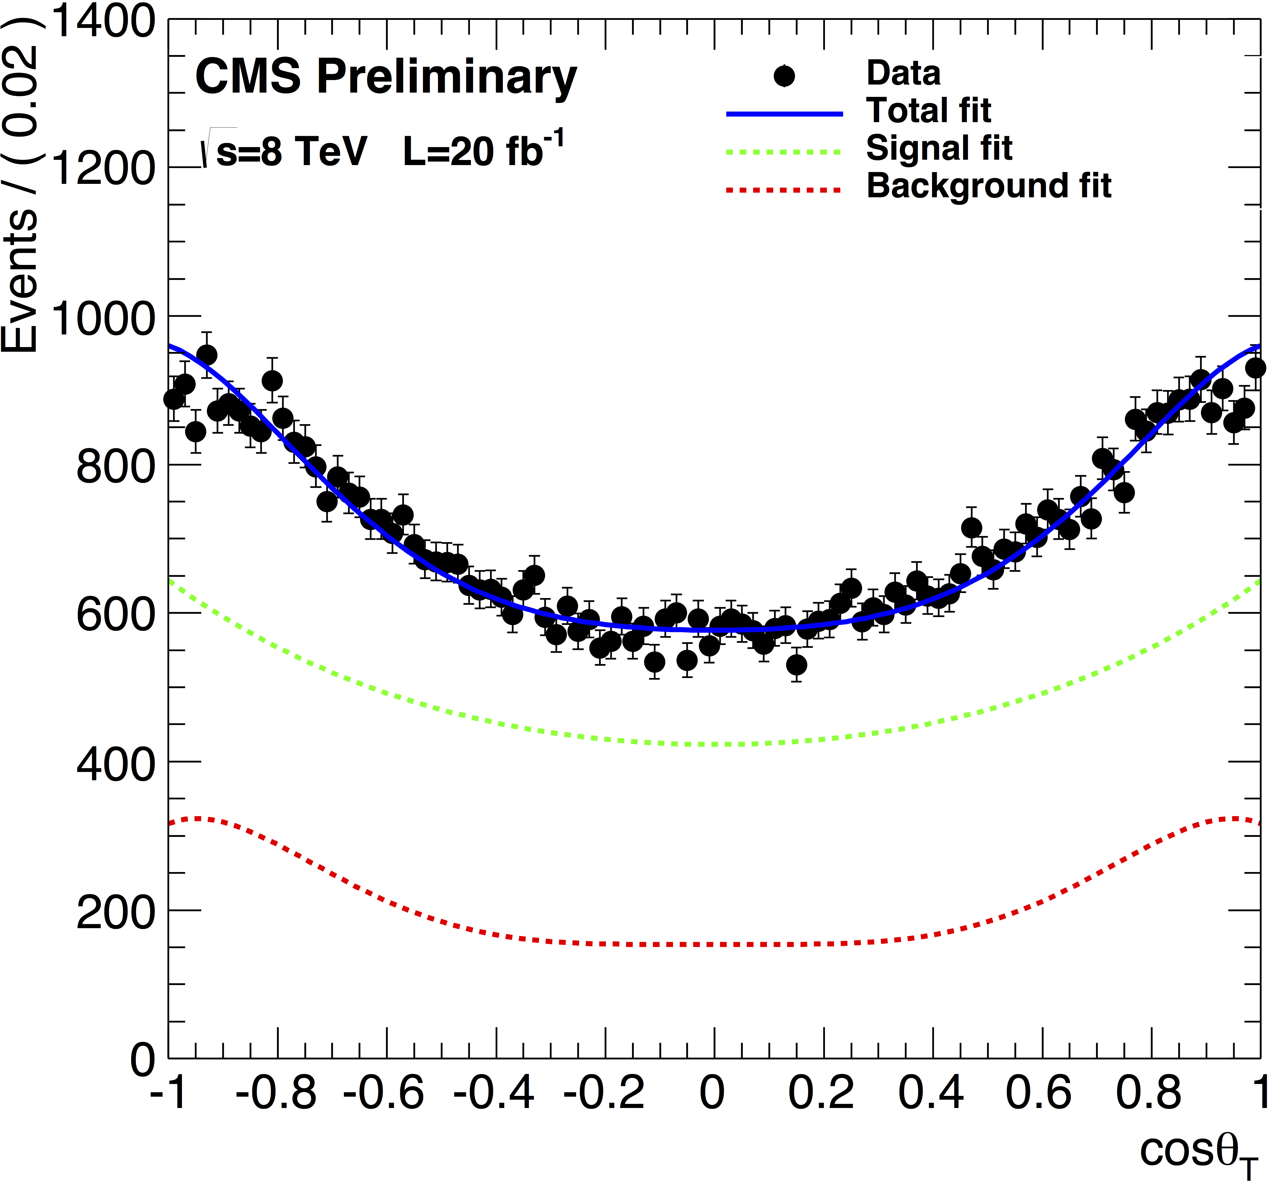
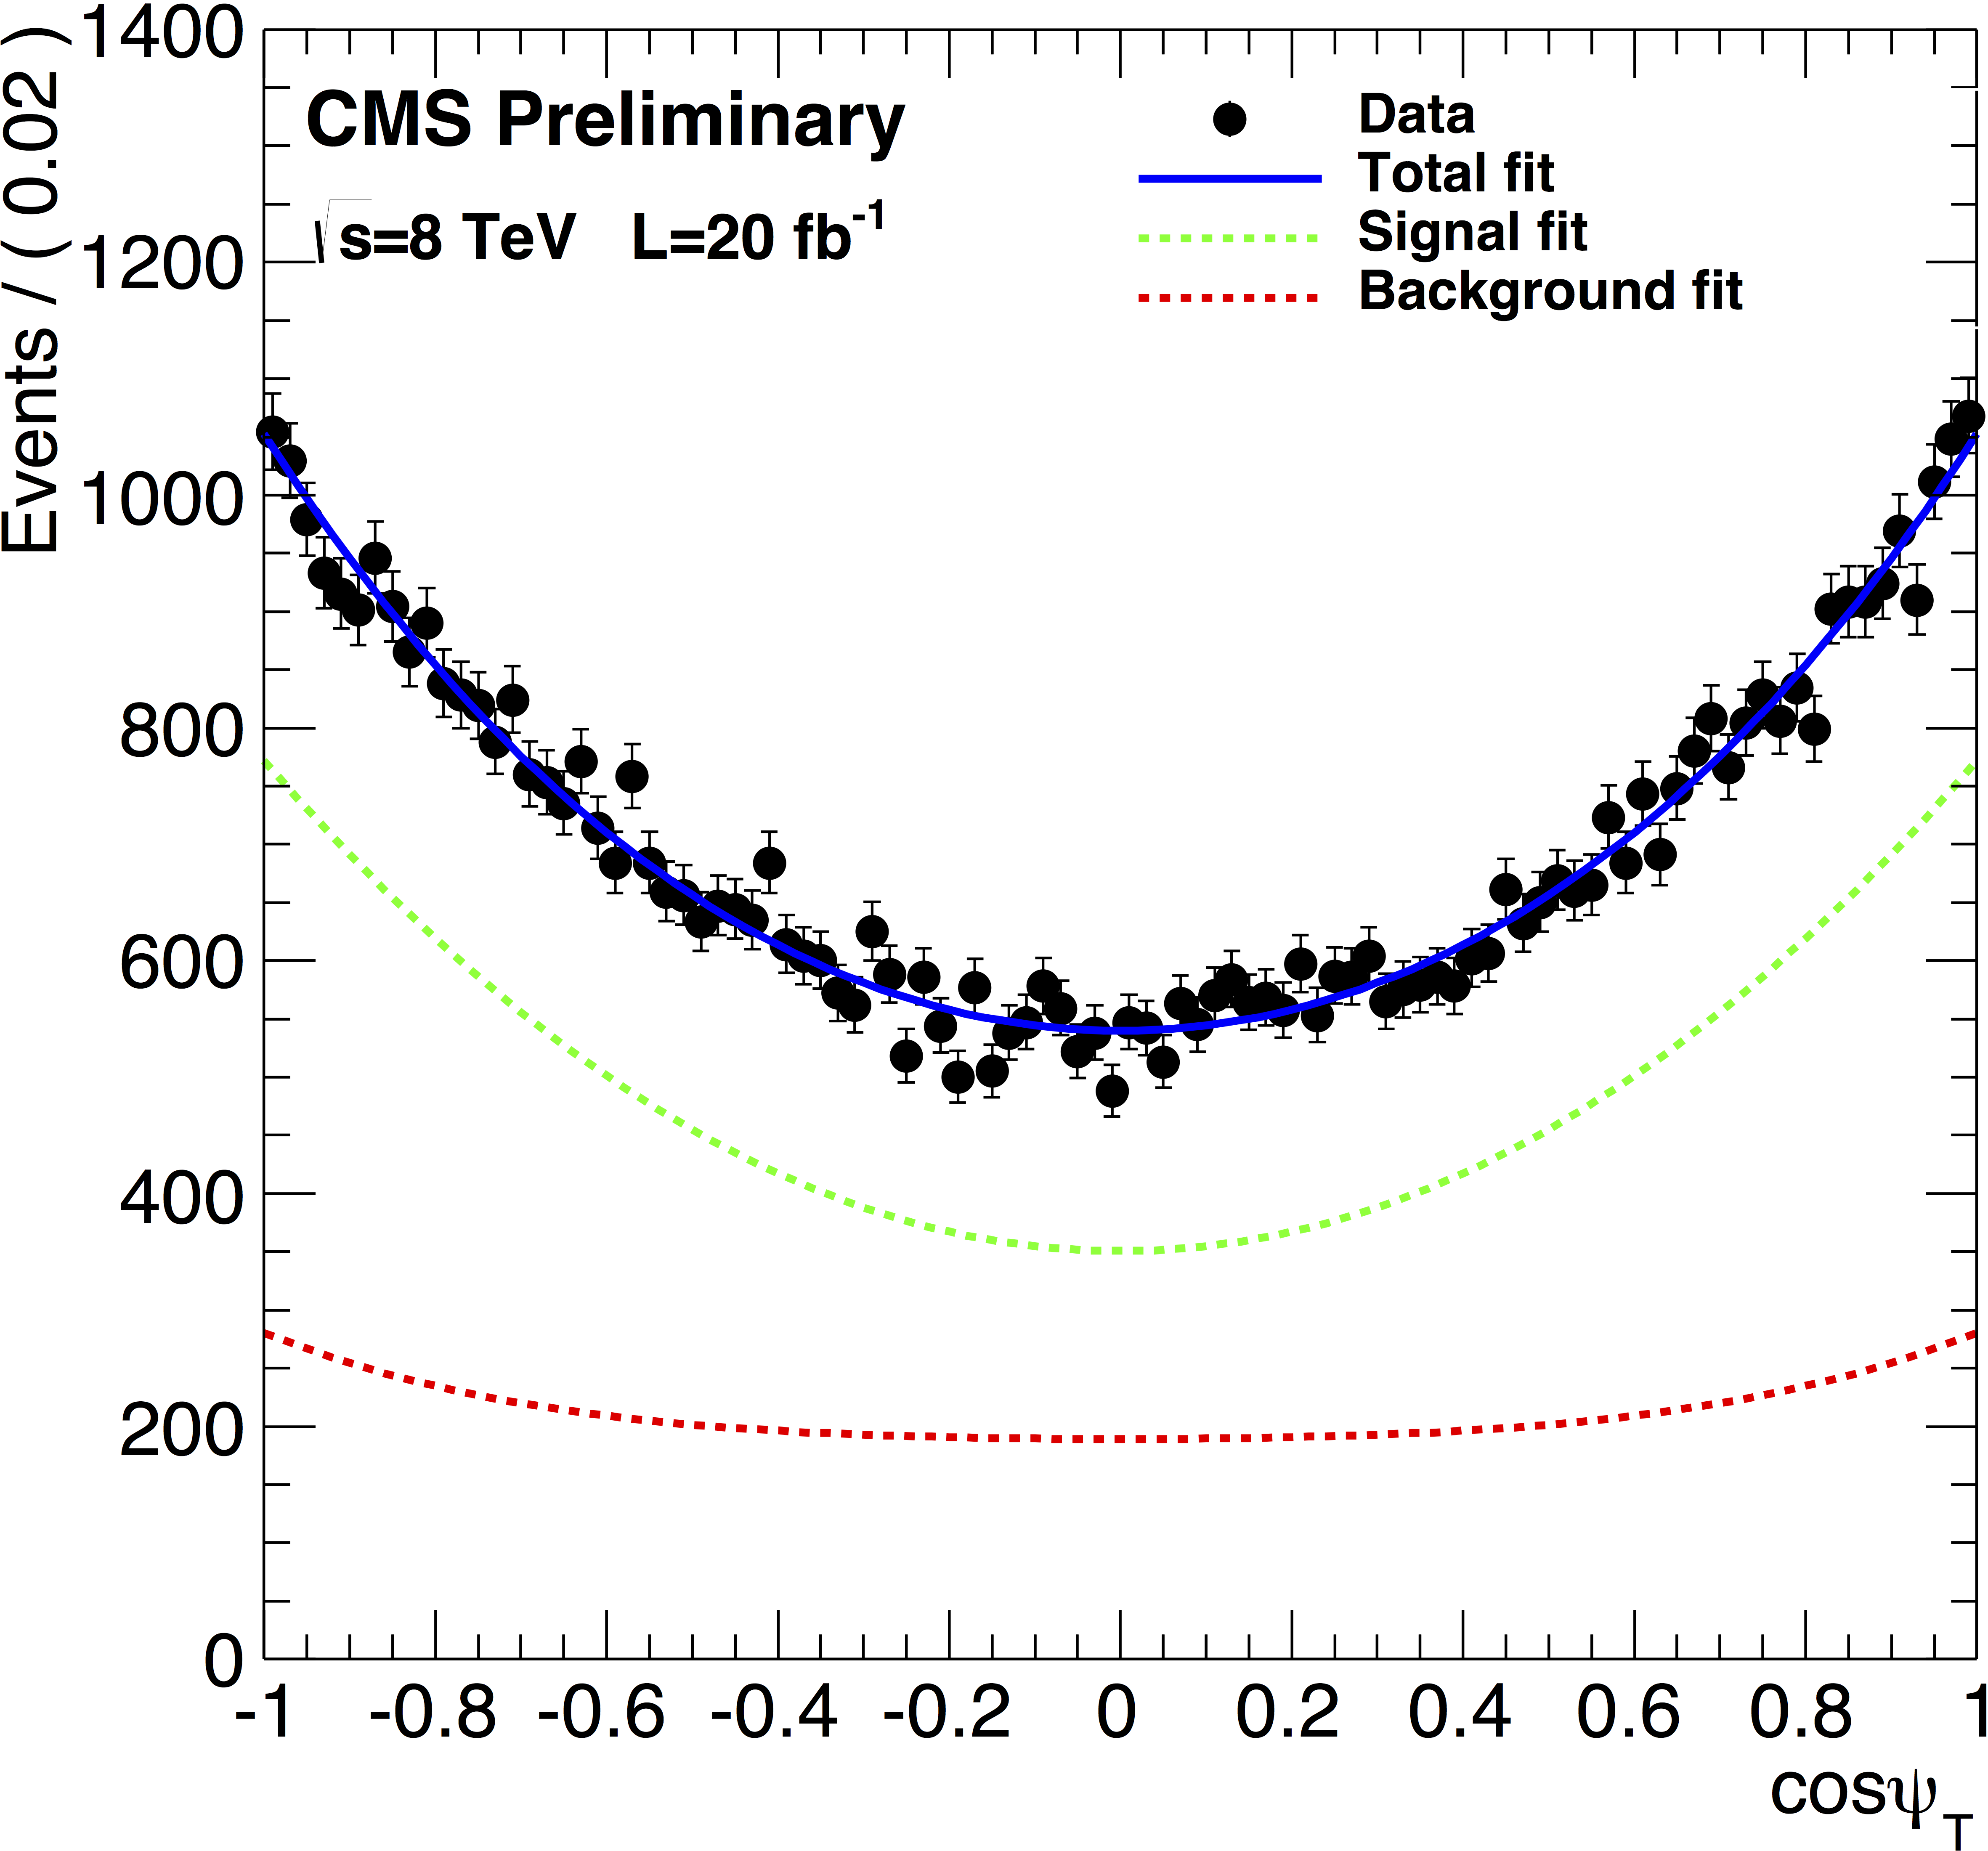
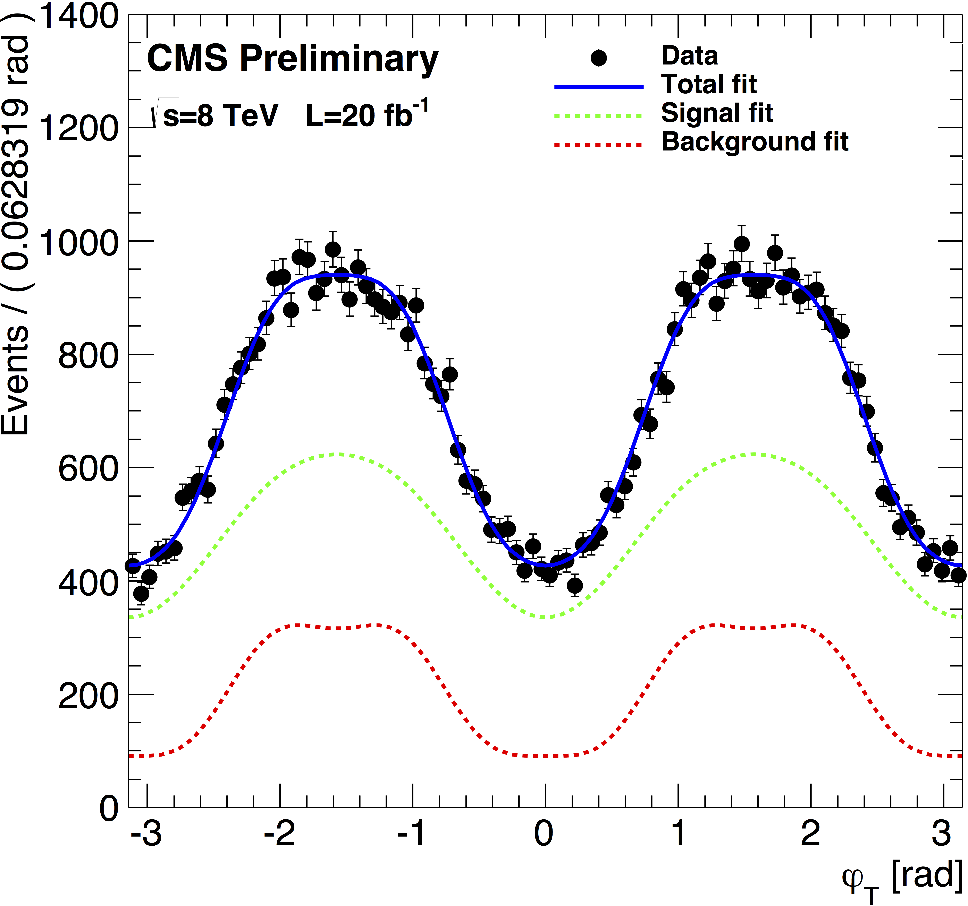
Fit results
Multi-dimensional maximum likelihood fit applied with tagged signal model, Gaussian constraint on Δm_{s} to PDG value
Fit range:
B_{s} mass in [5.24, 5.49] GeV
ct in [0.02, 0.3] cm
CMS PAS BPH-13-012

Slide 10
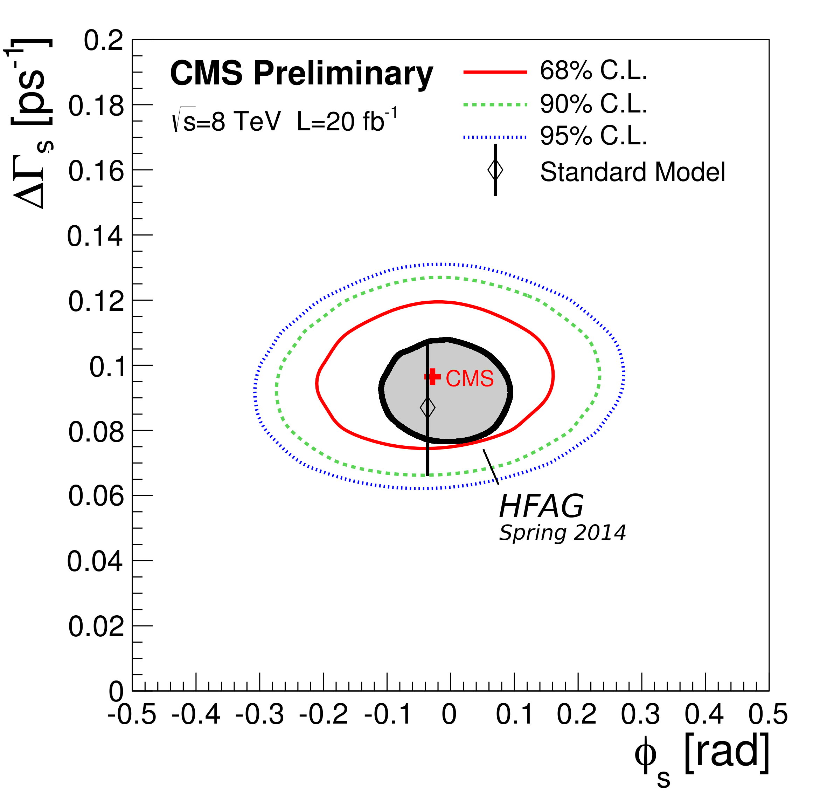
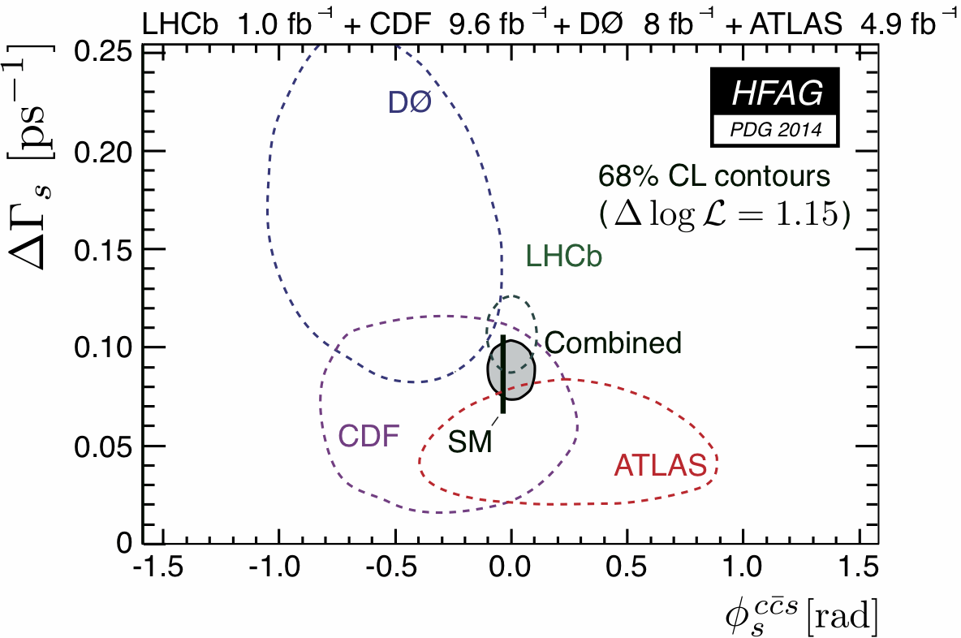
Results on Φ_{s}, ΔΓ_{s}
CMS PAS BPH-13-012
ϕ_{s} = - 0.03 ± 0.11 (stat.) ± 0.03 (syst.) rad
ΔΓ_{s} = 0.096 ± 0.014 (stat.) ± 0.007 (syst.) ps⁻¹

Slide 11
  Quarkonia cross sections and polarization
Heavy quarkonia interesting to understand hadron formation.
S-wave vector quarkonia formed from heavy qq pairs created as:
color singlet (CS) ³S₁^{[1]} or one of 3 color octets (CO) ¹S₀^{[8]}, ³S₁^{[8]}, ³P_{J}^{[8]} -> similar cross section shapes, but different polarizations.
Experimental situation on polarization not clear up to now,
cross sections only measured in lower p_{T} range.
_

Slide 12

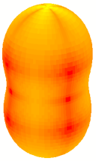
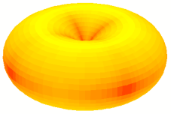
Quarkonium polarization
Polarization of J^{PC} = 1–– quarkonium states measured through angular distribution of dileptons from J/ψ or ϒ decay
PRD 16 (1977) 2219
PRD 19 (1979) 207
z
Transverse
J_{Z} = ±1
Quarkonium rest frame
ϑ
Quantization axis z
ℓ ⁺
production plane
x
φ
y
EPJC C69 (2010) 657
Longitudinal
J_{Z} = 0
Frame-invariant:
Notes:
Polarization parameters defined in PRD reference.

Slide 13
  Selection of prompt charmonia
Prompt charmonia distinguished from B-hadron decays through μμ pseudo-proper decay length l (L_{xy} ... most probable transverse decay length)
Yield: extended unbinned maximum-likelihood fit to 2D M-l distribution
l = L_{xy} . m_{ψ(nS)}/p_{T}
EPJC 71(2011) 1575

Slide 14
  Single μ efficiencies, correlations and acceptance
Single muon efficiencies: tag&probe method
ρ: trigger-induced muon pair correlations
Acceptance: polarization-dependent
Unpolarized scenario used for cross section measurements
CMS-PAS-BPH-14-001

Slide 15
  J/ψ and ψ(2S) production
CMS PAS BPH-14-001
ICNFP, Aug. 2014

Slide 16
ψ(nS) and ϒ(nS) polarizations
PLB 727(2013) 381
J/ψ and ψ(2S) polarizations, 7 TeV
ϒ(1S), ϒ(2S), ϒ(3S) polarizations, 7 TeV
PRL 110 (2013) 081802
ϒ(1S)
J/ψ
ψ(2S)
ϒ(2S)
ϒ(3S)
- Full angular decay distributions measured in 3 frames and frame-independently
- Continuum background from sidebands in the invariant mass distribution
- Non-prompt charmonium contributions removed using decay length

Slide 17
J/ψ and ψ(2S) polarization
No strong polarization
No strong p_{T} or y dependence

Slide 18
ϒ(nS) polarization
No strong polarization
No strong p_{T} or y dependence
PRL 110 (2013) 081802
PRL 108 (2012) 151802
Notes:
Squares are for CDF

Slide 19
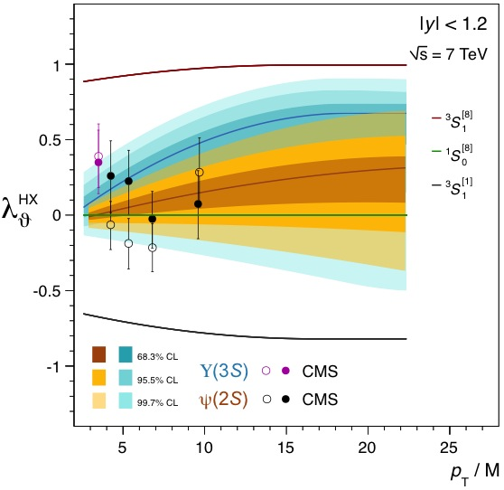
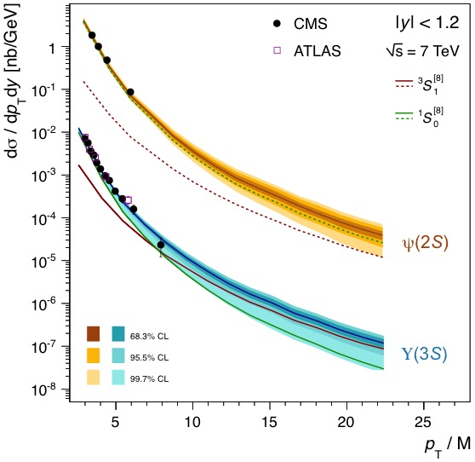
ψ(2S), ϒ(3S) production versus NRQCD
PLB 727 (2013) 381
PRL 110 (2013) 081802
JHEP 02 (2012) 011
PRD 87 (2013) 052004
CMS-PAS-BPH-12-006
PLB 736 (2014) 98
χ_{b}(3P) feed-down to ϒ(3S) neglected
Unpolarized ¹S₀^{[8]} component dominates quarkonium production
Notes:
πσι(2S), ϒ(3S) assumed to be feed-down free

Slide 20
Conclusions on new CMS results
CMS has measured with very good precision CP-violating phase φ_{s} and decay width difference ΔΓ_{s} of B_{s} with B_{s} -> J/ψ(μμ) φ(KK), in agreement with standard model (√s = 8 TeV, L_{int} = 20 fb⁻¹).
  CMS has measured J/ψ and ψ(2S) prompt double-differential cross sections up to O(100 GeV) in p_{T} (√s = 7 TeV, L_{int} = 4.9 fb⁻¹).
CMS has measured polarization of J^{PC} = 1–– quarkonium states through angular distribution of dileptons from J/ψ or ϒ decays (√s = 7 TeV, L_{int} = 4.9 fb⁻¹). No strong polarization is seen. Unpolarized ¹S₀^{[8]} component dominates quarkonium production.
CMS is preparing to take new B physics data at √s = 13 TeV in 2015.
ICNFP, Aug. 2014

Slide 21
BACKUP

Slide 22
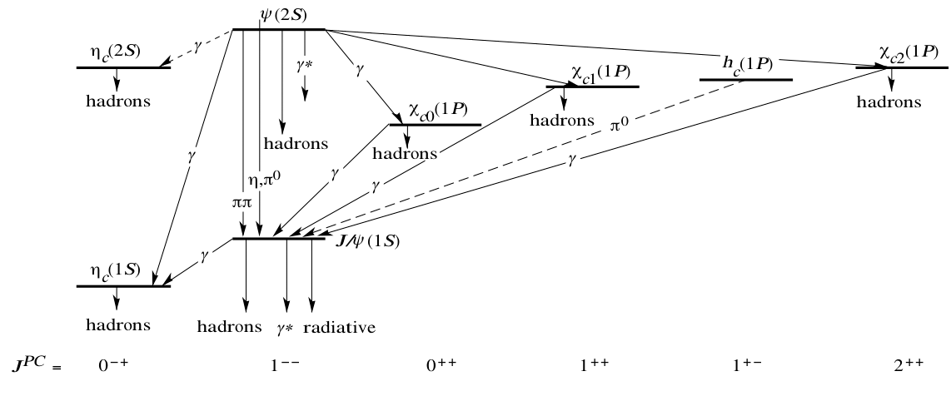
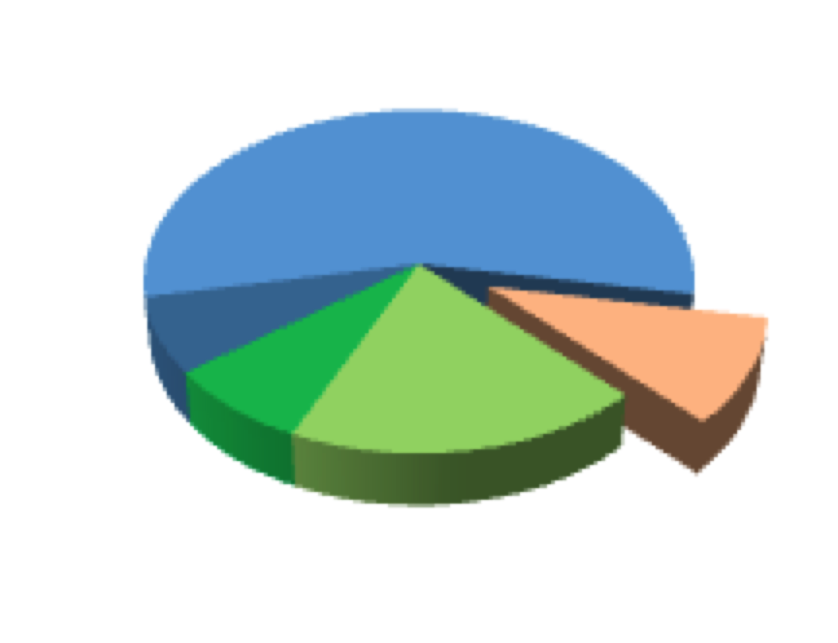

Charmonium spectrum
cc
_
1⁻⁻
J/ψ
directly produced
ψ‘
directly produced
ψ’
non-prompt
(b-hadrons)
non-prompt
(b-hadrons)
χ_{c2}
χ_{c1}

Slide 23
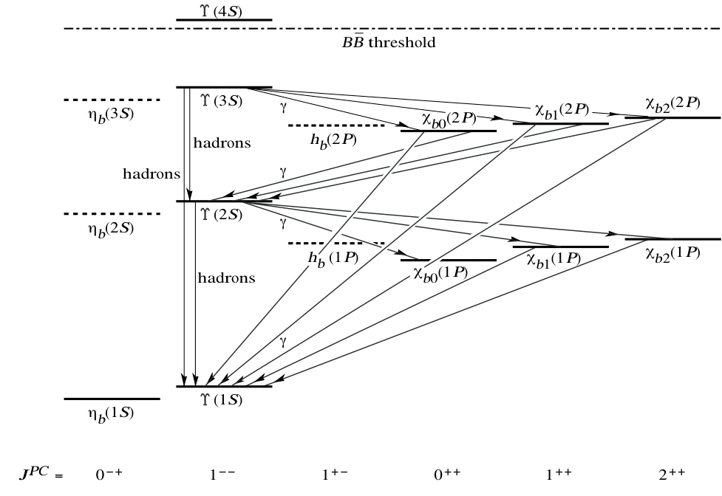
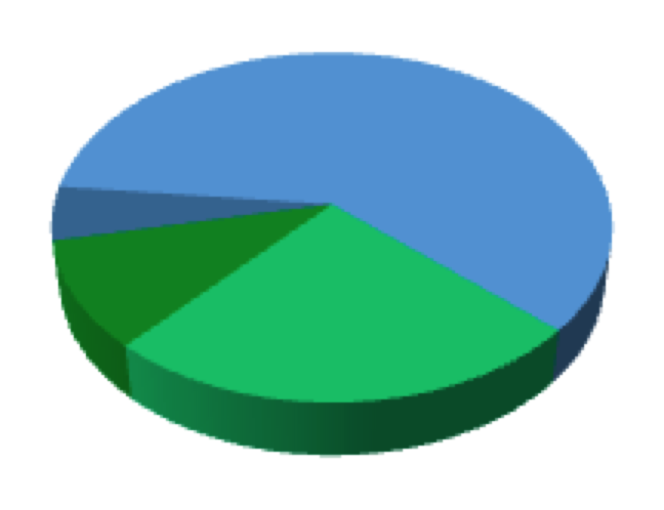
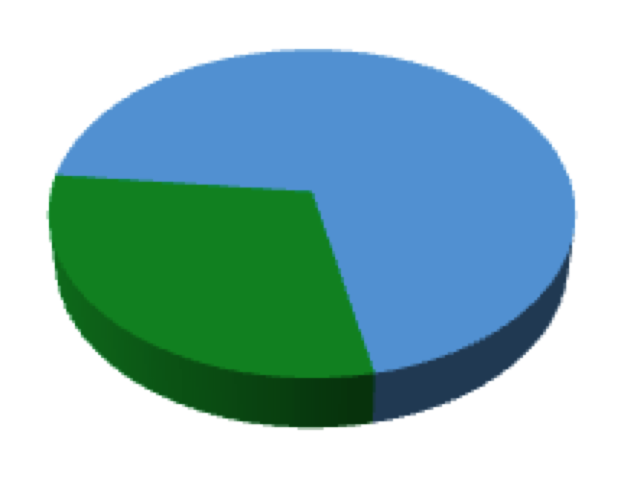
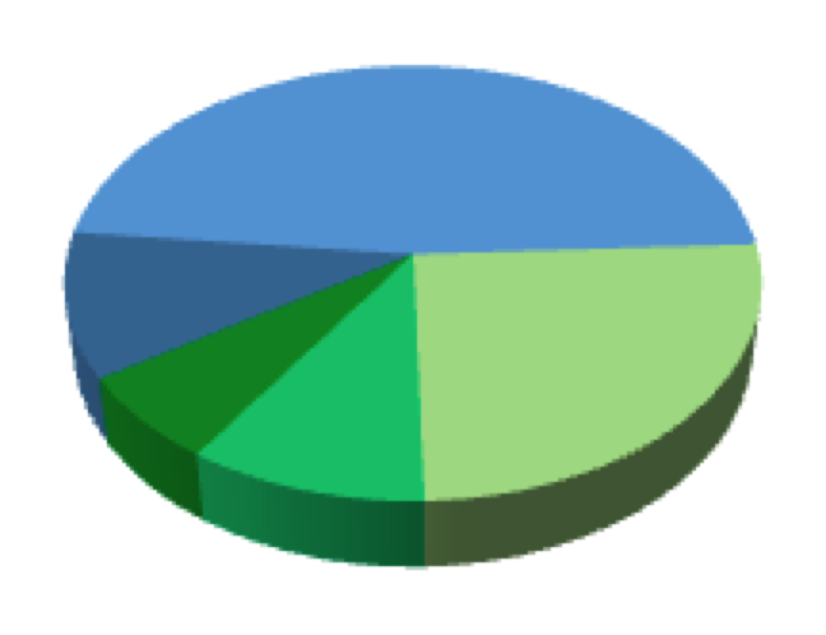
Bottomonium spectrum
χ_{bJ}(3P)
1⁻⁻
_
bb
1⁻⁻
ϒ(1S)
directly produced
ϒ(2S)
directly produced
ϒ(3S)
directly produced
ϒ(2S,3S)
ϒ(3S)
35-45%
χ_{bj}(3P)
χ_{bj}(3P)
χ_{bj}(3P)
χ_{bj}(1P)
χ_{bj}(2P)
χ_{bj}(2P)

Slide 24
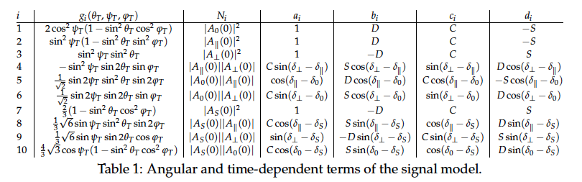

Terms of signal model
|λ| is set to 1, assuming no direct CP violation

Slide 25
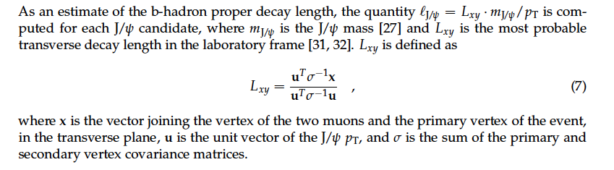
Pseudo-proper decay length
^{l = L}xy^{· m}ψ(nS)^{/p}T
Eur.Phys.J.C71:1575,2011

Slide 26
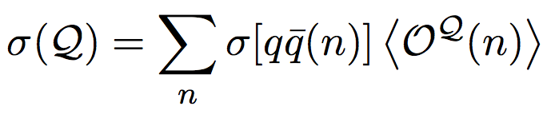
Hadron formation and NRQCD
NRQCD is an effective field theory that factorizes quarkonium production in two steps:
production of the initial quark-antiquark pair (perturbative QCD)
hadronization of the quark pair into a bound quarkonium state (non-perturbative QCD)
NRQCD predicts the existence of intermediate color-octet (CO) states in nature, that subsequently evolve into physical color-singlet (CS) quarkonia by non-perturbative emission of soft gluons.
= ^{2S+1}L_{J}^{[C]} , C = 1,8
Quantum numbers of the heavy quark pair
S, L, J = spin, orbital and total ang. momentum
_
quarkonium ( )
possibly colored qq pair
of any possible ^{2S+1}L_{J}
quantum numbers
red
anti
red
green
Cartoon by P. Faccioli
anti
blue
2) non-perturbative evolution
to the observed bound state
Quantum numbers change!
1) perturbative phase

Slide 27
NRQCD factorization approach
NRQCD is an effective field theory that factorizes quarkonium production in two steps:
production of the initial quark-antiquark pair (perturbative QCD)
hadronization of the quark pair into a bound quarkonium state (non-perturbative QCD)
The LDMEs should follow a hierarchy in powers of v, the relative velocity of the quark pair in the quarkonium system → Non-relativistic approximation (v²∼0.3 for the ψ and ∼0.1 for the ϒ):
Truncation of v-expansion for S-wave states
NRQCD includes 4 terms (intermediate states):
CS term ³S₁^{[1]} (same as )
CO terms: ¹S₀^{[8]}, ³S₁^{[8]} and ³P_{J}^{[8]}
= ^{2S+1}L_{J}^{[C]} , C = 1,8
Quantum numbers of the heavy quark pair
S, L, J = spin, orbital and total ang. momentum
Short-distance coefficients (SDC)
Long-distance matrix elements (LDME)
Short-distance coefficients (SDCs)
Cross section of partonic processes to form
QQ in state PDF
Process-dependent functions of kinematics
Can be calculated perturbatively (expansion in α_{s})
Long-distance matrix elements (LDMEs)
Probability of QQ in state to form
quarkonium state
Universal constants (independent of kinematics)
Determined from fits to experimental data
_
_
Every term has a specific polarization:
³S₁^{[1]} → λ_{θ} ≈ −0.9 (longitudinal)
¹S₀^{[8]} → λ_{θ} = 0 (isotropic)
³S₁^{[8]} → λ_{θ} ≈ +1 (transverse)
³P_{J}^{[8]} → λ_{θ} >> +1 (“hyper-transverse“)
@NLO, approximations, HX frame

Slide 28
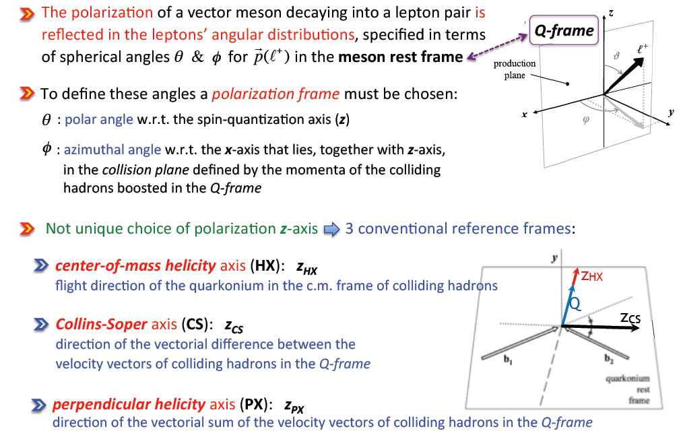
Polarization frames

Slide 29
J/ψ and ψ(2S) polarization
No strong polarization
No strong p_{T} dependence
Similar in other frames and for other polarization parameters
NLO NRQCD predictions (no feed-down for J/ψ) do not agree with data

